Slide 1
Water, Heat, and Climate

Slide 2
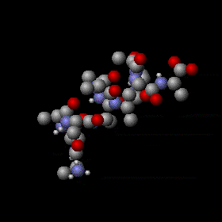
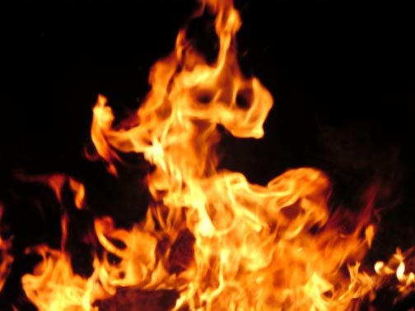
Heat Capacity
The amount of heat input required to raise the
temperature of a 1 g of a substance by 1ºC.
Cal
g . ºC
Notes:
At the molecular level the addition of heat energy increases the speed with which molecules move while the loss of heat energy decreases their rate of motion. Heat energy is required to break hydrogen bonds between water molecules, and heat is released when hydrogen bonds are formed. The addition of heat to water causes a relatively small change in the temperature of the water, because much of the heat energy is used to disrupt the hydrogen bonds. These bonds must be broken before the molecules are able to move more rapidly. When heat is removed from water, the molecules slow, many additional hydrogen bonds are formed, and considerable energy is released as heat, which prevents any rapid drop in temperature.

Slide 3
Heat Capacity of Liquids
Water 1.00 cal/g·ºC
Alcohol 0.52
Oil 0.38
Mercury 0.03
The amount of heat (calories) required
raise the temperature of a given amount
of a substance by 1º Celsius.
Notes:
At the molecular level the addition of heat energy increases the speed with which molecules move while the loss of heat energy decreases their rate of motion. Heat energy is required to break hydrogen bonds between water molecules, and heat is released when hydrogen bonds are formed. The addition of heat to water causes a relatively small change in the temperature of the water, because much of the heat energy is used to disrupt the hydrogen bonds. These bonds must be broken before the molecules are able to move more rapidly. When heat is removed from water, the molecules slow, many additional hydrogen bonds are formed, and considerable energy is released as heat, which prevents any rapid drop in temperature.

Slide 4
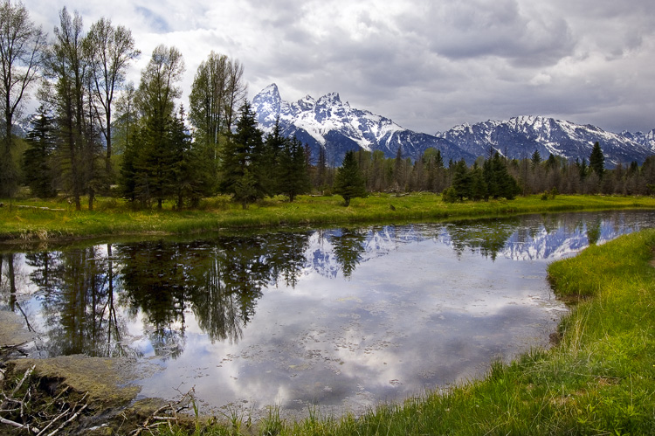
Heat Capacity
Temperatures of large standing bodies of
water remain relatively constant.

Slide 5
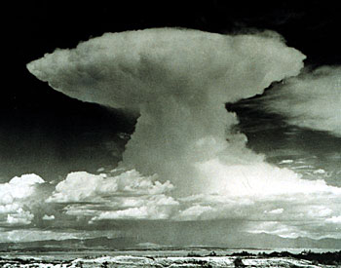
cools
Low pressure
Florida
Sand
Asphalt
Vegetation
Sun Warms water
Gulf of Mexico
Atlantic Ocean

Slide 6
What is evaporation?
Air
Liquid Water

Slide 7
cooling
What is condensation?
Air
Liquid Water

Slide 8
Vaporization and Condensation
How much heat?

Slide 9
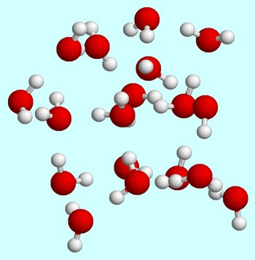
Quantified by Latent Heat
Amount of heat added or removed
from water to effect a phase change.
Liquid
Gas

Slide 10
Latent Heat of Vaporization
Amount of heat added to water to
change it from a liquid to a gas.
Liquid
Gas
580 cal/g (temperature-dependent)
580 cal of heat added for each gram of water

Slide 11
Latent Heats of Vaporization
Water 580 cal/g
Ammonia 350 cal/g
Alcohol 215 cal/g
Acetone 133 cal/g
Amount of heat input to the liquid to change it to a gas

Slide 12
Latent Heat of Condensation
Amount of heat removed from gaseous
water to change it from a gas to a liquid.
Liquid
Gas
580 cal/g
580 cal of heat removed for each gram of water

Slide 13
Conservation of Energy
Gas
580 cal/g
Liquid

Slide 14
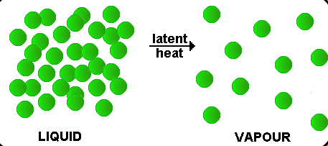
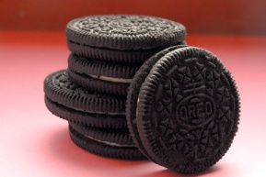
How much heat is needed to evaporate or condense 1 L of water?
Heat required to vaporize or condense 1 g of water = 580 cal
1 L of water = g water
1000
1000 g x 580 cal = 580,000 cal
g
11
Notes:
Run 5 miles, walk 2 hrs.

Slide 15
Importance

Slide 16
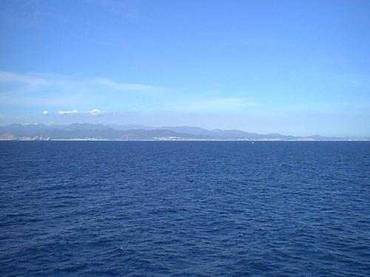
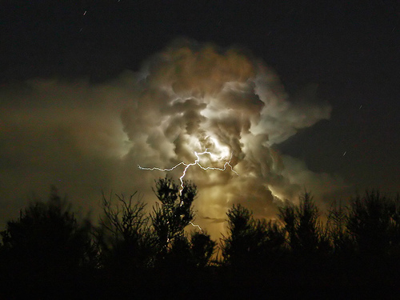
Latent Heat and Climate
580 cal/g
580 cal/g
Water stores energy (heat) in the gas
Water releases energy (heat) from gas
Liquid
gas
Liquid

Slide 17
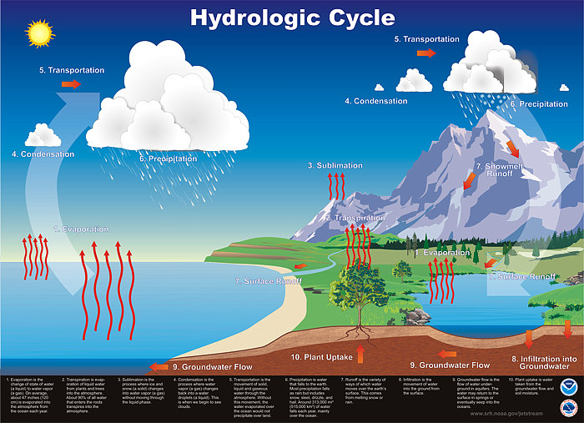
How Much Energy?
Ocean Evaporation
500,000 km³/day
5 x 10¹⁴ L/day
5 x 10¹⁷ g/day
500,000 km³/day
2.7 x 10²⁰ cal/day
200,000 MT TNT
Roughly equivalent to 10,000 atomic bombs
Notes:
The average amount of evaporation from the sea surface is about 120 cm/yr or about 9 x 10^13 gallons perday
Evaporation energy roughly equivalent to 10,000 atomic bombs

Slide 18
Latent Heat: Effect on Climate

Slide 19
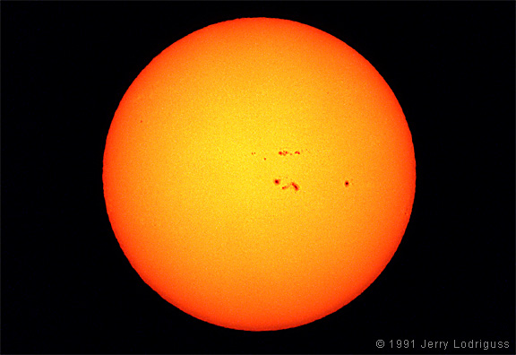
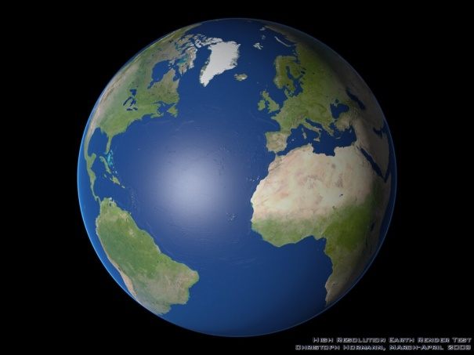
Latent Heat and Climate
Equinox

Slide 20
Equinox
Equinox
Low
Pressure
Notes:
Equinox

Slide 21
Low
Pressure

Slide 22
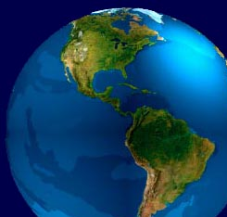
Latent Heat Transport
580 cal/g
Surface
wind
580 cal/g
Surface
wind
Notes:
Wind and Ocean Currents: “Heat Movers”
Both air currents and ocean currents move heat. Energy is stored as "latent heat" in the atmosphere. In the surface waters of the ocean it is stored as "sensible heat." Atmospheric and oceanic circulation share the task of heat redistribution on a roughly fifty-fifty basis. Even though transfer of heat by moving water in ocean currents is much less efficient than transfer by moving vapor in wind, the masses involved are much greater in the ocean currents than in the air currents. On the whole, heat has to be moved from the tropics (where the Sun is close to being overhead at noon) to the higher latitudes (where the Sun is 40 degrees off the vertical or lower, on average). These regions, beyond the 40th degree of latitude on either side of the equator, have a heat deficit, while the tropical belt has excess heat. "Heat deficit" refers to the fact that from these regions more heat is radiated back to space than is received from the Sun, while for the regions with a "heat excess" the reverse is the case. The climate machine acts as a heat-distributing device; It involves the energy received from the Sun (see "solar constant"), the energy reflected back to space (see "albedo") and the energy retained in the atmosphere through the trapping of infrared radiation (see "greenhouse effect"). If there were no energy transfer the poles would be 25 degrees Celsius cooler, and the equator 14 degrees Celsius warmer!

Slide 23
1. Equatorial latitudes receive more solar energy than other latitudes
2. Equatorial regions are dominated by oceans
3. Solar heat evaporates water near the equator (water absorbs 580 cal/g)
4. Warm, moist air rises from the equator
5. Rising moist air creates low pressure at the surface
6. Cooler air from northern and southern latitudes moves to the equator
7. Air rising from the equator eventually moves to northern and southern
latitudes carrying latent heat of vaporization obtained at the equator.
8. This air eventually cools, condenses, releasing energy (580 cal/g)
obtained at equator
9. The overall process cools the equator and warms northern and
southern latitudes, redistributing heat globally.

Slide 24
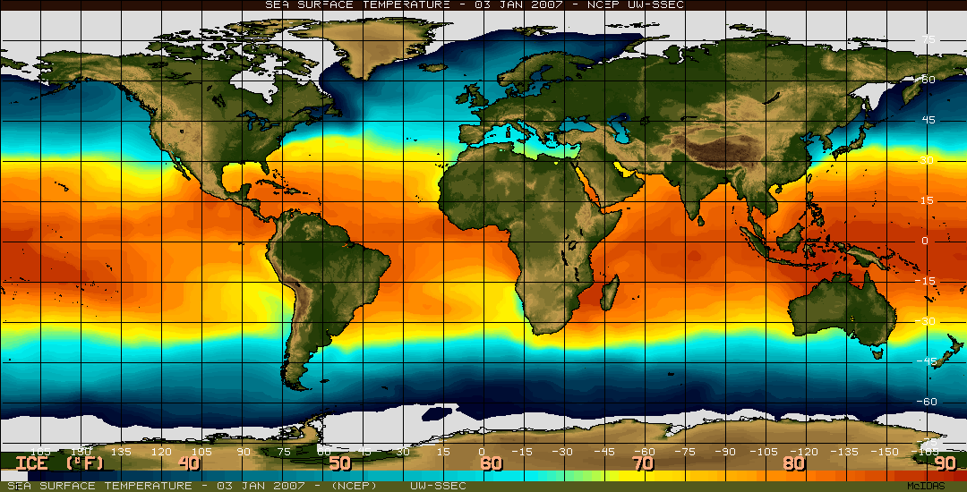
55º
85º
55º

Slide 25
h
Redistribution of Heat
60
30
0

Slide 26
Northern Hemisphere
60º
30º
0º
Do Winds Really Blow in these Directions?

Slide 27
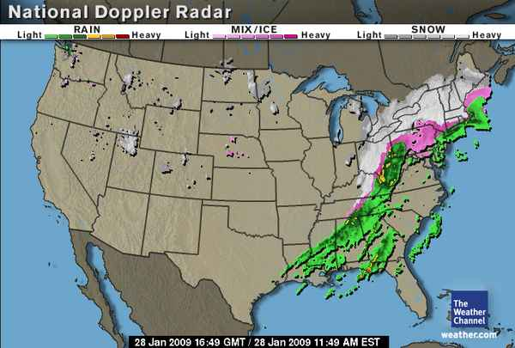
Today: mostly cloudy
Tomorrow: Rain
30º
60º
30º
0º

Slide 28
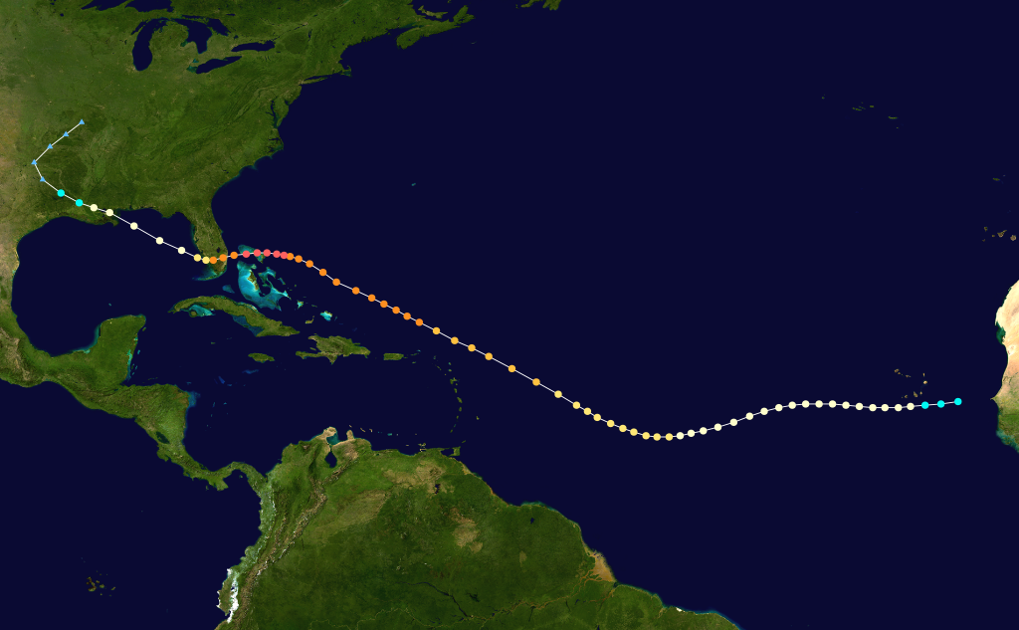
Hurricanes
60º
30º
0º
30º N
wind
equator

Slide 29
Northern Hemisphere
60º
Fronts
30º
Hurricanes
0º
Something is redirecting the wind

Slide 30
Next: Wind Direction and the Coriolis Effect

