Slide 1
Unusual Properties of Water

Slide 2
Polarity
_
+
+
+
Electric Dipole

Slide 3
Orientation
Bond
(hydrogen bond)
+
+
-
-
Opposite charges attract each other
http://games.mochiads.com/c/g/polarityfreak/polarityfreak-11-Mochi-Sec.swf
Notes:
If we place two water molecules near each other they will behave just like the magnets. They will orient themselves so that the opposite poles align and they will be attracted to each other. They will bond electrostatically together. This bond is called a hydrogen bond.

Slide 4
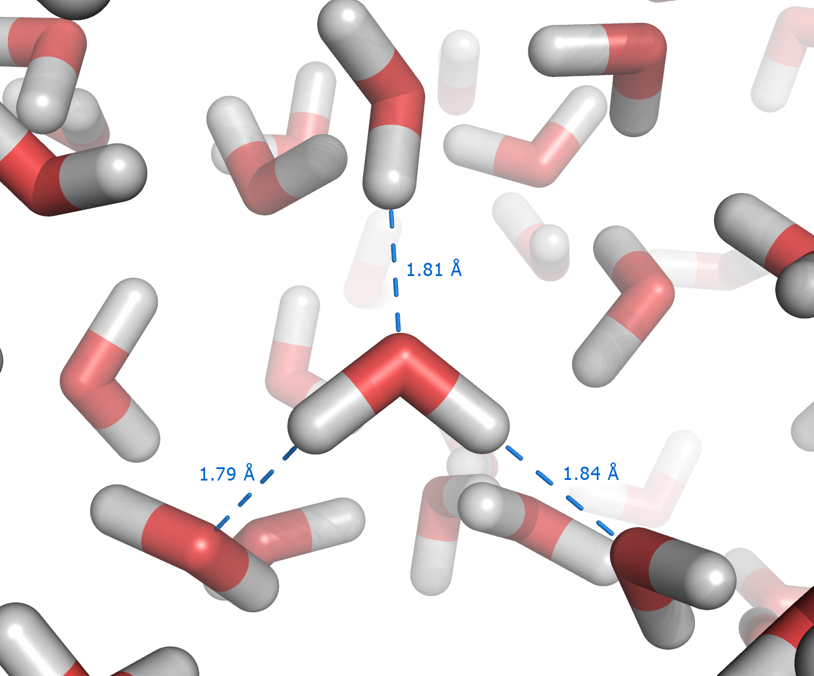
Hydrogen Bonding in Water
Hydrogen Bonding Gives Water Unusual Stability
Notes:
In liquid water, the water molecules orient themselves so that their partial positive charges align with the partial negative charges of neighboring molecules to form a loose structure like that pictured here. The dotted lines represent the hydrogen bonds between the water molecules. Each of these bonds is relatively weak, less than one twentieth of that between hydrogen and oxygen within each water molecule. However they are extremely numerous. So while they are individually weak they are collectively very strong. Like strands in a rope. This makes water a very stable and a very powerful structure and imparts a number of unique properties.

Slide 5
Properties
Extensive Hydrogen Bonding Allows Water
to Exist as a Liquid at Normal Temperatures
And across a wide range in temperatures
High Boiling and Freezing Points
Wide Liquid Range (100ºC)
Other Unusual Thermal Properties
Unusual Density

Slide 6
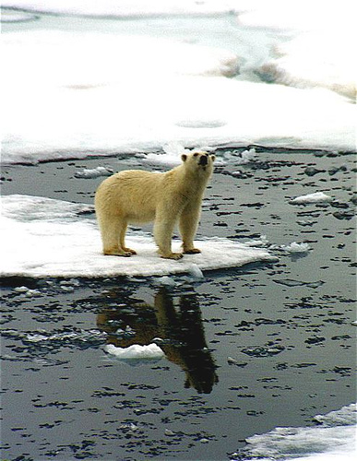
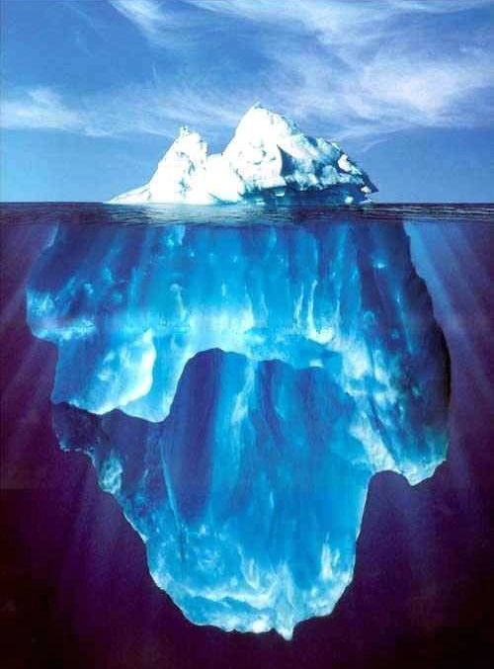
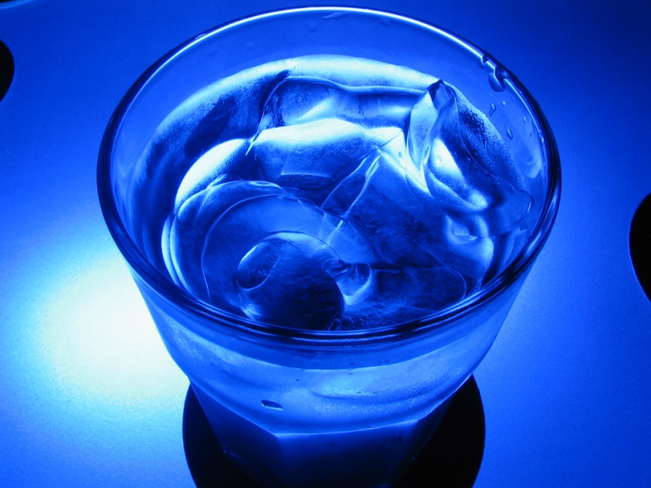
Density
M
V
grams
cm³
Low mass and high volume = low density
High mass and low volume = high density
Notes:
Most substances are denser in their solid state than in their liquid state. This has a simple explanation in terms of the atomic nature of matter. In a solid state the atoms are in relatively fixed locations, held there by their bonds to other nearby atoms. As the temperature is raised, the atoms get more energetic, break free from their constrained environments, and roam over a larger volume. Thus clearly a substance should be less dense in its liquid state. So in this simple picture, ice should be heavier than liquid water: the iceberg should have been at the bottom of the sea, posing no threat to the Titanic.

Slide 7
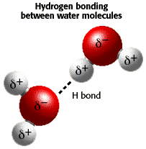
Water
Density
M (mass)
V (volume)
In liquid water each water molecule is bonded
On average to 3 other water molecules. The
Averagae distance between them is 1.82 Angstroms
In solid water, each water molecule is bonded to
4 other water molecules and the bonds are farther apart (2.76 A)
For the same amount (mass) of water molecules, the volume occupied
is greater for solid water compared to liquid water. Therefore, the density
of solid water is less than the density of liquid water.

Slide 8
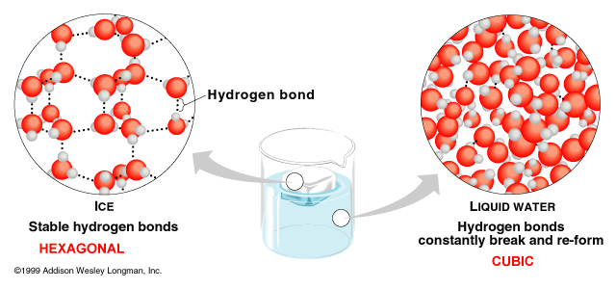
Low density
High density
Fewer molecules
In a given volume
More molecules
In a given volume
The density of pure water at 25ºC is 0.997 g/mL.
The density of ice at 0ºC is 0.917 g/mL.

Slide 9
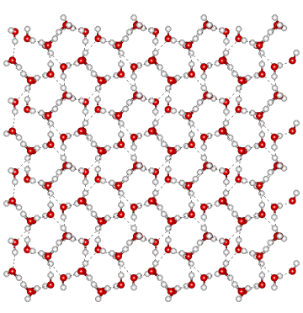
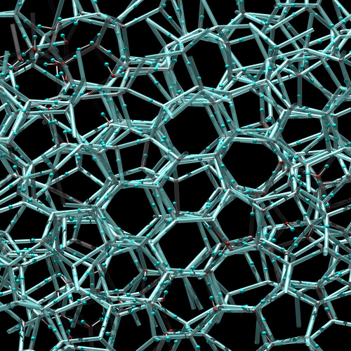
Density
Liquid
Crystalline Ice
Hydrogen bonds
Break and re-form
Stable hydrogen bonds yield
Fixed distances between molecules
(same number of molecules occupy a larger volume)
http://www.youtube.com/watch?v=SVR7tfsjPO0&NR=1
Why is this important?

Slide 10
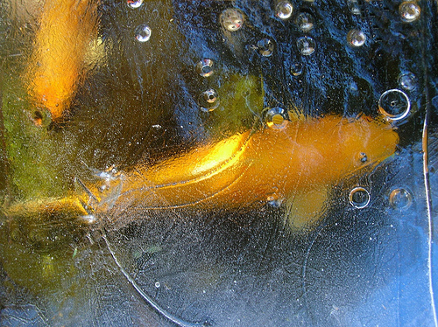
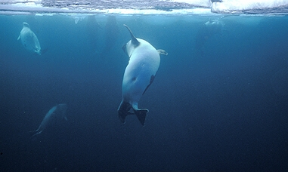
Importance
lakes

Slide 11
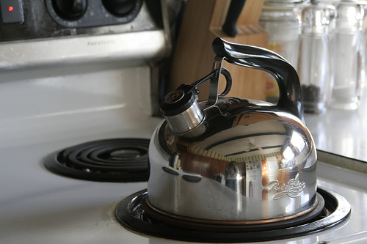
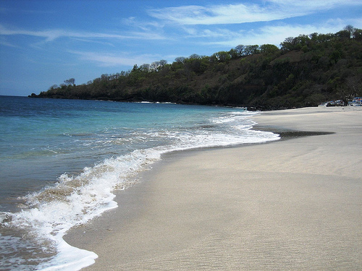
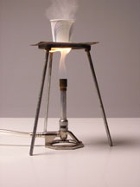
Thermal Properties
Heat and Temperature Change
paper

Slide 12
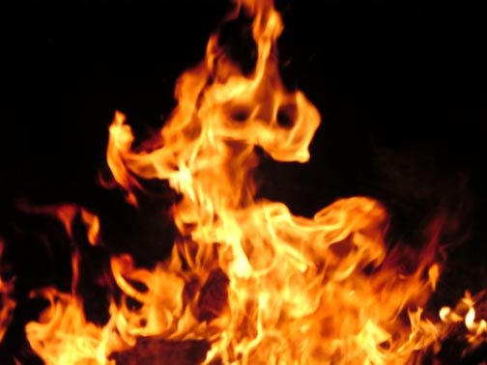
Thermometers
water
alcohol

Slide 13
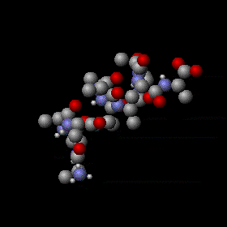
Heat Capacity
The amount of heat input required to raise the
temperature of a 1 g of a substance by 1ºC.
When heat is added to water, the molecules speed up or vibrate more freely. This disturbs hydrogen bonds, but causes only a small change in temperature, because much of the heat energy is used to break or disrupt the hydrogen bonds
Notes:
At the molecular level the addition of heat energy increases the speed with which molecules move while the loss of heat energy decreases their rate of motion. Heat energy is required to break hydrogen bonds between water molecules, and heat is released when hydrogen bonds are formed. The addition of heat to water causes a relatively small change in the temperature of the water, because much of the heat energy is used to disrupt the hydrogen bonds. These bonds must be broken before the molecules are able to move more rapidly. When heat is removed from water, the molecules slow, many additional hydrogen bonds are formed, and considerable energy is released as heat, which prevents any rapid drop in temperature.

Slide 14
Heat capacity of Water
Cal
g . ºC
It requires 1 calorie of heat input
to raise the temperature of 1 g
of water by 1 degree Celsius
1 g of water is equal to 1 mL

Slide 15
Heat Capacity of Liquids
Water 1.00 cal/g·ºC
Alcohol 0.52
Oil 0.38
Mercury 0.03
The amount of heat (calories) required
raise the temperature of a given amount
of a substance by 1º Celsius.
Notes:
At the molecular level the addition of heat energy increases the speed with which molecules move while the loss of heat energy decreases their rate of motion. Heat energy is required to break hydrogen bonds between water molecules, and heat is released when hydrogen bonds are formed. The addition of heat to water causes a relatively small change in the temperature of the water, because much of the heat energy is used to disrupt the hydrogen bonds. These bonds must be broken before the molecules are able to move more rapidly. When heat is removed from water, the molecules slow, many additional hydrogen bonds are formed, and considerable energy is released as heat, which prevents any rapid drop in temperature.

Slide 16
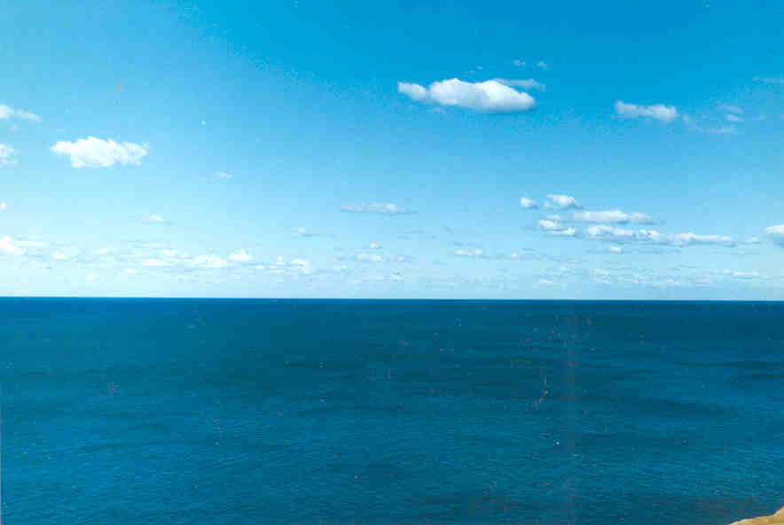
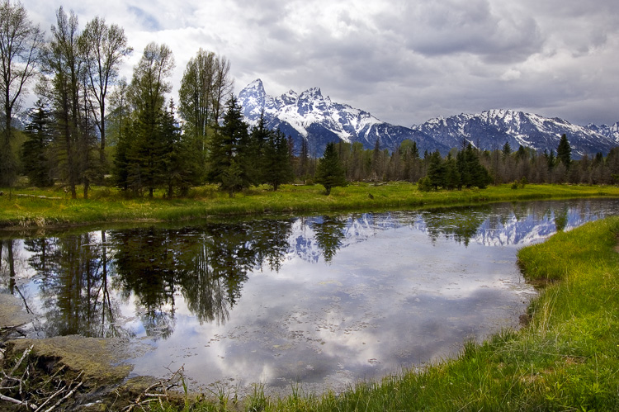
Temperatures of large standing bodies of
water remain relatively constant.
This thermal buffering protects life on Earth from otherwise possibly lethal temperature fluctuations.

Slide 17
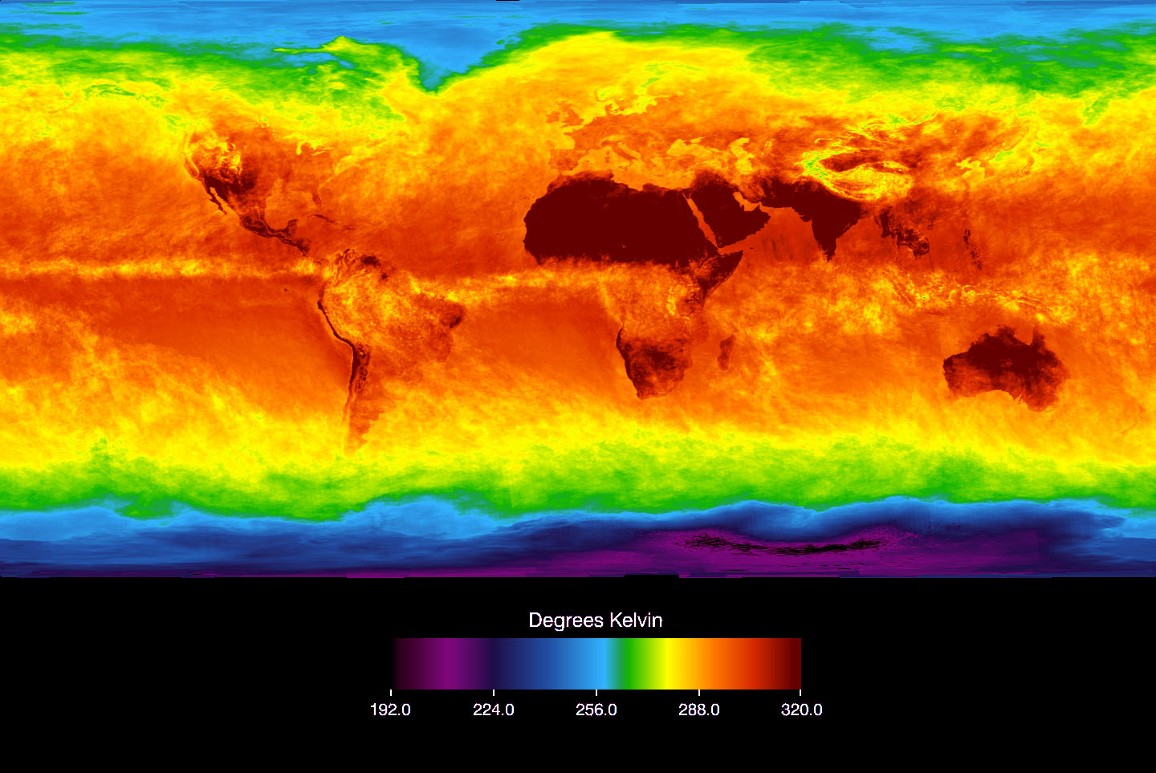
45º F
80º F
110º F
45º F

Slide 18
Heat Capacity and Florida Climate
Why does Florida typically receive rain
in the afternoon during the summer?
Notes:
SubstanceSpecific Heat Capacity - cp -(cal/gram oC) 1)(J/kg oC)Air, dry (sea level)0.241,005Ice (0oC)0.502,093Granite0.19294Sandy clay0.331,381Quartz sand0.19295Water, pure1.004,186Wet mud0.602,5121) 1 calorie = 4.186 joules = 0.00 1 Btu/(lbmoF)

Slide 19
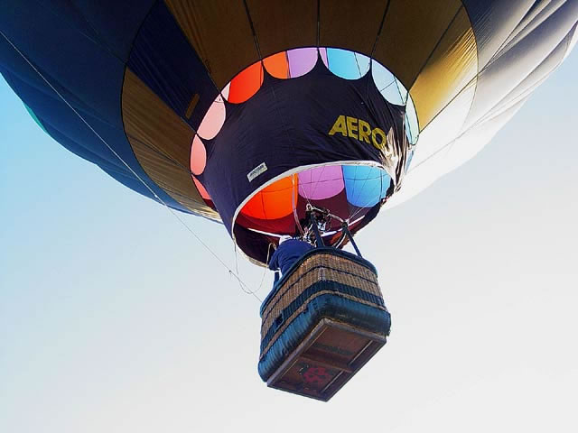
Rainfall
Warm air can hold more moisture than cold air.
Warm air rises
When warm air rises, it eventually cools.
Cooling reduces the amount of water the air can hold
Water condenses from the air as rainfall

Slide 20
Air moves in response to differences in pressure.
Air will move from areas of high
pressure to areas of low pressure.
Try breathing.

Slide 21
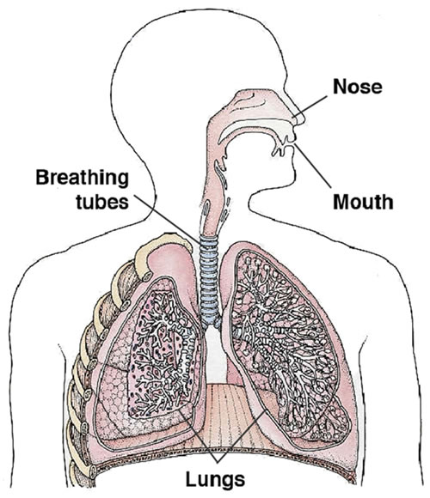
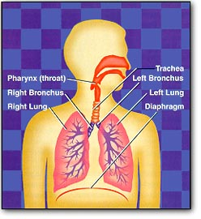
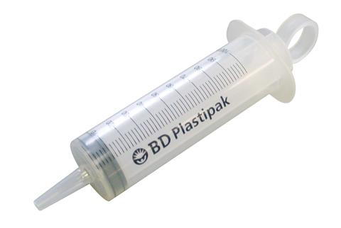

Slide 22
Low
Pressure

Slide 23
Heat Capacity, Pressure, and Florida Weather
Heat Capacities:
Water 1.00 cal/g·ºC
Asphalt 0.22
Sand 0.19
Vegetation 0.85
Land

Slide 24
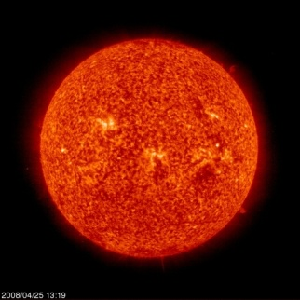
Land heats faster than water
Solar heat
Rising warm air
Moist air
Low pressure
Moist air
Florida
Sand
Asphalt
Vegetation
Gulf of Mexico
Atlantic Ocean

Slide 25
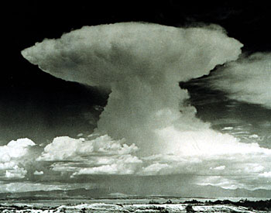
Cools and
condenses
Low pressure
Florida
Sand
Asphalt
Vegetation
Sun Warms water
Gulf of Mexico
Atlantic Ocean

Slide 26
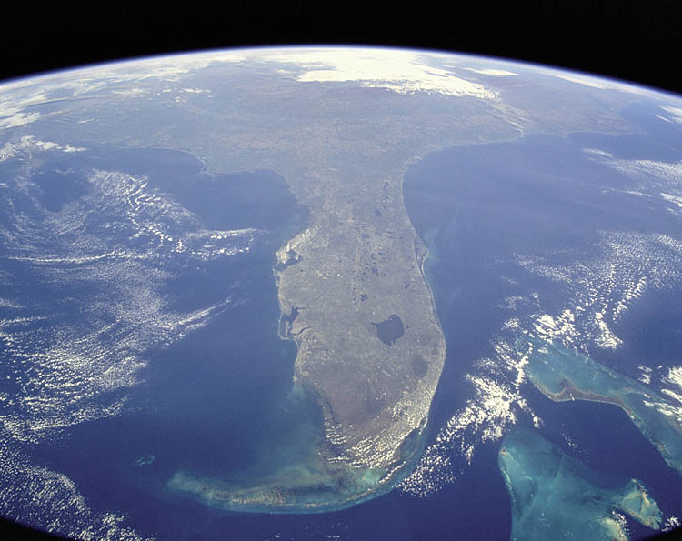
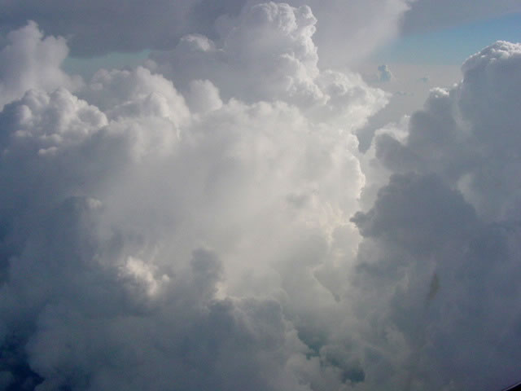
Cooling
And
Condensation
Warm Air
Warm, Moist
Air
Warm, Moist
Air
Low pressure

Slide 27
Heat, Evaporation and Condensation

Slide 28
What is evaporation?
Air
Liquid Water

Slide 29
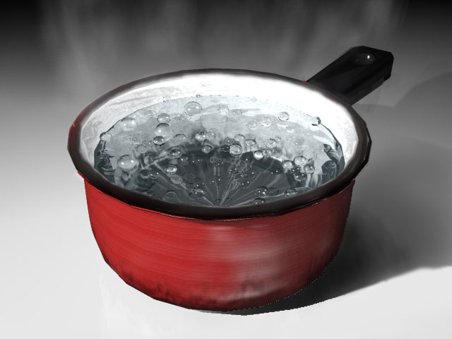
vapor

Slide 30
cooling
What is condensation?
Air
Liquid Water

Slide 31
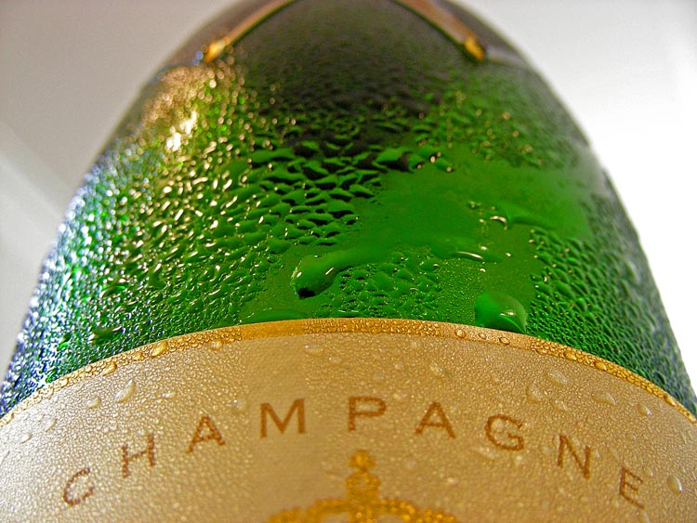

Slide 32
Evaporation: heat input to liquid water excites
molecules, breaks hydrogen bonds
and molecules escape to vapor phase.
Condensation: heat removal from gaseous water
lowers their energy allowing them
to rejoin the liquid phase and
re-establish hydrogen bonds.
Both processes are ultimately controlled by hydrogen bonding

Slide 33
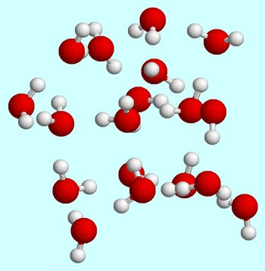
Remove
Heat
Gas
Add heat
Liquid

Slide 34
How Much Heat?

