Slide 1
Water, Life, Civilization: Why Water?

Slide 2
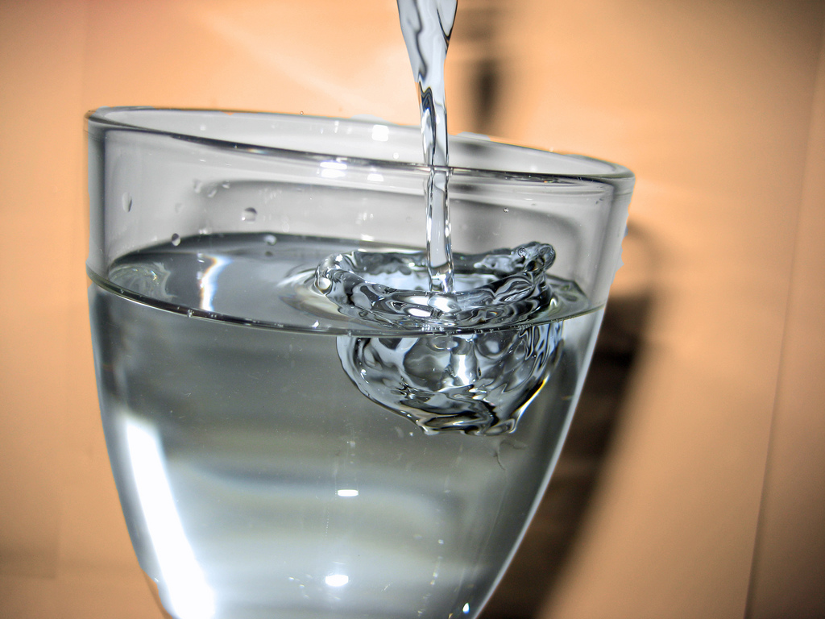
Water: H₂O

Slide 3

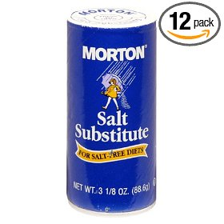
Water: H₂O

Slide 4
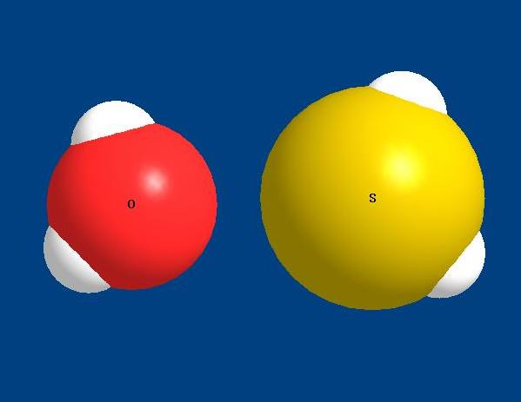
Water and Similar Compounds
H
H
H
H
O
S
Water
Hydrogen Sulfide
H₂O
H₂S

Slide 5

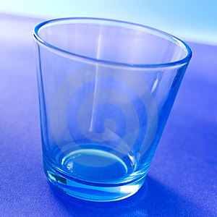
Water: H₂O
Hydrogen Sulfide: H₂S

Slide 6
Water is the only substance that exists as a gas, solid, and
liquid at ambient earth temperatures
Solid
Gas
Boiling Point and Freezing Point
F.P B.P liquid range
Water (H₂O) 0ºC 100ºC 100ºC
Hydrogen Sulfide (H₂S) -84ºC -60ºC 24ºC
Hydrogen Selenide (H₂Se) -64ºC -42ºC 22ºC
Hydrogen Telluride (H₂Te) -49ºC 2ºC 47ºC
Notes:
The moderate climate in coastal areas is the result of the absorbing of huge
amounts of solar heat energy by water during the day and the slow release of
heat energy during the night. Inland areas away from the coast typically
experience much wider temperature extremes. The vast oceans on earth (about
75 percent of the surface area) are responsible for tempering the climate on
earth permitting life to exist.

Slide 7
H₂O
Two hydrogen atoms
One Oxygen atom
What makes water so unusual?

Slide 8
Hydrogen: 1 electron (-), 1 proton (+)
Oxygen: 8 electrons (-), 8 protons (+)
In water, the hydrogens shares their one
electron with oxygen, which shares
one of its electrons with each hydrogen.
This sharing of electrons forms the
bond between hydrogen and oxygen
atoms to make the water molecule.

Slide 9
Hydrogen
H
1 Electron (-)
Nucleus
1 Proton (+)
Notes:
Electrons can be lost or gained by atoms.

Slide 10
Oxygen
8 electrons
Outer shell
e⁻
e⁻
e⁻
e⁻
8 protons
O
e⁻
e⁻
e⁻
e⁻
The outer shell of electrons determines reactivity
Notes:
So, for oxygen we have 8 protons in the nucleus and 8 electrons to distribute around the nucleus. Electrons do not just orbit randomly around the nucleus. They are constrained to what are called electronic shells that can contain differing numbers of electrons. Oxygen has two electronic shells: an inner shell and an outer shell. The inner shell can contain 2 electrons. Click. That leaves 6 electrons to occupy the outer shell. Click. They arrange themselves in this manner. Notice that some of the electrons are paired up and others are not.

Slide 11
Oxygen
Atoms prefer 8 electrons in the outer shell
e⁻
e⁻
Outer Shell
e⁻
O
e⁻
e⁻
e⁻
e⁻
e⁻
Notes:
This is a view of oxygen showing only its outer shell electrons. It is the outer shell electrons that are responsible for chemical reactions. Click. Atoms, including oxygen, prefer to have 8 electrons in their outer shells. Elemental oxygen has only six and is therefore very reactive. Click. If 2 electrons were available, they could easily take residence in the outer shell of oxygen and complete it. But electrons typically don’t simply just float around. They must be obtained from other atoms. This is why elemental oxygen is extremely reactive and we do not see elemental oxygen with just 6 electrons in the outer shell under normal circumstances. Think about it. How does oxygen exist in the atmosphere?

Slide 12
How does oxygen exist in the atmosphere?
O₂

Slide 13
O₂
Covalent Bonding
e⁻
e⁻
e⁻
e⁻
O
O
e⁻
e⁻
e⁻
e⁻
e⁻
e⁻
e⁻
e⁻
Atoms prefer 8 electrons in the outer shell

Slide 14
Water
e⁻
e⁻
H
H
H
e⁻
O
e⁻
e⁻
e⁻
H
H
e⁻
e⁻
Bonding of hydrogen to oxygen in a water molecule is called Covalent Bonding
Notes:
In the case of water, the electrons needed to complete the outer shell of oxygen come from the hydrogen atoms. Hydrogen and oxygen react readily to create water. The single electrons from the hydrogen atoms complete the outer shell of oxygen. Recall that this sharing of electrons is called covalent bonding.

Slide 15
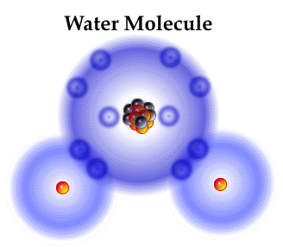
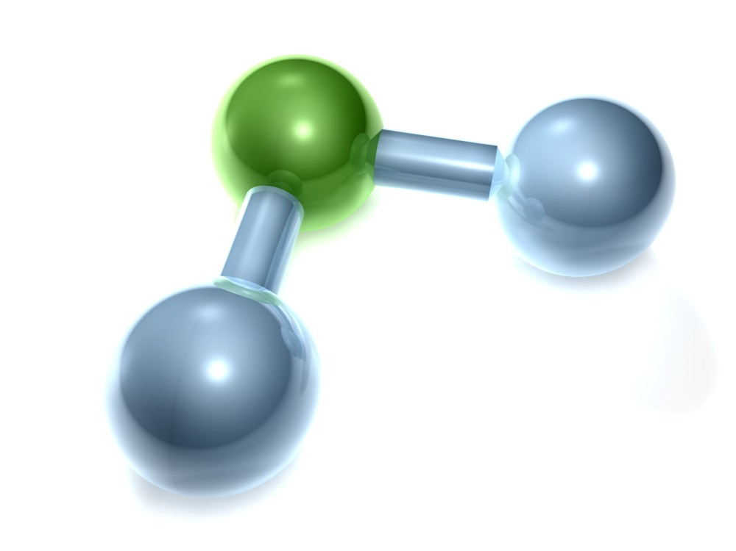
Water Molecule
Shared electrons
Bond of shared
electrons
O
H
H
O
H
H
Shared electrons
Notes:
In other words, we have an imbalance of electrons in water. There is a greater density of negative charge near the oxygen atom due to the unbonded electrons and a slightly greater positive charge near the hydrogen atom. This is one of the features of water molecules that give them their unusual properties compared to other substances.

Slide 16
Water is Unbalanced by Oxygen
H
H
O

Slide 17
Oxygen is “Electron Greedy”
Oxygen attracts electrons very strongly
e⁻
e⁻
e⁻
O
H
e⁻
e⁻
e⁻
Oxygen’s pull on electrons is about 50% stronger than hydrogen
Notes:
Electronegativity is the ability of an atom to attract electrons toward itself. Click. The electronegativity of oxygen is about 50% greater than that of hydrogen. In other words, if you placed electrons (click) between an oxygen atom and a hydrogen atom (Click) the electrons would be drawn toward the oxygen atom and away from the hydrogen atom.

Slide 18
Electrons are negatively charged, protons positive
Oxygen is “electron greedy”
Oxygen pulls electrons toward itself and away from hydrogen
e⁻
e⁻
e⁻
O
e⁻
e⁻
H
e⁻
e⁻
e⁻
P+
P+
H
P+
P+
This pulling of electrons toward itself is called “electronegativity”
Notes:
In other words, we have an imbalance of electrons in water. There is a greater density of negative charge near the oxygen atom due to the unbonded electrons and a slightly greater positive charge near the hydrogen atom. This is one of the features of water molecules that give them their unusual properties compared to other substances.

Slide 19
Abundant electrons (negative charge)
e⁻
e⁻
e⁻
O
e⁻
e⁻
e⁻
H
e⁻
e⁻
P+
P+
H
Two protons (+ charge)
Notes:
In other words, we have an imbalance of electrons in water. There is a greater density of negative charge near the oxygen atom due to the unbonded electrons and a slightly greater positive charge near the hydrogen atom. This is one of the features of water molecules that give them their unusual properties compared to other substances.

Slide 20
More negative charges
( - )
Fewer negative charges

Slide 21
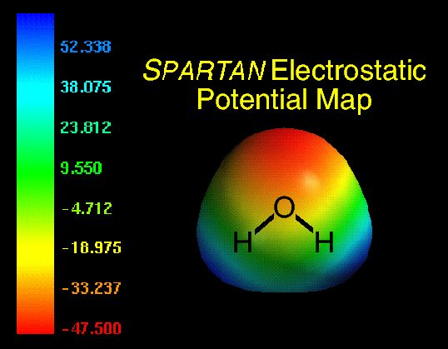
Polarity
_
Red = lots of e⁻
Blue = few e⁻
+
+
+
Electric Dipole

Slide 22
Consequences of Polarity

Slide 23
Magnets and Polarity
N
Magnetic Dipole
S
Notes:
To examine the consequences of polarity, let’s look at a simple bar magnet. As you know magnets have a north and a south pole: a magnetic dipole.

Slide 24
Polarity
N
N
S
S
Opposite Poles Attract
Notes:
Opposites attract. If we place two magnets end to end such that the north pole of one is facing the south pole of another there will be an attraction between the magnets and they will come together. Click

Slide 25
Polarity
N
N
S
S
Same Poles Repel
Notes:
The opposite is true if we place both north poles in close proximity. They will repel one another. We have all played with magnets and noticed this property.

Slide 26
Polarity
N
N
S
S
http://games.mochiads.com/c/g/polarityfreak/polarityfreak-11-Mochi-Sec.swf
Notes:
We also know that if we place two sufficiently powerful magnets in close proximity they will orient themselves so that the opposite poles align with each other and the magnets will come together. Click.

Slide 27
Polarity
Slight positive charge
+
Electric
Dipole
-
Slight negative charge
Notes:
Water molecules behave essentially the same way. Instead of a magnetic dipole, we have an electric dipole with positve charge near the hydrogen end of the molecule and negative charge near the oxygen end of the molecule.

Slide 28
Orientation
Bond
(hydrogen bond)
+
+
-
-
Opposite charges attract each other
Notes:
If we place two water molecules near each other they will behave just like the magnets. They will orient themselves so that the opposite poles align and they will be attracted to each other. They will bond electrostatically together. This bond is called a hydrogen bond.

Slide 29
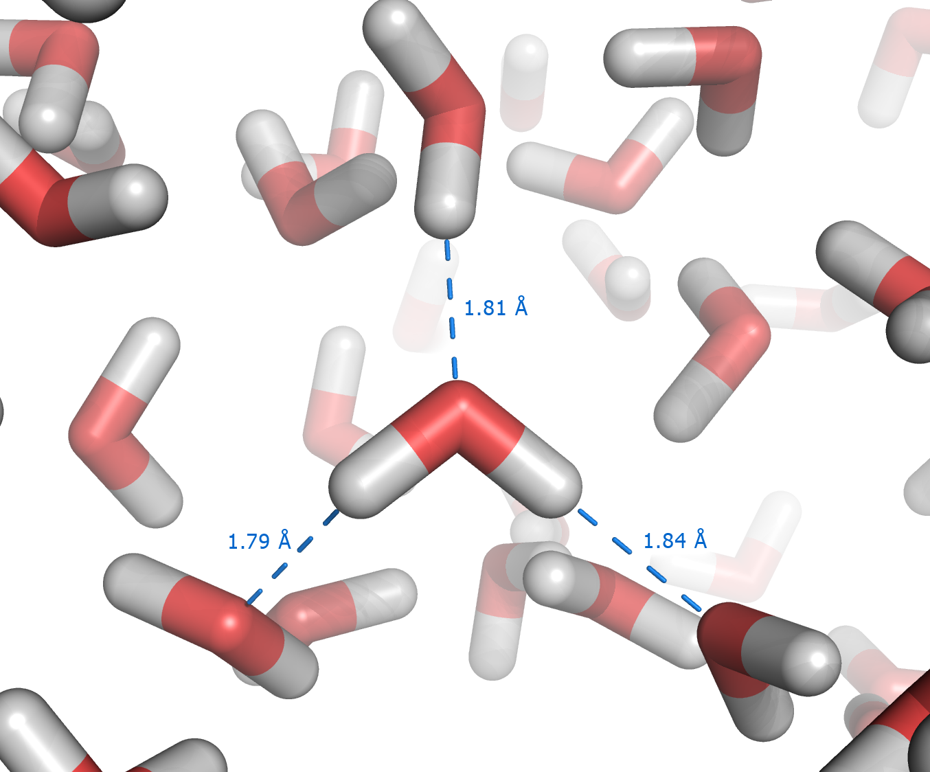
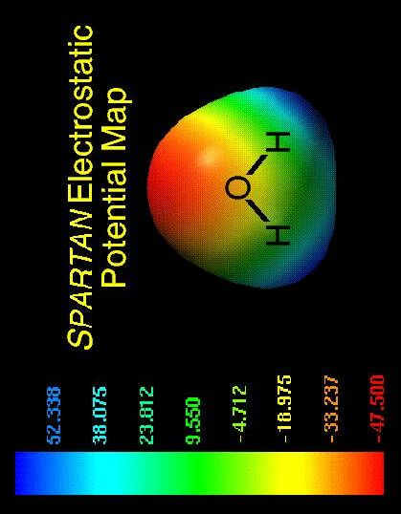
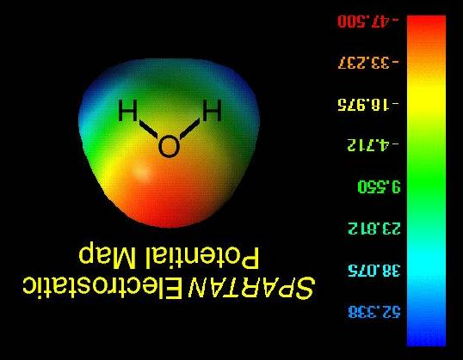
Hydrogen Bonding in Water
Hydrogen Bonding Gives Water Unusual Stability
Notes:
In liquid water, the water molecules orient themselves so that their partial positive charges align with the partial negative charges of neighboring molecules to form a loose structure like that pictured here. The dotted lines represent the hydrogen bonds between the water molecules. Each of these bonds is relatively weak, less than one twentieth of that between hydrogen and oxygen within each water molecule. However they are extremely numerous. So while they are individually weak they are collectively very strong. Like strands in a rope. This makes water a very stable and a very powerful structure and imparts a number of unique properties.

Slide 30
Summary
Hydrogen and oxygen share electrons to form water
The water molecule is electrically unbalanced
Oxygen is electron greedy; it is highly electronegative
Oxygen draws electrons toward itself and away from hydrogen
This creates a slight negative charge near oxygen
There is also a slight positive charge near hydrogen
The result is a molecule that is polar (+ and – poles)
This polarity accounts for electrostatic bonding between water molecules
Bonding between water molecules gives water unusual stability.

Slide 31
Effect on Properties
Extensive Hydrogen Bonding Allows Water
to Exist as a Liquid at Normal Temperatures
and across a wide range in temperatures
High Boiling and Freezing Points
Other Unusual Thermal Properties
Unusual Density

