Slide 1
Chemical Pollutants
Mercury and Synthetic Organics
Notes:
Chemical Pollutants
Heavy metals represent a common type of chemical pollution in water. They can be found naturally in bedrock and sediment or they may be introduced into water from industrial sources and household chemicals. Heavy metals harm humans through direct ingestion of contaminated water or through accumulation in the tissues of other organisms that are eaten by humans. The following are some common heavy metals found in water:
Mercury (Hg): Enters the environment through the leaching of soil due to acid rain, coal burning, or industrial, household, and mining wastes. Causes damage to nervous system, kidneys, and vision.
Lead (Pb): Sources include paint, mining wastes, incinerator ash, water from lead pipes and solder, and automobile exhaust. Causes damage to kidneys, nervous system, learning ability, ability to synthesize protein, and nerve and red blood cells.
Cadmium (Cd): Sources include electroplating, mining, and plastic industries, as well as sewage. Causes kidney disease.
Arsenic (As): Enters the environment through herbicides, wood preservatives, and mining industry. Causes damage to skin, eyes, gastrointestinal tract, and liver. May also cause cancer.
Aluminum (Al): Enters the environment through leaching due to acid deposition. Causes anemia and loss of bone strength, and may also contribute to dementia and Alzheimer’s disease.

Slide 2
Mercury

Slide 3
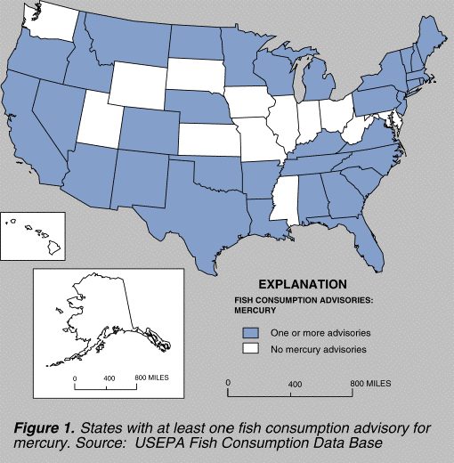
Mercury Advisories
70% of states
Where does it come from?
Notes:
3
Mercury has been well known as an environmental pollutant for several decades. As early as the 1950's it was established that emissions of mercury to the environment could have serious effects on human health. These early studies demonstrated that fish and other wildlife from various ecosystems commonly attain mercury levels of toxicological concern when directly affected by mercury-containing emissions from human-related activities. Human health concerns arise when fish and wildlife from these ecosystems are consumed by humans.
During the past decade, a new trend has emerged with regard to mercury pollution. Investigations initiated in the late 1980's in the northern-tier states of the U.S., Canada, and Nordic countries found that fish, mainly from nutrient-poor lakes and often in very remote areas, commonly have high levels of mercury. More recent fish sampling surveys in other regions of the U.S. have shown widespread mercury contamination in streams, wet-lands, reservoirs, and lakes. To date, 33 states have issued fish consumption advisories because of mercury contamination

Slide 4
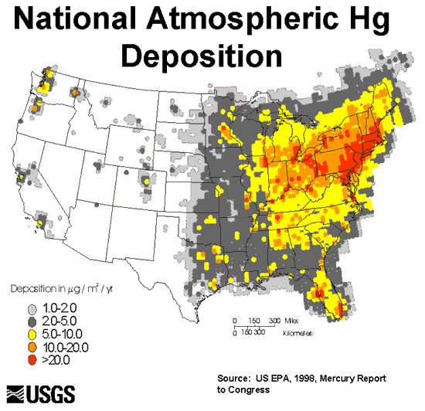
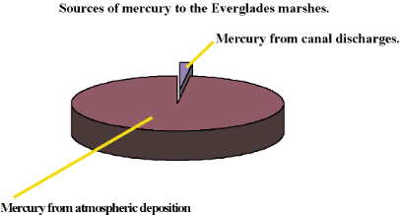
Enters water bodies principally from the atmosphere
Mercury is naturally occurring
(coal, volcanism, rock weathering)
The number 1 anthropogenic source
is the combustion of coal
48 tons of elemental mercury to the atmosphere each year.
Notes:
4
These continental to global scale occurrences of mercury contamination cannot be linked to individual emissions of mercury, but instead are due to widespread air pollution. When scientists measure mercury levels in air and surface water, however, the observed levels are extraordinarily low. The droplet of mercury shown in this slide is about 1 gram; the same amount that is in a standard mercury thermometer and the total amount that is deposited annually on a lake in northern Wisconsin with a surface area of 27 acres.

Slide 5

Mercury
The drinking water standard for Mercury is 0.002 mg/L.
 | blindness, deafness brain damage digestive problems kidney damage lack of coordination cognitive degeneration
1 gram
Electrical products such as dry-cell
batteries, fluorescent light bulbs,
switches, and other control equipment
account for 50% of mercury used.
Notes:
When scientists measure mercury levels in air and surface water, however, the observed levels are extraordinarily low. The droplet of mercury shown in this slide is about 1 gram; the same amount that is in a standard mercury thermometer and the total amount that is deposited annually on a lake in northern Wisconsin with a surface area of 27 acres.
5

Slide 6
Fluorescent Lights
A typical fluorescent lamp is composed of a phosphor-coated
glass tube with electrodes located at either end. The tube
contains a small amount of mercury vapor. When a voltage is
applied, the electrodes energize the mercury vapor, causing
it to emit ultraviolet (UV) energy. The phosphor coating
absorbs the UV energy, causing the phosphorus to fluoresce
and emit visible light.
Phosphor
Coating
Hg gas
UV
Voltage

Slide 7


Recycling and Handling
4 mg Hg
Each year, an estimated 600 million fluorescent lamps are disposed
of in US landfills amounting to 30,000 pounds of mercury waste.

Slide 8
Forms of Mercury
The dominant inorganic forms are Hgº and
Hg²⁺ in many aqueous environments.
Hgº exists as both a liquid and a gas
Hg²⁺ is the dissolved form in water
Hg²⁺
(inorganic) interacts with soil and sediment
particles (- charge) becoming part of lake
bottom sediments (limits availability)

Slide 9
Interaction with Sediment Particles
- charge
Small organic and
Inorganic particles
Hg²⁺
Hg²⁺
Hg²⁺
- charge
- charge
Notes:
Remember that soil and sediment particles can possess a negative electrical charge and are therefore attractive to positively charged mercury, effectively removing them from solution, but still subject to transport by sediments in rivers and streams.

Slide 10
Mercury Bound to Sediments
Mercury, however, can undergo chemical
changes in lakes which render mercury
more environmentally dangerous
Hg²⁺
Hg²⁺
sediments
Negatively charged particles bind mercury
And retain it in bottom sediments.
- charge
Notes:
10

Slide 11
Mercury Methylation
Mercury can be converted to more
toxic forms in bottom sediments
under anaerobic conditions

Slide 12
Mercury Methylation
Methylation: conversion of inorganic forms of mercury,
Hg²⁺, to an organic form: methyl mercury
under anaerobic conditions
Hg²⁺ (CH₃Hg⁺) methylmercury
Methylmercury is strongly accumulated in the body
and is generally more toxic than inorganic Hg
Notes:
12
particularly coal. Although inorganic mercury is only a trace constituent of such fuels, their large scale combustion in the United States alone results in release of some 48 tons of elemental mercury to the atmosphere each year. About 3 times as much additional inorganic mercury is contributed by natural sources such as volcanoes, forest fires and weathering of mercury-bearing rocks.[3]

Slide 13
Mercury Methylation
Occurs primarily in bottom sediments as a byproduct of the life processes of anaerobic sulfate-reducing bacteria (SO₄ to HS-) that live in high sulfur, low oxygen environments.
Requires 4 elements:
anaerobic conditions
a carbon source (organic sediments)
a source of sulfur (SO₄⁻)
sulfur reducing bacteria
Sulfate Respiration
e-
C₆H₁₂O₆ + 3SO₄²⁻ + 3H⁺ = 6HCO₃⁻ + 3HS⁻
When sulfur accepts electrons it is said to be “reduced”.
Notes:
13
Sulfate occurs widely in seawater, sediment, or water rich in decaying organic material The exact mechanisms by which mercury enters the food chain remain largely unknown and may vary among ecosystems. Certain bacteria play an important early role. Bacteria that process sulfate (SO4=) in the environment take up mercury in its inorganic form and convert it to methylmercury through metabolic processes. The conversion of inorganic mercury to methylmercury is important because its toxicity is greater and because organisms require considerably longer to eliminate methylmercury.

Slide 14
The exact role of sulfate-reducing bacteria
In mercury methylation is poorly understood
However, bacterial sulfate respiration requires sulfate.
The addition of sulfate to water stimulates the metabolic activity of sulfate-reducing bacteria and the inadvertent methylation of inorganic mercury
C₆H₁₂O₆ + 3SO₄²⁻ + 3H⁺ = 6HCO₃⁻ + 3HS⁻
Notes:
14
the State of Florida has issued human health advisories that ban or restrict consumption of freshwater fishes from over 2 million acres of the Everglades and Big Cypress Swamp. Although Hg contamination has been detected at levels of concern in largemouth bass throughout the State (Lange et al. 1993), maximum concentrations found in Everglades largemouth bass (4.4 mg/kg)
and bowfin (>7 mg/kg) are the highest Hg contaminant levels thus far reported from Florida waters.

Slide 15
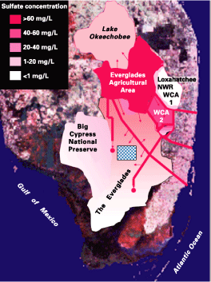
The addition of sulfate to water stimulates the inadvertent methylation of inorganic mercury
Sulfate concentrations in EAA runoff and Lake Okeechobee average more than 50 times background concentrations than in the pristine Everglades
Fertilizers
Sulfate
Potassium Sulfate
Calcium Sulfate
Elemental Sulfur

Slide 16
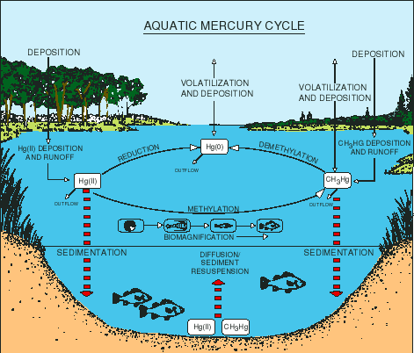
Hg²⁺ from coal, volcanism, rock weathering, point sources
Water
Sediments
(Bound)
Sulfur reducing bacteria, low O₂
methylmercury
Aquatic Organisms
Notes:
16
Sulfate concentrations in EAA runoff and Lake Okeechobee releases are on
average more than 50 times background concentrations in the pristine Everglades

Slide 17
Enhanced Risk
Methylmercury attaches to proteins in animals (enters food chain)
Methylmercury has a half-life in human blood of about 70 days
(twice as long as inorganic mercury (Hg²⁺).
Methylmercury can be accumulated in the body
and is generally more toxic than inorganic Hg
Bioaccumulation: concentration of a chemical in
organisms relative to the amount in water.

Slide 18
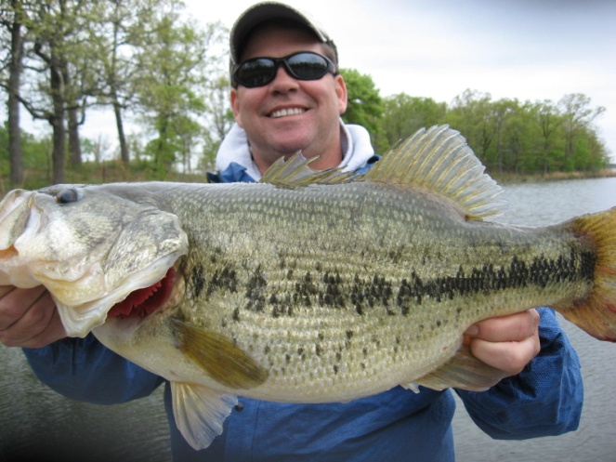
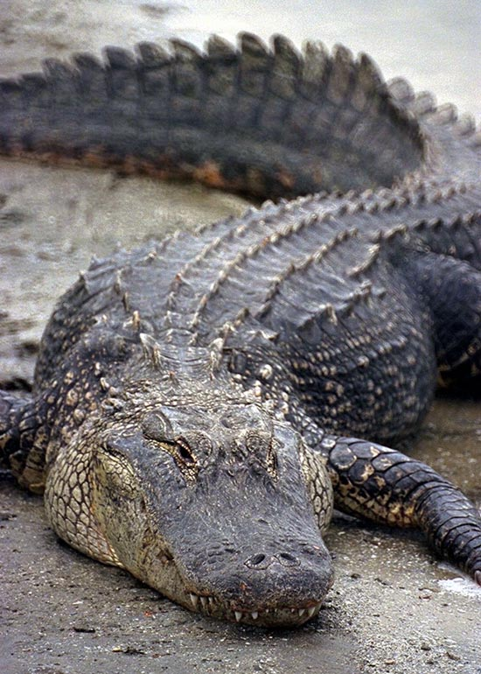
Bioaccumulation and Biomagnification
BAF =
Chemical Concentration in organism
Chemical Concentration in water
Bioaccumulation factors (BAF's) of up to 10 million in largemouth bass have been reported for the Everglades. Fish-eating birds, otters, alligators, raccoons and panthers can have even higher bioaccumulation factors. Methylmercury in the organs and tissues causes birth defects & disorders of the brain, reproductive system, immune system, kidney, and liver at extremely low levels in food.
Notes:
18
Like many environmental contaminants, mercury undergoes bioaccumulation. Bioaccumulation is the process by which organisms (including humans) can take up contaminants more rapidly than their bodies can eliminate them, thus the amount of mercury in their body accumulates over time. If for a period of time an organism does not ingest mercury, its body burden of mercury will decline. If, however, an organism continually ingests mercury, its body burden can reach toxic levels. The rate of increase or decline in body burden is specific to each organism. For humans, about half the body burden of mercury can be eliminated in 70 days if no mercury is ingested during that time. Biomagnification is the incremental increase in concentration of a contaminant at each level of a food chain
Methylmercury is first taken up by bacteria and tiny plants and animals known as plankton.
Then the plankton and bacteria are eaten by small fish.
These small fish are eaten by larger predatory fish which accumulate large amounts of methylmercury in their tissues.
The large fish are caught and eaten by humans and animals, exposing them to large amounts of methylmercury which will accumulate in their bodies as well.

Slide 19
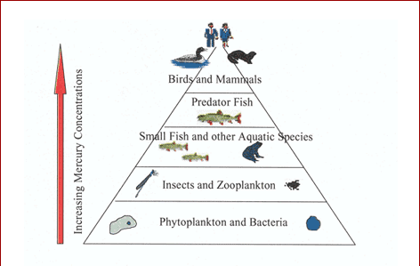
Bio-magnification
Biomagnification: concentration of a chemical in
organisms as it moves up the food chain.

Slide 20
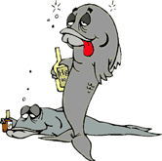
Assessing Your Risk
http://www.edf.org/page.cfm?tagID=17694
http://www.mercuryfacts.org/fSafeFish.cfm
Nearly all fish and shellfish contain traces of methylmercury.
However, larger fish that have lived longer have the highest
levels of methylmercury because they've had more time to
accumulate it. These large fish (swordfish, shark, king mackerel
and Albacore tuna) pose the greatest risk.
Some of the most commonly eaten that are low in mercury are
shrimp, canned light tuna, salmon, pollock, and scallops.
Fish sticks and "fast-food" are commonly made from fish that are low in mercury.

Slide 21
Other Bioaccumulative Toxins
Synthetic Organic Chemicals

Slide 22

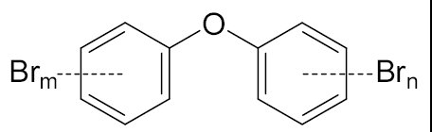
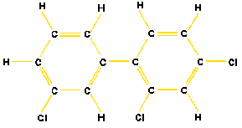
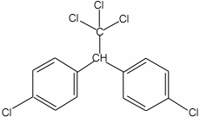
Synthetic Organic Chemicals
Organic = carbon-rich compounds
Dioxin
Dioxins
Pesticides
PBDE
PCBs
Flame Retardants
Polybrominateddiphenyl ether
PCB
DDT
Organochlorines
dichlorodiphenyltrichloroethane
Notes:
Dioxins: paper bleaching, by-product of organochlorine production.

Slide 23

Potential Toxicity
July November
dioxin
2004
Viktor Yushchenko
Ukrainian President
6,000 times the usual concentration in his body
the second highest dioxin level ever measured in a human
Notes:
The most toxic compound is 2,3,7,8-tetrachlorodibenzo-p-dioxin or TCDD. The toxicity of other dioxins and chemicals like PCBs that act like dioxin are measured in relation to TCDD. Dioxin is formed as an unintentional by-product of many industrial processes involving chlorine such as waste incineration, chemical and pesticide manufacturing and pulp and paper bleaching. Dioxin was the primary toxic component of Agent Orange, was found at Love Canal in Niagara Falls, NY and was the basis for evacuations at Times Beach, MO and Seveso, Italy.

Slide 24
Chemicals like dioxin are acutely toxic
In high doses, but they also can bioaccumulate
at lower doses, creating chronic toxicity
The cause of their ability to bioaccumulate
is related to their water solubility.

Slide 25
Water Solubility
NaCl Na⁺ + Cl⁻
Sodium Chloride 350 g/L
Potassium Chloride 280 g/L
Notes:
NaCl = 875,000 kg/pool

Slide 26
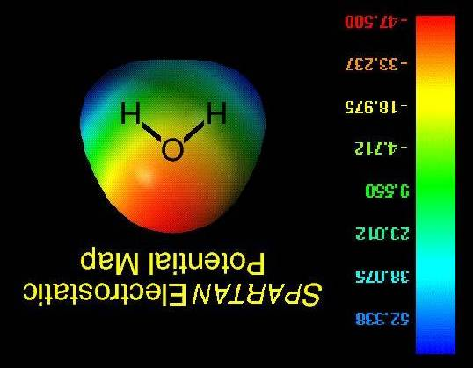
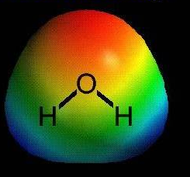
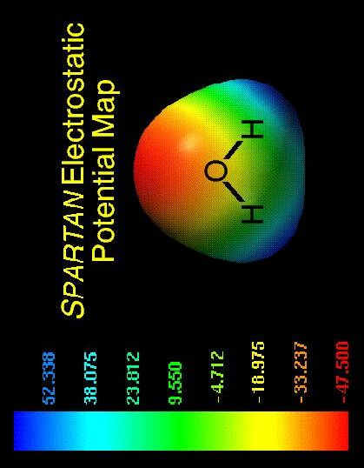
Water Molecules are Polar
+
+
Unequal distribution of electrons
Oxygen is electron-greedy
-

Slide 27
NaCl Na⁺ + Cl⁻
Na⁺
Cl⁻
Sodium Chloride water solubility: 350 g/L

Slide 28
Contrast with Organic Chemicals

Slide 29
Organic Chemicals
Carbon-rich compounds
Greases, Oils, Paints, Pesticides, Industrial Chemicals
Grease and Oil
Oil Paint
Carbon | 83 to 87%
Hydrogen | 10 to 14%
C₁₆H₁₄OS
Composed mostly of carbon and hydrogen,
and possessing no electrical charge.

Slide 30
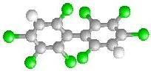
Dioxin
C₁₁H₁₈O₂Cl₄
DDT
C₁₄H₂₂Cl₅
PCB
C₁₂H₂₁Cl₈
Principally carbon, hydrogen
Generally poorly soluble in water
Notes:
.2 ug/L = .5g in an olympic sized swimming pool (2,500,000 L)

Slide 31
Dioxin
Dioxin water solubility: 0.2 µg/L

Slide 32
Dioxin
0.2 µg/L
DDT
< 0.1 µg/L
PCB
10 µg/L
Uncharged and principally carbon, hydrogen
Notes:
.2 ug/L = .5g in an olympic sized swimming pool (2,500,000 L)

Slide 33
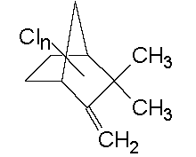
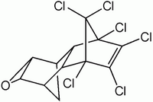
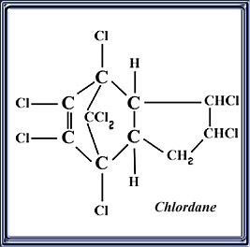
Toxaphene: 3 mg/L
Dieldrin: 186 ug/L
Chlordane: 9 ug/L

Slide 34
Greases, Oils, Paints, Pesticides, Industrial Chemicals
These types of chemicals are poorly soluble in water
In what substances do they dissolve?
Notes:
PCBs are very stable compounds and do not degrade easily. However, under specific conditions they may be destroyed by chemical, thermal, and biochemical processes. These processes may occur intentionally (e.g., incineration), unintentionally, or metabolically. Because of their high thermodynamic stability, all degradation mechanisms are difficult. Intentional degradation as a treatment of unwanted PCBs generally requires high heat or catalysis. Environmental and metabolic degradation generally proceeds quite slowly relative to most other compounds.
The major North American producer, Monsanto, marketed PCBs under the trade name Aroclor from 1930 to 1977

Slide 35

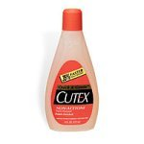
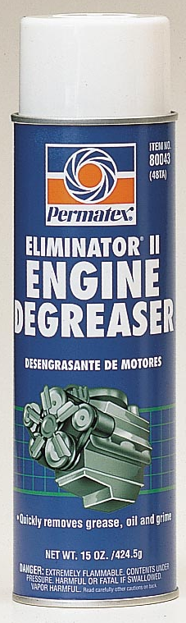
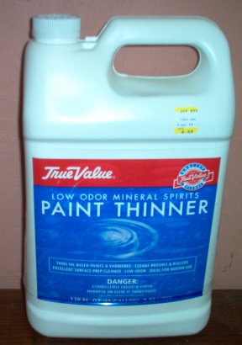
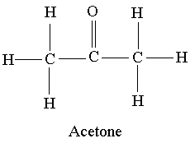

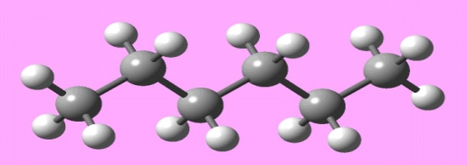
Common Organic Solvents
Carbon-based
D-limonene oil
petroleum
Hexane

Slide 36
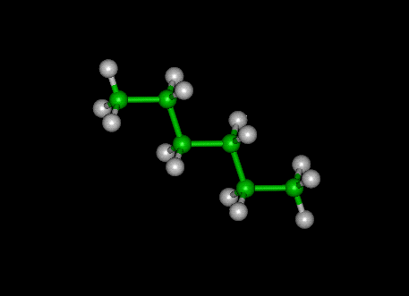
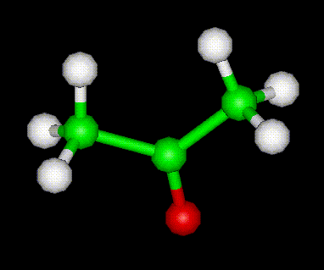
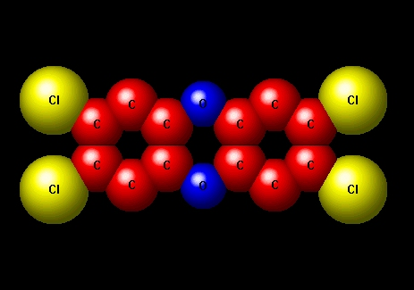
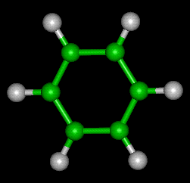
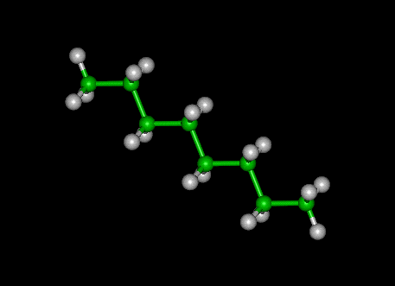
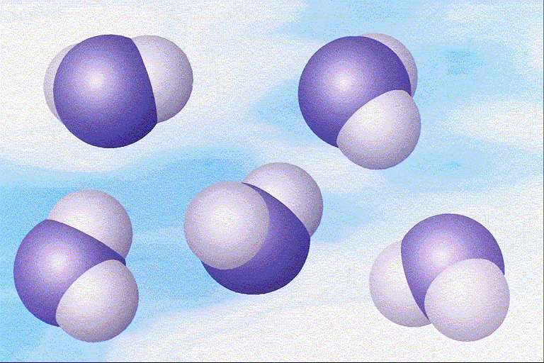
Organic Solvents
carbon
*
carbon
Organic
solvents
Dioxin
carbon
carbon
Carbon-based compounds
dissolve more easily in carbon-
based solvents.
water

Slide 37
What is the most common solvent used every day?

Slide 38
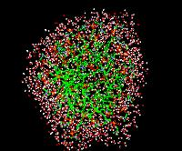
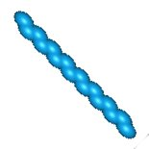

Detergents
SO₄⁻
SO₄⁻
SO₄⁻
hydrophilic
hydrophobic
⁻SO₄
SO₄⁻
SO₄⁻
SO₄⁻
SO₄⁻
SO₄⁻
High Carbon Concentration

Slide 39
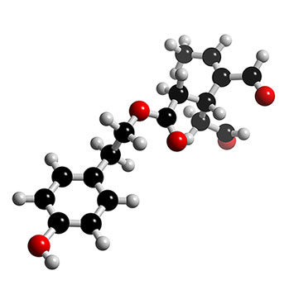
Detergent Micelles
Vegetable Oil
(insoluble in water)

Slide 40
Synthetic Organics and Organisms

Slide 41
Synthetic organic chemicals can be acutely toxic
In high doses, but they also can bioaccumulate
creating chronic toxicity at lower doses
Their ability to bioaccumulate
is related to their poor water solubility.

Slide 42
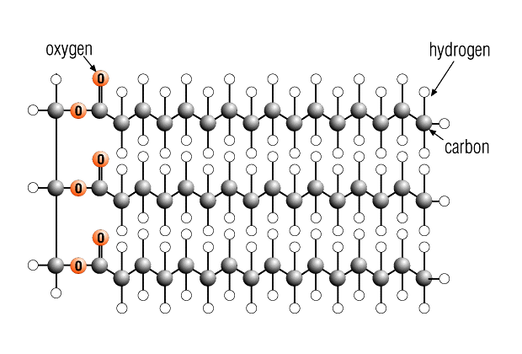
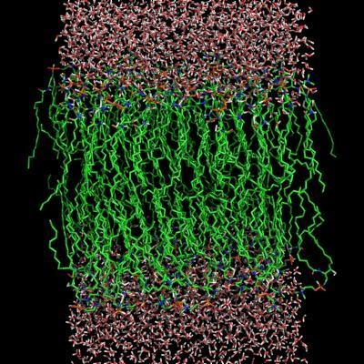
Bioaccumulation in Organisms
Lipid Tissue in Organisms
carbon
Principally Carbon and Hydrogen

Slide 43
Bioaccumulation in Organisms
Dioxin
carbon
The chemical essentially dissolves into the lipid tissues

Slide 44
Synthetic organic chemicals are poorly soluble in water
They are soluble in organic solvents and lipids
Lipids are found in all organisms
Despite low levels of organic chemicals in water due
to their low water solubility, high amounts can
accumulate in the tissues of living organisms

Slide 45
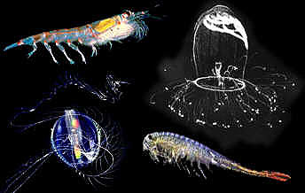
Bioaccumulation
Water Concentration = 0.2μg/L
Zooplankton concentration = 160 μg/L
Magnification of 800 x

Slide 46
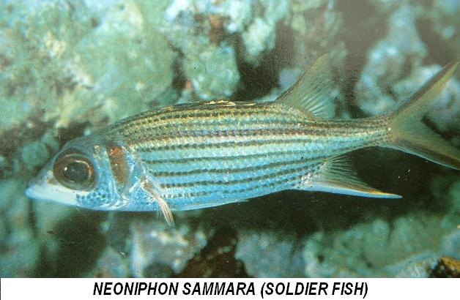
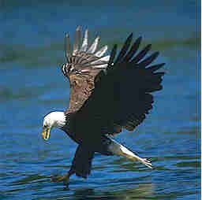
Bio-Magnification
Water and phytoplankton
to zooplankton: 800 x
Zooplankton to fish: 31 x
Fish to eagle: 4.8x
Overall: 120,000 times original concentration in water
Notes:
water to zooplankton: 800x zooplankton to fish #1: 31x fish #1 to fish #2: 1.7x fish #2 to gull: 4.8x overall: 202,368x

Slide 47
Bioaccumulative Organics
PCBs and Pesticides

Slide 48
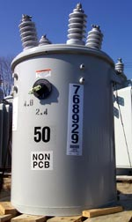
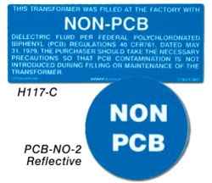
PCBs
Used as insulating fluids and coolants in electrical equipment and machinery from 1929-1977.
Electrical equipment
plasticizers in paints,
plastics and rubber products
pigments, dyes and carbonless
copy paper
EPA estimates that 150 million
pounds of PCBs are dispersed
throughout the environment,
including air and water supplies;
an additional 290 million pounds
are located in landfills in this country
some PCBs act like hormones,
and other PCBs are nerve poisons
PCBs were “banned” in 1979
Notes:
PCBs are very stable compounds and do not degrade easily. However, under specific conditions they may be destroyed by chemical, thermal, and biochemical processes. These processes may occur intentionally (e.g., incineration), unintentionally, or metabolically. Because of their high thermodynamic stability, all degradation mechanisms are difficult. Intentional degradation as a treatment of unwanted PCBs generally requires high heat or catalysis. Environmental and metabolic degradation generally proceeds quite slowly relative to most other compounds.
The major North American producer, Monsanto, marketed PCBs under the trade name Aroclor from 1930 to 1977

Slide 49
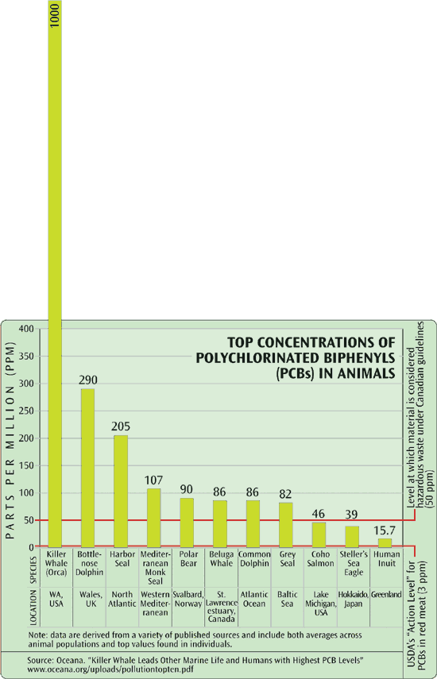
Killer Whales
(1000 ppm)
PCBs in Marine Mammals
High on food chain
Lipid tissues
Hazardous
Waste level
(Canada)

Slide 50
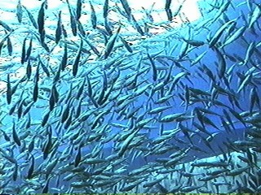
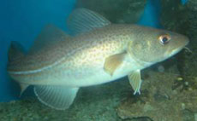
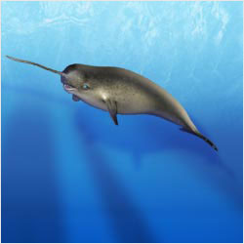
Toxaphene
(670 chemicals)
carbon
lipid
400,000 tons: 1946 to 1974
Seawater
0.0003 ppb
Arctic cod muscle
14 - 46 ppb
50,000 X
Narwhal
blubber
2440 - 9160 ppb
~ 8 M X
Notes:
Toxaphene is a manufactured insecticide that contains over 670 Chemicals (ATSDR, 2001).Toxaphene, one of the heaviest used insecticides in the U.S., has been used to control insect pests on crops and livestock and to kill unwanted fish in lakes (ATSDR, 2001). Cumulative world use from 1946 to 1974 was more than 409,000 metric tons (O'Shea, 1999). The United States ceased using toxaphene in 1982, but it is still used in many other countries (O'Shea, 1999). For example, the Virgin Islands and Puerto Rico use it in banana and pineapple cultivation (Burland).Once Toxaphene is added to the environment by human action, it can then enter the air, water and soil. It can enter the air by evaporation, the water through runoff, and the soil by sticking to soil particles (ATSDR, 2001). The most likely route of entry for toxaphene into the environment is evaporation from soils (GPA). Although toxaphene can be in water, it does not dissolve well so it is more likely to be found in air, soil, or sediments underwater (ATSDR, 2001). Once the toxaphene is introduced into the environment it remains there for a long time due to its very slow break down time (ATSDR, 2001). Toxaphene has a half-life as long as twelve years once in the soil (GPA).Toxaphene can be spread through the environment by atmospheric transport and is found in low concentrations in tissues of marine mammals in remote areas were it has never been used, such as the artic (O'Shea, 1999).

Slide 51
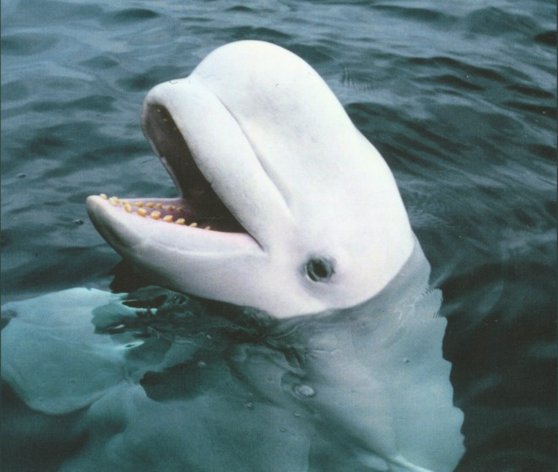
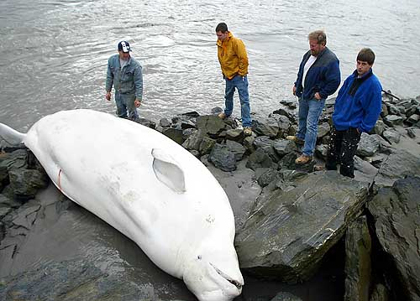
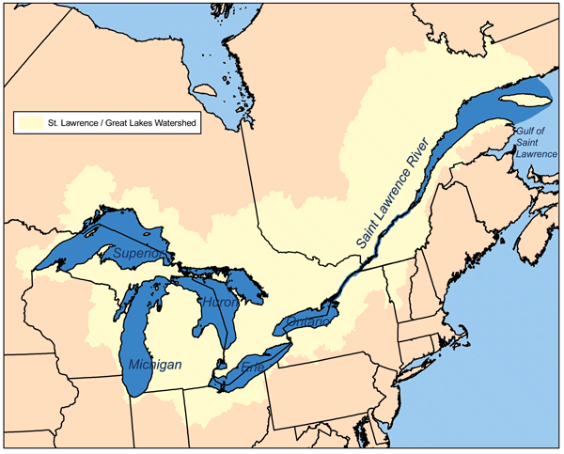
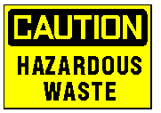
Toxaphene and Mirex: 1959 - 1976
highest levels ever recorded in a living organism.
Notes:
Hooker Chemical and Plastics Corporation manufactured mirex from 1959 through 1976 to control fire ants in the southern United States and also as a fire-retardant in the manufacturing of plastics.
Hooker Chemical (now Occidental Chemical Corporation) on the Niagara River and Armstrong Cork Company on the Oswego River are responsible for the release of and subsequent
contamination of lake ontario with mirex (1-4).
The influence of pollutants such as PCBs, DDT, mirex, and toxaphene is assessed in a population of 500 beluga whales residing in the St. Lawrence River system. This population suffered a dramatic decrease in numbers at the turn of the century, and population numbers continue to slowly decrease. Reasons for this continual decline including biomagnification factors and bioaccummulation are considered. Because they occupy a high level on the food chain, beluga whales accumulate larger quantities of pollutants. Due to the transferance of pollutants through lactation, calves, younger females, and males have higher concentrations than older females. Some of the effects of the pollution are compromised immune systems, reproductive problems, and increased death rates. Pollution is so concentrated in some beluga whale carcasses that they are treated as hazardous waste.
Even though belugas have been protected from hunting since the 1970s, their numbers have failed to rebound. Chemical analyses of their blubber have detected PCBs, DDT, chlordane and toxaphene - at some of the highest levels ever recorded in a living organism.

Slide 52
Persistence in the Environment

Slide 53
Many synthetic organic chemicals, particularly
those like PCBs and DDT are very persistent
in the environment. They last for decades.
They become stored in organic materials
that naturally occur in aquatic and terrestrial systems
Where in these environments
do we find high levels of carbon?

Slide 54
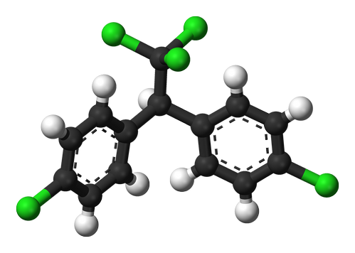

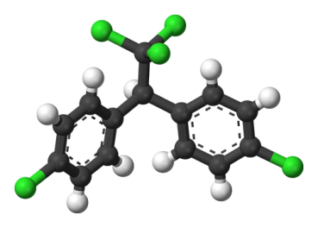
Environmental Persistence
Water
DDT
Solubility of < 0.1 μg/L
Organic Sediments
Organic chemicals become stored in organic sediments
This protects them from degradation and increases their lifetime in the environment
Notes:
So, despite the extremely low water solubility of these chemicals they persist in the environment. But why are they such a problem if they exist in such low concentrations in the water column?

Slide 55



½ Life and Organochlorines
PCBs 1 month
2-6 years
> 60 years
Dioxin 1 - 30 years (7 years in humans)
DDT 28 days
15 – 20 years
up to 150 years
Muck: high in organic carbon

Slide 56



Lake Michigan
PCBs
“banned” in 1979
EPA 2004
N
Concentration
Organic Carbon
mg Carbon /g sediment
PCBs
µg PCB/Kg sediment
(parts per billion)
Open water PCB concentration = < 1 part per trillion

Slide 57

Lake Erie PCB levels
PCBs
EPA, 2004
After 30 years, PCBs continue to persist in the Environment

Slide 58

Persistence in the Environment
Old sediments

Slide 59
Florida Lakes and Organics

Slide 60
DDT
dichloro-diphenyl-trichloroethane
First Modern Pesticide
1948 Nobel Prize in Physiology and Medicine
Insecticide developed to combat insect-borne disease
Use was later expanded to include agriculture
Notes:
DDT was the first modern pesticide and is arguably the most well known organic pesticide. It is a highly hydrophobic colorless solid with a weak, chemical odor that is nearly insoluble in water but has a good solubility in most organic solvents, fat, and oils.
DDT was developed as the first of the modern insecticides early in World War II. It was initially used with great effect to combat mosquitoes spreading malaria, typhus, and other insect-borne human diseases among both military and civilian populations. The Swiss chemist Paul Hermann Müller was awarded the Nobel Prize in Physiology or Medicine in 1948 "for his discovery of the high efficiency of DDT as a contact poison against several arthropods."
In 1962, an American activist named Rachel Carson published the book Silent Spring, which alleged that DDT caused cancer and harmed bird reproduction by thinning egg shells. The book resulted in a large public outcry which eventually led to the pesticide being banned for agricultural use in the USA, and was one of the signature events in the birth of the environmental movement. It was subsequently banned for agricultural use in many countries in the 1970s due to its negative environmental impact.
DDT and its metabolic products accumulate through the food chain, with apex predators such as raptors having a higher concentration of the chemicals than other animals sharing the same environment. In particular, DDT has been cited as a major reason for the decline of the bald eagle in the 1950s and 1960s. In general, however, DDT in small quantities has very little effect on birds; its primary metabolite, DDE, has a much greater impact. DDT and DDE have had little impact on some birds which are not apex predators, like the chicken.

Slide 61


Launch of the
Environmental Movement
Thinning egg shells
Lower hatching rates
Declining Eagle population
Carcinogenic
decline in the eagle population occurred before the DDT years
(bounties between 1917 and 1942)
primates were fed 33,000 times more DDT than the estimated exposure
human volunteers ingested 35 mg of DDT
1962
http://faculty.unionky.edu/rbotkin/RECM_480_ISSUE_16A_YES_BLUE.PPT#291,22,Issue%2016:%20Yes
Notes:
Alaska paid over $100,000 in bounties for 115,000 bald eagles between 1917 and 1942.

Slide 62




Torry and Rita Islands
Organic soils
DDT levels ranging from
2,200 to 110,000 µg/kg (ppb)
in organic soils and sediments.
Notes:
Lake Okeechobee (Figure 1) and its tributaries have been the catch basins of agricultural runoff containing pesticides and animal wastes (29,30). Historically, Moonshine Bay, our intermediate site on Lake Okeechobee, has shown detectable sediment levels of DDE (1.2 µg/kg) and dichlorodiphenyldichloroethane (DDD; 2.4 µg/kg) that are lower than those reported for the Belle Glade area on the south shore of Lake Okeechobee and WCA 3A in the northern Everglades (30). More recent sampling at the mouth of Fish Eating Creek (located near Moonshine Bay) has shown DDD and DDE to be nondetectable in sediments (31,32). The south end of the lake (Belle Glade area) has three islands, Kreamer Island, Torry Island, and Rita Island. Torry and Rita Islands have had documented organochlorine levels (DDT, DDD, DDE) ranging from 2,200 to 110,000 µg/kg sediment (30). This is not surprising due to the agricultural activities (muck farming) that historically occurred on these islands. More recent reports show that sediment samples collected from the south end of the lake contain detectable levels of DDD (ranging from near detection limits to 24 µg/kg) and DDE (7.4-47 µg/kg) (31,32). WCA 3A has had reported sediment levels of DDE ranging from 3.8 to 150 µg/kg and DDD ranging from 0.1 to 62 µg/kg (30). Chlordane, DDT, dieldrin, and endrin were all reported at levels < 0.1 µg/kg (30). More recent sampling in and around WCA 3A has shown DDD levels at or slightly above the minimum detection limit, whereas DDE levels range from slightly above the minimum detection limit to 21 µg/kg sediment (31,32). Altered circulating testosterone concentrations have recently been detected in juvenile alligators from Lake Okeechobee (21,33).

Slide 63


Lake Apopka
30,800 acres
mean depth is 5.4 feet
15 miles northwest of Orlando
Historically characterized by clear water and a highly prized sports fishery, it served as a popular destination for boaters, swimmers, and fishermen for decades.

Slide 64

Pesticide Use in Agricultural Area
Agriculture
Pesticide use included high amounts of DDT

Slide 65

"Lake Apopka is a big chemical soup,"
Michael Fry, a researcher from the University of California
Tower Chemical Company
Sediment Organic carbon content ranges from 33 to 37%
Produced dicofol, a mixture of the pesticide DDT and DDE,
a by-product of DDT. Periodic spills occurred there, but a particularly
large accident in 1980 caused dicofol to spread into the lake
Notes:
In the late 1970s, scientists considered Lake Apopka a prime place to harvest eggs and hatchlings, and they began collecting there to see how baby alligators would fare in captivity. In 1980 and 1981, Woodward says, the scientists counted populations of 1,200 to 2,000 alligators in a single night on the lake. By the late 1980s, they found 150 a night. "We hadn't seen such a population crash," says Woodward, who continues to monitor the population. There was nothing quite like it elsewhere, even on lakes with comparable agricultural runoff, adds Guillette. In the years just after the 1980 chemical spill, the number of hatchlings dramatically dropped

Slide 66

In the 1970s, scientists considered Lake Apopka
a prime place to harvest eggs and hatchlings to study
them in captivity.
In 1980 and 1981, scientists counted populations of
1,200 to 2,000 alligators in a single night on the lake
By the late 1980s, they counted only 150 per night
Notes:
Guillette wondered if pollution could be causing the strange defects he found at Lake Apopka. In 1980, Lake Apopka had been the site of a severe chemical spill that left it one of Florida's most polluted lakes. A waste pond at the Tower Chemical Company overflowed, spilling large amounts of the pesticides DDT and dicofol into the lake. Soon afterward, 90% of Apopka's alligators disappeared. Tissue samples from the remaining alligators showed high levels of p,p'-DDE, a breakdown product of DDT, along with a host of other contaminants. p,p'-DDE was the most common contaminant in the alligators' eggs. In addition, Apopka suffered chemical runoff from agricultural areas around the lake, and from a nearby sewage treatment plant. Could this be the difference between Lake Apopka and Lake Woodruff? Could a spill that took place over a decade earlier still be hurting the alligators of Lake Apopka?
Guillette still remembers when the pieces of this puzzle fell into place. It happened when a colleague told Guillette what he had learned at a recent meeting organized by Theo Colborn. Environmental contaminants, the colleague said, could act like hormones. For example, p,p'-DDE, the major contaminant in Lake Apopka, was known to block the action of testosterone. Suddenly, what Guillette was seeing in Lake Apopka made sense; chemicals were disrupting hormones in these animals.

Slide 67

Alligator Population crash was linked to poor egg viability
Alligators typically produce 40-45 eggs with a hatching
rate of about 65%. In Lake Apopka, only 15-20% hatch

Slide 68
DDT, DDE and Feminization of Alligators
DDE, a breakdown product of DDT, is
a major contaminant in Lake Apopka
DDE is known to block the action of testosterone
Apopka's juvenile alligators have abnormal
testes and ovaries and abnormal hormone balances
Estradiol Testosterone
Apopka males had high levels of estradiol relative to testosterone

Slide 69
' Teeny Weenies '
Alligators in Florida's Lake Apopka have Smaller Penises
Kyla Dunne for PBS June, 1998
http://www.mindfully.org/Pesticide/Alligators-Apopka-PBS2jun98.htm

Slide 70
Synthetic Organics, Organochlorines
Assessing the Danger: Octanol

Slide 71
Solubility
carbon
Hexane
carbon
Acetone
Dioxin
carbon
Lipids
organochlorine
Carbon-based compounds
dissolve more easily in carbon-
based solvents.
Organic
Sediments
carbon

Slide 72
How strong is the interaction?
Bioaccumulation
Persistence

Slide 73

An Important Organic Solvent: Octanol
C₈H₁₈O
c
c
c
c
c
c
c
c
Octanol is used as a reference organic solvent for neutral organic chemicals

Slide 74
Octanol and Water
C₈H₁₈O
Octanol and water are immiscible (they do not mix)
Octanol is less dense than water: 0.824 g/cm3
octanol
C₈H₁₈O
water

Slide 75
Partitioning Between Octanol and Water
Carbon/hydrogen
Octanol (Carbon/Hydrogen)
water
C₁₀H₂₀

Slide 76
Octanol-Water Partitioning Coefficient
Kow =
Concentration of chemical in octanol
Concentration of chemical in water
At equilibrium

Slide 77
Add 10 mg chemical
1 L Octanol
1L Water
separate
octanol
chemical
water
chemical
Analyze the water phase for the chemical.
Difference between initial amount and amount in water = amount in octanol
The ratio between the two yields the K_{ow}

Slide 78
Add 10 mg chemical
1 L Octanol
1L Waterl
separate
Chemical
In octanol
Chemical
In water
0.01 mg
L
9.99 mg
L
9.99 mg
L
Kow =
= 999
Water phase
octanol phase
0.01 mg
L

Slide 79
K_{ow} of some Organochlorine Compounds
DDT 8,000,000
PCBs 2,000,000 +
Dieldrin 1,600,000
Mirex 3,000,000
chemical in octanol
chemical in water
A high K_{ow} indicates strong interaction with
organic solvents and, therefore, sediments
and lipid tissues

Slide 80


Range for Some Modern Pesticides
Kow = 2 – 10,000 mL/g
Dicamba = 4
Malathion = 2919
Chlorpyrophos = 10,521
diazinon
Can be more acutely toxic
Inhibit acetyl cholinesterase, an enzyme
necessary for proper nervous system function
Far less potential for bioaccumulation
Rapid Breakdown (1/2 life measured in days or weeks)
Notes:
Here's a range.

Slide 81


Water Filters
What is the most common component?
Carbon

Slide 82

Is this effective at removing
Synthetic organic chemicals
from your tap water?
Is it more effective removing
chemicals with a high or low Kow?

Slide 83
Most Common Filtration
Solid Carbon Block faucet mount filters
These filters, by nature, are quite small and because filter effectiveness is
dependent on contact time of the water with the filter media, a larger, high-quality
solid carbon block filter will be more effective at reducing contaminants at the
same flow rate.
A high-quality solid block activated carbon replacement filter will filter water for
between 7 and 10 cents per gallon. 2 gallons of filtered water per day would cost
between $50 and $100 per year

