Slide 1
Freshwater and Freshwater Pollutants

Slide 2
Water Pollution
"any biological, chemical, or physical change
in water quality that has a harmful
effect on living organisms or makes water
unsuitable for desired uses."
44% of lakes,
37% of rives unsafe for recreation due to toxic water pollutants
32% of estuaries.

Slide 3
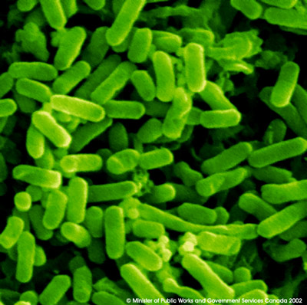
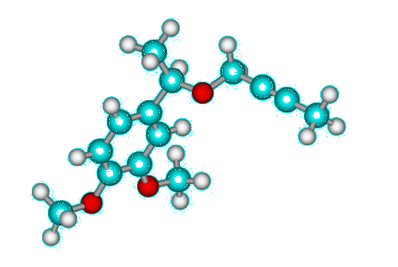
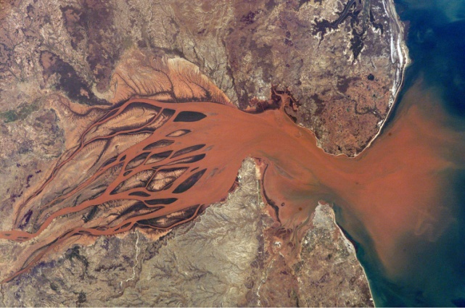
Basic Types of Pollution
1) Biological
2) Physical
3) Chemical
Notes:
Such pollutants fall into three main categories: 1) biological, such as bacteria or viruses; 2) chemical, including heavy metals, nutrients, pesticides, and wastes; 3) physical, such as sediment, radioactive material, and heat.

Slide 4
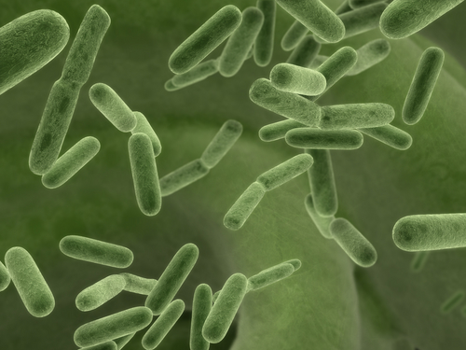
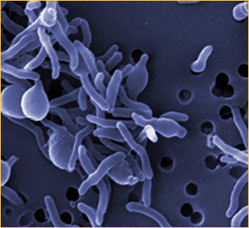
Biological Water Pollution
Develops from microorganisms and their activities.

Slide 5
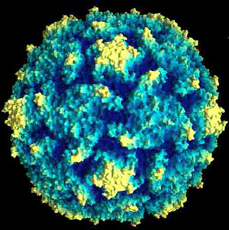
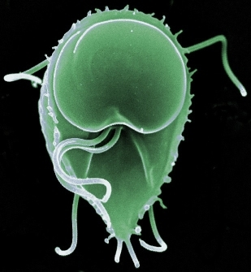
Biological Pathogens
Pathogen: An agent of disease. An infectious organism
Bacteria
Typhoid
Cholera
Tuberculosis
Hepatitis
Polio
poliovirus
Viruses
Protozoa
Parasites
Schistosomiasis
Amoebic dysentery
Giardiasis
giardia
Each year, 1.5 million Americans become ill as a
result of bacterial contamination in drinking water
Notes:
Each year, about 1.5 million Americans become ill as a result of bacterial contamination in drinking water. Other examples of biological pollutants include viruses, protozoa, and parasitic worms. These infectious agents enter the environment from human and animal wastes, and they cause a variety of serious diseases. The United States Environmental Protection Agency uses the number of coliform bacteria per 100 milliliters of a water sample in order to determine the severity of biological pollution in water. The EPA recommends that drinking water contain zero colonies per 100 milliliters, and that swimming water contain no more than 200 colonies per 100 milliliters.

Slide 6
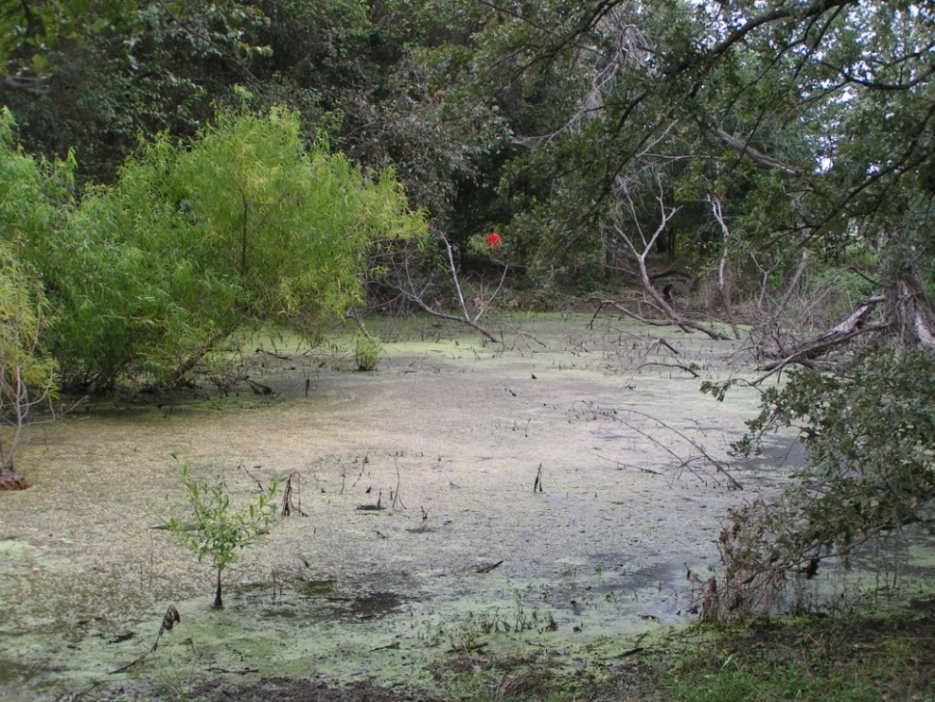
Biological Pollution: Microbial Metabolism
Metabolic activities of otherwise benign microorganisms
can significantly alter surface water quality
Discharge of organic material to surface water increases microbial activity
Increased microbial activity can cause a decline in oxygen content of water
Sources of Organics
human waste
animal waste
food operations
meat packing plants
medical facilities
Notes:
Water pollution is any chemical, physical or biological change in the quality of water that has a harmful effect on any living thing that drinks or uses or lives (in) it. When humans drink polluted water it often has serious effects on their health. Water pollution can also make water unsuited for the desired use.
So oje form of biological polllution are disease-causing agents. These are bacteria, viruses, protozoa and parasitic worms that enter aquatic systems through sewage systems and untreated waste.
A second category of biologicval r pollution results from the activitei of microrganism particularly as they break down or consume organic matrerial that is introduced into aquatic environments. these wastes areoxygen-demandin; The wastes are continually decomposed by oxygen-requiring bacteria. When large populations of decomposing bacteria are converting organic wastes it can deplete oxygen levels in the water. This causes other organisms in the water, such as fish, to die and affect species diversity genreally.
. A third class of water pollutants is water-soluble inorganic pollutants, such as acids, salts and toxic metals. Large quantities of these compounds will make water unfit to drink and will cause the death of aquatic life. Another class of water pollutants are nutrients; they are water-soluble nitrates and phosphates that cause excessive growth of algae and other water plants, which deplete the water's oxygen supply. This kills fish and, when found in drinking water, can kill young children. Water can also be polluted by a number of organic compounds such as oil, plastics and pesticides, which are harmful to humans and all plants and animals in the water. A very dangerous category is suspended sediment, because it causes depletion in the water's light absorption and the particles spread dangerous compounds such as pesticides through the water. Finally, water-soluble radioactive compounds can cause cancer, birth defects and genetic damage and are thus very dangerous water pollutants. More information on health effects of microrganisms Where does water pollution come from?
Water pollution is usually caused by human activities. Different human sources add to the pollution of water. There are two sorts of sources, point and nonpoint sources. Point sources discharge pollutants at specific locations through pipelines or sewers into the surface water. Nonpoint sources are sources that cannot be traced to a single site of discharge. Examples of point sources are: factories, sewage treatment plants, underground mines, oil wells, oil tankers and agriculture. Examples of nonpoint sources are: acid deposition from the air, traffic, pollutants that are spread through rivers and pollutants that enter the water through groundwater. Nonpoint pollution is hard to control because the perpetrators cannot be traced.
Read more: http://www.lenntech.com/water-pollution-faq.htm#ixzz0V93LMdSa

Slide 7
Physical Pollutants

Slide 8
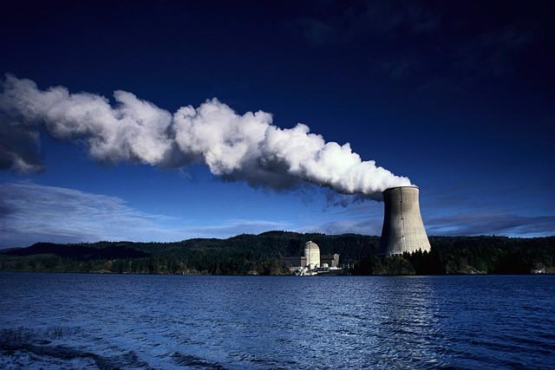
Physical Pollutants
Heat
electric power plants – O₂, thermal shock
½ of water withdrawn in the U.S.
Warm water holds less O₂
Notes:
Physical Pollutants
Sediment, solid fragments of inorganic or organic material that do not dissolve in water, represents the most significant source of water pollution, physical or otherwise. Sources of sediment include erosion, deforestation, and agricultural and hydroelectric projects. Sediment chokes and fills lakes, reservoirs, harbors, and other aquatic environments, and disrupting aquatic food webs. Sediment may also carry pesticides, bacteria, and other harmful substances, and it can destroy the feeding and spawning grounds of fish.
Heat is another physical water pollutant. Excessive heat in water results when large quantities of water are used for cooling of electric power plants. Each year, almost half of the water withdrawn in the United States is used for such cooling. Thermal pollution in water lowers dissolved oxygen levels and makes aquatic species more susceptible to disease, parasites, and toxic chemicals. Thermal shock occurs when an organism adapted to a certain temperature range is suddenly exposed to a temperature outside of that range. Thermal pollution results in death for many aquatic species.
Fuel used in a boiler heats up water until the water in the boiler pipes become steam.
The steam travels through the pipes to the turbine.
The steam spins the turbine blades. Sometimes steps #1 and 2 are skipped and wind or falling water turns the turbine.
The spinning blades turn a shaft connected to the generator.
In the generator, wire loops spin close to electromagnets.
When this happens, electrical current is produced in the wires.
The current goes out through huge transmission wires and delivers electrical energy to homes, schools, and businesses.
NEXT: Problems & Solutions

Slide 9
Physical Pollutants
Sediment
chokes and fills lakes, reservoirs
erosion, deforestation, agriculture, building and road construction
Turbidity and reduction of the euphotic zone
Sediment particles harbor pathogens and pollutants
Notes:
Nutrients, pesticides.

Slide 10
Chemical Pollutants
Nutrients
Pesticides
Metals
Salts
Organics

Slide 11
Chemical Pollutants
Nutrients
Nitrogen Phosphorus
NO₃⁻
NH₄⁺
HPO₄⁻²
H₂PO₄⁻
Animal Wastes, Agricultural Runoff, Sewage Discharge, OSWT
Notes:
Nutrients constitute a second category of chemical water pollutants. Sources of nitrogen and phosphorus, two common plant nutrients, include animal wastes, agricultural runoff, and sewage. When these nutrients enter a body of water in large quantities, they cause eutrophication. Because eutrophication significantly lowers the levels of dissolved oxygen in water, many species of fish can no longer survive. In addition, consuming water that contains excess levels of nitrates may reduce the bloodstream’s oxygen-carrying capacity, leading to a number of undesirable health effects for humans.

Slide 12
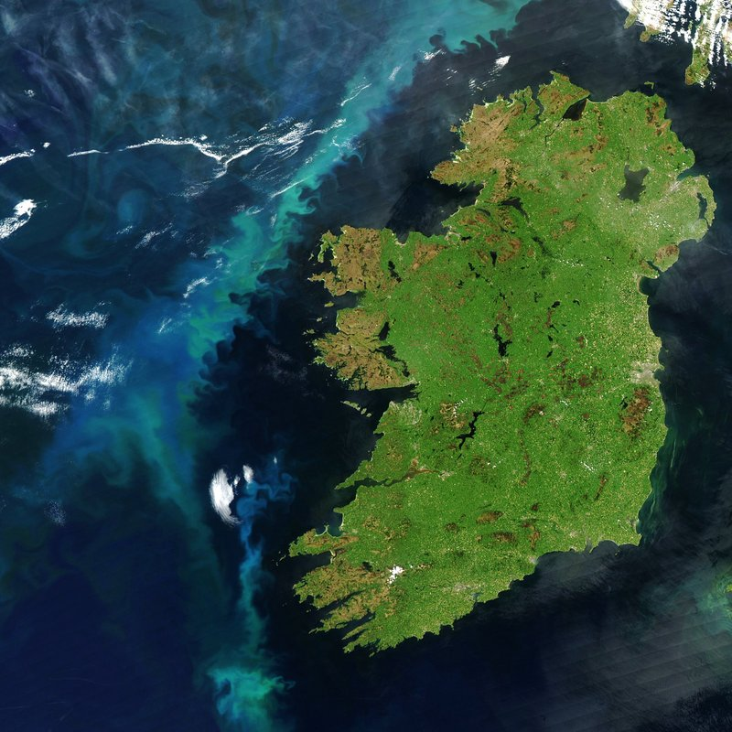
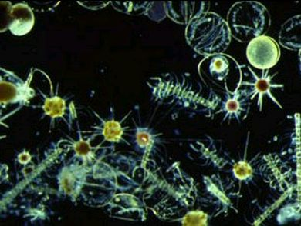
Nutrient additions stimulate primary productivity
All life on earth is directly or indirectly reliant on primary production. In terrestrial ecosystems, these are mainly plants, while in aquatic ecosystems algae and phytoplankton are primarily responsible.
N and P stimulate primary productivity
Primary Productivity

Slide 13
Stimulation of Primary Productivity
Warm Temperatures
Water
Nutrients

Slide 14
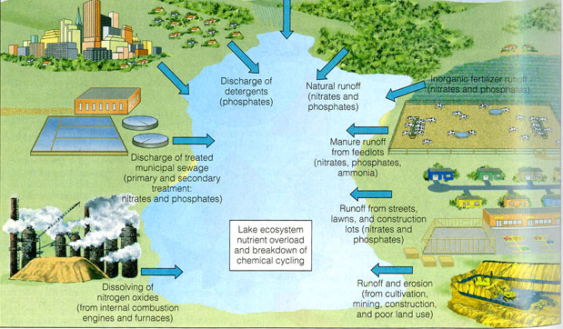
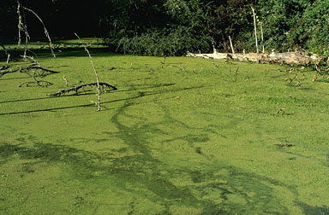
Excess Nutrients Over-stimulate Primary Productivity
Wastewater
Agriculture
Urban
Decreased light penetration
Decreased oxygen content
Changes in species diversity

Slide 15
Heavy Metals and Metalloids

Slide 16
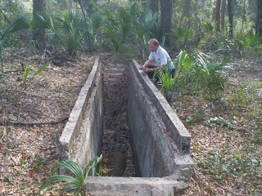
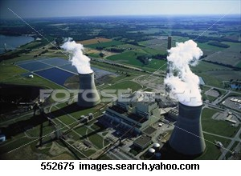
Heavy Metals and Metalloids
Arsenic
Erosion of natural deposits; pesticide waste, runoff from glass & electronics production wastes, treated lumber, groundwater
Mercury
Erosion of natural deposits; discharge from refineries and factories; runoff from landfills, coal burning
Lead
Corrosion of household plumbing systems; natural deposits, paint, fuels, electronics

Slide 17
Mercury, Arsenic, and Lead
Lead found in blood sample from 1 of 10 Washingtonians
Arsenic found in urine samples from 4 of 10 Washingtonians
Mercury found in hair samples from 10 of 10 Washingtonians

Slide 18
Organic Chemicals

Slide 19
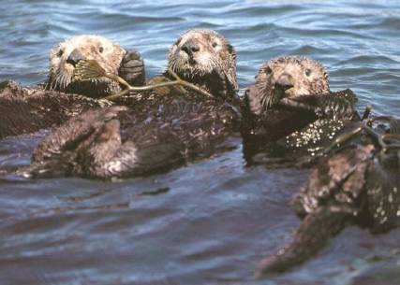
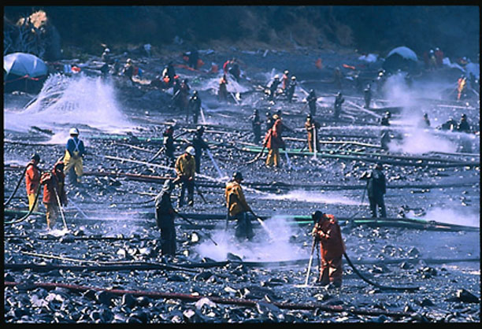
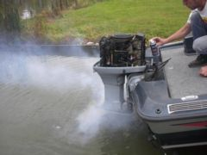
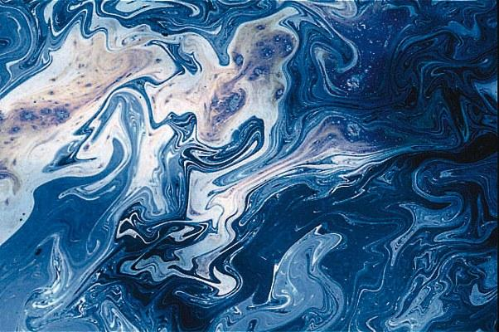
Chemical Pollutants
Petroleum
three to six million metric tons
Spills account for about 5% of
petroleum entering waterways.
oil changes, bilge cleaning and ship maintenance, recreational boating.
New emission standards
In 2006 (EPA)
Notes:
Oil, another chemical pollutant, is introduced into aquatic environments through leaks from oil tankers or dumping down storm drains. Each year, humans discharge approximately three to six million metric tons of oil into the ocean. In 1989, the oil tanker Exxon Valdez spilled eleven million gallons of oil into Alaskan waters. Over 300,000 birds and 2,500 otters were killed, and the total environmental damage amounted to a cost of over fifteen billion dollars.
But big spills account for only about 5% of the total. The rest is from oil changes, natural seeps, bilge cleaning and ship maintenance, recreational boating.

Slide 20
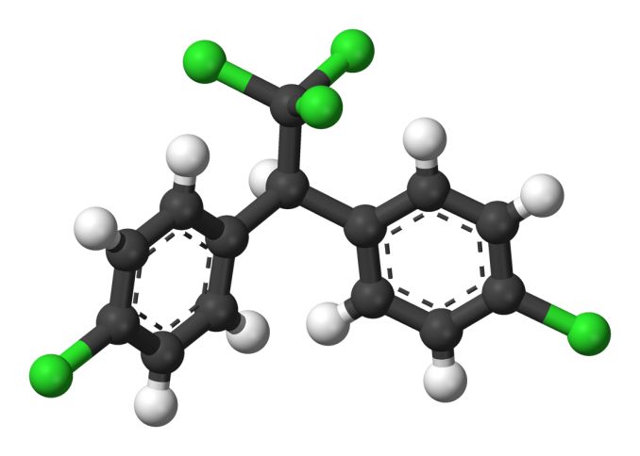
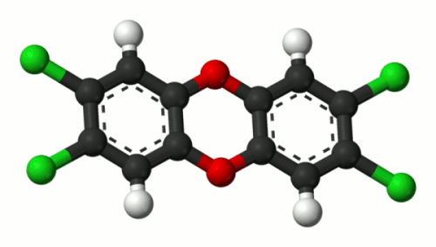
Synthetic Organic Chemicals
Pesticides
Industrial Solvents and Cleaners
Flame Retardants
DDT, Dieldrin
PCBs/Dioxin
TCE /PCE
PBDE
Potentially highly toxic
Persistent in the environment
http://www.npr.org/templates/story/story.php?storyId=6100179
Notes:
Estimates range from 28 days to 150 years, with some consensus of about 15-20 years. Here is why the answer is so tricky. 1. If you feed DDT to some test species for some period of time and then cease and monitor the level of DDT vs. time -- that gives one type of half-life that depends on the species, its diet, and other factors. For some birds I saw the figure of about 8 years. 2. If you measure the concentration of DDT in sun-exposed, oxygenated surface water and have conditions so that there is no steady state -- you get another half life. Under these conditions volatilization and absorption onto the river/lake bed occurs. I saw the number 28 days for this route. 3. If you measure the level of DDT in a contaminated soil, to which DDT adheres tenaciously, you get yet another half-life. This is where I saw the number from 15 to 20 years. 4. If you test the soil in temperate climates where the average temperature is milder, this decade or two stretches out to 3 or 4 decades. 5. In cool dry sand, I saw the number 150 years -- although that has to be suspect because DDT was not widely available until 1945-1950 (after World War II).

Slide 21
Basic Types of Pollution
1) Biological
2) Physical
3) Chemical
Notes:
Such pollutants fall into three main categories: 1) biological, such as bacteria or viruses; 2) chemical, including heavy metals, nutrients, pesticides, and wastes; 3) physical, such as sediment, radioactive material, and heat.

Slide 22
Determining Water Quality

Slide 23
Major Determinants of Water Quality
and the Impact or Availability of Water Pollutants
Organisms
Solubility
Oxygen
pH

Slide 24
Determinants of Water Quality
Microorganisms
Pathogenic – harmful, Disease-causing
Non-pathogenic - benign

Slide 25
Heterotrophic Organisms

Slide 26
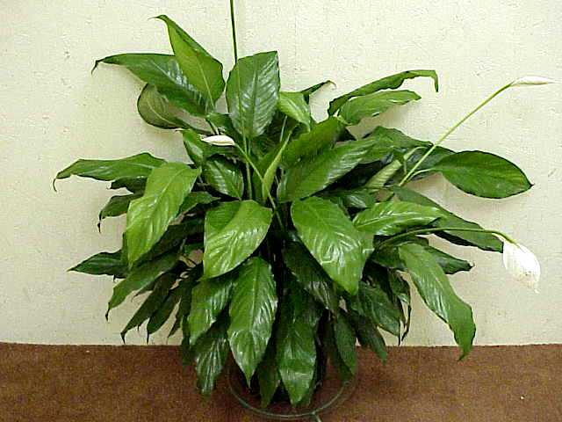
Autotrophs – Plants, Algae, Cyanobacteria
Produce complex organic compounds from
carbon dioxide using energy from light.
Primary producers – base of the food chain
energy
light
6CO₂ + 6H₂O C₆H₁₂O₆ + 6O₂
simple inorganic molecule
complex organic compound

Slide 27
Heterotrophs
Derive energy from consumption of complex
organic compounds produced by autotrophs
Autotrophs store energy from the sun in carbon compounds (C₆H₁₂O₆)
Heterotrophs consume these complex carbon compounds for energy
autotrophs
Heterotrophs
carbon compounds
(C₆H₁₂O₆)
Producers
Consumers

Slide 28
Heterotrophic Organisms
Two Basic Types Related to Oxygen Status
Anaerobic
Aerobic
low-oxygen environments
high oxygen environments
Anaerobic heterotrophs
Aerobic heterotrophs

Slide 29
Aerobic Heterotrophic Organisms

Slide 30
Aerobic Heterotrophs
Live in high-oxygen environments
Consume organic compounds for energy
Obtain the energy stored in complex organic
compounds by combining them with oxygen
C₆H₁₂O₆ + Oxygen = energy

Slide 31
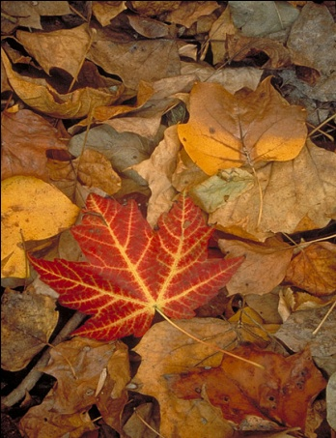
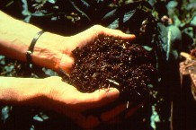
Aerobic Respiration
C₆H₁₂O₆ + 6O₂ → 6CO₂ + 6H₂O
+ energy
organisms

Slide 32
The energy is obtained by exchanging
electrons between carbon and oxygen.
Electron poor
Electron rich
C₆H₁₂O₆ + 6O₂ → 6CO₂ + 6H₂O + energy
Electron rich
Electron poor
2880 kJ of energy is produced
Aerobic respiration is very efficient, yielding high amounts of energy

Slide 33
Anaerobic Heterotrophic Organisms

Slide 34
Anaerobic Heterotrophic Organisms
Anaerobic: Live in low-oxygen environments
Heterotrophic: Consume organic compounds for energy
Can use energy stored in complex carbon
compounds in the absence of free oxygen
The energy is obtained by exchanging
electrons with elements other than oxygen.
Nitrogen
Manganese
Sulfur
Iron
Notes:
Florida has more natural lakes than any other state in the southeast. Unlike the large, deep lakes of the northern U.S. which were generally formed by glacial processes, most of Florida's shallow and sloping lakes were primarily formed by erosion and/or collapse of the karst limestone bedrock.
Florida's lakes reign as some of the most "biologically productive" systems in the world. The state's climate and topography provide year round growing seasons for large aquatic plants (macrophytes), as well as for microscopic plants (algae, phytoplankton). Besides supporting the growth of native plants and animals, Florida's lakes also are susceptible to invasive plant species, algae blooms and nuisance native plant overgrowth

Slide 35
Aerobic Respiration
Electron poor
Electron rich
C₆H₁₂O₆ + 6O₂ → 6CO₂ + 6H₂O
Electron rich
Electron poor
Anaerobic respiration
Electron poor
Electron rich
C₆H₁₂O₆ + 3NO₃⁻ + 3H₂O = 6HCO₃⁻ + 3NH₄⁺
Electron rich
Electron poor

Slide 36
e-
Aerobic Heterotrophs
Anaerobic Heterotrophs
C₆H₁₂O₆
O₂
e-
C₆H₁₂O₆
N Mn S Fe
Bacteria
Pseudomonas, Desulfovibrio

Slide 37
Two Types of Heterotrophic Organisms
Aerobic Heterotrophs
Anaerobic Heterotrophs
Both produce energy by transferring electrons
from carbon (organic) to an electron acceptor
Aerobic Heterotrophs use oxygen to accept electrons
Anaerobic Heterotrophs use other elements to accept electrons
Nitrogen, Manganese, Sulfur, Iron

Slide 38
Becoming Anaerobic
Oxygen contents of water determine the type,
Abundance, and diversity of aquatic species.

Slide 39
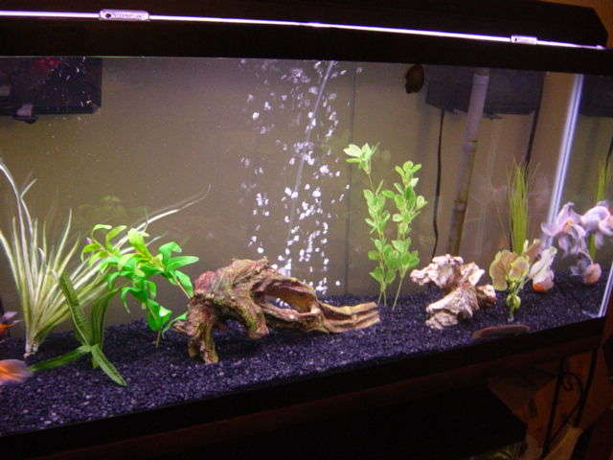
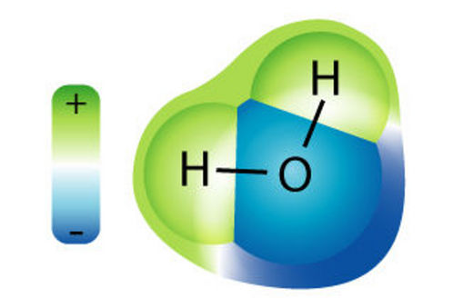
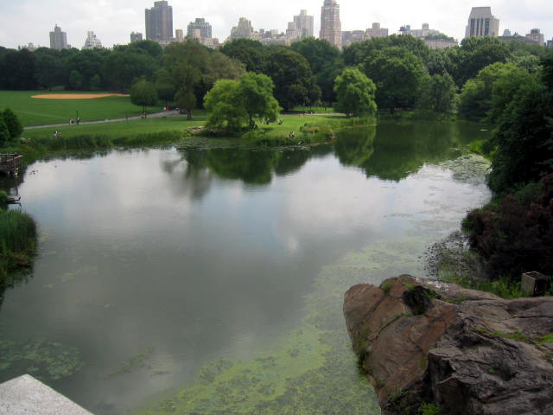
Oxygen is Water Soluble
Solubility: 0.043 g/L
(20ºC)
O₂
O₂
Notes:
39
The diffusion of oxygen is often of great importance in relation to water, particularly in lakes and rivers. Oxygen contents dictate in many ways the life limits of aquatic organisms. We will explore in some detail the factors controlling oxygen contents in water particularly in relation to temperature. The solubility of oxygen is greater in colder water than in warm water.

Slide 40
Factors that Control O₂ Content in Water
Photosynthesis
Agitation of Water
Temperature
Activity of Aerobic Heterotrophs
Notes:
oxygen solubility is greater in colder water than in warm water

Slide 41
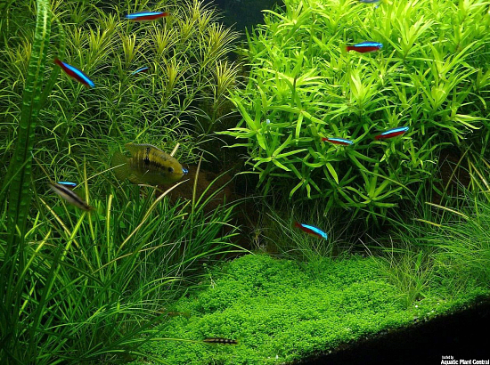
Oxygen enters water from the atmosphere
and from aquatic photosynthetic organisms
Oxygen
Diffusion of O₂ through the water and
from the atmosphere into water is generally slow

Slide 42
Diffusion of O₂ through the water and
from the atmosphere into water is generally slow
Flooding of an aerobic terrestrial
system can result in oxygen depletion
Introducing a food source for microbes to an
aquatic system can increase metabolic activity
of aerobic heterotrophs, reducing oxygen levels

Slide 43
Heterotrophic organisms together with inputs of organic
materials (food sources) control the oxygen status of waters.
C₆H₁₂O₆ + 6O₂ → 6CO₂ + 6H₂O
Accelerated metabolic activity of aerobic heterotrophs
due to an abundance of organic materials (food source)
can significantly reduce the amount of dissolved oxygen

Slide 44
Biological Pollution: Microbial Metabolism
Metabolic activities of otherwise benign microorganisms
can significantly alter surface water quality
Discharge of organic material to surface water increases microbial activity
Increased microbial activity can cause a decline in oxygen content of water
Sources of Organics
human waste
animal waste
food operations
meat packing plants
medical facilities
Notes:
Water pollution is any chemical, physical or biological change in the quality of water that has a harmful effect on any living thing that drinks or uses or lives (in) it. When humans drink polluted water it often has serious effects on their health. Water pollution can also make water unsuited for the desired use.
What are the major water pollutants? There are several classes of water pollutants. The first are disease-causing agents. These are bacteria, viruses, protozoa and parasitic worms that enter sewage systems and untreated waste.
A second category of water pollutants is oxygen-demanding wastes; wastes that can be decomposed by oxygen-requiring bacteria. When large populations of decomposing bacteria are converting these wastes it can deplete oxygen levels in the water. This causes other organisms in the water, such as fish, to die. A third class of water pollutants is water-soluble inorganic pollutants, such as acids, salts and toxic metals. Large quantities of these compounds will make water unfit to drink and will cause the death of aquatic life. Another class of water pollutants are nutrients; they are water-soluble nitrates and phosphates that cause excessive growth of algae and other water plants, which deplete the water's oxygen supply. This kills fish and, when found in drinking water, can kill young children. Water can also be polluted by a number of organic compounds such as oil, plastics and pesticides, which are harmful to humans and all plants and animals in the water. A very dangerous category is suspended sediment, because it causes depletion in the water's light absorption and the particles spread dangerous compounds such as pesticides through the water. Finally, water-soluble radioactive compounds can cause cancer, birth defects and genetic damage and are thus very dangerous water pollutants. More information on health effects of microrganisms Where does water pollution come from?
Water pollution is usually caused by human activities. Different human sources add to the pollution of water. There are two sorts of sources, point and nonpoint sources. Point sources discharge pollutants at specific locations through pipelines or sewers into the surface water. Nonpoint sources are sources that cannot be traced to a single site of discharge. Examples of point sources are: factories, sewage treatment plants, underground mines, oil wells, oil tankers and agriculture. Examples of nonpoint sources are: acid deposition from the air, traffic, pollutants that are spread through rivers and pollutants that enter the water through groundwater. Nonpoint pollution is hard to control because the perpetrators cannot be traced.
Read more: http://www.lenntech.com/water-pollution-faq.htm#ixzz0V93LMdSa

Slide 45
Other Implications: Carbon Storage

Slide 46
Anaerobic respiration produces less
energy than aerobic respiration
C₆H₁₂O₆ + 6O₂ → 6CO₂ + 6H₂O
2880 kJ
C₆H₁₂O₆ + 3NO₃⁻ + 3H₂O = 6HCO₃⁻ + 3NH₄⁺
1796 kJ
C₆H₁₂O₆ + 3SO₄²⁻ + 3H⁺ = 6HCO₃⁻ + 3HS⁻
453 kJ
Anaerobic respiration, therefore, is slower
and less efficient than aerobic respiration.

Slide 47
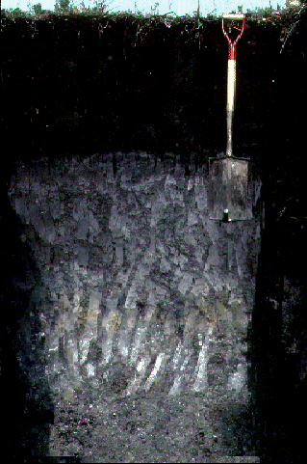
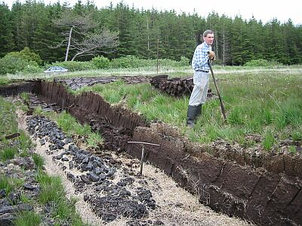
Accumulation of organic matter under anaerobic
conditions is responsible for fossil fuels and
the build-up of peat (organic matter) in wetlands.

Slide 48
Carbon Storage in Florida

Slide 49
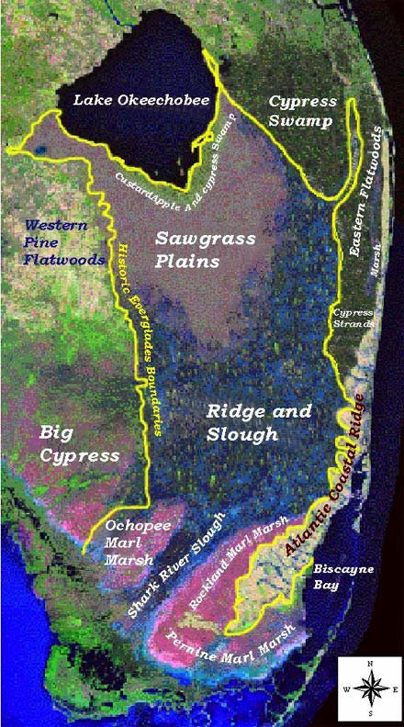
Historical Flow
Rainfall in Kissimmee valley
overflow
Everglades
Elevation change: inches/mile
few inches to a few feet in
depth and over 100 miles wide
Notes:
Historically, rainfall from the Kissimmee Valley filled the Lake during the summer rainy season and excess water spilled out along its southern shore. Some of the waters were absorbed into the soil, converting decaying plant materials into rich, fertile mucky soils; the rest were released to the beginning flows of the Everglade’s "River of Grass". Shallow waters a few inches to a few feet in depth and over 50 miles wide, slowly flowed 100 miles south to the Gulf of Mexico and Florida Bay.

Slide 50
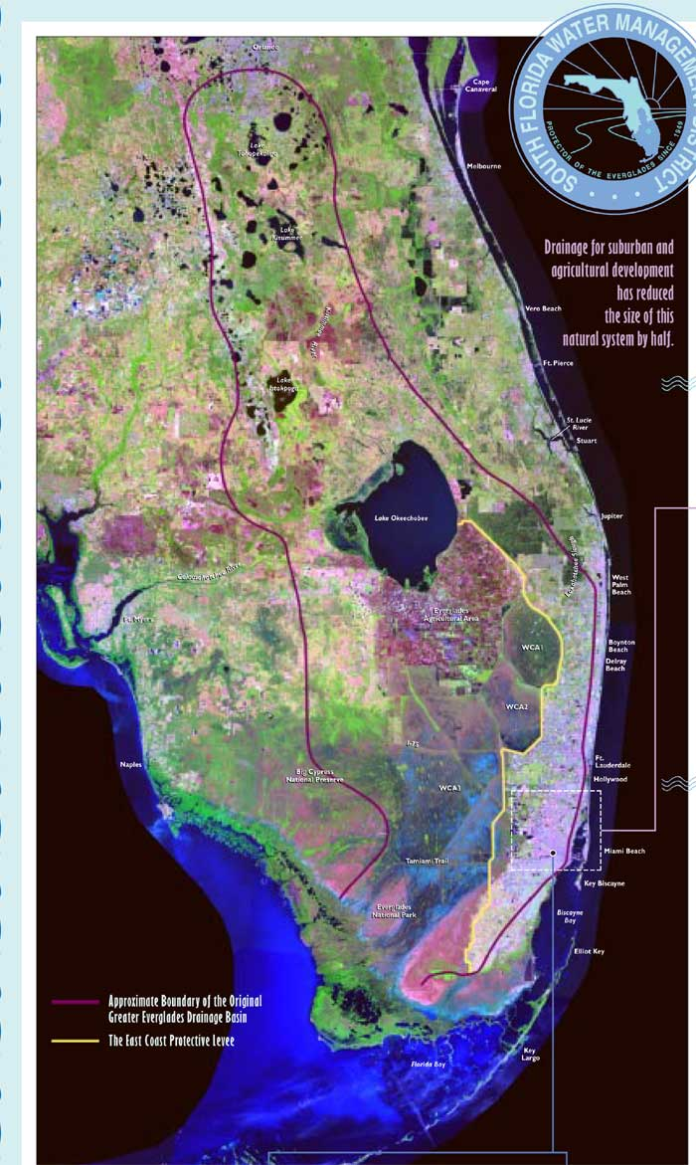
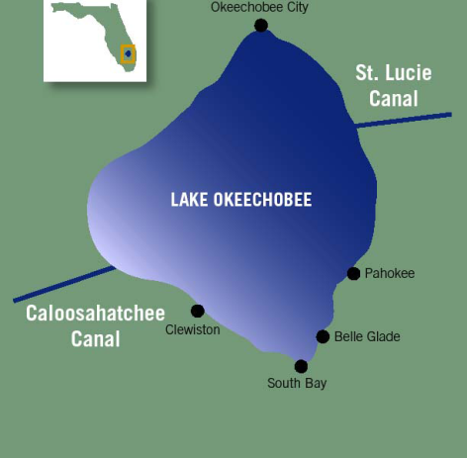
Former extent of Kissimmee
Basin and floodplain
Hoover Dike (1932)
Significant drainage
Perimeter Levee (1954)
Water Conservation Areas
(management of flow)
To Atlantic
To Gulf

Slide 51
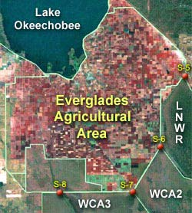
Crops: Everglades Agricultural Area
EAA
700,000 ac
Notes:
A significant product of the drainage efforts was the creation of the Everglades Agricultural Area south of Lake Okeechobee. The EAA encompasses about 700,000 acres and is used for sugar rice and vegetable production.

Slide 52
EAA
1940’s thousands of acres converted to agricultural production
1959 Cuban exiles established sugar plantations
1960s Sugar production increased 4-fold
Today, sugarcane production contributes two-thirds of the economic production of
Everglades agriculture, and uses nearly 80% of the crop land in the EAA
Sugar
382,000 acres
46% U.S.
Palm Beach, Glades, Hendry
Notes:
The beginning of excessive phosphorus input into the Everglades can be traced back to the 1940s,
when several thousand acres of land were cleared and converted to agricultural
production. This clearing exposed soils,which began to erode and leach phosphorus
into waterways that connected to the Everglades. Production intensified after the
Cuban revolution in 1959, as Cuban exiles fled to Florida and established sugar
plantations. By the mid-1960s, Florida sugar production had increased four-fold.
Today, sugarcane production contributes two-thirds of the economic production of
Everglades agriculture, and uses nearly 80% of the crop land in the Everglades
AgriculturalArea. Sugar production contributes phosphorus
to the ecosystem primarily through fertilizers and to a lesser extent through
decomposition of plants. Fertilizers and plant decomposition are also the main
causes of phosphorus leaching from vegetable production.

Slide 53
Florida to Buy Out Sugar Land for Everglades Restoration WTVJ NBC 6 June 25, 2008: WEST PALM BEACH, Florida -- The largest U.S. producer of cane sugar, U.S. Sugar Corp., would close up shop in a $1.34 billion deal to sell its 292 square miles of land to Florida for Everglades restoration, the company president and Florida Governor Charlie Crist said Tuesday. The deal, announced at a news conference at the Arthur R. Marshall Loxahatchee National Wildlife Refuge, allows the state to buy U.S. Sugar's holdings in the Everglades south of Lake Okeechobee, the heart of the wetland ecosystem.
186,000 acres
Notes:
Governor Charlie Crist’s original proposal to buy all of U.S. Sugar Corp. has been
downsized twice due to the economic downturn.
The two-phased acquisition allows the SFWMD to acquire 73,000 acres for $536 million
with a 10-year option to purchase the remaining 107,000 acres when financial and
economic conditions improve. The deal enables U.S. Sugar Corp. to remain in business
by leasing back the purchased land for a minimum of seven years and up to 20 years at $150 an acre per year.

Slide 54
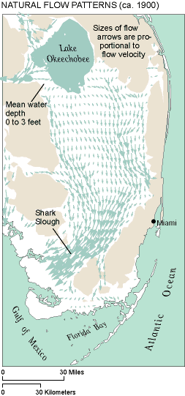
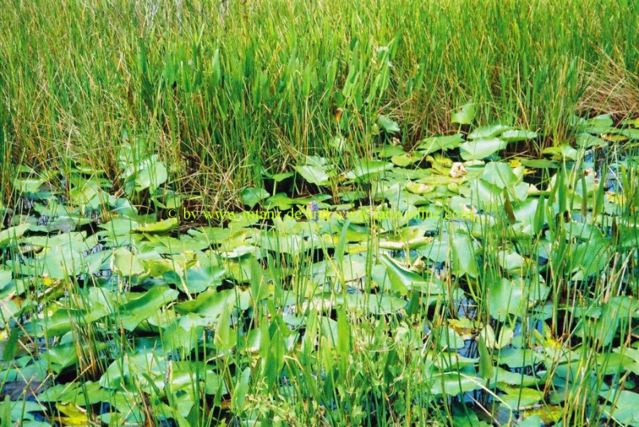
Flooded Conditions

Slide 55
Water restricts the movement of oxygen
The diffusion of oxygen through water is about
10,000 times slower than diffusion through air
Flooded Marsh
Under flooded conditions, oxygen levels tend to be low
Organisms?

Slide 56
Anaerobic Heterotrophic Organisms
Can use energy stored in complex carbon
compounds in the absence of free oxygen
The energy is obtained by exchanging
electrons with elements other than oxygen.
Nitrogen
Manganese
Sulfur
Iron
Notes:
Florida has more natural lakes than any other state in the southeast. Unlike the large, deep lakes of the northern U.S. which were generally formed by glacial processes, most of Florida's shallow and sloping lakes were primarily formed by erosion and/or collapse of the karst limestone bedrock.
Florida's lakes reign as some of the most "biologically productive" systems in the world. The state's climate and topography provide year round growing seasons for large aquatic plants (macrophytes), as well as for microscopic plants (algae, phytoplankton). Besides supporting the growth of native plants and animals, Florida's lakes also are susceptible to invasive plant species, algae blooms and nuisance native plant overgrowth

Slide 57
Anaerobic respiration is less efficient
and produces less energy.
C₆H₁₂O₆ + 6O₂ → 6CO₂ + 6H₂O
2880 kJ
C₆H₁₂O₆ + 3NO₃⁻ + 3H₂O = 6HCO₃⁻ + 3NH₄⁺
1796 kJ
C₆H₁₂O₆ + 3SO₄²⁻ + 3H⁺ = 6HCO₃⁻ + 3HS⁻
453 kJ
Therefore, anaerobic decomposition is
much slower than aerobic decomposition.

Slide 58
Flooded Soils
additions
anaerobic decomposition
of organic matter is
much slower than aerobic
decomposition.
Losses (CO₂)
Organic matter
Organic matter is added to the
soil faster than it can be
decomposed by microorganisms
limestone
Accumulation of organic
matter at the soil surface
Notes:
Sugar cane is the primary crop grown in the EAA, with relatively smaller crops of vegetables (winter vegetables, rice, etc.) and sod. In an average year, close to 50 percent of the cane sugar produced nationally is harvested in the EAA

Slide 59
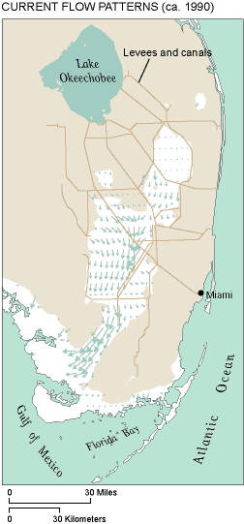
Drainage
EAA
Drainage exposes soils
to oxygen and decomposition
by aerobic heterotrophic
organisms which can more
efficiently decompose
organic matter

Slide 60
Drainage
Losses (CO₂)
additions
Conversion from anaerobic to
Aerobic decomposition
(much more efficient)
C₆H₁₂O₆ + 6O₂ → 6CO₂ + 6H₂O
Losses of organic matter
by decomposition exceed
new additions –
soils disappear

Slide 61
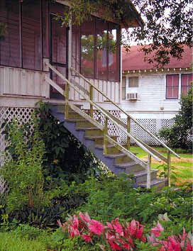
Subsidence of Organic soils
Greater than 10 feet
Notes:
Conventional surveying has always been extremely difficult in the Everglades. Stable bedrock bench marks are nonexistent or very distant, the surficial material is soft and yielding, and access is difficult. Current best estimates suggest that there have been 3 to 9 feet of subsidence in the current Everglades agricultural area and that an equally large uncultivated area has experienced up to 3 feet of subsidence. Such elevation changes are tremendously significant to a near-sea-level wetlands system in which flow is driven by less than 20 feet of total relief.
The current management infrastructure and policies have abated land subsidence in undrained areas of the historic Everglades to some extent, although comparison of recent soil-depth measurements by the U.S. Environmental Protection Agency (Scheidt, US EPA, written communication 1997) with 1940s estimates of peat thickness (Davis, 1946; Jones and others, 1948) suggest that there has been widespread subsidence in the water-conservation areas over the past 50 years. The northern parts of individual water-conservation areas may still experience some minor subsidence. The southern or downstream parts of the impoundments are generally wetter and may be accumulating peat (Craft and Richardson, 1993a, 1993b), very gradually increasing in elevation. In the drained agricultural and urban areas, subsidence is an ongoing process, except where the peat has already disappeared entirely.
This building at the Everglades Experiment Station was originally constructed at the land surface; latticework and stairs were added after substantial land subsidence.

Slide 62
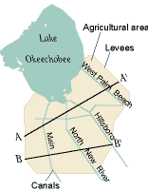
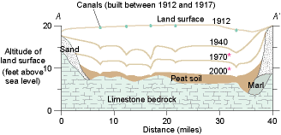
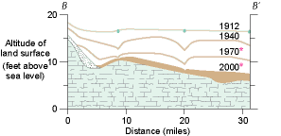
1912 to 2000

Slide 63
Florida to Buy Out Sugar Land for Everglades Restoration
Good Idea?

Slide 64
Major Determinants of Water Quality
and the Impact or Availability of Water Pollutants
Organisms
Solubility
Oxygen
pH

Slide 65
Solubility
The ease with which substances dissolve in water

Slide 66
Sodium Chloride is extremely soluble in water
NaCl Na⁺ + Cl⁻
Na⁺
Notes:
Water molecules have the ability to orient themselves relative to the introduction of a solute.

Slide 67
Forms and Solubility
Pb²⁺
Hg²⁺
AsO₄⁻
PO₄⁻³
NH₄⁺
NO₃⁻
Cd²⁺
HgCl₂ soluble
PbCO₃ poorly soluble
FePO₄ poorly soluble
AlPO₄ poorly soluble
KH₂PO₄ soluble
CdCO₃ poorly soluble
CdCl₂ soluble
The degree to which contaminants impact
water quality is often determined by their solubility
Notes:
carbonates, hydroxides, chlorides or sulphates

Slide 68
The solubility of other ionic salts varies
KCl soluble
CaCO₃ somewhat soluble
HgCl₂ soluble
PbCO₃ poorly soluble
FePO₄ poorly soluble
The degree to which contaminants impact
water quality is often determined by their solubility
Solubility also can be influenced strongly by
factors such as pH and oxygen content

Slide 69
Many toxic organic pollutants including
pesticides, and industrial products
are extremely insoluble in water.
DDT
Dioxins
PCBs
Ironically their insolubility in water is partly responsible
for their persistence in the environment.

Slide 70
pH and Acidity

Slide 71
pH is based on the abundance of hydrogen ions in water
When elemental hydrogen loses its electron
it becomes a positively charged ion.
1 Electron (-)
Nucleus
1 Proton (+)
Hydrogen ions participate in enormous
numbers of environmental reactions

Slide 72
Acid: any substance that increases
the H⁺ concentration in solution
Common Acids
Hydrochloric Acid HCl
Sulfuric Acid H₂SO₄
Nitric Acid HNO₃
Carbonic Acid H₂CO₃
Acetic Acid HC₂H₃O₂

Slide 73
Dissociation of acids
HCl H⁺ + Cl⁻
HNO₃ H⁺ + NO₃⁻
H₂SO₄ H⁺ + HSO₄⁻

Slide 74
pH
A measure of the amount of Hydrogen ions in water
- Log (H⁺)
Low pH = High amount of Hydrogen ions in water
High pH = Low amount of Hydrogen ions in water
Low pH: acidic

Slide 75
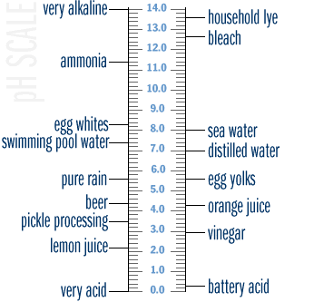
pH (hydrogen)
Natural rainfall has a pH of 5.6
H⁺
Acid: any substance which
increases the hydrogen ion
concentration in water.
- Log (H⁺)
Low pH = High H⁺
pH 4 = 0.0001 g H⁺/ L
pH 2 = 0.01 g H⁺/ L
There is 100 times more H+ in water at pH 2 compared to pH 4
Notes:
The pH of a sample of water is a measure of the concentration of hydrogen ions. The term pH was derived from the manner in which the hydrogen ion concentration is calculated - it is the negative logarithm of the hydrogen ion (H+) concentration. What this means to those of us who are not mathematicians is that at higher pH, there are fewer free hydrogen ions, and that a change of one pH unit reflects a tenfold change in the concentrations of the hydrogen ion. For example, there are 10 times as many hydrogen ions available at a pH of 7 than at a pH of 8.
The pH of water determines the solubility (amount that can be dissolved in the water) and biological availability (amount that can be utilized by aquatic life) of chemical constituents such as nutrients (phosphorus, nitrogen, and carbon) and heavy metals (lead, copper, cadmium, etc.). For example, in addition to affecting how much and what form of phosphorus is most abundant in the water, pH may also determine whether aquatic life can use it. In the case of heavy metals, the degree to which they are soluble determines their toxicity. Metals tend to be more toxic at lower pH because they are more soluble.

Slide 76
pH and Availability of Nutrients and Metals

Slide 77
pH and Availability and Form of Nutrients
Nitrogen
When organisms decompose organic material
essential nutrients are released, including NH₄⁺
NH₄⁺ NO₃⁻
Aerobic organisms
NH₄⁺ is converted to NO₃⁻ under aerobic conditions
Nitrate generally is the preferred form for plant uptake
Notes:
The pH of water determines the solubility (amount that can be dissolved in the water) and biological availability (amount that can be utilized by aquatic life) of chemical constituents such as nutrients (phosphorus, nitrogen, and carbon) and heavy metals (lead, copper, cadmium, etc.). For example, in addition to affecting how much and what form of phosphorus is most abundant in the water, pH may also determine whether aquatic life can use it. In the case of heavy metals, the degree to which they are soluble determines their toxicity. Metals tend to be more toxic at lower pH because they are more soluble.

Slide 78
Nitrate and Ammonia
NH₄⁺ NO₃⁻
Aerobic organisms
NH₄⁺ is converted to NO₃⁻ by aerobic bacteria
The conversion, therefore, is controlled by oxygen levels
The organisms also are controlled by pH.
They do not function well at low pH.
NH₄⁺ dominant at low pH
NO₃⁻ dominant at higher pH

Slide 79
Dominant Forms: NH₄⁺ and NO₃⁻
Sources: fertilizers, manures, wastewater discharge
NO₃⁻ is more mobile in the environment than NH₄⁺
_
NH₄⁺
_
_
_
_
_
_
_
NO₃⁻
_
Soil particles possess
a negative electrical charge
Leaching to ground
or surface water

Slide 80
pH and Metals

Slide 81
Forms and Solubility
Pb²⁺
Hg²⁺
PO₄⁻³
NH₄⁺
NO₃⁻
Cd²⁺
HgCl₂ soluble
PbCO₃ poorly soluble
FePO₄ poorly soluble
AlPO₄ poorly soluble
KH₂PO₄ soluble
CdCO₃ poorly soluble
CdCl₂ soluble
The degree to which contaminants impact
water quality is often determined by their solubility
Acids can alter solulbilities
Notes:
carbonates, hydroxides, chlorides or sulphates

Slide 82
Availability and Form of Metals
PbCO₃ + H⁺ Pb²⁺ + HCO₃⁻
Solid
(unavailable)
dissolved
(available)
CdSO₄ + H⁺ Cd²⁺ + SO₄⁻²
Solid
(unavailable)
dissolved
(available)
Acid dissolution of metals increases their mobility
Notes:
The pH of water determines the solubility (amount that can be dissolved in the water) and biological availability (amount that can be utilized by aquatic life) of chemical constituents such as nutrients (phosphorus, nitrogen, and carbon) and heavy metals (lead, copper, cadmium, etc.). For example, in addition to affecting how much and what form of phosphorus is most abundant in the water, pH may also determine whether aquatic life can use it. In the case of heavy metals, the degree to which they are soluble determines their toxicity. Metals tend to be more toxic at lower pH because they are more soluble.

Slide 83
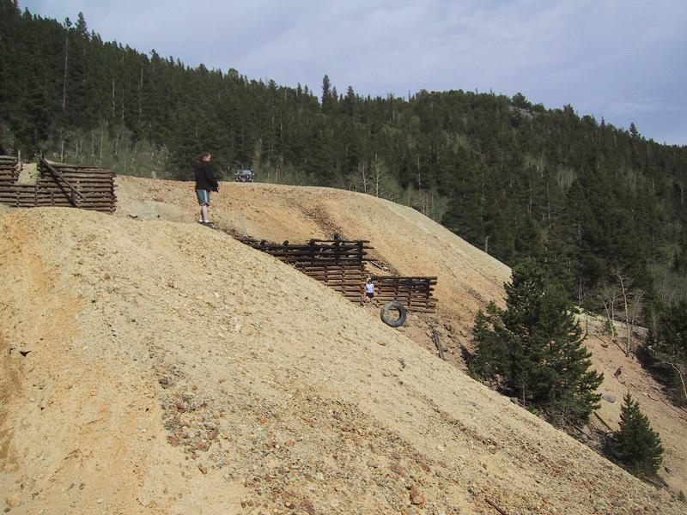
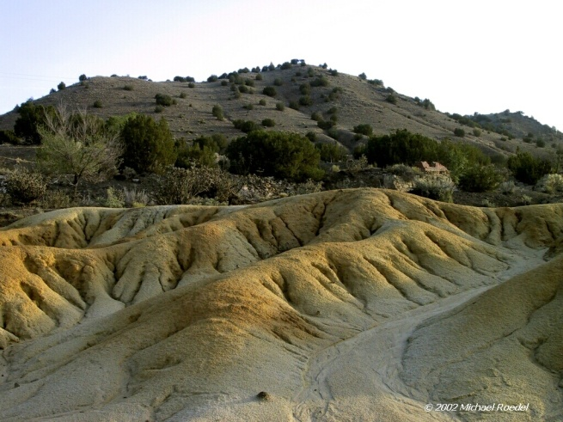
Mine Tailings
There are approximately 420,000 abandoned mines
in the states of California, Arizona and Nevada
Cd, Pb, Zn,
Cr, Cu, Al
oxygen
FeS₂ 2H₂SO₄
2H⁺ + SO₄²⁻
water
PbCO₃ + H⁺ Pb²⁺ + HCO₃⁻
solid
soluble
Direct toxicity plus dissolution of associated metal contaminants such as arsenic, lead, and cadmium

Slide 84
pH and Acid Rainfall

Slide 85
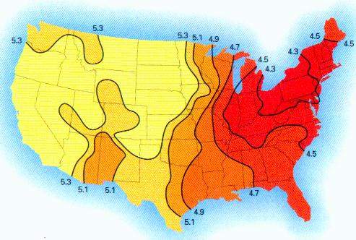
Natural rainfall is acidic: pH 5.6
CO₂ + H₂O = H₂CO₃
H₂CO₃ => H⁺ + HCO₃⁻
Acid
Pollution by sulfur dioxide and nitrogen oxides
contributes additional acidity to rainfall.
SO₂ + H₂O → H₂SO₃

Slide 86
National Surface Water Survey (EPA)
Investigated the effects of acidic deposition in over 1,000 lakes
Acid rain caused acidity in 75 percent of the acidic
lakes and about 50 percent of the acidic streams
Most lakes and streams have a pH between 6 and 8.
In the Northeast U.S. many lakes have pH less than 5.
Adirondacks and Catskill Mountains
mid-Appalachian highlands
Little Echo Pond has a pH of 4.2.
The Canadian government has estimated that
14,000 lakes in eastern Canada are acidic.
Notes:
Little Echo is in Franklin NY. pH 6 is 100 times less hydrogen than pH 4.

Slide 87
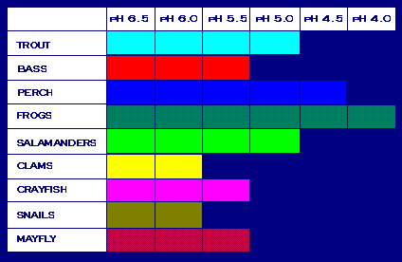
Low pH can be directly toxic to fish and other species
As acid rain flows through soils in a watershed, aluminum is released
Low pH and increased aluminum levels cause chronic stress that
may not kill individual fish, but leads to lower body weight and
smaller size and makes fish less able to compete for food and habitat.
Acid tolerances
food
Increasing acidity
At pH 5, most fish eggs cannot hatch

Slide 88
Next: Water Quality and Contaminants

