Slide 1
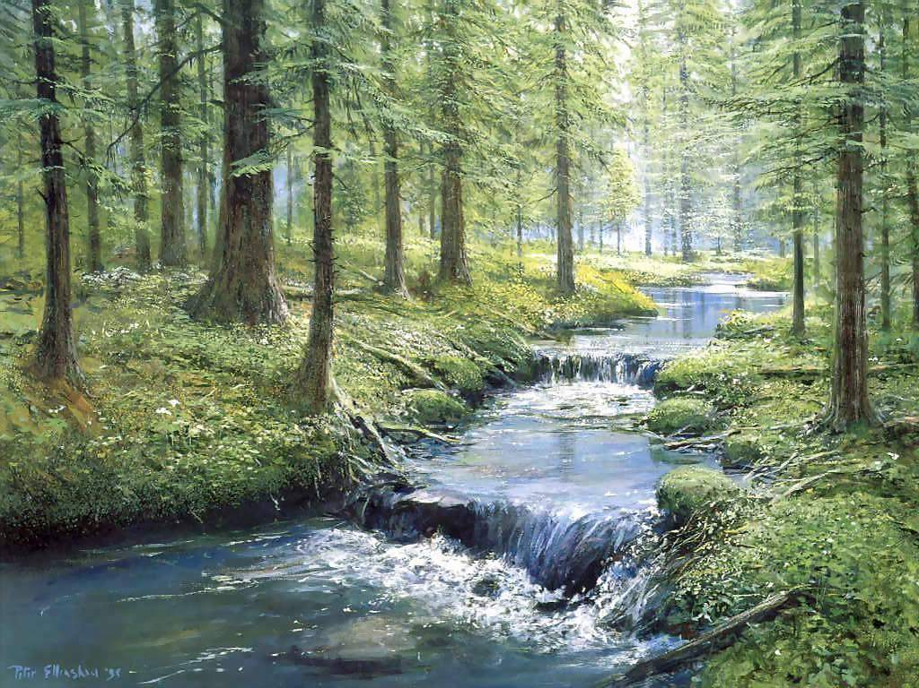
Rivers and Streams
Notes:
Today we will briefly discuss rivers and streams.

Slide 2
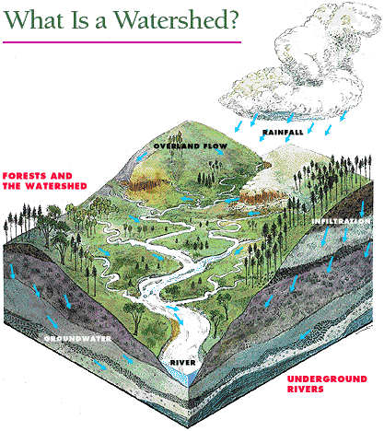
Watershed
Total land area that drains surface water to a common point.
water divide
Separated topographically from adjacent basins by a geographical barrier such as a ridge, hill or mountain, which is known as a water divide.
Notes:
To understand rivers we must also understand the land areas that contrivbute water to them. The combined effect of water moving over the land surface, draining to a common point creates watersheds. It Can be as small as a parcel of ground that drains into a pond or as large as the 1.26 M mile basin that drains into the Mississippi. Waterheds are Separated topographically from adjacent basins by a geographical barrier such as a ridge, hill or mountain, which is known as a water divide.
A watershed is either (1) a region of land where water flows into a specified body of water, such as a river, lake, sea, or ocean or (2) a topographical boundary between catchment basins. In the first sense a watershed is also a water basin or catchment basin, and this is the sense intended in this article, unless otherwise indicated. Water divide may be used to avoid confusion with the other meaning of watershed.
Rain that falls anywhere within a given body of water's watershed or basin will eventually drain into that body of water. A map of the primary watersheds in the world can be found at [1]. A watershed that drains into a river is usually known as a river basin.

Slide 3
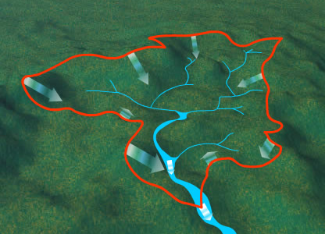
1/5 of rainwater falling a watershed collects directly in rivers
Evaporation
Groundwater
Lakes
Sinks
Soil Water
Wetlands
80%
Notes:
The orange line indicates the water divide that separates the watershed from surrounding areas. Only about 20% of rainwater fallin on a water shed collects directly in rivers. The remaining 80% evaporates or is deliverd to groundwater…
Groundwater seepage and soil flow can be important to developing rivers and streams as well.

Slide 4
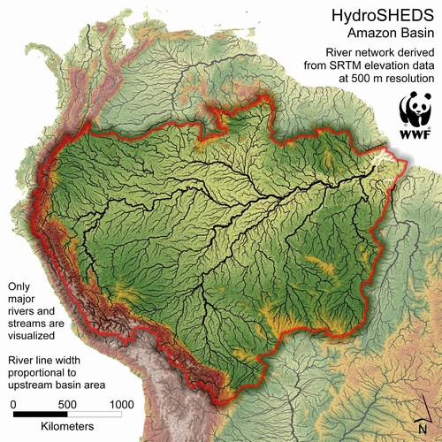
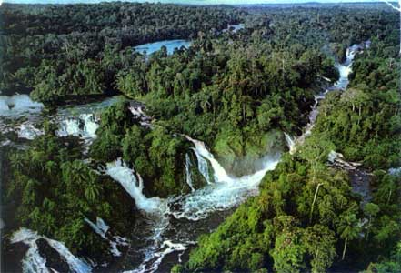
Amazon Watershed
¾ the size of United States
2,720,000 sq mi
80 – 110 ‘’ rainfall/year
World’s Largest Watershed
Notes:
The largest watershed on earh is The Amazon watershed which is about ¾ the size of United States,
The area covered by the water of the River and its tributaries more than triples over the course of a year. In an average dry season (42,000 sq mi) of land are water-covered, while in the wet season the flooded area of the Amazon Basin rises to (135,000 sq mi At its widest point the Amazon River can be (7 mi) wide during the dry season, but during the rainy season when the Amazon floods the surrounding plains it can be up (28 mi) wide.
Because of the basin’s size and the very high rainfall in this region, The quantity of water released by the Amazon to the Atlantic Ocean is enormous: up to 300,000 m³ per second in the rainy season.

Slide 5
The Amazon River
largest river in the world by volume,
with a total flow greater than the
next top ten largest rivers combined.
Notes:
This make the amazon the largest river in the world by volume with a total flow greater than the next top ten rivers combined.
The Amazon River (occasionally River Amazon; Spanish: Río Amazonas, Portuguese: Rio Amazonas) of South America is one of the longest two rivers on Earth, the Nile River in Africa being the other. The Amazon has by far the greatest total flow of any river, carrying more than the Mississippi, Nile, and Yangtze rivers combined. It also has the largest drainage area of any river system. It may be correctly stated that the Nile is the longest river, while the Amazon is the strongest.

Slide 6
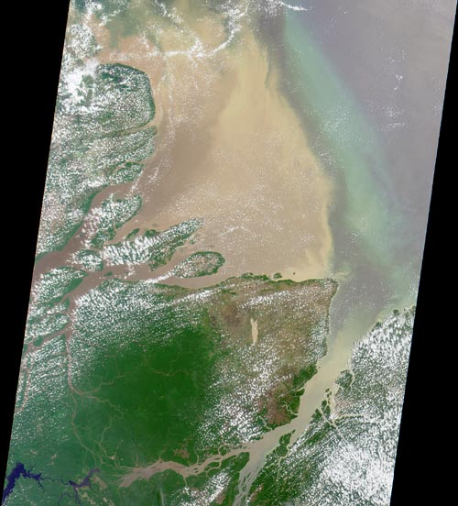
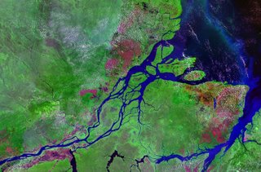
World Hydrology
Mouth of
Amazon
Discharge: 319,000 m³ per sec.
20% of freshwater
entering the oceans
Notes:
The amazon is extttaordinarly important to world hydrology. The Amazon is responsible for one fifth of the total volume of fresh water entering the oceans worldwide. It is said that offshore of the mouth of the Amazon potable water can be drawn from the ocean while still out of sight of the coastline, and the salinity of the ocean is notably lower a hundred miles out to sea.

Slide 7
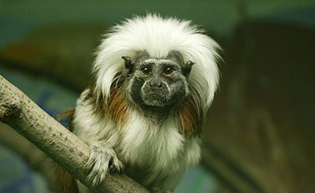
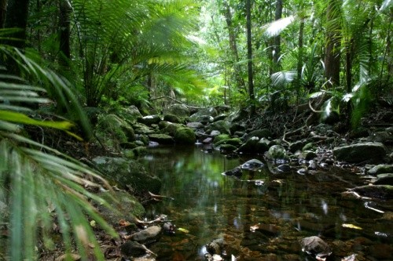
Watershed Biodiversity
largest collection of living plants
and animal species in the world
2.5 million insect species
2000 bird and mammal species
75,000 types of trees/km²
150,000 species of vascular plants/km²
1 in 5
Notes:
The region is home to ~2.5 million insect species, tens of thousands of plants species, and some 2000 birds spies. One out of every 5 birds int eh world live in the amazon rainforest. The diversity of plant species is the highest on earth with some experts estimating that one square kilometer may contain over 75,000 types of trees and 150,000 species of higher plants. One square kilometer of Amazon rainforest can contain about 90,000 tons of living plants. This constitutes the largest collection of living plants and animal species in the worldTo date, an estimated 438,000 species of plants of economic and social interest have been registered in the region with many more remaining to be discovered or cataloged.
1 in 5 birds

Slide 8
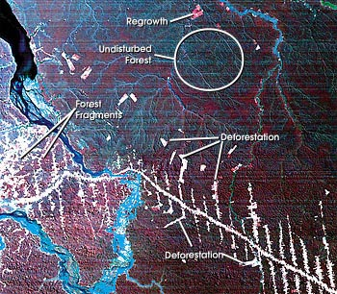
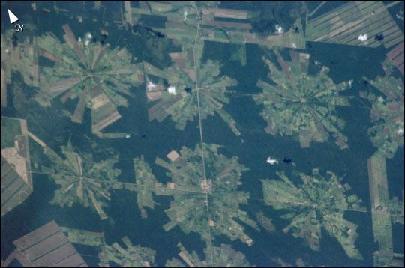
10% of the World’s Terrestrial Primary Productivity
Accumulated 0.62 tons of
carbon per hectare per year
between 1975 and 1996
More than 20 percent of the world
oxygen is produced in the Amazon
vanishing at a rate of 20,000 miles² per year
Deforestation: releases 200 million metric tons of CO₂/yr
Notes:
Deforestation of the Amazon is of enormous importance. The 90,000 tons of living plants per kilometer represents an enormous carbon storage pool. However, more than one fifth of the Amazon Rainforest has already been destroyed, and the forest which remains is threatened. Not only are environmentalists concerned about the loss of biodiversity which will result from the forest's destruction, they are also concerned about the release of the carbon contained within the trees, which likely will impact global climate.
Amazonian evergreen forests account for about 10% of the world's terrestrial primary productivity and 10% of the carbon stores in ecosystems [2] — on the order of 1.1 x 1011 metric tonnes of carbon [2]. Amazonian forests are estimated to have accumulated 0.62 ± 0.37 tonnes of carbon per hectare per year between 1975 and 1996 [3]. But, Fires related to Amazonian deforestation have made Brazil one of the top greenhouse gas producers. Brazil produces about 300 million metric tonnes of carbon dioxide a year; 200 million of these are come from logging and burning in the Amazon (pdf file).
There has been concern among environmentalists for many years, regarding the deforestation of the region, stemming mainly from the fact that more than one fifth of the Amazon Rainforest has already been destroyed; and much more is threatened. Not only are environmentalists concerned about the loss of biodiversity which will result from the forest's destruction, they are also concerned about the release of the carbon which is held within the trees -- this carbon will accelerate global warming.
The deforestation of this area in the 1980s was largely considered catastrophic. Yet, in 1996, the Amazon was reported to have shown a 34 per cent increase in deforestation since 1992. A new report by a congressional committee says the Amazon is vanishing at a rate of 52,000 square kilometers (20,000 miles²) a year, over three times the rate for which the last official figures were reported, in 1994.
Environmentalists commonly stress the fact that there is not only a biological incentive to protecting the rainforest, but also an economic one. One square kilometer in the Peruvian Amazon has been calculated to have a value of $682,000 if intact forest is sustainably harvested for fruits, latex, and timber; $100,000 if clear-cut for commercial timber (not sustainably harvested); or $14,800 if used as cattle pasture.

Slide 9
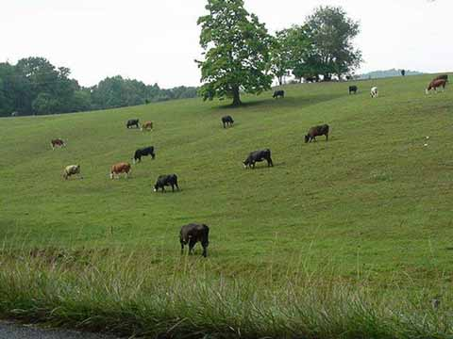
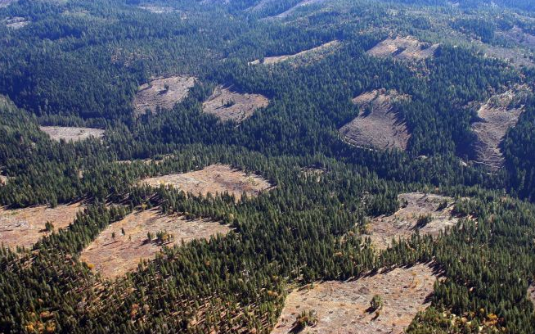
Currently, 121 prescription drugs sold worldwide come
from plant-derived sources.
25% of Western pharmaceuticals are derived
from rainforest ingredients, but less that 1% of these
tropical trees and plants have been tested by scientists.
$6820/hectare (intact)
$1000/hectare (clear cut)
$148/hectare (pasture)
Notes:
In addition to global climate effects, currently 25% of western pharmaceuticals are derived from rainforest ingredients, but less than 1 % of the trees and plants have been tested thus far. From an economic standpoint, then, the rainforests have enormous value beyond their wood and use for pasture. For example, it is estimated that intact forest has a value of almost 7000 dollars per hectare, but only 1000 dollars if clearcut and a mer 148 dollars when used as pasture land.

Slide 10
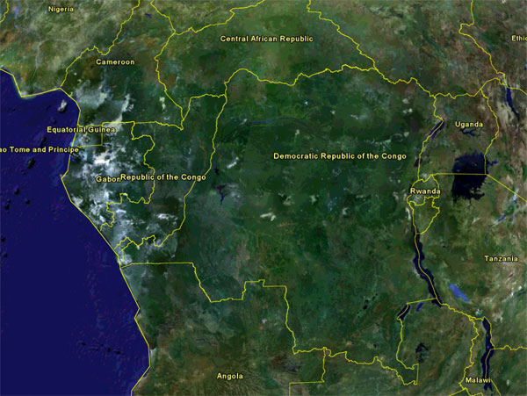
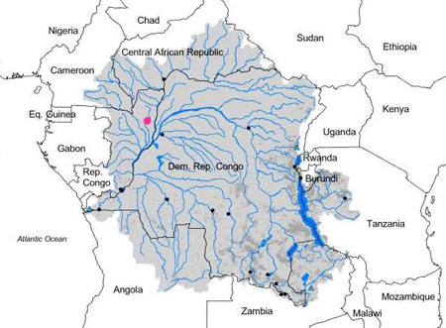
Congo Watershed
2nd Largest
West Africa
1,335,000 mi²
700,000 mi² of
tropical rainforest
Discharge: 41,800 m³/s
3,000 mi² lost each year
Amazon: 319,000 m³/sec
Notes:
The congo, the second largest watershed in the world, and far smaller than the Amazon, nonetheless faces similar problems with respect to deforestation, loosing approximately 3000 square miles each year.

Slide 11
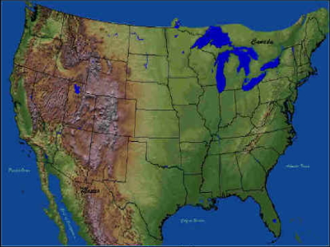
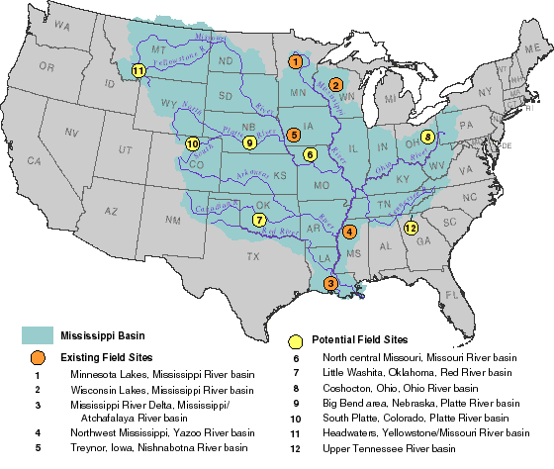
Mississippi Watershed
3rd Largest
confluence
mouth
Discharge: 12,800 m³/sec
1,151,000 sq mi
Notes:
The Mississippi is the largest watershed in the U.S. and the third largest in the world. It is bounded in the east by the appalacians and to the west by the rockies. These are the water divides. Its discharge, however, is quite small compared to either the Amazon or Congo. Much of the watershed lies in areas of low rainfall.

Slide 12
Watershed/River Components
headwaters
tributary
Watershed
(basin)
confluence
Headwaters: the source of the river
Mouth: end of river
Confluence: the point where two rivers meet
Tributary: a smaller river which flows into a larger river
mouth
Length = headwaters to mouth
Notes:
So watersheds are essentially networks of smaller rivers, soil flow, groundwater flow, etc. that contribute to river flow and discharge. I the mississippi, for example water flows to the main river from a number of tributaries, the largest being the Missouri. The point at which one river joins another like the missouri to the mississippi is called a confluence. Total length of a rive is measured from its headwaters or source to the mouth.

Slide 13
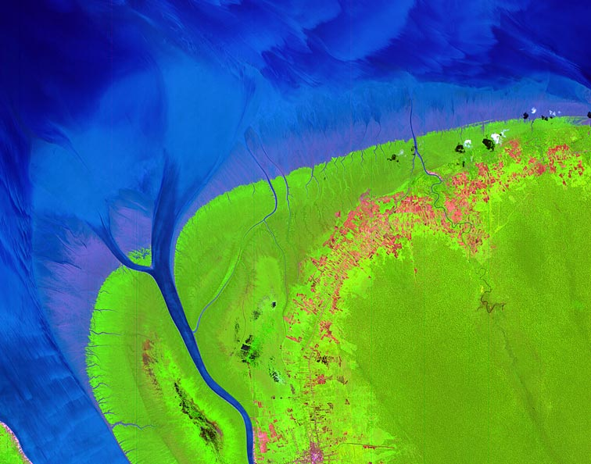
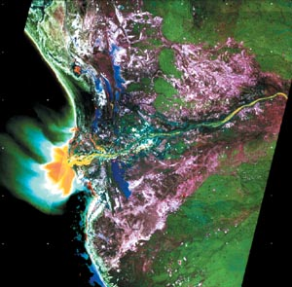
Total Length of the Longest Rivers
Nile = 4135 miles
Amazon = 3980 miles
Yangtze = 3917 miles
Mouth of Nile
Mississippi/Missouri = 3902 miles
Congo
Notes:
Th longest rivers in the world by this measure are the nile, amazon, and yangtze. In the U.S. only the Mississipp/Missour complex approaches the lenths of the worlds long rivers.

Slide 14
River Flow
Flow is from headwaters to mouth

Slide 15
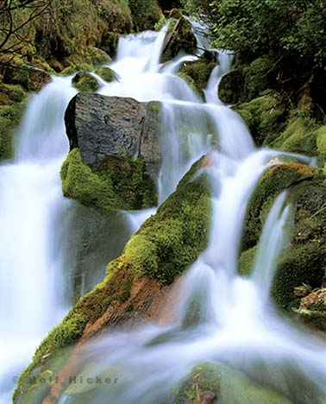
River flow is due to gravity.
Flow velocity strongly depends on the altitude
of the headwaters in relation to the mouth
Notes:
River flow is of course, due to gravity. Therefore flow velocity stronly depends …

Slide 16
River Flow
Rivers flow due to gravity.
Flow velocity is quantified, in part, by
differences in elevation over a lateral distance.
This driving force for river flow is called a gradient,
or the difference in elevation divided by the length
source
Δh
ΔL
h
mouth
L
Notes:
In extimating the impact of gravity on a rivers flow velocity, the differeence in elevation between the source and the mouth is not the sole component. You must consider the distanc over which the elevation change takes place. This is represented by the gradient which is the driving force for river flow.. It is simply the difference in elevatino between the source and the mouth divided by the distance between the two points.

Slide 17
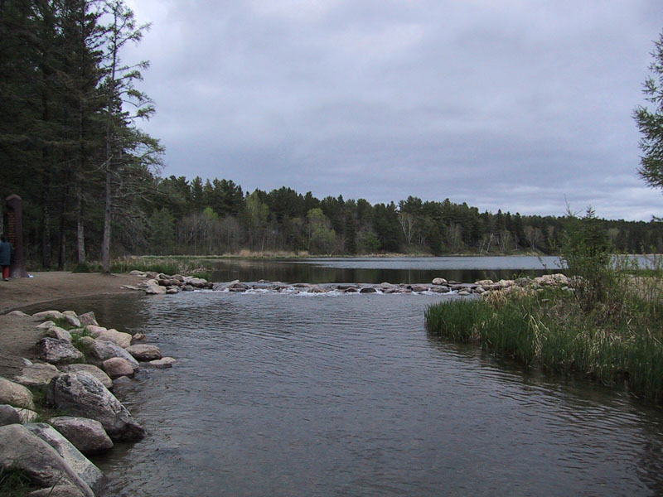
The Mississippi
Source: Lake Itasca at 1475 feet
Mouth: Gulf of Mexico at 0 feet
Notes:
Lets use the mississsippi as and example.The Mississippi River, derived from the Algonquin missi sipi meaning 'great river' literally 'Father of waters', is the second-longest river in the United States; the longest is the Missouri River, which flows into the Mississippi. Taken together, they form the largest river system in North America. If measured from the head of the Missouri, the length of the Missouri/Mississippi combination is approximately 3,895 miles (6,270 km) long.
With its source Lake Itasca at 1475 feet (450 m) above sea level in Itasca State Park in northern Minnesota, the river falls to 725 feet (220 m) just below Saint Anthony Falls in Minneapolis. The Mississippi is joined by the Illinois River and the Missouri River near Saint Louis, and by the Ohio at Cairo, Illinois. The Arkansas River joins the Mississippi in the state of Arkansas. The Mississippi drains most of the area between the Rocky Mountains and the Appalachian Mountains, except for the area drained by the Great Lakes. It runs through, or borders, ten states in the United States -- Minnesota, Wisconsin, Iowa, Illinois, Missouri, Kentucky, Arkansas, Tennessee, Mississippi and Louisiana -- before emptying into the Gulf of Mexico about 100 miles (160 km) downstream from New Orleans. Measurements of the length of the Mississippi from Lake Itasca to the Gulf of Mexico vary, but the EPA's number is 2,320 miles (3733 km).

Slide 18
Gradient
Mississippi : headwaters = 1475 ft
mouth = 0 ft
length = 2330 miles
Lake Itasca
New Orleans
Elevation:
Δh = 1475 feet – 0 feet = 1475 ft.
Length:
ΔL = 2330 miles
Δh = 1475 ft = 0.63 ft/mi
ΔL 2330 mi
Notes:
The gradient, in part, determines the flow velocity. Taking other factors into account, an average velocity can be determeind such that a raindrop falling in Lake Itasca would arrive at the Gulf of Mexico in about 90 days. [1]

Slide 19
Gradients of the Three Longest Rivers
Lake Victoria
Nile = 3721 ft = 0.9 ft/mile
4135 miles
Andes
Amazon = 16,962 ft = 4.24 ft/mile
3980 miles
Tibet Plateau
Yangtze = 16,542 feet = 4.17 ft/mile
3917 miles
Notes:
Up to 70% of the Nile's 84 billion cubic meters (at Aswan) comes from the Blue Nile system during its flood season, with the remainder from the White Nile and Atbara. The White Nile's flow is especially important because it arrives during the months when the Blue Nile is very low, when the Blue Nile may contribute only 20% of the flow to the lower Nile. The Atbara, during its flood stage, may contribute 13% of the annual flow of the Nile (11 billion cubic meters,) but from January to June the Atbara shrinks to pools and ponds.

Slide 20
Large Gradient
source
Δh
ΔL
h
mouth
L
Small Gradient
Δh
ΔL
h
source
mouth
L
Notes:
So the gradient supplies us with one component to river velocity. A large gradient tend to increas velocity while small gradients result typically in slow flow, all else being equal.
Were interested in gradients and river flow velocity because they have extraordinaly impacts on the transport of materials of both environmental and ecological importance that we will discuss in upcoming lectures.

Slide 21
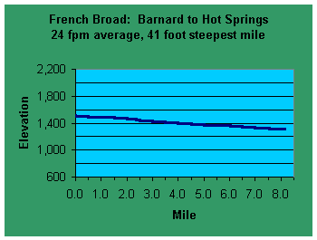
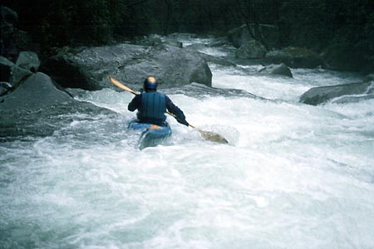
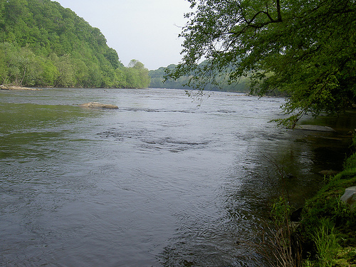
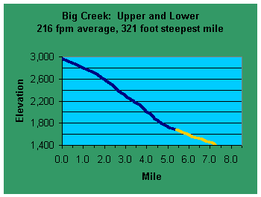
North Carolina Mountains
1600 ft = 213 ft/mi
7.5 mi
200 ft = 25 ft/mi
8.0 mi
The gradient, in part, determines the flow velocity
Notes:
To illustrate the importance of a rivers gradient on flow consider equal lenght portions of two river in NC. Both have a lenght of about 7.5 to 8 miles, but the difference in elevation allong that lateral distance is far different. For the big creek river the diffeence in measured elevations is 1600 ft while for the French Broad on the right the elevation difference is onhly 200 ft. so, the gradient of Big creek in nearly 10 times that of the french broad and we can see this differnec in their flow patterns.

Slide 22
The gradient of the river is a dominant
factor In river flow velocity
Constrictions increase velocity
Bottom roughness decreases flow velocity
Winding or meandering rivers tend to flow more slowly
Length decreases velocity, but increases volume and width

Slide 23
River Flow in Florida

Slide 24
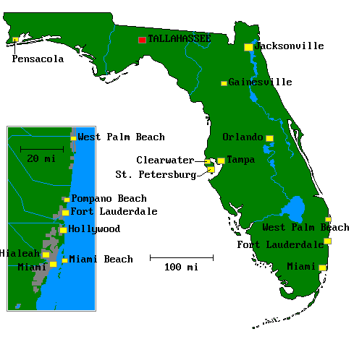
Florida River Flow
Apalachicola
Suwannee
St. Johns
Kissimmee
Generally sluggish flow
Notes:
Theses are some of the major rivers in florida. They all flow vvery slowly. Any idea why.

Slide 25
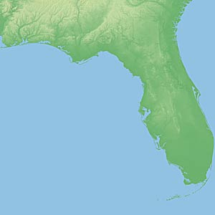
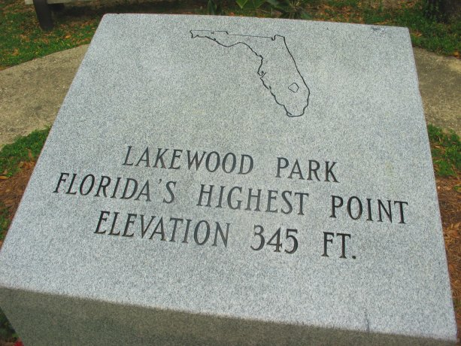
Florida
Elevation
- Highest point
- Mean
- Lowest point
345 ft
Britton Hill
98 ft
0 ft
Notes:
Obviulsly because florida is relatively flat.. The highest point in the state is in Britton Hill near Lakewood in Fort Walton Co. the mean elevation in the stat is only 98 ft and of course the lowest point is at sea level.

Slide 26
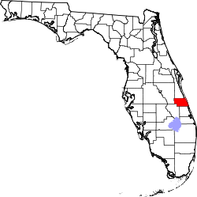
Florida’s Rivers
Source
River length Elevation Gradient
St. Johns 310 miles 30 feet 1.16 in/mile
Suwannee 266 miles 200 feet 9.02 in/mile
Kissimmee 134 miles 14 feet 1.25 in/mile
Apalachicola 112 miles 77 feet 8.25 in/mile
Slow flow of contaminants
Notes:
slow flow of contaminants and other materials of environmental or ecological importance.
1962 to 1970 the United States Army Corps of Engineers dredged the C-38 Canal down the Kissimmee valley. Channelization of the Kissimmee shortened the river to 56 miles. Efforts are currently underway to reverse the process and re-introduce the many oxbows in the river that slowed the water. While the Kissimmee was not a significant source of pollution for Lake Okeechobee before channelization, in the 1970s and later the river contributed about 25% of the nitrogen and 20% of the phosphorus flowing into the lake The Lower Kissimmee River Basin is the second largest source of external phosphorus loading to Lake Okeechobee, delivering 20% of the total phosphorus (TP) and 25% of the total nitrogen in 31% of the inflow to the lake. The project seeks to reduce phosphorus loadings to Lake Okeechobee by 43%, as measured at the watershed outlets (S65E and S154).
Over 95% of the land use in the watershed is agricultural. Dairy and beef operations are the primary sources of phosphorus. Runoff from dairy holding areas and milking barns, direct stream access by large numbers of dairy cattle, and runoff from improved pastures are the main contributors. Most of the beef cattle pastures have been fertilized and surface drained to improve drainage during the wet season. The critical area covers 15,500 acres and includes all dairies in the project area. In 1988 there were 19 milking barns with approximately 12,655 milking cows in the project area. The number of milking barns decreased to 11 in 1992; however, the number of milking cows remained in excess of 10,000.

Slide 27
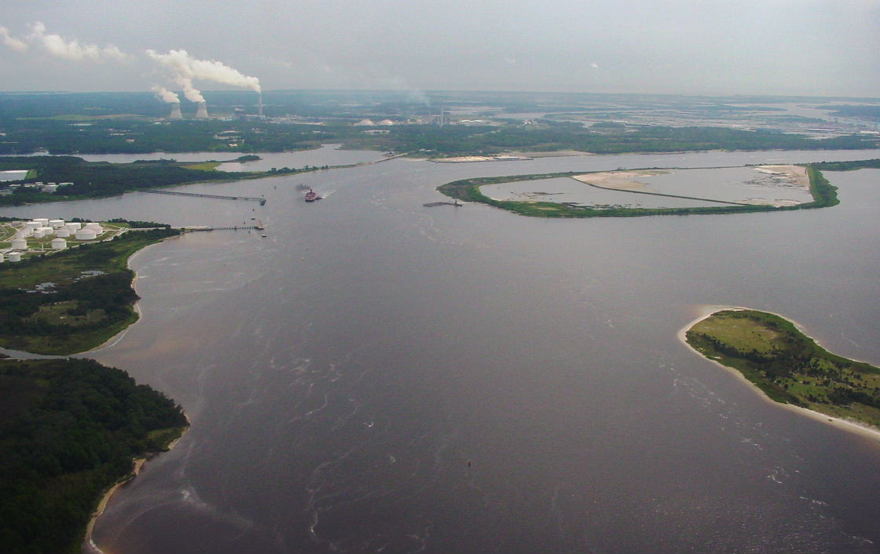
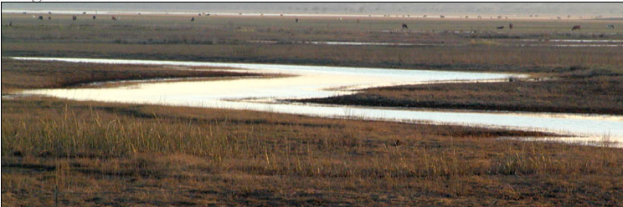
St. Johns River
“Laziest river in the world”
30 foot elevation change over 310 miles
Gradient = 0.096 ft/mile
(1.16 in/mile)
Notes:
The St. Johns River (commonly misspelled as the St. John's River) is the longest river in the U.S. state of Florida, stretching 310 miles (500 km) from Indian River County to the Atlantic Ocean in Duval County. It is one of only a handful of North American rivers that flow from South to North. The elevation change from headwaters to mouth is only about 30 feet, making the St. Johns one of the world's "laziest" rivers. This slow flow makes it difficult for pollutants to be flushed from the waters, which has become a serious problem for the river ecosystem. Despite the pollution the river is home to numerous species. It is not uncommon to see dolphins in the river north of Jacksonville, manatees in the springtime when the water warms up, alligators, bald eagles, ospreys, stingrays, and many species of fish, both salt and fresh water.
The source of the river, or headwaters, is a large marshy area in Indian River County that flows north and turns eastward at Jacksonville to its mouth in the Atlantic Ocean.

Slide 28
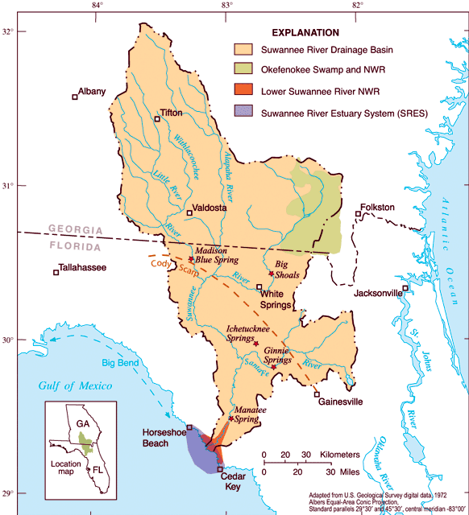
Suwannee River
Gradient: 0.75 ft./mile
Origin: Okeefenokee Swamp
Diverse
Largely unspoiled

Slide 29
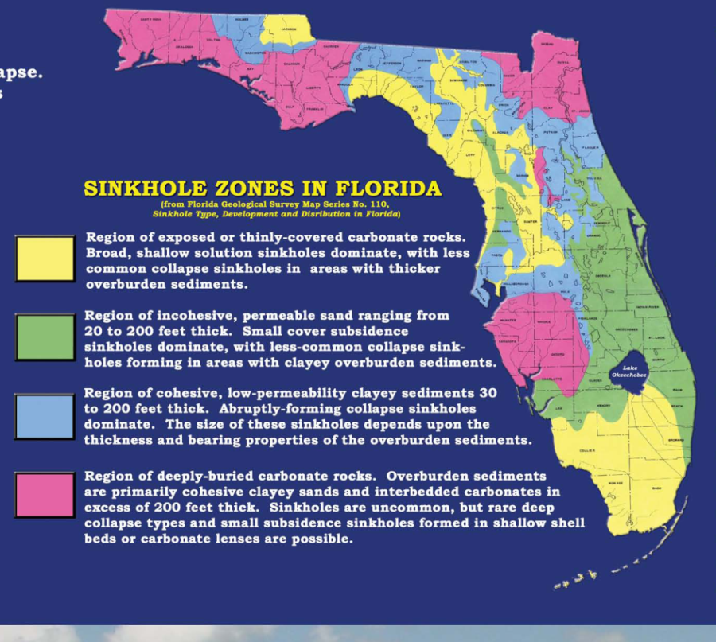
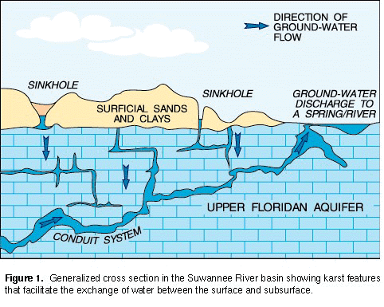
The basin includes Lafayette and Suwannee counties,
residential and commercial septic systems in rural areas
about 300 row crop and vegetable farms,
44 dairies with more than 25,000 animals
150 poultry operations with more than 38 million birds
Notes:
Nonetheless, with a small gradient and consequent slow flow it is difficult for the river to discharge contaminants and is subject to concentration of contaminants from a number of sources including a number of residental and commercial septic systems since it flows through largley rural areas that are not served by municipal wastewater systems. The basin also contains...
Notice geographically where the river basin occurs and the types of material that ovely these regions, mostly thin sandy material over limestone. Therefore contaminants, principally nitrogen and phosphorus from agriculture and septic systems introduced at the surface migrate easily to the underlying limestone aquifer.

Slide 30
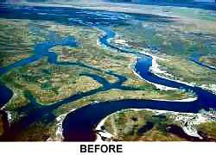
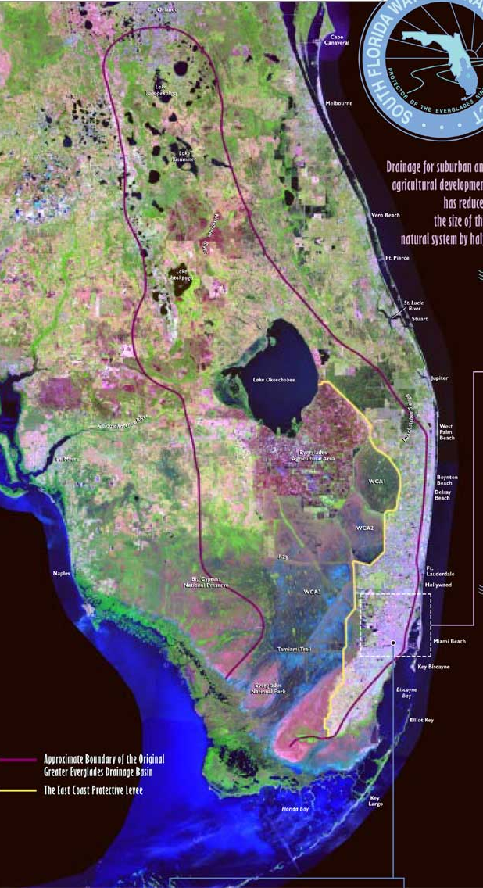
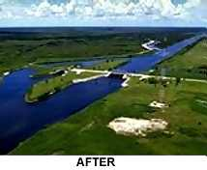
Kissimmee
14 ft over 134 miles
0.1 ft/mile
(1.25 in/mile)
0.25 ft/mile
(3.0 in/mile)
Kissimmee – Okeechobee – Everglades
Notes:
The Kissimmee river is an interesting case and is related to our earlier discussion of river-floodplain interacitons. In the 1950s the river was extensively channelized which dramatically altered its flow from a wide meandering series of streams subject to frequent flooding to a narrow, straight channel which largely prevents flooding and diminishes the extent of its floodplian and the rivers interaction with the floodplain.

Slide 31
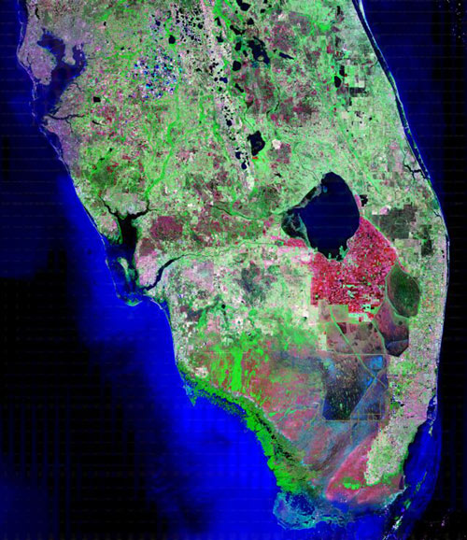
Notes:
On the left is an image of the former extent of the floodplain and the river sweapt extensively throughout this region. it has now become a channelized remenant illustrated on the right.

Slide 32
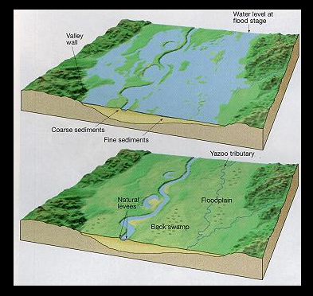
Floodplains
Floodplain - area of relatively level land that is inundated from time to time by river flooding
Notes:
Due to channelization, the historical river floodplain interactioon was almost completyl circumvented.
Now imagine what occurs when a river overflows its banks and spreads out into the surrounding floodplain. The largest particles, the sand and gravel, settle first near the banks of the river. Smaller particles, the silt and clay fractions settle much later and farther out in the floodplain. These are primarily responsible for the increased fertility of these regions. The Sumerians, in particular, were especially skillful in harnessing, redirecting and storing the products of periodic floods in the region, allowing systematic agriculture to take hold. The Egyptian's situation required less skillful hydraulic engineering, but local conditions did not require the same intensity of effort.

Slide 33
Floodplains and Productivity
Wetting of the floodplain soil releases a surge of nutrients
Primary productivity (photosynthesis) stimulated
Microscopic organisms thrive
Increase in overall productivity up the food chain
Larger species enter a rapid breeding cycle.
Opportunistic feeders (particularly birds) move in
The surge of new growth endures for some time.
A floodplain can contain up to 1000 times as many species as a river
Interaction of the river with the floodplain also
can remove excess nutrients from the river water

Slide 34
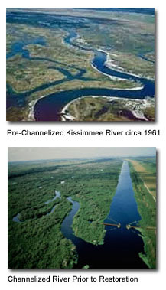
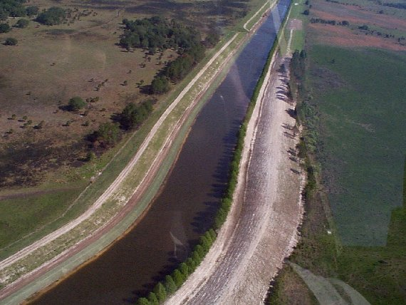
Kissimmee River Channelization
25% of N and P entering
Lake Okeechobee
eliminated river-floodplain interactions
eliminated adult spawning and foraging habitat,
as well as larval and juvenile refuge sites for fish on the floodplain.
Floodplain utilization by waterfowl declined by 92%.
Notes:
River channelization and degradation of the floodplain let to severe impacts on the system's biological components. Low-and no-flow regimes in the canal and remnant river channels resulted in chronically low dissolved oxygen levels and sport fish species like largemouth bass were being replaced by species tolerant of lower dissolved oxygen regimes (such as Florida gar and bowfin). Stabilized water levels and reduced flow also eliminated river-floodplain interactions. The Influx of organic matter, invertebrates, and forage fishes to the river from the floodplain during periods of water recession was eliminated. Stabilized water levels also largely eliminated adult spawning and foraging habitat, as well as larval and juvenile refuge sites for fish on the floodplain. By the early 1970s, floodplain utilization by wintering waterfowl declined by 92%. Wading bird populations, a highly visible component of the historic system, declined and were largely replaced by cattle egrets, a species generally associated with upland, terrestrial habitats.

Slide 35
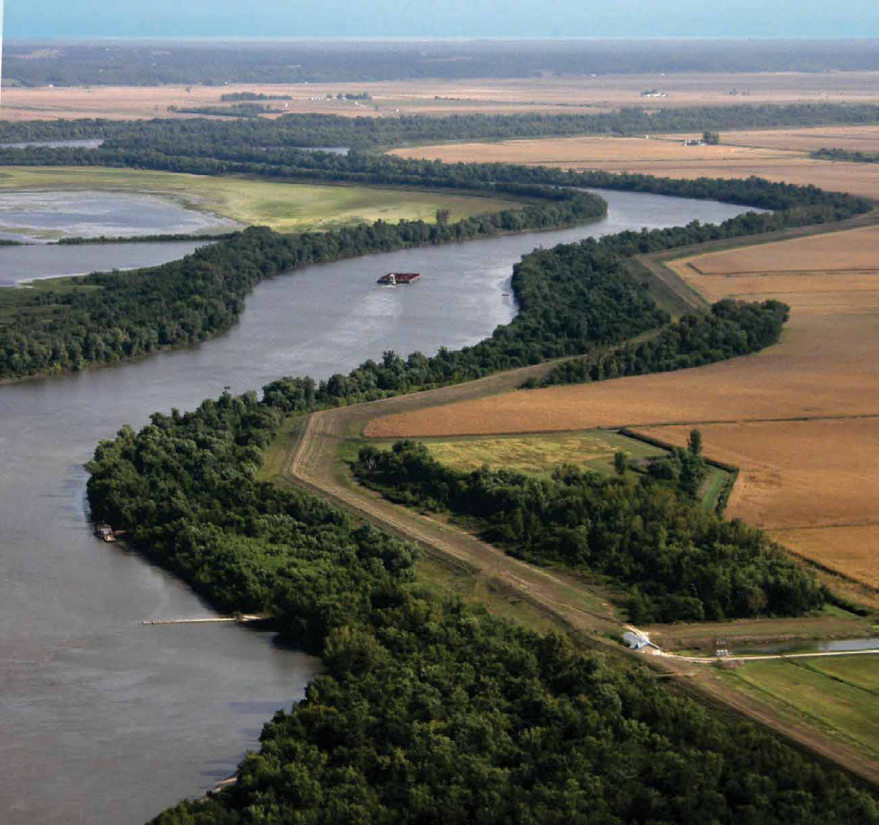
The Mississippi
Levee
Levee
Notes:
Levees along the mississippi have had similar impacts. Levees prevent flooding but also critical river floodplain interactions that have important consequences to the river system that we will discuss later.

Slide 36
The Mekong and Tonle Sap
Notes:
An excellent example of river-floodplain interaction that is critical to the lives of millions are the Mekong and Tonle Sap rivers.

Slide 37
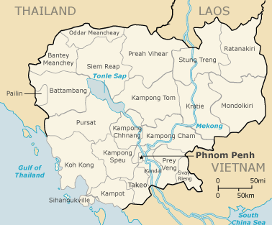
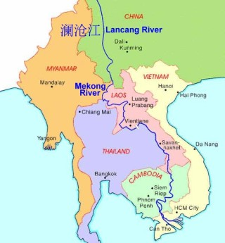
Mekong
17,139 ft
Gradient: 5.7 ft/mile
12th longest
China, Thailand, Cambodia, Laos, Vietnam
The least modified major river in the world
Characterized by seasonal pulses of monsoon water
Notes:
Mekong is th 12th longest and one of the least modified rivers in the world. It runs through China, Thailand, Cambodia, Laos and Vietnam and is an important lifeline for people along its course. It is also characterized by seasonal pulses of monsoon water that cause flooding and important interacitons with the river’s floodplain.

Slide 38
Mekong River
Lifeblood of S.E. Asia.
80% of Cambodia’s population is involved
in fishing and processing of Mekong harvest.
60 million people in Laos, Cambodia, and Vietnam
subsist on the river and its wetlands which yield
approximately 2 million tons of fish per year: equal
to 2% of the entire would catch of wild fish.
The biological hearts of the river’s productivity
are the Tonle Sap river and Tonle Sap Lake.
Notes:
People and animals have adapted to the annual pulse of the river

Slide 39
Tonle Sap
Mekong
Tonle Sap
The Tonle Sap river is a
tributary to the Mekong
The Tonle Sap lake is the source of the river

Slide 40
Reversing its Flow
Dry season from November to May
Monsoon rains from June to September
Mekong forces the
tributary to flow
backward into
Tonle Sap Lake
Absorbs 1/5 of the
Mekong’s flood waters
Notes:
Seasoanl flooding of the Mekong occurs between June and September adding enormously to the vloume of the river to the point that it forces the Tonle Sap to reverse its direction each year while the monsoon rains continue. Water spills over the banks of both the Mekong and the Tonle Sap creating important interactions with the floodplain, but it is in the tonle sap lake that the greatest impact is felt. The tonle sap lake is ordinarly the source of the tonle sap river, but durring monsoon season it absorbs much of the flood waters of the river in its floodplain.
The tremendous life that the Ganges supports is also the source of its greatest threat: pollution. The majority of the Ganges’ pollution is organic waste—sewage, trash, food, and human and animal remains. Over the past century, city populations along the Ganges have grown at a tremendous rate, while waste-control infrastructure has remained relatively unchanged. Sewage systems designed near the turn of the 20th century today do little more than channel waste into the river. Some 300 million gallons of waste go into the Ganges each day, and the effects are stunning: recent water samples collected in Varanasi revealed fecal-coliform counts of about 50,000 bacteria per 100 milliliters of water, 10,000% higher than the government standard for safe river bathing. The result of this pollution is an array of water-borne diseases including cholera, hepatitis, typhoid and amoebic dysentery. An estimated 80% of all health problems and one-third of deaths in India are attributable to water-borne diseases.
The combination of bacteriophages and large populations of people bathing in the river have apparently produced a self-purification effect, in which water-bourne bacteria such as dysentery and cholera are killed off, preventing large-scale epidemics. The river also has an unusual ability to retain dissolved oxygen.[1]

Slide 41
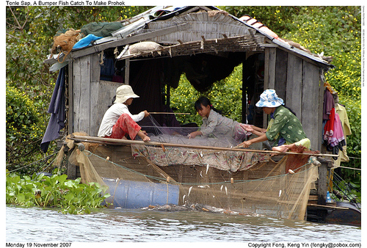
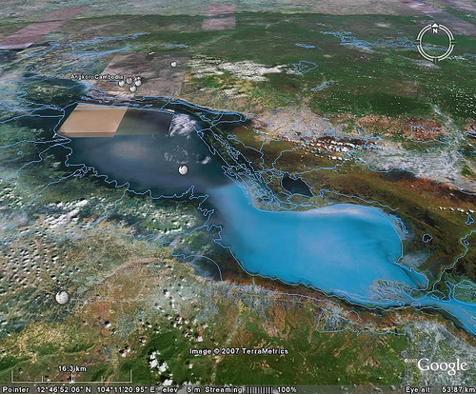
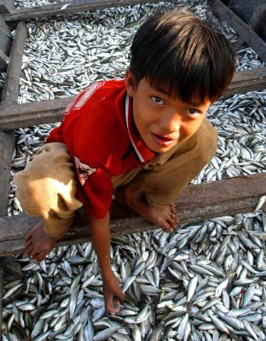
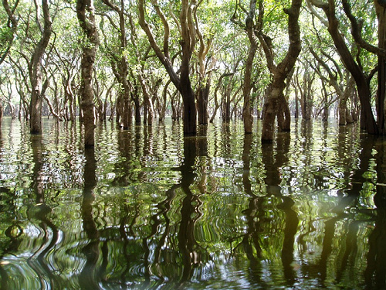
1000 species of fish
2700 to 16,000 km²
Trey Riel
60% of the Cambodians'
protein intake
6 X its normal area
Juvenile fry are swept into the
flooded forests of the Tonle Sap
floodplain and feed on floating vegetation
Nets surrounding the entire lake
and river floodplain harvest the fish.
Notes:
As the plain surrounding the lake is inundated, water carried by the river sweep juvenile fish, principally the trey riel into the flooded forests where they feed on floating vegetation. By the time the floodwaters recede and the tonle sap river resumes its normal course toward the Meknong, the fish mature and are caught in nets that surround the entir lake, provideing 60% of cambodias protien intake.
They feed on the floating vegetation. And when the flood recedes in autumn the fattened fish are caught in nets surrounding the entire lake.

Slide 42
Next: rivers, floodplains, lakes, groundwater and water quality.
Notes:
These kind of interacitons are extraordinarily important to the livelihood of people around the world, but they are also cirtical components ot water quality of lakes, rivers and ground water. We will explore these topics in the last section of the course.

