Slide 1
Aquifer Recharge, Lakes, and Springs
Notes:
Last time we examined the source of porosity of the Floridan aquifer and the implications with respect to sinkhole formation. Today i would like to explore how Karst conditions impact aqifer recharge, lakes, and springs.

Slide 2
The Florida Platform was dominated by marine
carbonate deposition between 150 and 24 mya
The most recently deposited carbonates from
the Oligocene and the Eocene between 55 and
24 Mya comprise the principal water bearing
unit of the Floridan aquifer.
Silicon-based (siliciclastic) Miocene sediments from
the continent, principally the Appalachians, settled
over the carbonates beginning 24 million years
ago forming the upper confining unit for the aquifer
Sandier sediments subsequently covered the
Miocene deposits
Notes:
To Review

Slide 3


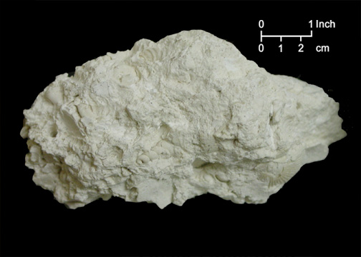
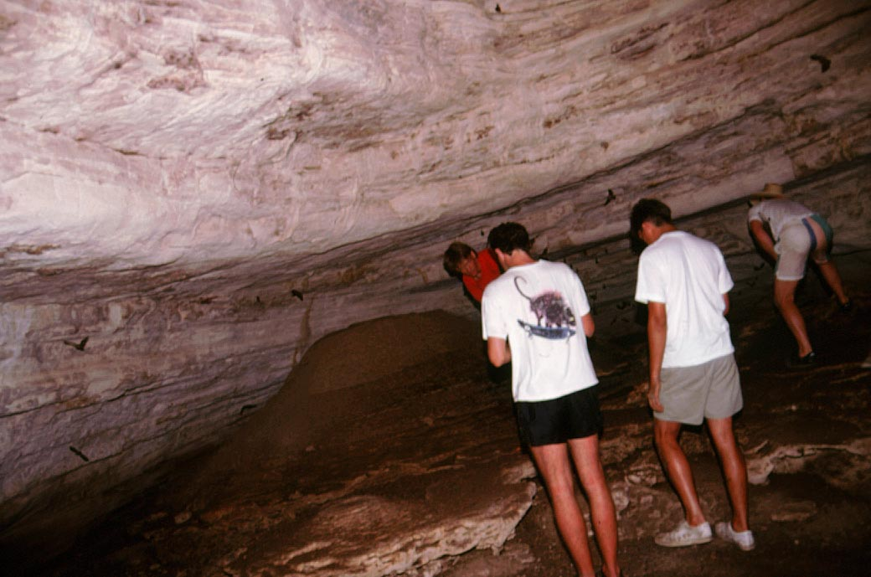
Rudimentary Picture
Surface Siliciclastics (sandy)
(highly permeable)
Unconfined aquifer is
extensive throughout
the state of Florida
Miocene Clays
(low permeability)
Low Permeability
Confining Unit
(poor water movement)
The Floridan aquifer
is a confined aquifer.
The water-bearing unit
is permeable limestone.
55 – 24 million years ago
Source of permeability
Low permeability rock
Low permeability rock (confining)
Notes:
So this is an overall picture based on the depositonal patterns we have discussed. Recall that the floridan is both consolidaed and confined. The upper confining unit is the hawthorne siliciclastic materials which also serve as the lower confining unit for the surficial aquifer. Given that the Floridan is a consolidated rock aquifer the source of its porosity was also discussed

Slide 4
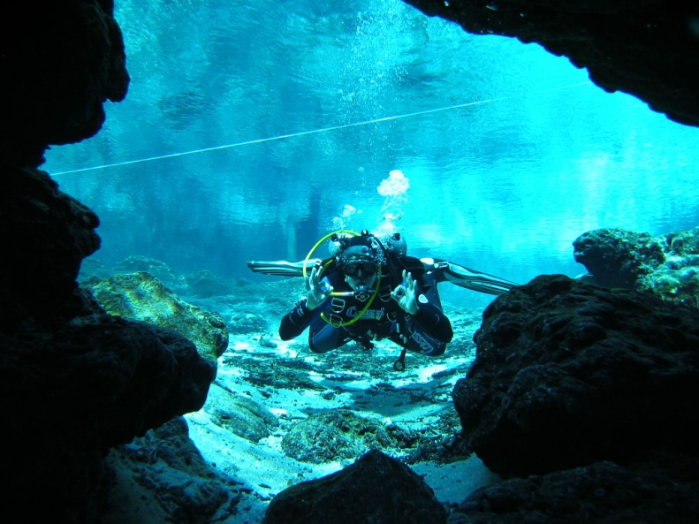
Acidity from rainfall reacts with CaCO₃
and dissolves the carbonate rock.
CO₂ + H₂O = H₂CO₃
H₂CO₃ => H⁺ + HCO₃⁻
CaCO₃ + H⁺ = HCO₃⁻ + Ca²⁺
(solid)
(acid)
(solution)
(solution)
Dissolution Cave
Notes:
Recall that acid dissolution of the limestone is principally responsible for the aquifer's ability to contain and transmit large quantities of water. Rainfall is naturally acidic due to dissolution of atmosp;heric carbon dioxide into rainwater which produces carbonic acid. This is the source of hydrogen ions which can attack the bonds betwween calcium and carbonate and over time results in an extensive network of contiguous cavities and caves, some of which can be very large.

Slide 5
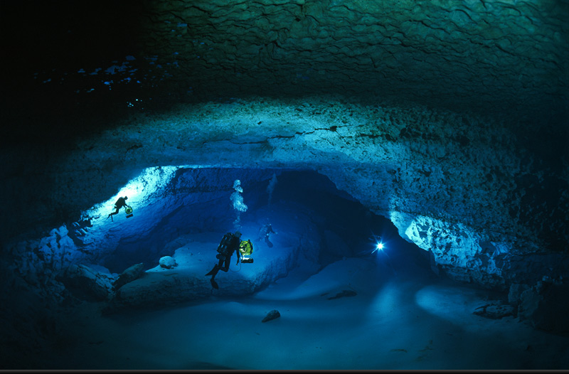
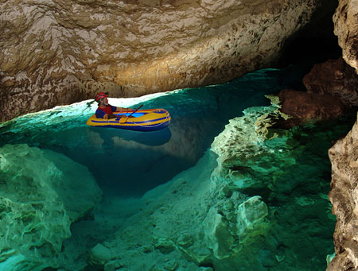
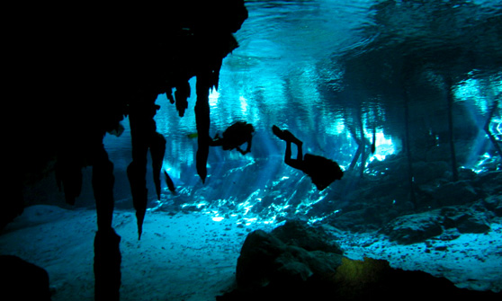
Acid dissolves calcium carbonate
Caves and
Solution Cavities
CaCO₃ + H⁺ = HCO₃⁻ + Ca²⁺
Hold and deliver
billions of gallons
of fresh water
Notes:
5
This process allows the aquifer to contain and deliver billions of gallons of freshwater for the state of Florida.
Precipitation absorbs some carbon dioxide from the atmosphere as the precipitation falls and much more carbon dioxide from organic matter in soil as the precipitation percolates downward through the soil, thus forming weak carbonic acid. This acidic water dissolves the limestone and dolomite of the Floridan aquifer system, initially by enlarging pre-existing openings such as pores between grains of limestone or fractures (joints) in the rock. These small solution openings become larger as more of the acidic water moves through the aquifer; eventually the openings may be tens of feet in diameter.

Slide 6
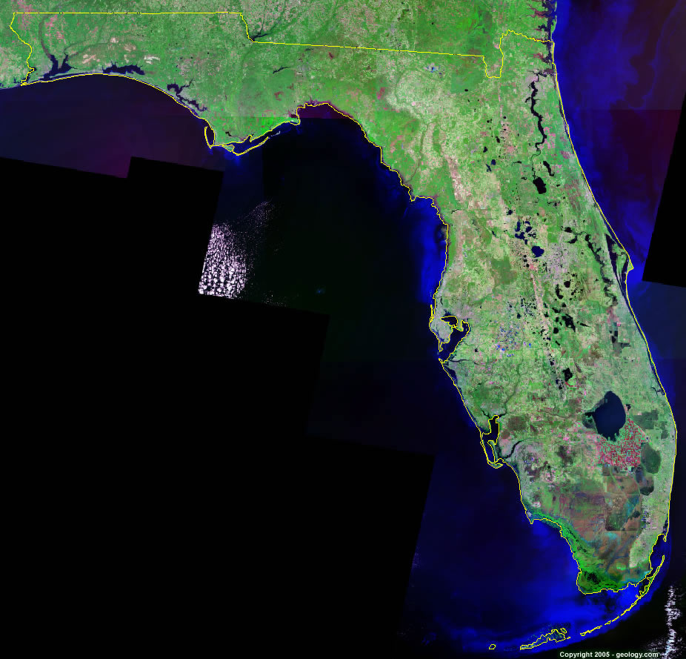
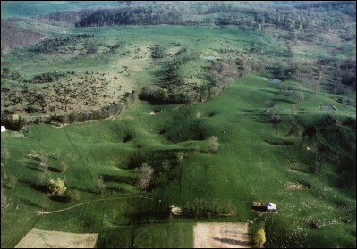
Florida is Dominated by Karst Topography.
Characterized by sinkholes, springs, depressions, lakes
Notes:
Another consequence of carbonate dissollution is Karst topography which is dominated by sinkholes springs, depressions and lakes. Sinkholes in particular are a common feature and haave important implications for florida’s hydrology.

Slide 7

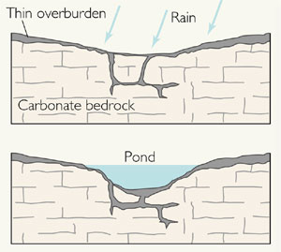

Sinkhole Types
Dissolution
Cover Subsidence
Cover Collapse
Gradual
Abrupt
Gradual
Notes:
There are basically 3 types of sinkholes: dissolution sinkholes form where the material overlying the carbonates is very thin. Acidic precipitation simply dissolves carbonate near the surface and creates generally small depressional areas. Cover subsidence sinkholes require a thick, sandy overburden and form slowly as sand from above trickles or “pipes” into the underlying cavity producing often broad depressional areas at the surface. Collapse sinkholes are the most dramatic and require thick clay above the limestone. Erosion of the clay from below creates a structural arch that eventually becomes to thin to support weight at the surface and suddenly collapses into the underlying cavern.

Slide 8
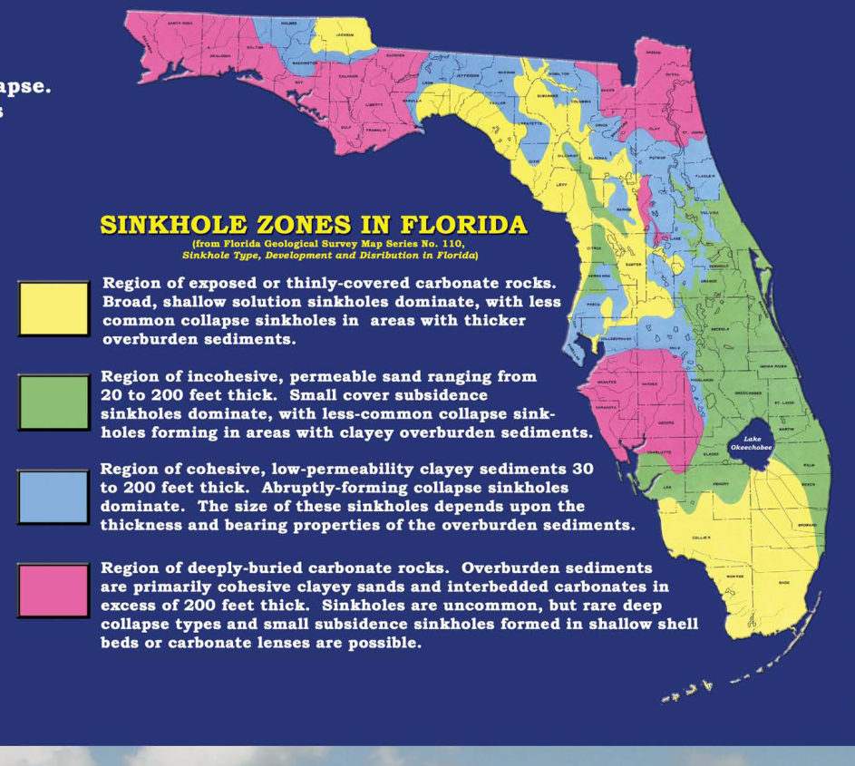
Sinkhole formation depends on the material
overlying the carbonate water-bearing unit
Thin, sandy covering
Dissolution Sinkholes
Cohesive clays up
to 200ft thick
Collapse Sinkholes
Thick sands up to 200 ft
thick and some clays
Subsidence Sinkholes
Miocene clays have been eroded and shaped throughout their history
resulting in extreme variability in thickness across the state.
Notes:
Where these types of sinkholes occur is determined by the types of materials overlying the limestone and are well known geographically. This generalized map indicates the types of materials overlying the limestone and the resultant sinkhole type that dominates. Take a moment to study this map; the materials over the limestone and their geographic location is extraordinarily important to Florida’s overall hydrology.

Slide 9
Sinkholes, Lakes, Aquifer Recharge
Notes:
Today we will begin to explore the relationship between carbonates and the marterials which overly them as well as the importance of these materials with respect to sinkholes, lakes, and aquifer recharge.

Slide 10
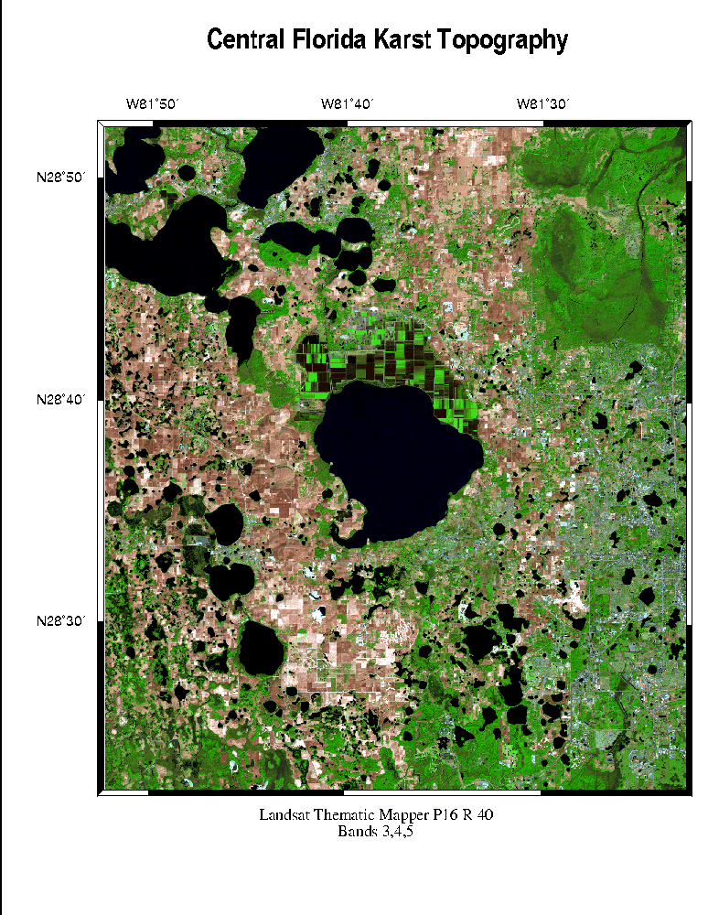
Sinkholes and Lakes
The most common origin of lake formation in Florida
Limestone bedrock is dissolved by acids
Land subsidence into dissolved
limestone cavities creates
depressions filled with water
Subsidence and collapse
sinkholes both can form
lakes. Subsidence lakes
are the most common.
Notes:
The most common origin of lake formation in Florida is due to karst conditions. The limestone is dissolved by acids and surfical material subsdides into the underlying cavitiy. This creates depressional areas at the surface which fill with water. Both subsdidence and collaplse inkholes can form lakes, but subsidence lakes are genreally larger and are more common. They also tend to occcur in clusters like those depicted here.
a chemical process that takes place when underground limestone is dissolved by carbon dioxide enriched water. Most solution lakes are a result of sinkhole activity and thus are circular, steeply sided and deeper than other Florida lakes. Shape irregularities develop due to adjacent sinkholes or additional subsidence. Solution lakes primarily occur in clusters. Examples are the many connected lakes in the Tsala Apopka marsh of Citrus county and Lakes Harris, Griffin, Eustis, and Yale of Lake County.

Slide 11
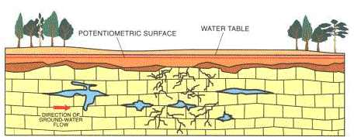
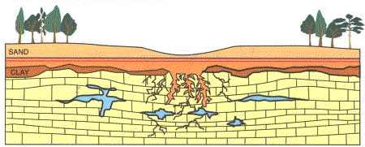
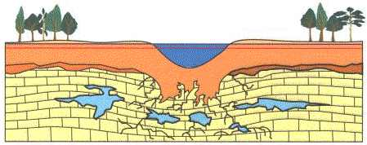
Subsidence Lakes
(most common)
Initially the limestone contains
fractures, but no subsidence
has occurred
Small cavities and cracks grow
larger as time progresses, and
water moving through the rock
erodes the rock matrix. Sediments
carried by the water fill the voids
in the rock.
Sediments from the upper layers
continue to fill in the openings in
the limestone, causing a depression
at the land surface. If water collects
in the depression, a new lake is formed.
Notes:
Solution (sinkhole) lakes. The most common origin of lake formation in Florida is by karst erosion, a chemical process that takes place when underground limestone is dissolved by carbon dioxide enriched water. Most solution lakes are a result of sinkhole activity and thus are circular, steeply sided and deeper than other Florida lakes. Shape irregularities develop due to adjacent sinkholes or additional subsidence. Solution lakes primarily occur in clusters. Examples are the many connected lakes in the Tsala Apopka marsh of Citrus county and Lakes Harris, Griffin, Eustis, and Yale of Lake County.

Slide 12
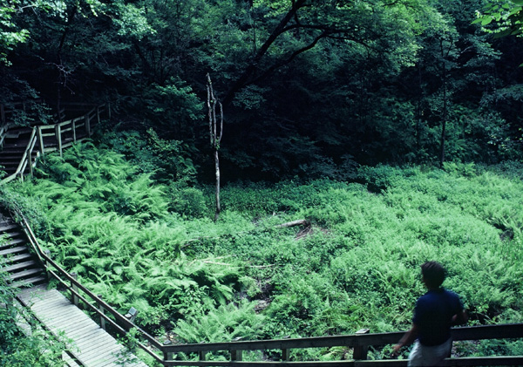
The Importance of Sinkholes and Sinkhole Lakes
Hydrologic connections between the surface
and the underlying limestone are often maintained.
Notes:
The formation of numerous lakes throughout the state is important to surface water resources in Florida. But, they are important in other ways as well. Because of the sandy nature of many subsidence lake bottoms, hydrolgic connections with the underlying ground water is often maintained. Therefore, these types of lakes can serve as recharge areas for the aquifer when lake levels are high and the aquifer can serve as a source of water to the lake when lake levels are low. In other words, water can be readily exchanged between the two reservoirs.

Slide 13
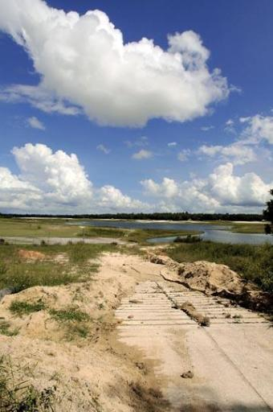
Lakes and Water Levels
Rainfall and shallow groundwater are
the greatest factors affecting water
levels in Florida’s lakes.
As water levels belowground decline, the
pressure beneath the land surface drops,
causing an increase in water seeping from
lakes into the ground
Notes:
Therefore, rainfall and groundwater can have enormous impacts on lake levels. As water levels in the aquifer decline, the pressure in the aquifer also drops, causing water to seep from the lake to underlying groundwater. This causes an overall reduction in lake levels that are immediately evident as we can see from these two photographs. The upper photo is a boat ramp that now serves dry land. The remnant of the lake can be seen in the distance. The lower photo claearly indicates former lake levels. Unfortunately, due to heavy pumping of the aquifer to meet the growing needs of Floridians, this scenario is becoming more common around the state.

Slide 14
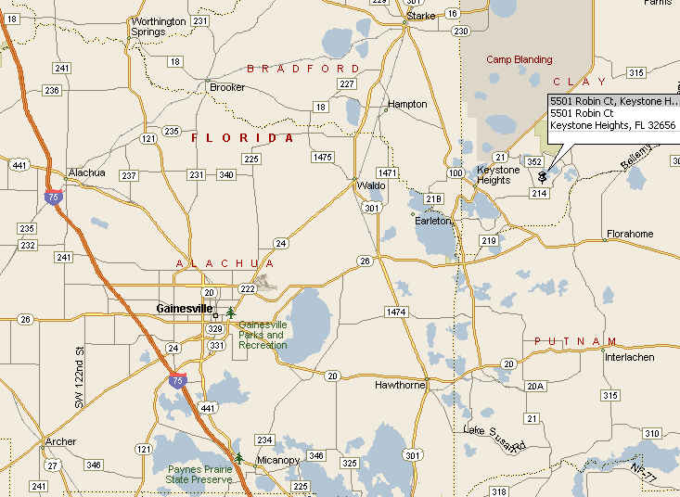
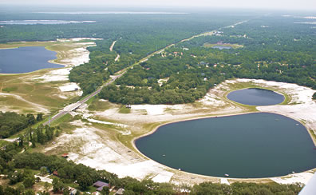
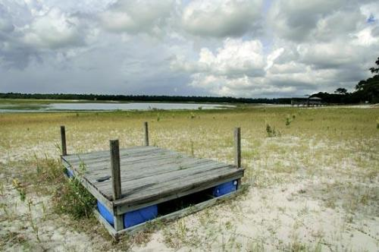
Thriving Lake Community
Keystone Heights
Blue Pond
Lake Lowry
Magnolia Lake
Lake Brooklyn
Lake Geneva
Interconnected cluster of lakes
Supplied by rainwater
Sandy bottoms contact the Floridan Aquifer below
Lake levels are controlled by water in the aquifer.
Groundwater withdrawals continue to increase.
Notes:
A good example of this is Keystone Heights, about 30 miles northeast of gainesville. Once a thriving community surrounding a group of subsidence lakes, Keystone Heights has been plagued by declining lake levels for more than 20 years. Drought and declining groundwater levels are believed to be responsible, and lake levels in this region have declined appreciabley. The light colored areas surrounding the small bodies of water in this photo indicate the former extent of the lake. In the 80s it was possible to boat beneath the highway bridge and sights like this are common throughout the region.

Slide 15
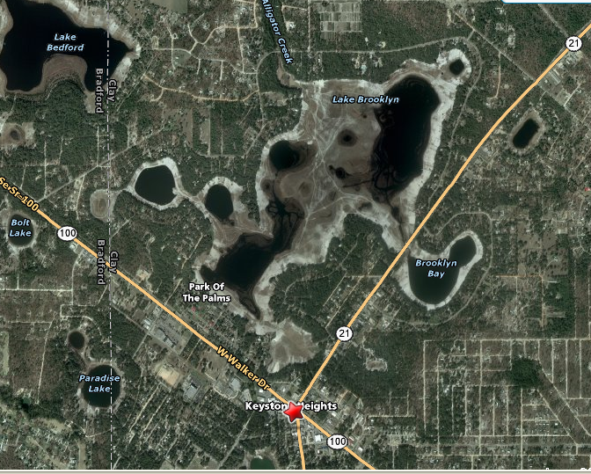
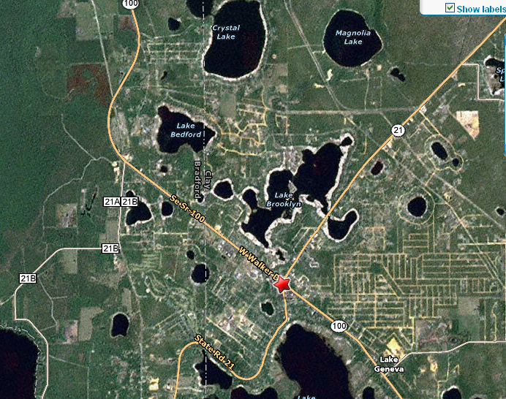
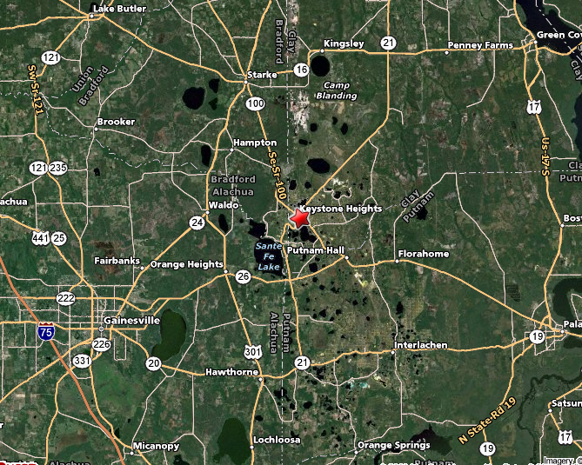
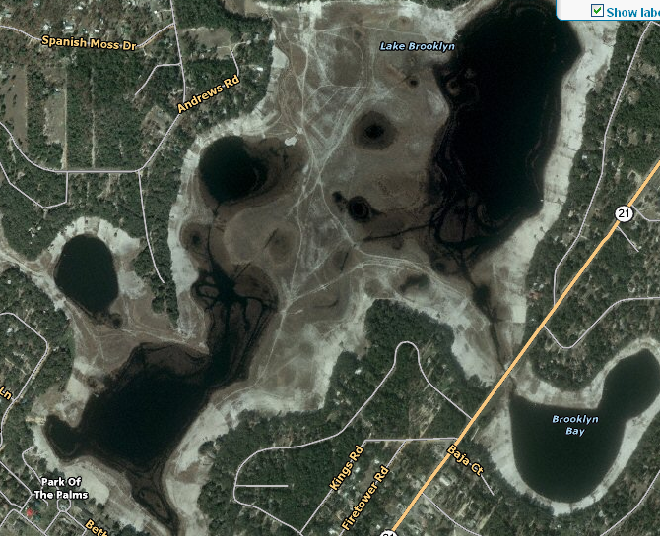
Plug the Bottom?
Notes:
The lakes of Keystone Heights are a cluster of sandy bottom subsidence sinkhole lakes. We can see the major sinks as we zoom in. notice the circular pattern of sinks that maintain hydrologic connection with the underlying ground water. It is clear that these sinks are in essence draining the lakes as groundwater levels decline. Some have suggested plugging the sinks to prevent water from leaving the lakes. Similar practices have been proposed elsewhere as well. However, plugging the bottoms of significant numbers of these lakes will impact recharge of the aquifer below.

Slide 16
Sinkholes and Lakes Statewide
Cohesive clays up to 200ft
(Cover Collapse sinkholes)
Thicker sands and some clays
(subsidence sinkholes)
Notes:
The ability of sinkhole lakes to recharge the Floridan is extraordinarily important to the overall hydrology of theh state. Note the geographic locations of the surfical materials most conducive to sinkhole formation. Now compare that with the satellite view of the state. By far, the largest and greatest number of lakes occur in these regions and are a principal source of aquifer recharge.

Slide 17

Subsidence Sinkhole Lakes
*
35% of
Florida’s
lakes
Lake, Polk, Osceola, Orange
Thick sands and some clays
(subsidence sinkholes)
Notes:
In fact about 35% of Florida’s lakes occur in just 3 counties which are dominated by subsidence sinkhole conditions.

Slide 18
Lakes and Aquifer Recharge
Maintenance of hydrologic connection with the underlying
limestone is a primary source of recharge to the Floridan
Notes:
Now lets look at the geological and geographical implications of floridas lakes with respect to aquifer recharge.

Slide 19
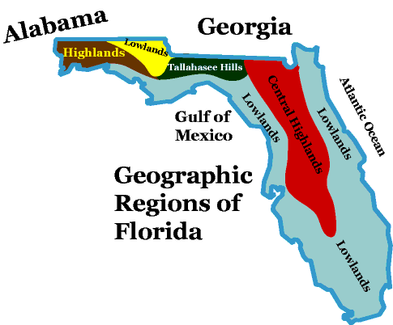
Elevation, Recharge, and
Groundwater Movement
Subsidence lakes and sinks are
a primary source of recharge
to the Floridan Aquifer
Notes:
This is the generalized area of the greatest concentration of lakes in the state. They occur where conditions are optimal for sinkhole lake formation. Now if we compare this region with a generalized map of surface elevation in the state we note that the high concentraion of lakes coincides with generally high elevations along the central highlands.

Slide 20
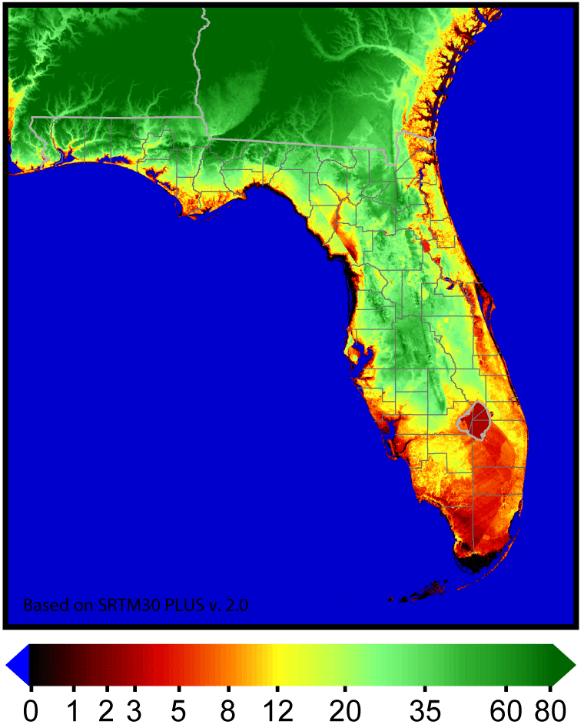
Much of the Recharge Occurs at Higher Elevations
Recharge Areas
Elevation (m)
Notes:
This suggests that most of the recharge of the Floridan aquifer occurs at relatively higher elevations.

Slide 21
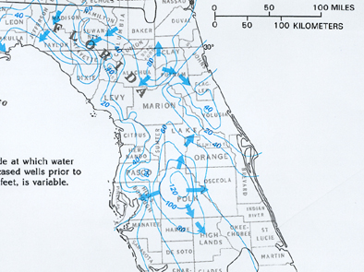
Groundwater flows from topographic
highs toward lower elevations
Notes:
Water moves in response to gravity. Therfore if we are recharging the aquifer at high elevations ih the central part of the state, groundwater will logically move toward lower elevations. In other words, there is a general movement of groundwater from the central part of the state towards the coasts.

Slide 22
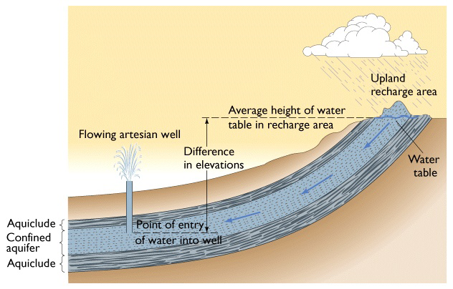
Generalized Groundwater Movement and Artesian Conditions
Recharge
Central part
Of state
Artesian Aquifer
Groundwater
Coast
Thin sandy
overburden
confining
confining
Water under pressure
Notes:
This generalized movement tends to produce artesian conditions at lower elevations. Remember that artesian conditions occur due to pressure exerted by water at different elevations. In this representation, Water near the coast is under pressure because it is at a lower elevation relative to the central part of the state where the aquifer is being recharged. If a well is inserted into the confined aquifer shown, the pressure will force water up into the well and it will flow spontaneously without being pumped. However, as long as the upper confining layer is not breached water will simply continue to flow in the aquifer. But, what happens if the confining layer is breached? This might happen in areas where the upper confining layer is thin. Recall your map indicating the materials overlying the limestone. Where geographically is the upper confining layer thin or absent?

Slide 23
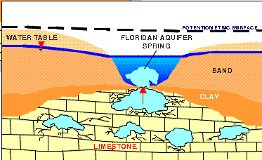
Artesian Aquifers Produce Springs
Water under pressure breaks through upper
confining layers producing water at the surface
Notes:
In regions where water is under pressure and the confining layer is thin or absent groundwater spontaneously bubbles to the surface as a spring.

Slide 24
Thick confining layer
Thin confining layer
Groundwater
Notes:
This occurs in the regions outlined in yellow where the carbonates are thinly overlain by sands and the water is under pressure due to differences in elevation relative to the recharge areas in the central part of the state.

Slide 25
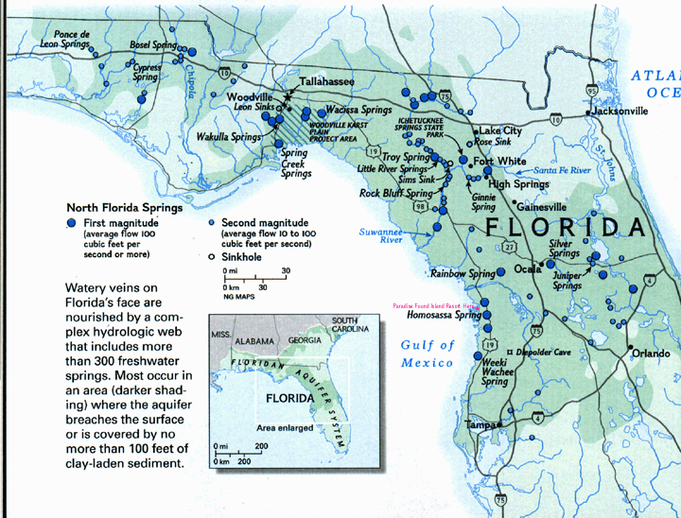
Springs Form Best Where the Confining Layer is Thin
Groundwater
Thin sandy
overburden
Notes:
So looking at a map of the major springs in florida, it is clear that there is a close correspondence between their locations and the physical features of the landscape.

Slide 26
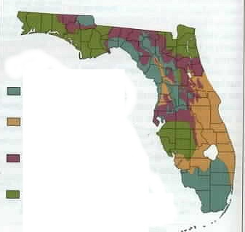
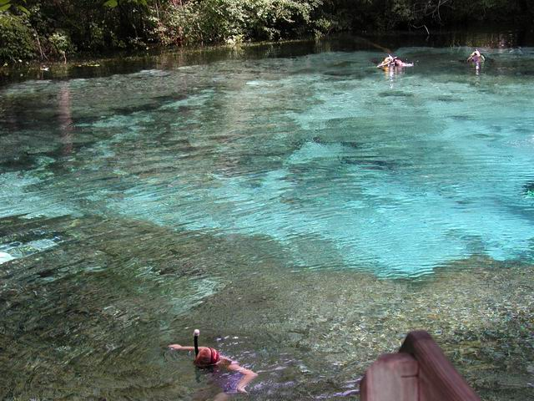
Florida’s Springs
Hawthorne Thickness
27 of 78 First Magnitude
Springs Nationally
Thin or absent
(64.6 million gallons per day)
30 – 200 ft sandy
Form at low elevations
where the upper confining
unit is thin or absent
30 – 200 ft clayey
> 200 ft thick
Notes:
Springs are common in areas of karst topography. Spring flow is controlled by the size of the replenishment area, the difference in altitude between the spring opening and the water level in the aquifer, and the size of the opening or openings through which the springs issue..
Florida has 27 first-magnitude springs (springs with a flow of 100 cubic feet per second or more) out of a total of 78 in the entire Nation.. All of them issue from the Upper Floridan aquifer, and practically all of them are located in areas where the upper confining unit of the Floridan aquifer system either is less than 100 feet thick or is absent. The distribution of large springs discharging from the Floridan aquifer systemis the direct result of dissolution of carbonate rocks, which results in the development of large conduits. Many of these caverns channel the ground water to the point where they are exposed at land surface and become the orifices of major springs (fig. 58).

Slide 27
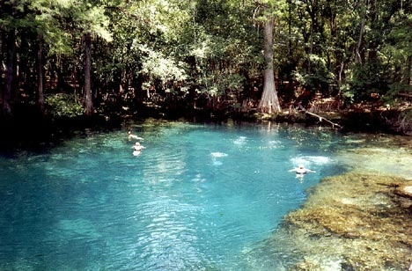
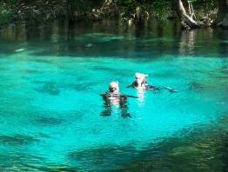

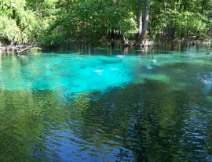
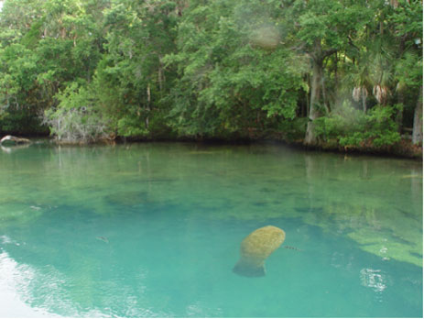
Poe Spring
Manatee
Ginnie
Homosassa
Juniper
http://www.underwaterflorida.homestead.com/springs.html
Notes:
I refer you to the link at the bottom. It is a virtual compendium of the major and minor springs around the state. Please visit this site. People come from all over the world to explore the springs of florida.

Slide 28
Summary
The Floridan Aquifer is under confined conditions
The water-bearing unit is marked by dissolution cavities
Dissolved limestone caves and cavities create karst conditions
Karst is characterized by depressions, sinkholes, lakes, springs
Subsidence and collapse sinkholes produce numerous lakes
Lakes often maintain hydrologic connection with the underlying
limestone and can function in recharge for the aquifer
Much of the recharge occurs at higher elevations leading
to a generalized movement of groundwater to lower elevations
Water under pressure at lower elevations can discharge at
the surface as springs, particularly when confinement is thin

Slide 29
Next
Florida Lakes: Features and Types
Florida has more natural lakes than any other state in the southeast

