Slide 1
Florida Groundwater and Hydrogeology

Slide 2
Groundwater provides 98% of all available freshwater
Total Water Withdrawals
21%
62%
United States
Florida
Surface Water
Groundwater
More than 90% of Florida’s drinking water is from groundwater
Notes:
Now remember that groundwater accounts for about 99% of all available freshwater. And although the rest of the country is not as heavily reliant on groundwater, approximately 62% of all water with drawn in Florida is from groundwater sources. Currently, more than 90% of Florida's drinking water is from groundwater sources. Some estimates put this figure at almost 95%.

Slide 3
Florida’s Groundwater

Slide 4
The Florida Platform
-300 ft
The edge is defined as where the water depth is at 300 feet.
100 miles west of Tampa
3-5 miles east of Miami
30-40 miles east of St. Augustine
Notes:
What we perceive as the state of Florida today is only the emergent portion of a much larger platform that extends more than 100 miles to the west and up to 50 or 60 miles to the northeast. The edge of this platform is defined as where the water depth is greater than 300 ft. This edge is sharply delineated dropping off to a depth exceeding 10,000 ft is some regions.

Slide 5
Origins of the Florida Platform
Precambian 4.6 Bya to 570 Mya
Paleozoic 570 Mya to 248 Mya
Mesozoic 248 Mya to 65 Mya
Cenozoic 65 Mya to present
(Earth formation, cooling, oceans, atmosphere, life, oxygen)
Notes:
5

Slide 6
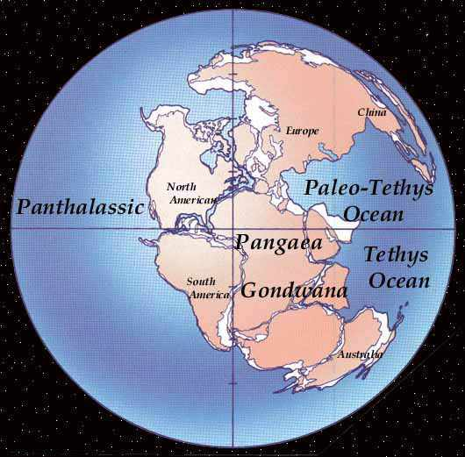
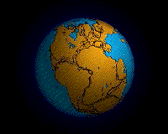
Approximately 250 million years ago
Notes:
at the beginning of the mnesozoic the landforms on earth existed as a super continent called Pangaea. Eventually this supercontinent broke up and as the earth's plates moved formed the individual continents we see today.

Slide 7
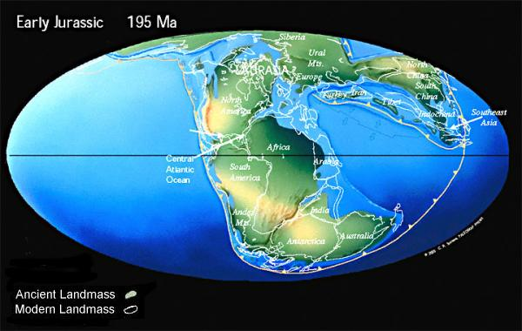
Breakup of Pangaea
Late Triassic, early Jurassic ~200Mya
- 250 Mya
Rifting phase: Creation of the Atlantic Ocean
Notes:
This breakup was fully underway by the late Triassic, early Jurrasic about 200 million years ago. We are particularly interested in the movement of the North American continent away from the African and South American continents which will eventually create the Atlantic Ocean. and the basin in which the state of florida will emerge.

Slide 8
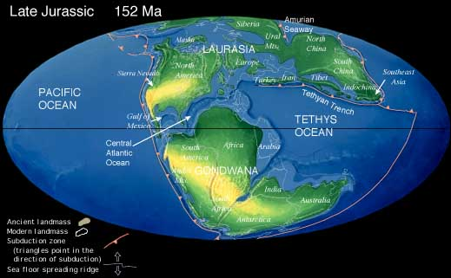
Approximately 150 million years ago
Stable, shallow sea floor
Subject to marine sedimentation
Late Jurassic
Sedimentation: settling
of particles from a fluid
due to gravity
For the next several million years
the area was dominated by
carbonate sedimentation
Notes:
By 150 million years ago rifting and separation between North America and regions to the southeast were complete and the incipient atlantic ocean is formed. What is interesting is that as N. America moved away from Africa, it apparentlly tore loose a fragment of the african continent that will form the basis for future development of the florida Platform. Examination of the rocks underlying the state strongly indicates a compositional similarity between Florida's basement geology and that of the african continent.
So imagine that as the N. American continent migrates toward the Northwest it is dragging a small submerged portion of africa with it. This small remnant of the africann continent forms a stable plateau upon which a variety of sedimentary events will occur for the next several million years. The dominant type of sedimentation is Carbonate sedimentation.

Slide 9
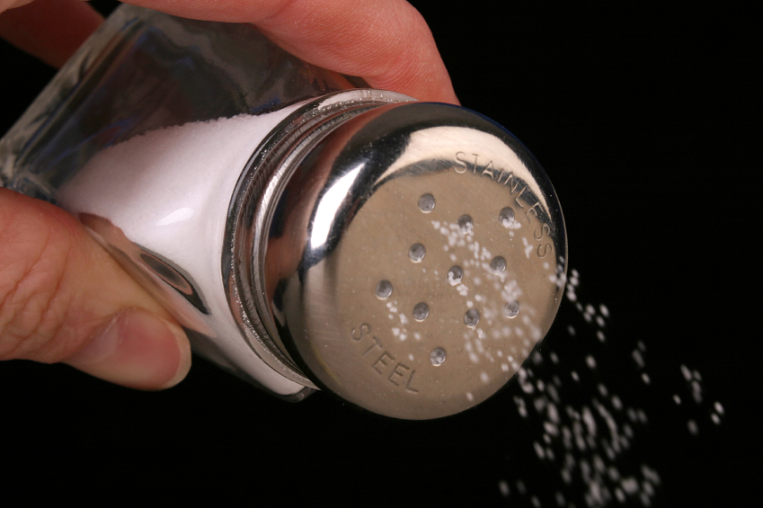
Dissolving Salt in Water
NaCl
Ions: stable forms of
the elements that
obtain charge by
gaining or losing
electrons.
KCl solubility
In water = 280 g/L
CaSO₄ solubility
In water = 2.4 g/L
Na⁺
Cl⁻
Cl⁻
Na⁺
NaCl solubility
In water = 350 g/L
Notes:
To understand sedimentation, we need to recall how salts exist in water. Recall that in our dissucssion of ocean salinity we indicated thtat salts dissolve in water to varying degrees and exist as ions in solution. so for example, if we dissolve simple talbe salt or sodium chloride in water, it exists as the constituent ions, sodium and chloride in water.

Slide 10
Precipitation and Sedimentation
The opposite of dissolution is precipitation
Ions in solution come together to make a solid
+ charge ion
Solid
- charge ion
Notes:
Now, the opposite of dissolution is precipitation. In this case ions already in solution come together to form solids. So for example if we have a positively charged and a negatively chared ion in solution, under the appropriate circumstances, these two oppositely charged ions can come together to form a solid.

Slide 11
Ocean Salts
Chloride
Sodium
Cl⁻
Na⁺
Carbonate
Potassium
CO₃⁻²
Calcium
K⁺
Ca⁺²
Magnesium
Mg²⁺
Sulfate
SO₄⁻²
Notes:
Consider the ionic compostion of oceanic waters. The dominant ions are chloride, sodium, with varing amounts of virtually every other ion known including, for example, potassium, magnesiium and sulfate.
And as we indiccated earlier, there are small amounts of calcium and carbonate.
In the present case, we are particularly interested in calcium and carbonate.

Slide 12
Precipitation and Carbonate Platforms
Chloride
Sodium
Cl⁻
Na⁺
Carbonate
Calcium
CO₃⁻²
Ca⁺²
solid
Ca²⁺ + CO₃²⁻ = CaCO₃
Sulfate
Calcium and carbonate are at near saturation levels in oceans
(amounts are close to a threshold for precipitation)
SO₄⁻²
Notes:
In the present case we are particularly intereasted in calcium and carbonate. Calcium is a cation with two positive charges and carbonate is an anion with two negative charges. Tjherrefore, it is not unreasonable to expect that under the right conditions the two could combine to form an uncharged solid compound called calcium carbonate. Despite hte low percentages of calcium and carbonate in ocean waters relative to chloride and sodium hte amounts of calcium and carbonate are very close to the threshold for precipitation. In other word, the ocean is essentially saturated with rrespect to these two ions.

Slide 13
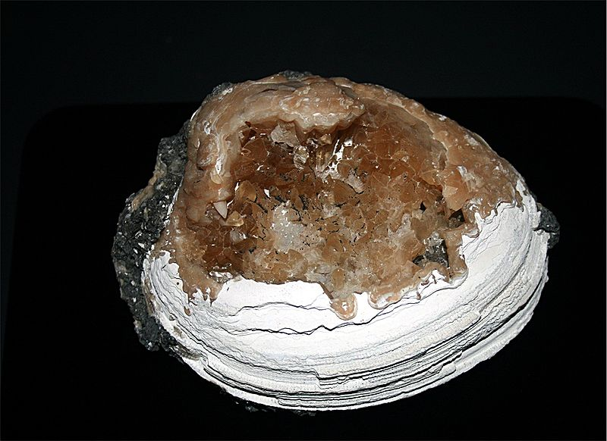
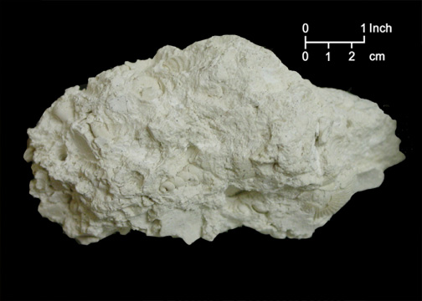
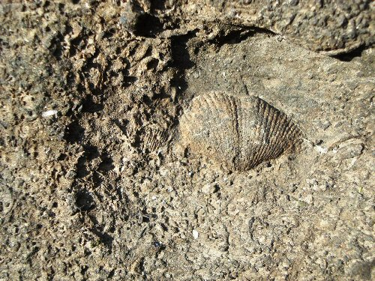
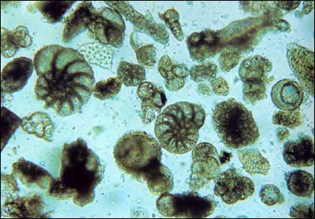
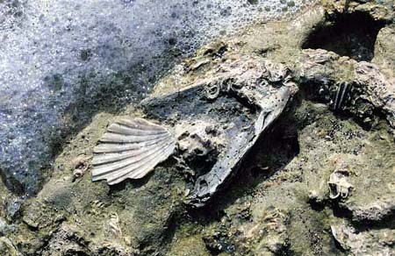
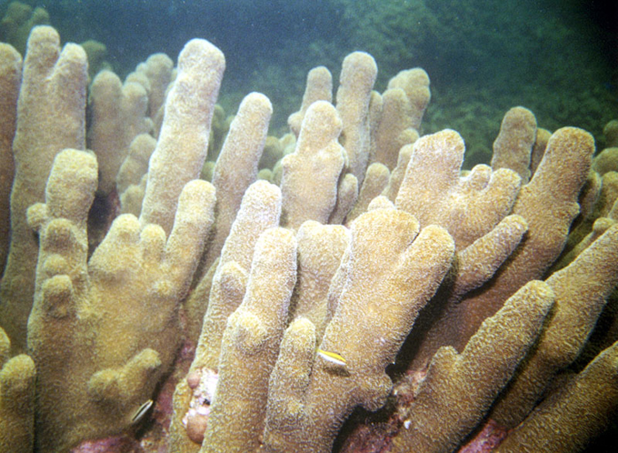
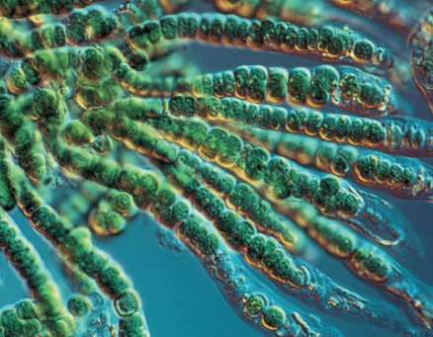
Carbonate Deposition/Sedimentation
Marine Calcium and
Magnesium Carbonate
Foraminifera
CaCO₃
MgCO₃
Mollusks
Algae
Corals
Notes:
Some precipitation of calcium carbonate occurs spontaneously based on their concentrations in water as well as other factors like temperature and pH. However, the majority of calcium carbonate precipitation is driven by biological processes like those we discussed earlier with respect to rivers and oceans.
organisms (such as corals and mollusks and even certain algae can exploit carbonate dissolved in seawater to build their calcium containing exoskeletons. Thus they live and die over millions of years they can develop vast carbonate structues that as they alter over time can produce what we call limestone which is in essence extensive deposits of calcium and magnisiumm carbonate.
hard reef structures. Biotically induced precipitation takes place outside the cell of the organism, thus carbonate is not directly produced by organisms, but precipitates because of their metabolism. Abiotic precipitation involves little or no biological influence.
Foraminifera typically produce a test, or shell, which can have either one or multiple chambers, some becoming quite elaborate in structure.[2] These shells are made of calcium carbonate (CaCO3)
The mineralogic composition of carbonate platforms may be either calcitic or aragonitic. Seawater is oversaturated in carbonate, so under certain conditions CaCO3 precipitation is possible. Carbonate precipitation is thermodynamically favoured at high temperature and low pressure. Three types of carbonate precipitation are possible: biotically controlled, biotically induced and abiotic. Carbonate precipitation is biotically controlled when

Slide 14
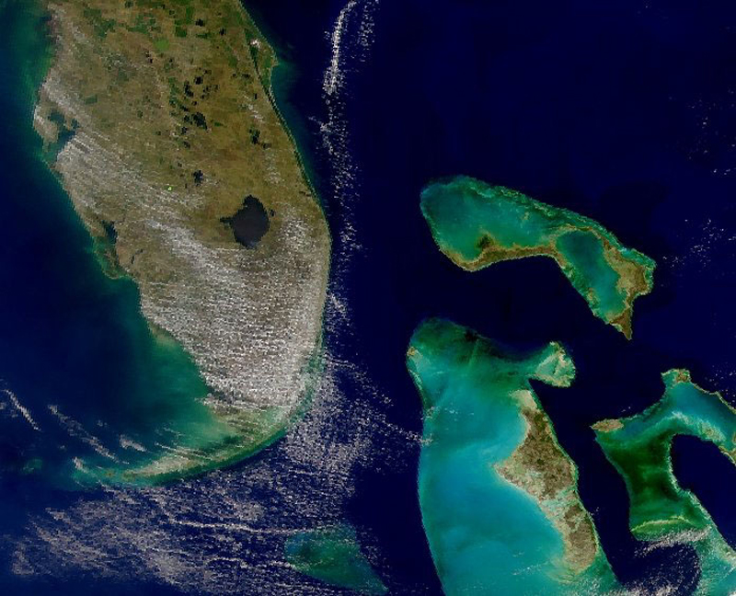
Calcification requires:
Warm, shallow water, sunlight
Notes:
Calcification is thermodynamically favored at high temperature and low pressure. So, a shallow plateau like that created by the separation of the N. American plate from africa is ideal for facilitating extensive calcification. Sunlight helps too. Some organisms can exploit photosynthesis as a means of accelerrating hte building of carbonate exoskeletons.

Slide 15
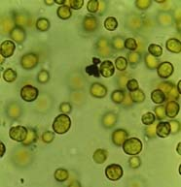
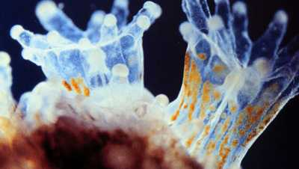
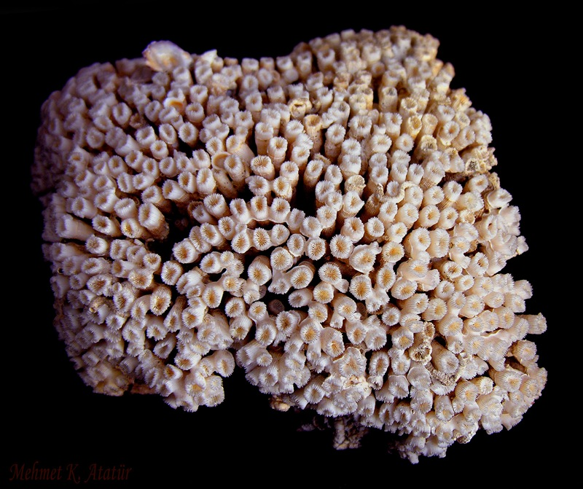
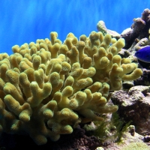
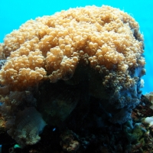
zooxantellae
Hermatypic Corals
Symbiosis
Symbiosis promotes
Calcium precipitation
Photosynthetic:
Consumes CO₂
Precipitated CaCO₃
Coral polyp
Notes:
Sopme of he most prolific reef builders and carbonate generators are corals, particularly those who live in symbiosis with photosynthetic algae called zooxanthalle.Zooxanthallae live in the tissues of the coral. The corals and algae have a mutualistic relationship. The coral provides the algae with a protected environment and compounds they need for photosynthesis. In return, the algae produce oxygen and help the coral to remove wastes. Most importantly, zooxanthellae supply the coral with glucose, glycerol, and amino acids, which are the products of photosynthesis. The coral uses these products to make proteins, fats, and carbohydrates, and produce calcium carbonate
Zooxanthellae also promote calcification by removing carbon dioxide during photosynthesis. Carbon dioxide in high concentrations can prevent the precipitation of calcium carbonate. Under optimum conditions, this enhanced calcification builds the reef faster than it can be eroded by physical or biological factors.

Slide 16
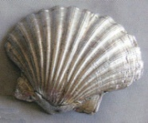
Between about 150 Mya and 25 Mya
Between about 150 Mya and 25 Mya
Florida platform was a flooded, submarine
plateau dominated by carbonate deposition
CaCO₃
Sea level
Changes
Present
Sea level
FL platform
150
Time: millions of years ago
25
Notes:
Now, let's go back to the time after the formation of our rocky plateau following the breakup of Pangaea. If we exame sea levels relative to present levels we notice that between about 150 million year ago and 25 milliion years ago sea levels were generally high and the plateau was shallowly submerged creating optimal conditions for carbonate sedimentation.

Slide 17
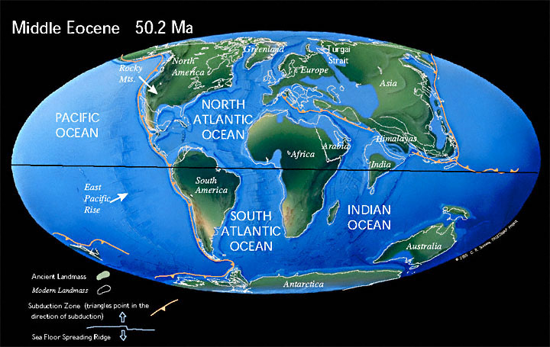
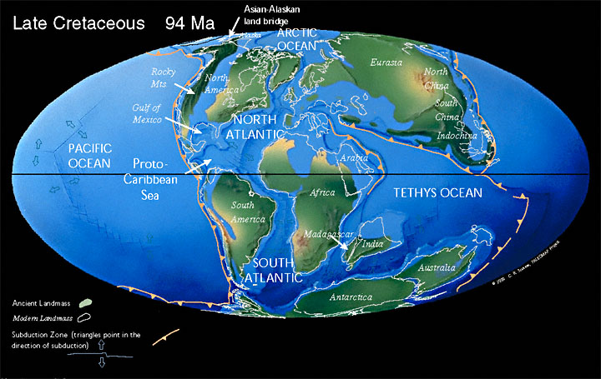
*

Slide 18
The Eocene and Oligocene Limestone
The Eocene and Oligocene limestone forms the
principal fresh water-bearing unit of the Floridan Aquifer,
one of the most productive aquifer systems in the world
Eocene: 55 – 34 million years ago
Oligocene: 34 – 24 million years ago
Notes:
Now this time beginning about 50 million years ago is of particular and practical importance to us as Floridians. It is during this period between about 55 million years and 24 million years during the eocene and oligocene that the depostion of the principal water bearing unit of the Floridan Aquifer occurs. This is the limestone from which we derive the majority of our freshwater resources.

Slide 19
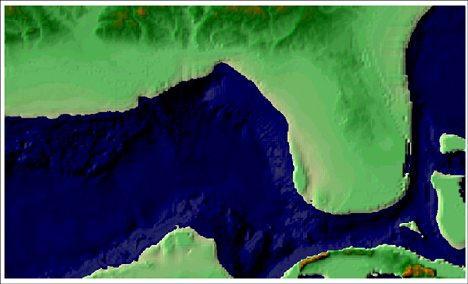
Extensive Carbonate Platform
*
Millions of years, miles thick
Notes:
So basically, we live on the emerrgbent portion of a vast carbonate platform that formed over millions of years and is miles thick. These carbonates extend to the west throughout the gulf coastal plain and to the north along the southeast coastal plain. They also include the Bahamas and other regions of the Carribean.

Slide 20
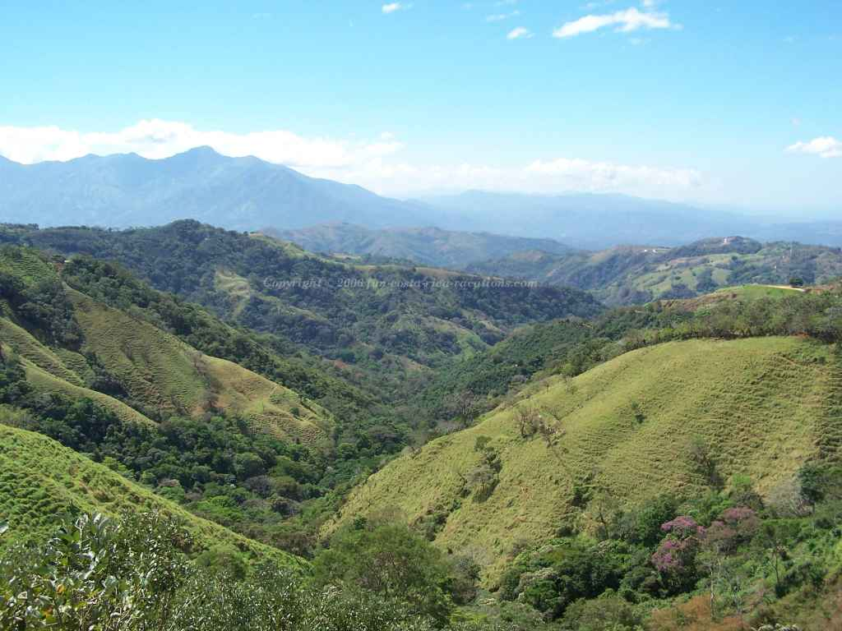
Continental Influences
Notes:
Now we have discussed the long slow buildup of carbonates that dominate the florida platform and comprise much of the water bearing formation for our major aquifer system. However we have not considered continental influences. On the N. American continent, mountain ranges are rising, erosion is occurring, and sediments are moving. Why did they not significantly alter and influence the depostionoal histiory of the platform for these many millions of years.

Slide 21
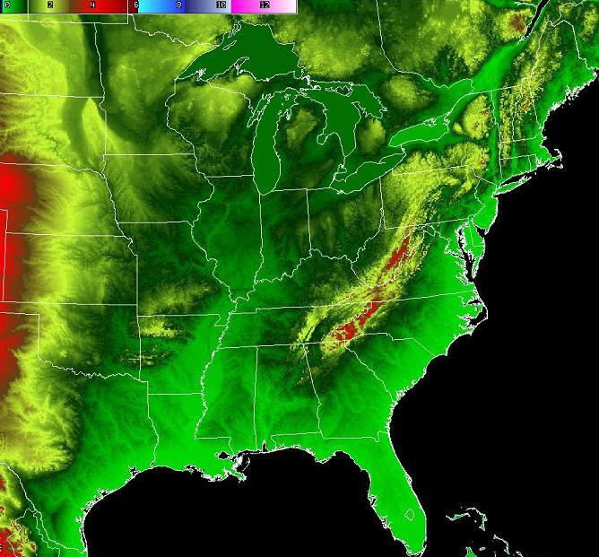
Sedimentation on the Florida Peninsula
Sediments
Notes:
Consider this image. Yellows and reds indicate high elevations and greens low elevations. It is logical to conclude that erosion of various landforms to the north woudl crreate enormous amounts of sediments that would tend to move from high toward low elevations carried by rivers and longshore currents. These sediments just as logically should be found intermixed in large quantities with the carbonates that are forming at the same time. But this is generally not the case.

Slide 22
Isolation of the Florida Platform
Sandy, Clayey Sediments
Georgia Channel
Suwannee Current
Notes:
22
The later evolution of the Florida landscape and especially its karsification has had much to do with the tremendous climatic changes that took place during Cenozoic time. The Oligocene marked the beginning of a world wide cooling trend in the climate with the onset of a major glaciation in Antarctica. Later these glaciers will cover Greenland and eventually, in the Pliocene and Pleistocene will spread across North America and Europe and grow on mountain chains such as the Appalachians, Rockies, Alps and the Himalayas.

Slide 23
Isolation of the peninsula from continental
influences allowed carbonates to build
on the platform for 125 million years
Fundamental change came approximately 25 million years ago

Slide 24
Events of the Late Oligocene Epoch, approximately 25 Mya
Raising of the Florida Platform
Lowering of Sea Levels, Interruption of Suwannee Current
Suwannee Current
+100 ft
Notes:
In the late oligocene, the platform esxperienced a broad, generallized uplift, bringing the entire formatioin closer to sea level. The Oligocene also marked the beginning of a world wide cooling trend in the climate with the onset of a major glaciation in Antarctica. Later these glaciers covered Greenland and eventually, in the Pliocene and Pleistocene will spread across North America and Europe.
With cooling came a decline in sea levels and eventually an interruption of the suwannee current..

Slide 25
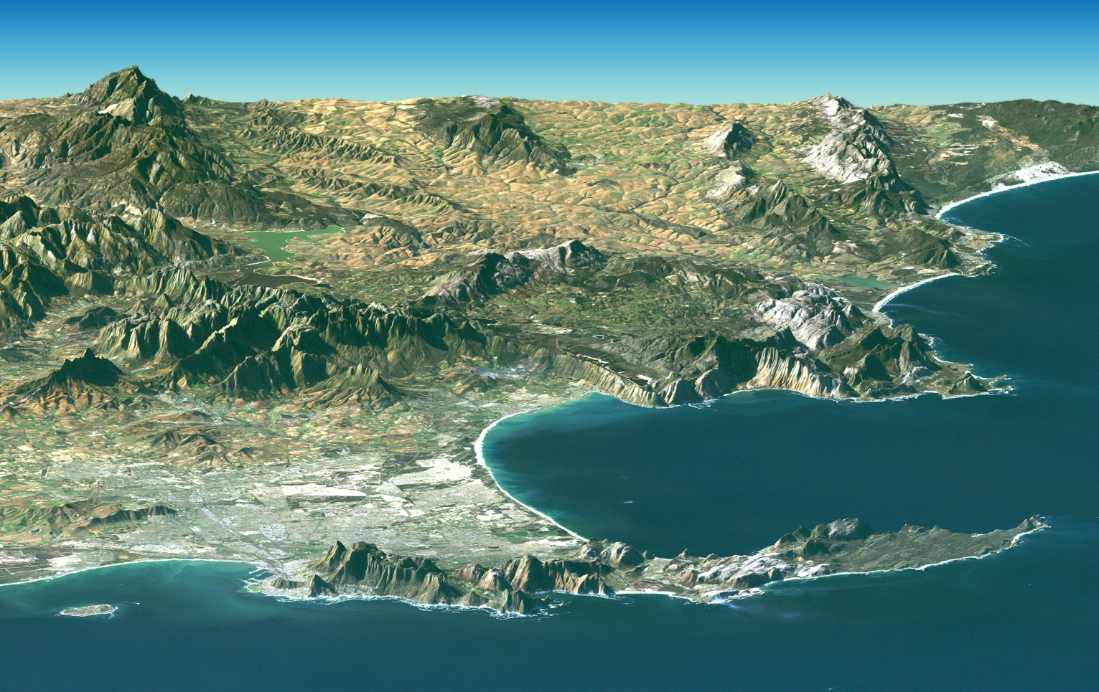
Rejuvenation of Appalachians, increased sediment load
sediments
Miocene Epoch: beginning approximately 24 Mya
Notes:
At the same time relatively speaking, the applacians experienced a renewed uplift. This rejuvenation of the Appalacians would produce an enormous amount of sediment, which again, would tend to move downhill toward the florida platform.

Slide 26
These Sediments were Silicon-based Sands,
Silts, Clays, Rocks, and Rock Fragments
KAlSi₃O₈
CaAl₂Si₂O₈
NaAlSi₃O₈
MgSiO₄
KAl₃Si₃O₁₀
Feldspars
Olivine
Muscovite
They are typically called “siliciclastics”
Notes:
26
Sands on beaches and shorelines can be divided according to their compositions into two major groups. One is the carbonate sands, sands made of particles of CaCO3 (calcium carbonate). The other is commonly called the "siliciclastic sands", where "silici-" refers to a chemical composition rich in silicate material and "-clastic" refers to the origin of the grains as clasts or fragments of silicate rocks.

Slide 27
Filling in the Georgia Channel
Sandy, Clayey Sediments
Georgia Channel
Suwannee Current
Notes:
27
So lets revisit our general premise. Prior to the miocene about 25 millionn yeras ago, siliciclastic sediments from the continent were prevented from reaching hte florida platform by the georgia channel and the suwannee current. However, with the interruptino of the suwannee current due to lower sea levels, these sediments now fill in the georgia channel and it ceases to exist.
The later evolution of the Florida landscape and especially its karsification has had much to do with the tremendous climatic changes that took place during Cenozoic time. The Oligocene marked the beginning of a world wide cooling trend in the climate with the onset of a major glaciation in Antarctica. Later these glaciers will cover Greenland and eventually, in the Pliocene and Pleistocene will spread across North America and Europe and grow on mountain chains such as the Appalachians, Rockies, Alps and the Himalayas.

Slide 28
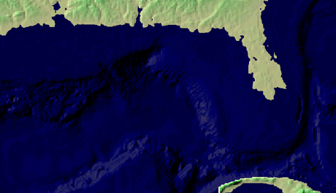
Sediments
Rising sea levels allow sediments to become
suspended in water and drift over the platform
Notes:
Withoyut the Ga. Channel and the suwaannee current, sediments can now move on to the florida platform. Later when sea levels rise again, these sediments become widely suspended in the shallow waters and drift over the full extent of the florida platform.

Slide 29
Sandy, Clayey Sediments
These sediments confine the water in the limestone
Commonly referred to as the Hawthorne Formation

Slide 30
Summary
Deposition of Eocene/Oligocene Limestone (55 – 24 Mya)
Raising of the Florida platform
Lowering of sea levels, interruption of the Suwannee Current
Infilling of the Georgia Channel with sediments derived from
Appalachian/continental erosion
Sea level rise, lack of Suwannee current.
Suspended siliciclastic sediments settle over the peninsula
These sediments blanket the underlying limestone forming
the upper confining layer for the Floridan Aquifer.

Slide 31
Basic Florida Geology
Sands
Confining
unit
sands, silts, clays, rock
Limestone
Water-bearing
unit
Miocene deposits are siliciclastic: sands, silts, clays, rocks
These deposits are known commonly as the Hawthorne Formation.
They overlie the Eocene and Oligocene limestone deposits and
form the upper confining unit for the Floridan Aquifer.
Notes:
Remember that confined aquifers have water bearing units sandwiched between two low permeabilty confining layers. For the Floridan the water bearing unit is the eocene and oligocene limestone. It is confined below by impermeable rock and it is confined above by miocene siliciclastics typically sands and clays which are poorly permeable to water. The miocene material, or the Hawthorne formation, is overlain to varying degrees by later sedimentary events and reworking and weathering of existing materials during the pliocene and pleistocene.
Keep in mind htat this image is highly generalized. It is mostly inaccurate, but for the present conceptually acceptable. The thickness of the hawthorne varies enormously as does the overlying sandy material. This will have important implications for the various landscape types in florida as well as the hydrology of the state that we will discuss next time.

