Slide 1
Non-Renewable Groundwater Resources
Notes:
In our last lecture we discussed briefly hte use of non-renewable ground water resources by a number of nations. Included in that discussion was the overuse of renewable sources. I would like to take a few moments to discuss these matters a little more fully.

Slide 2
Non-Renewable Groundwater Resources
Groundwater resources are never strictly non-renewable.
In cases where present-day aquifer replenishment is very limited but aquifer storage is very large, the groundwater resource can be termed non-renewable
Climate Changes
Time for Replenishment
Notes:
Groundwater resources are never strictly non-renewable. The simply may not be subject to contemporary recharge. In certain cases the period needed for replenishment (100s or 1000s of years) is very long in relation to the normal time-frame of human activity in general and of water resources planning in particular.

Slide 3
“Fossil” Aquifers
Non-renewable aquifers are often described as “fossil” aquifers.
These are aquifers with no appreciable modern recharge.
Groundwater is isolated from modern recharge
Contemporary climate does not support sufficient recharge
Most often found in arid climates. Fossil and other non-renewable
Aquifers are an important water resource for many nations.
Nubian Sandstone aquifer underlying Chad, Egypt Libya and Sudan.
Qa-Disi aquifer between Jordan and Saudi Arabia
Great Artesian Basin of Australia
Notes:
We earlier mentioned Fossil aquifers. By definition, fossil aquifers cannot be utilized sustainably as any withdrawal eventually will exhaust the resource.
Such aquifers generally contain ground water that is trapped in a geologic formation, either because of physical isolation of the aquifer from sources of recharge, or paucity of recharge in an arid region.
Typically, water in non-renewable aquifers is hundreds if not thousands of years old.

Slide 4
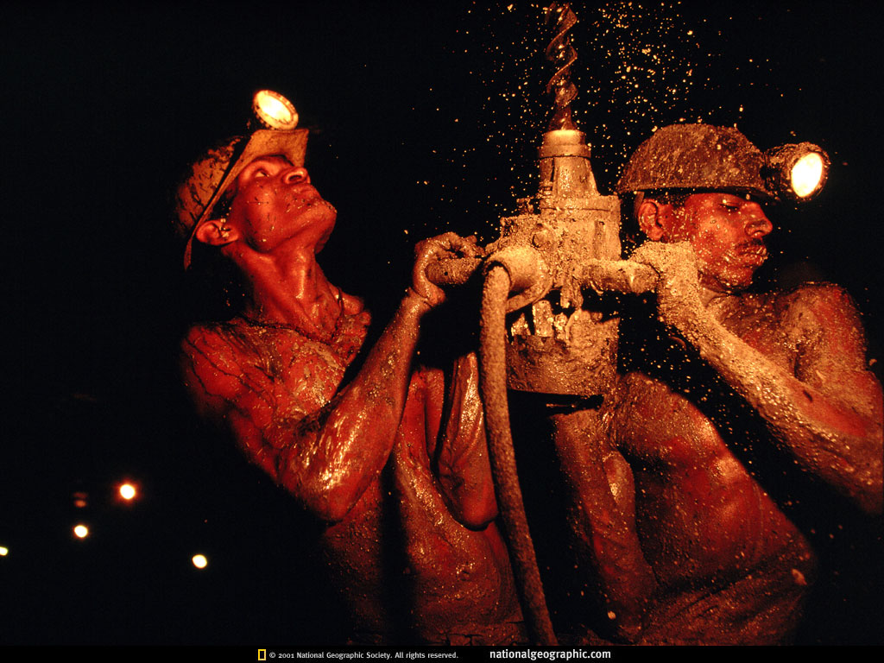
Water Mining
China
India
Iran
Israel
Jordan
Mexico
Morocco
Pakistan
Saudi Arabia
South Korea
Spain
Syria
Tunisia
United States
Yemen
Over-exploitation of renewable
and non-renewable aquifers
Withdrawals exceed recharge
creating deficits in the aquifer
Lack of contemporary recharge
Notes:
4
For fossil aquifers, such as the vast U.S. Ogallala aquifer, the deep aquifer under the North China Plain, or the Saudi aquifer, depletion brings pumping to an end. Farmers who lose their irrigation water have the option of returning to lower-yield dryland farming if rainfall permits. In more arid regions, however, such as in the southwestern United States or the Middle East, the loss of irrigation water means the end of agriculture.

Slide 5
The Middle East
 | GROUNDWATER . (Mm³/yr)
COUNTRY | Total use | % Non-renewable
Saudi Arabia | 21,000 | 84%
Bahrain | 258 | 35%
Egypt | 4,850 | 18%
Jordan | 486 | 35%
Libya | 4,280 | 70%
Yemen | 2,200 | 32%
Saudi Arabia and Libya, use 77% of the estimated total world extraction
of non-renewable groundwater for urban supply and irrigated agriculture.
Notes:
5
We see these types of trends particularly in the middle east where groundwater is not subjecft to appreciable contemporary recharge. As an example, Saudi Arabia and Libya,use 77% of the estimated total world extraction of non-renewable groundwater. In both these cases non-renewable groundwater represents an important or predominant source of water-supply (84% in Saudi Arabia and 70% in Libya), and is used for urban water-supply and for irrigated agriculture.

Slide 6
Other Large Deficits
India
China
Pakistan
½ the world’s
total use of
groundwater
for agriculture
1 foot
Area = 1 acre
Pumping: 325 million acre feet
Recharge: 205 million acre feet
Deficit: 120 million acre feet
1 acre-foot = 325,851 gallons
Notes:
6
Other large deficdits occur in india, china and pakistan where current pumping exceeds recharge by more than 120 million acre feet. An acre foot is a volume equivalent to one acre in area by one foot deep and is equal to more thatn 325 thousand gallons. This brings the total dificit to 3.9 times 10 to thte 12th gallons.or about 4 trillionn gallons.

Slide 7
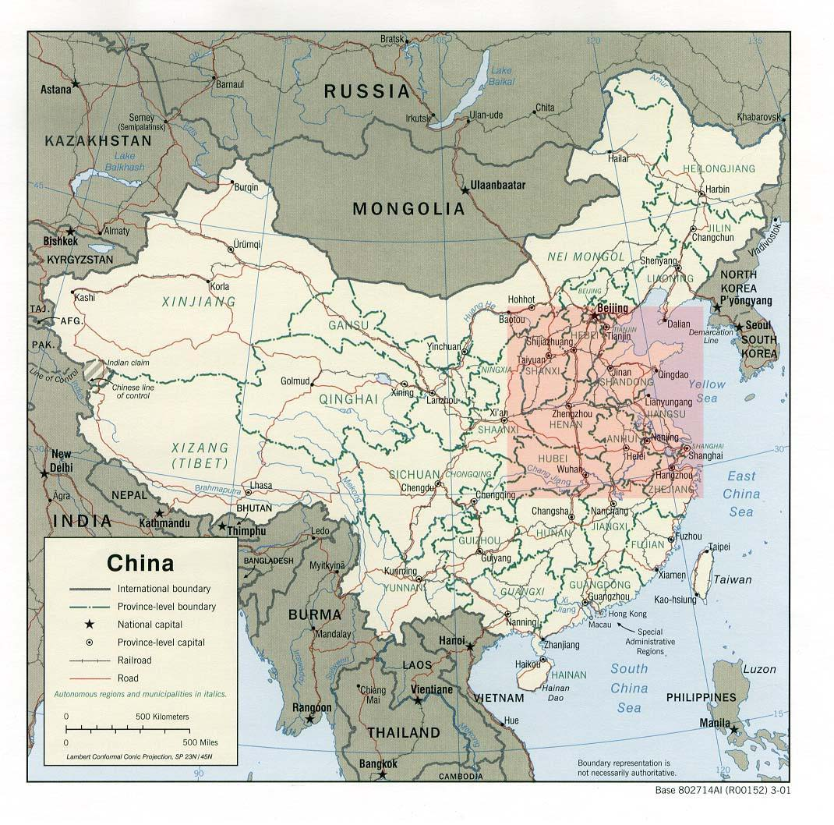
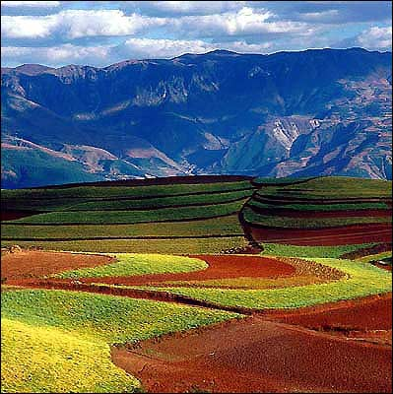
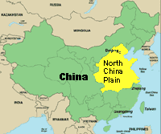
Shallow , unconfined
aquifer depleted
Deficit feeds 100 million people
Level of the deep aquifer is dropping nearly 3 meters (10 feet) per year
Deep wells must reach more than half a mile to tap fresh water
Notes:
7
The situations in china and india are particulaly distressing mostly because of the extremely rapid growth rates in these countries. Economic growht is broadly expanding both industry and as well as middle class lifestyles which tend to use far greater amounts of water. As we mentioned earlier, developed countries like the US and Canada consume perhaps 10 times more water per capita than the rest of the world on average. As economic growth continues in the developing nations, percapita water use will begin to approach that of the US.“Anecdotal evidence suggests that deep wells [drilled] around Beijing now have to reach 1,000 meters [more than half a mile] to tap fresh water, adding dramatically to the cost of supply.” The world bank foresees “catastrophic consequences for future generations” unless water use and supply can quickly be brought back into balance

Slide 8
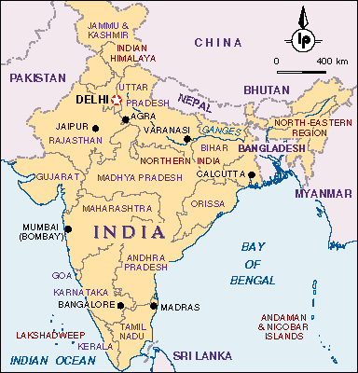
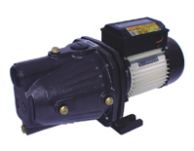
India
Deficit of 80 million acre-feet
Deficit feeds 200 million
Failure of 246 surface
irrigation projects
21 million wells
$600 electric pumps
(1% of GDP)
95 %
water table falling by 20 feet per year
Notes:
8
The situation in india is similar. Currenly, india is runnign a deficit of appproximatly 80 million acre feet of water, but this defict is feeding approxiamately 200 milliion people. The situation was caused in part by the faliure of a number of surface water projects including irrigation projects. This led to the drilling of some 21 million wells around the country. Most of these are small backyard tube wells that are operated by hand or by small, inexpensive electric pumps. At one time the commerce in these types of pumps accounted for 1% of indias GDP. The result is falling water tables throughout the country.
In Tamil Nadu, a state with more than 62 million people in southern India, wells are going dry almost everywhere., falling water tables have dried up 95 percent of the wells owned by small farmers, reducing the irrigated area in the state by half over the last decade.
As water tables fall, well drillers are using modified oil-drilling technology to reach water, going as deep as 1,000 meters in some locations. In communities where underground water sources have dried up entirely, all agriculture is rain-fed and drinking water is trucked in.

Slide 9
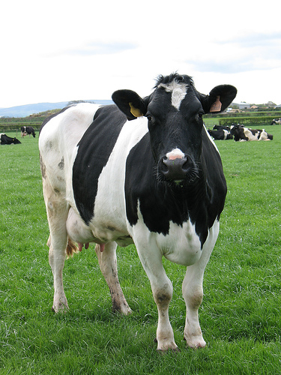
5 acres of land
Pumps 3200 gallons/hr
Irrigates alfalfa for 64 hours
24 times per year
4.9 million gallons water/yr
Yield: 6.5 gallons milk/day
4.9 million gallons => 2400 gallons milk
(2000 gallons water/ gallon milk)

Slide 10
Groundwater and Aquifer Fundamentals
Notes:
So as i indicated this type of prodigality with respect to wter use is wide spread throughout the country and is resulting in falling water tables nation wide.
However to understand on a more technical level exactly what is occurring around the world with respect to groundwater use, we need a fundamental understanding of aquifer types, their use and their limitations.

Slide 11
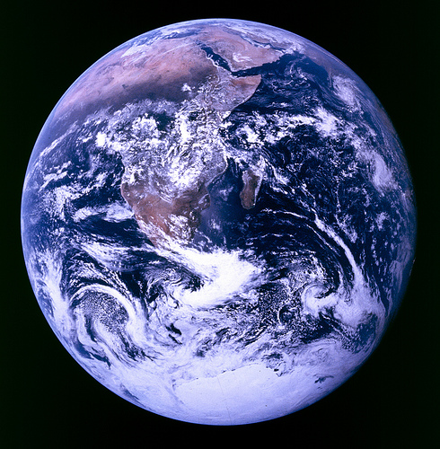
3% of total
Earth water
Freshwater
Glaciers
Atmosphere
Groundwater
Lakes
Soils
Rivers
Wetlands

Slide 12
Aquifers/Groundwater
99% of all readily available freshwater
Supplies ½ of the drinking water in U.S.
and >90% of the drinking water in FL.

Slide 13
Aquifers
Aqua – water
Ferre – to carry
Water-bearing formation that
can store and release usable
amounts of water.

Slide 14
Where is Groundwater?
Water found in pore spaces, seams
cracks, and fractures in geologic
material or soils beneath the surface
of the earth
Sands
Silts
Gravels
Muds
Clays
Rock
Water-bearing
Unit materials

Slide 15
Aquifers and Aquifer Types

Slide 16
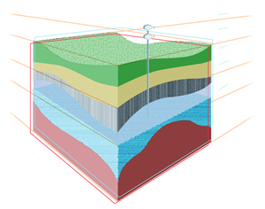
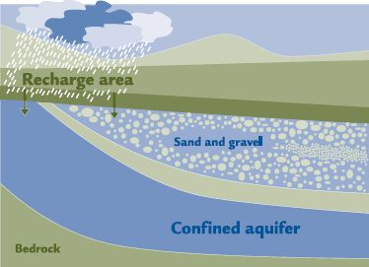
Aquifer Classification
Unconsolidated
Consolidated
Confined
Unconfined

Slide 17
Unconsolidated Aquifers

Slide 18
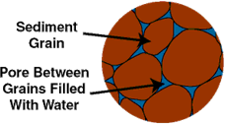
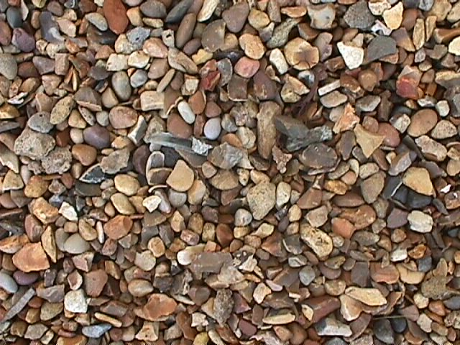
Basic Aquifer Classification
Unconsolidated Aquifers
Individual particles: granular sand, gravel, clays, silts
Water held in pore spaces between grains
of sand, gravel, clays, or rock fragments
Notes:
18
Aquifers occur in either consolidated or unconsolidated ground formations. Consolidated aquifers hold water in the cracks of solid rock, and the amount of water available depends upon the size and number of cracks. Unconsolidated aquifers hold water in a mixture of sand and gravel. The Snake River aquifer in southern Idaho is an example of a consolidated aquifer, and the Rathdrum aquifer in northern Idaho is an example of an unconsolidated aquifer.

Slide 19
Unconsolidated Water-Bearing Unit
Generally high-yield aquifers

Slide 20
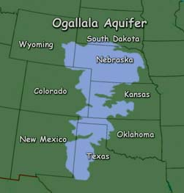
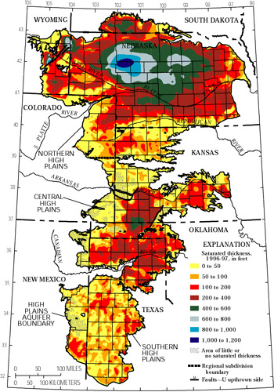
Unconsolidated: sand, gravel, and rock fragments
Coarse, sedimentary rocks
saturated thickness ranges from
a few feet to more than 1000 feet
thick
174,000 mi²
thin
High Plains Aquifer
27 percent of the irrigated land in the
United States overlies this aquifer and
yields about 30 percent of the nation's
ground water used for irrigation
Aquifer material dates back 2 to 6 million years
Erosion of the Rockies provided sediment that filled ancient channels
Notes:
20
unconsolidated, poorly sorted clay, silt, sand, and gravel with groundwater filling the spaces between grains below the water table. The Ogallala was laid down about 10 million years ago by fluvial deposition from streams that flowed eastward from the Rocky Mountains during the Pliocene epoch.* Erosion has removed the deposits The deposition of the aquifer material dates back 2 to 6 million years to late Miocene to early Pliocene age when the southern Rocky Mountains were still tectonically active. From the uplands to the west, rivers and streams cut channels in a generally west to east or southeast direction. Erosion of the Rockies provided alluvial and aeolian sediment that filled the ancient channels and eventually covered the entire area of the present-day aquifer, forming the water-bearing Ogallala Formation. The depth of the formation varies with the shape of the pre-Ogallala surface, being deepest where it fills ancient valleys and channels. The Ogallala Formation consists mostly of coarse sedimentary rocks in its lower sections, which grade upward into finer-grained The water-permeated thickness of the Ogallala Formation ranges from a few feet to more than 1000 feet (300 m) and is generally greater in the northern plains.[4] The depth of the water below the surface of the land ranges from almost 400 feet (122 m) in parts of the north to between 100 to 200 feet (30 to 61 m) throughout much of the south. Present-day recharge of the aquifer with fresh water occurs at a slow rate; this implies that much of the water in its pore spaces is paleowater, dating back to the last ice age.
The deposition of the aquifer material dates back to late Miocene to early Pliocene age when the Rocky Mountains were being uplifted. As the land to the west rose, rivers and streams cut channels in a generally west to east or southeast direction. Erosion of the Rockies provided alluvial and eolian sediment that filled the ancient channels and eventually covered the entire area of the present-day aquifer, forming the water-bearing Ogallala Formation. The depth of the formation varies with the shape of the pre-Ogallala surface, being deepest where it fills ancient valleys and channels. The Ogallala Formation consists mostly of coarse sedimentary rocks in its lower sections, which grade upward into finer-grained lithologies.[1]
The water-permeated thickness of the Ogallala Formation ranges from a few feet to more than 525 feet (160 m) and is generally greater in the northern plains. The depth of the water below the surface of the land ranges from almost 400 feet (122 m) in parts of the north to between 100 to 200 feet (30 to 61 m) throughout much of the south. Present-day recharge of the aquifer with fresh water occurs at a slow rate; this implies that much of the water in its pore spaces is paleowater, dating back to the last ice age.
The saturated thickness of the Ogallala Formation ranges from a few feet to more than 525 feet (160 m). In general, the areas of greatest saturated thickness occur in the North Plains. In the South Plains, between Lubbock and Midland, the saturated zone varies from less than 50 feet (15 m) to 200 feet (61 m). Depth to water below the land surface can range from almost 400 feet (122 m) in parts of the North Plains to between 100 to 200 feet (30 to 61 m) throughout much of the South Plains.

Slide 21
Consolidated Aquifers

Slide 22
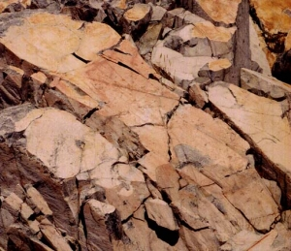
Consolidated Aquifers
Sandstone, limestone, granite
Water held in cracks, fissures, erosion
cavities and seams in solid rock formations.
Notes:
For a consolidated aquifer, we are generally describing a water bearing formation found in solid rock. For example, sandstone, granite or limestone. Many of the fossil aquifers found in the middle ease are consolidated sandstone aquifers. Recall the Nubian Sandstone aquifer which underlies lybia and Chad. In a consolidated aquifer, water is not held between individual particles, but in cracks, cavities and seams in the solid rock formation.

Slide 23
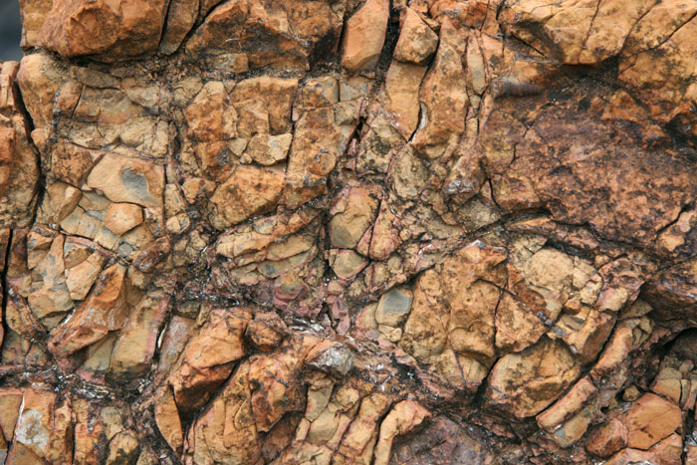
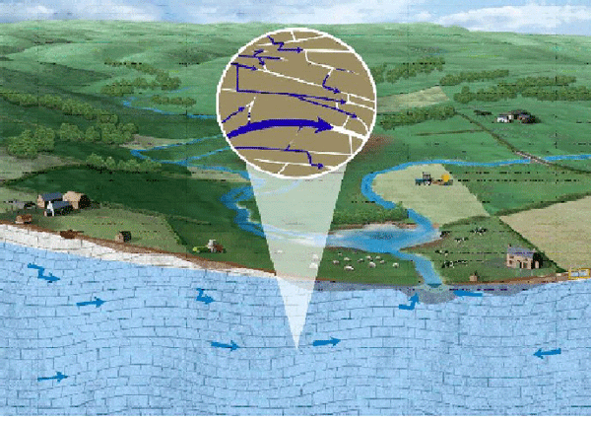
Water-Bearing Unit
Consolidated Rock: igneous or sedimentary
Notes:
So this might represent a consolidated water bearinbg unit. The water would be held in contiguous cracks and seams in the rock material. On a landscape scale, vast amounts of water can be stored in this manner.

Slide 24
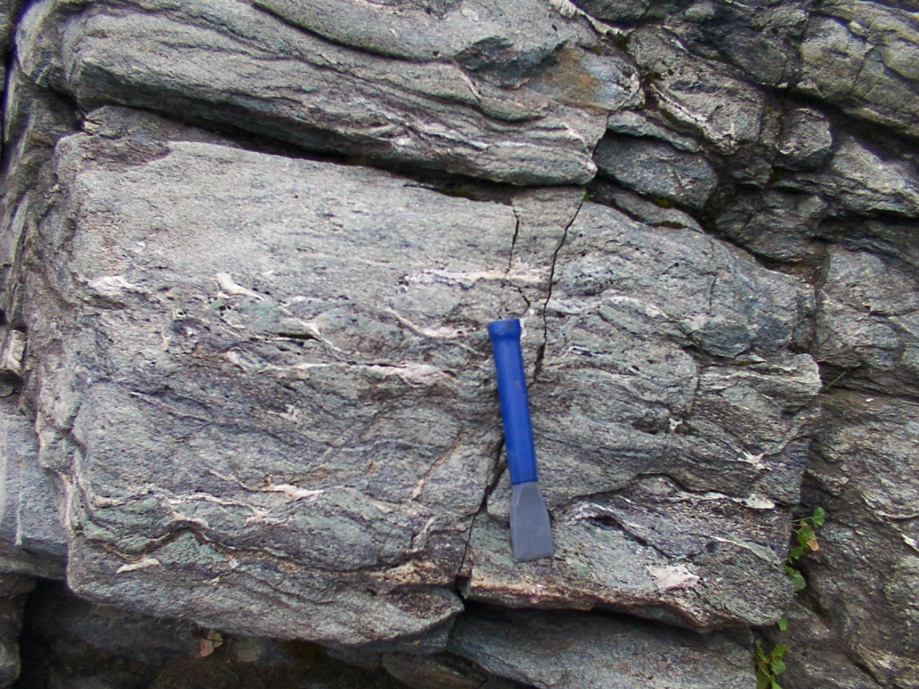
Consolidated Aquifers
Igneous Rocks
Rocks formed from the cooling and solidification
of molten magma originating in the earth's core
Extrusive rock is formed when the solidification process
occurs at or near the ground surface. These rocks are
generally very permeable because of the "bubbling"
of gases escaping during cooling and solidification.
horizontal fracturing
Granite
The Columbia River Plateau covering eastern Washington
and Oregon, and Idaho, averages about 500 m in thickness
and is one of the largest basalt deposits in the world. Basalt
aquifers are critically important water sources for the Hawaiian
Islands.
Notes:
24
Notice the cracks and seams in this igneous rock formation.

Slide 25
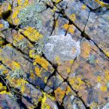
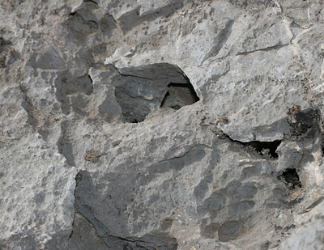
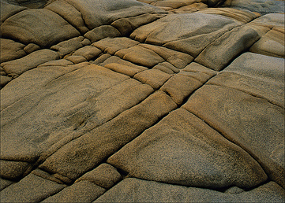
Consolidated Rock Aquifers
Sedimentary
Sandstone and Carbonate
Sandstone is a cemented form of sand and gravel
Carbonate formations include limestone (CaCO₃) and dolomite (MgCO₃)
Exhibit mostly secondary porosity due to fracturing and dissolution openings
cavity
sandstone
limestone
Notes:
We can also hold usable quantities of water in sedimentary formations both in fractures and seams, but also in dissolution openings that form cavities to hold water like we see in many limestone formations. Limestone is a relatively soft rock that is subject to dissolution by naturally occruing acids creating in some cases enormously large cavities which form the water bearing capacity of the overall formation.

Slide 26
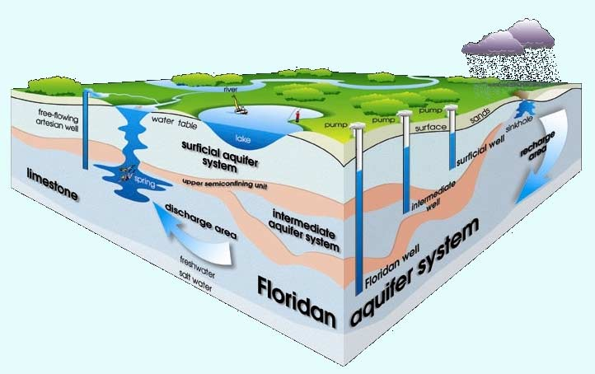
Florida’s Principal Aquifer is Consolidated Limestone
Calcium and Magnesium Carbonate

Slide 27
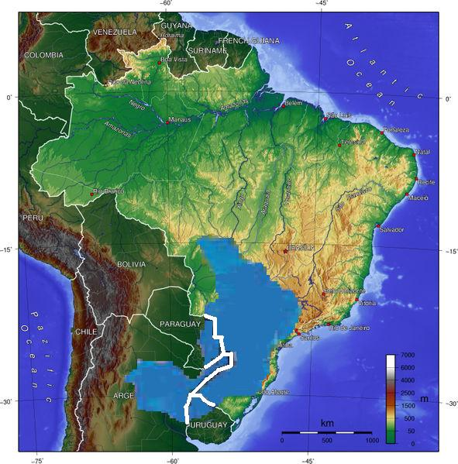
Consolidated Aquifers: Guaraní Aquifer
Sedimented sandstones deposited during the Triassic and Jurassic periods
Thickness: 50 m to 800 m
37,000 km³ of water
5% of world population
fresh drinking water for 200 years
overlaid with igneous
basalt with low-permeability
Slowly Recharged
(166 km³/year)
Transboundary Aquifer: Argentina, Brazil, Paraguay and Uruguay
Notes:
27
The Guaraní Aquifer, located beneath the surface of (Argentina, Brazil, Paraguay and Uruguay), It is one of the world's largest aquifer systems ]. Named after the Guaraní tribe, it covers 1,200,000 km², with a volume of about 40,000 km³,. Its thickness is between 50 m and 800 m and a maximum depth of about 1,800 m. It is estimated to contain about 37,000 km³ of water (arguably the largest single body of groundwater in the world), It is renuable with a total recharge rate of about 166 km³/year from precipitation. It is said that that this vast underground reservoir could suppy fresh drinking water to the world for 200 years. Due to an expected shortage of fresh water on a global scale, which environmentalists suggest will become critical in under 20 years, this important natural resource is rapidly becoming politicized, and the control of the resource becomes ever more controversial.
The Guaraní Aquifer consists primarily of sedimented sandstones deposited by fluvial and eolian processes during the Triassic and Jurassic periods (between 200 and 130 million years ago), with over 90% of the total area overlaid with igneous basalt of a low-permeability, deposited during the Cretacous period, acting as an aquitard and providing a high degree of containment. This greatly reduces the rate of infiltration

Slide 28
Confined and Unconfined Aquifers

Slide 29
Unconfined Aquifers
Sometimes called “surficial” aquifers
Open to the surface, but confined at
greater depth by low-permeability material
Low permeability – slow water movement
High permeability – rapid water movement

Slide 30
Unconfined Aquifer
Water
Groundwater table
High
Permeability
Saturated Zone
Low Permeability
Geologic or Soil material
Saturated Zone thickness dependent on rainfall

Slide 31
Unconfined or Surficial Aquifer
Impermeable

Slide 32
Confined Aquifers
A generally inclined, water-bearing formation
located between impermeable layers
of clay, rock, or shale.
Impermeable, confining layer
Water Bearing Unit
Impermeable confining layer

Slide 33
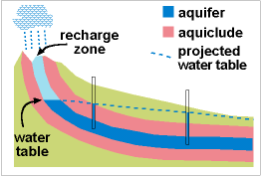
Water-bearing unit is confined between two layers of
material that are not permeable to water (confining units).
Confining units
(aquicludes)
Water-bearing unit (consolidated or unconsolidated)

Slide 34
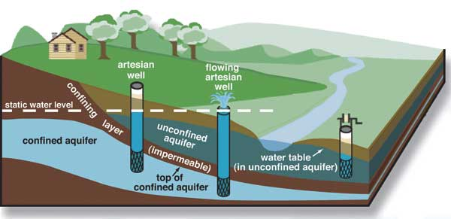
Confined Flow and Artesian Wells
Recharge
Flow
Water-bearing unit
Impermeable material
High Pressure

Slide 35
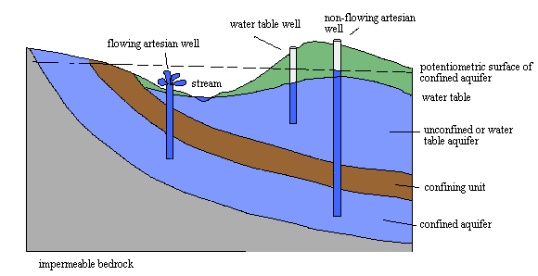
Confined and Unconfined
Recharge
Recharge
Water-bearing unit
impermeable
Water-bearing unit
impermeable

Slide 36
Unconfined aquifer (surficial aquifer)
Open to the surface, but confined at greater
depth by low-permeability material
Recharge is generally by rainfall and surface water bodies
Confined aquifer
Water-bearing unit is confined between two layers of
material that are not permeable to water (confining units).
Recharge is in areas where the upper confining unit is thin or absent
Water-bearing units: sands, gravel, silts, clays, porous or fractured rock

Slide 37
Florida’s Principal Aquifer is a confined,
consolidated limestone formation.

Slide 38
Florida’s main aquifer was formed
between 50 and 25 million years ago

Slide 39
Next: Florida’s Groundwater

