Slide 1
Origins of Ocean Salts

Slide 2
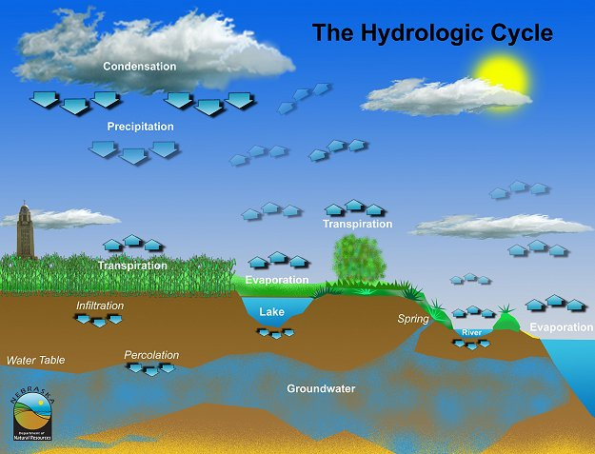
10%
90% of rainfall is on the oceans
Notes:
So far, we have considered the largest portion of the hydrologic cycle, the oceans, particularly with respect to their integrative effect on climate and heat distribution on earth. We’ve also discussed precipitation and rainfall and it’s causes. Remember that 90% of surface evaporation comes from the ocean and in turn about 90% of all precipitation returns to the oceans. This leaves only 10% that reaches the land. We’ll now begin to examine what happens to precipitation that strikes land in the form of fresh water; specifically, rivers, lakes, soil water, and groundwater.

Slide 3
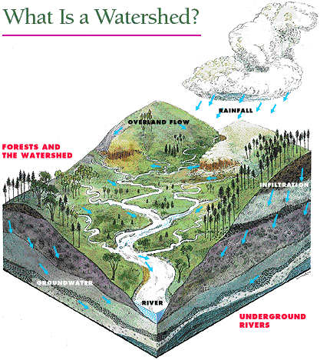
Watershed
Total land area that drains surface water to a common point.
River basin
Drainage basin
Catchment
Rain that falls anywhere within a given body of water's watershed or basin will eventually drain into that body of water.
Notes:
Recall that a watershed is the total land area that drains water to a common point. Thus, in terms of freshwater resources, the watershed encompasses all of the available freshwater reservoirs and the exchange of freshwater between them.

Slide 4
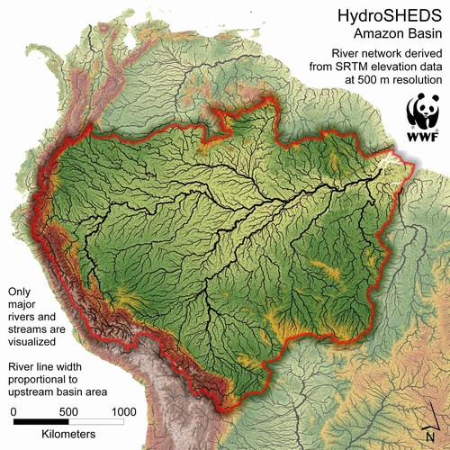
Amazon
Watershed
Atlantic

Slide 5
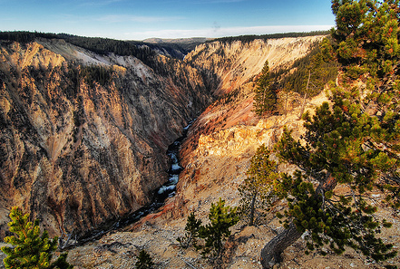
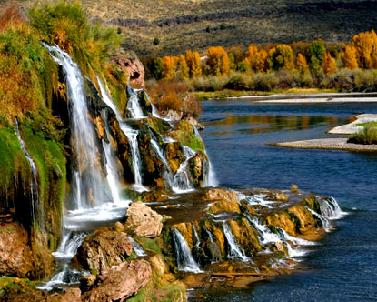
Watersheds, Erosion and Dissolution
rain
rain
salts
salts
Dissolution of salts; erosion of rocks and minerals

Slide 6
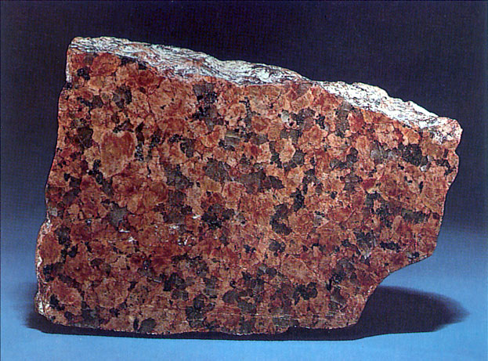
Minerals and Erosion
Feldspars
KAlSi₃O₈
CaAl₂Si₂O₈
NaAlSi₃O₈
KAlSi₃O₈
CaAl₂Si₂O₈
NaAlSi₃O₈
water
water
K⁺, Ca²⁺, Na⁺, Si⁴⁺
water
granite
Dissolved in water

Slide 7
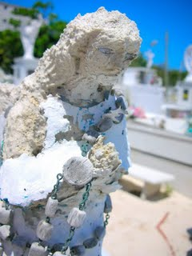
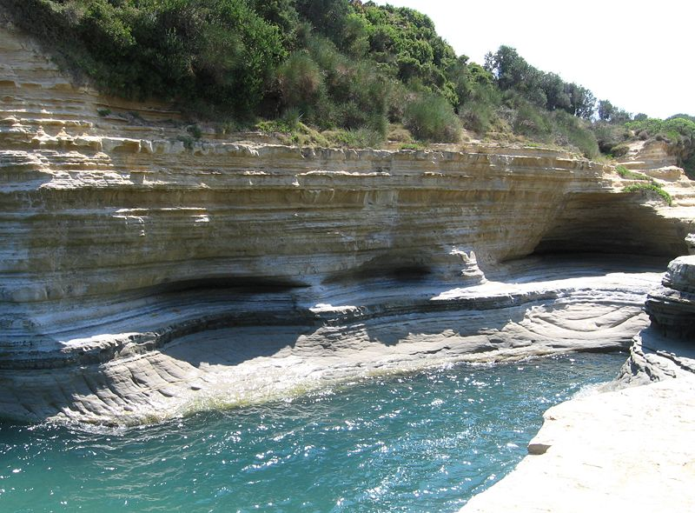

Slide 8
Dissolved Salts and Minerals
KAlSi₃O₈
CaAl₂Si₂O₈
NaAlSi₃O₈
KCl
NaCl
MgCl₂
CaCO₃
CaSO₄
Rivers contain small amounts of dissolved salts that are delivered to the oceans

Slide 9
Amazon
Watershed
Atlantic
K
Na
Mg
Cl
Ca
CO₃
Ca
SO₄
Si

Slide 10
Total Salts
Rivers < 500 mg/L
Oceans 35,000 mg/L
If rivers have low salt contents and they
are delivering salts to the oceans, why do
oceans have such high salt contents?

Slide 11
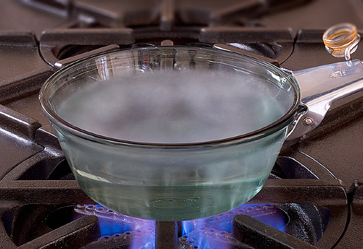
evaporation
Salts left behind
The primary factor leading to ocean salinity.

Slide 12
Salts are delivered to the oceans in small amounts
Evaporation removes water from the
oceans, but leaves the salts behind.
Rainfall on land dissolves more salts, which
are subsequently delivered to the oceans

Slide 13
What kind of Salts?

Slide 14
River Salt Composition
Ion
Carbonate
Calcium
Sulfate
Silicate
Chloride
Sodium
Magnesium
Potassium
River Water
35.15
20.39
12.14
11.67
5.68
5.79
3.41
2.12
KCl
NaCl
MgCl₂
CaCO₃
CaSO₄
KAlSi₃O₈
CaAl₂Si₂O₈
NaAlSi₃O₈
Dominated by Carbonate, Calcium, Sulfate, and Silicate

Slide 15
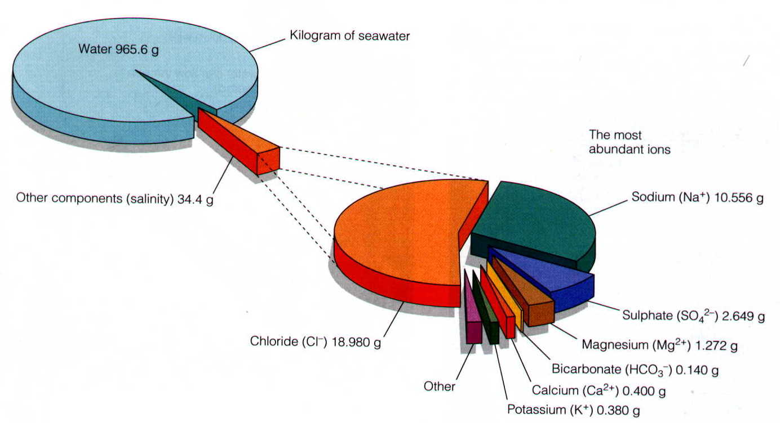
Ocean Salt Composition
Ion
Chloride
Sodium
Sulfate
Magnesium
Calcium
Potassium
Carbonate
Silicate
Sea Water (%)
55.04
30.62
7.68
3.69
1.15
1.10
0.40
.0004
Cl⁻
Na⁺
Na⁺ and Cl⁻
(85% of total)
Dominated by Chloride and Sodium
Notes:
In the beginning the primeval seas must have been only slightly salty. But ever since the first rains descended upon the young Earth hundreds of millions of years ago and ran over the land breaking up rocks and transporting their minerals to the seas, the ocean has become saltier. It is estimated that the rivers and streams flowing from the United States alone discharge 225 million tons of dissolved solids and 513 million tons of suspended sediment annually to the sea. Recent calculations show yields of dissolved solids from other land masses that range from about 6 tons per square mile for Australia to about 120 tons per square mile for Europe. Throughout the world, rivers carry an estimated 4 billion tons of dissolved salts to the ocean annually. About the same tonnage of salt from the ocean water probably is deposited as sediment on the ocean bottom, and thus, yearly gains may offset yearly losses. In other words, the oceans today probably have a balanced salt input and outgo.
Past accumulations of dissolved and suspended solids in the sea do not explain completely why the ocean is salty. Salts become concentrated in the sea because the Sun's heat distills or vaporizes almost pure water from the surface of the sea and leaves the salts behind. This process is part of the continual exchange of water between the Earth and the atmosphere that is called the hydrologic cycle. Water vapor rises from the ocean surface and is carried landward by the winds. When the vapor collides with a colder mass of air, it condenses (changes from a gas to a liquid) and falls to Earth as rain. The rain runs off into streams which in turn transport water to the ocean. Evaporation from both the land and the ocean again causes water to return to the atmosphere as vapor and the cycle starts anew. The ocean, then, is not fresh like river water because of the huge accumulation of salts by evaporation and the contribution of raw salts from the land. In fact, since the first rainfall, the seas have become saltier.

Slide 16
Percentage of Total Dissolved Minerals
Ion
Carbonate
Calcium
Silicate
Sulfate
Chloride
Sodium
Magnesium
Potassium
River Water
35.15
20.39
11.67
12.14
5.68
5.79
3.41
2.12
Sea Water
.40
1.15
.0004
7.68
55.04
30.62
3.69
1.10
}
79%
}
85%

Slide 17
Alterations
Enrich Chloride and Sodium
in ocean water
Remove Silica, Calcium, Carbonate
from river water
Notes:
No known biological process removes sodium from the sea. Therefore, it is very abundant in sea water. Certain constituents in sea water, such as calcium, magnesium, bicarbonate, and silica, are partly taken out of solution by biological organisms, chemical precipitation, or physical-chemical reactions Part of the explanation is the role played by marine life -- animals and plants -- in ocean water's composition. Sea water is not simply a solution of salts and dissolved gases unaffected by living organisms in the sea. Mollusks (oysters, clams, and mussels, for example) extract calcium from the sea to build their shells and skeletons. Foraminifers (very small one-celled sea animals) and crustaceans (such as crabs, shrimp, lobsters, and barnacles) likewise take out large amounts of calcium salts to build their bodies. Coral reefs, common in warm tropical seas, consist mostly of limestone (calcium carbonate) formed over millions of years from the skeletons of billions of small corals and other sea animals. Plankton (tiny floating animal and plant life) also exerts control on the composition of sea water. Diatoms, members of the plankton community, require silica to form their shells and they draw heavily on the ocean's silica for this purpose

Slide 18
Enriching Sodium and Chloride
Solubility: ease of salt dissolution in water
sodium, potassium, and ammonium salts are soluble
chloride, bromide and iodide salts are soluble.
Once these types of ions reach the oceans they stay dissolved
NaCl Solubility 350 g/L
Notes:
350 g/L = 0.75 lb/L

Slide 19
Ion
Chloride
Sodium
Sulfate
Magnesium
Calcium
Potassium
Carbonate
Silicate
Sea Water (%)
55.04
30.62
7.68
3.69
1.15
1.10
0.40
.0004
Both chloride salts and sodium salts are
extremely soluble in water and do not
combine with other elements to form solids

Slide 20
Alterations
Enrich Chloride and Sodium
in ocean water
Remove Silica, Calcium, Carbonate
from river water
Notes:
No known biological process removes sodium from the sea. Therefore, it is very abundant in sea water. Certain constituents in sea water, such as calcium, magnesium, bicarbonate, and silica, are partly taken out of solution by biological organisms, chemical precipitation, or physical-chemical reactions Part of the explanation is the role played by marine life -- animals and plants -- in ocean water's composition. Sea water is not simply a solution of salts and dissolved gases unaffected by living organisms in the sea. Mollusks (oysters, clams, and mussels, for example) extract calcium from the sea to build their shells and skeletons. Foraminifers (very small one-celled sea animals) and crustaceans (such as crabs, shrimp, lobsters, and barnacles) likewise take out large amounts of calcium salts to build their bodies. Coral reefs, common in warm tropical seas, consist mostly of limestone (calcium carbonate) formed over millions of years from the skeletons of billions of small corals and other sea animals. Plankton (tiny floating animal and plant life) also exerts control on the composition of sea water. Diatoms, members of the plankton community, require silica to form their shells and they draw heavily on the ocean's silica for this purpose

Slide 21
Precipitation and Carbonate Removal
Chloride
Sodium
Cl⁻
Na⁺
Carbonate
Calcium
CO₃⁻²
Ca⁺²
solid
Ca²⁺ + CO₃²⁻ = CaCO₃
Sulfate
Calcium and carbonate are at near saturation levels in oceans
(amounts are close to a threshold for precipitation)
SO₄⁻²

Slide 22
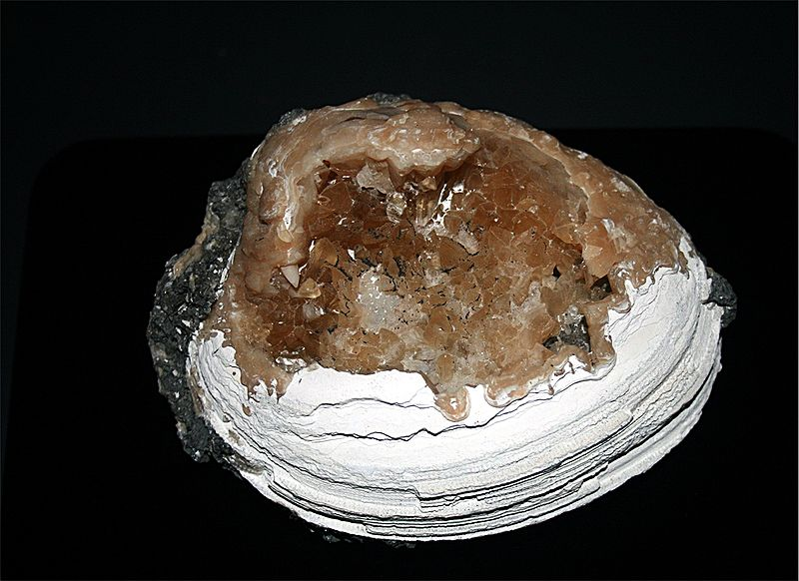
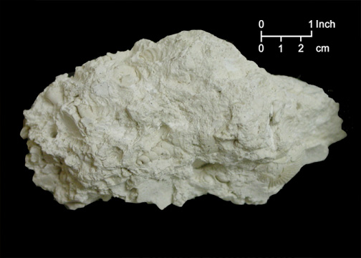
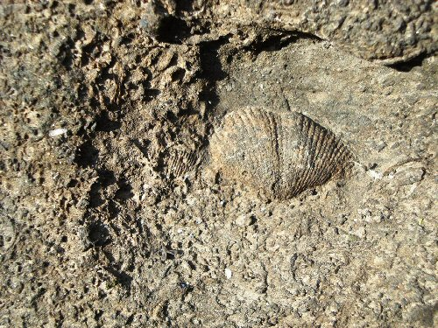
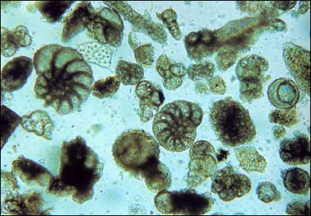
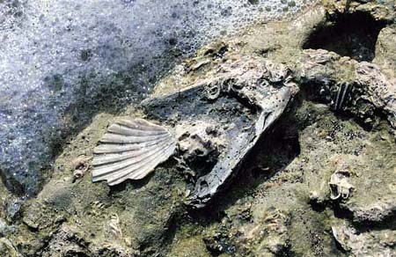
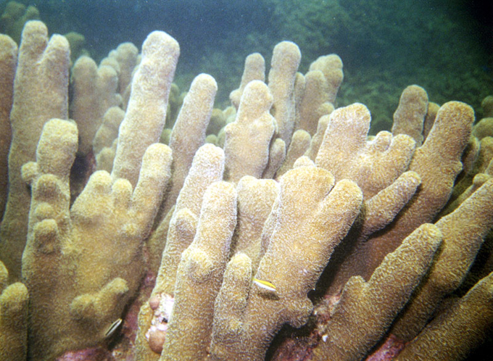
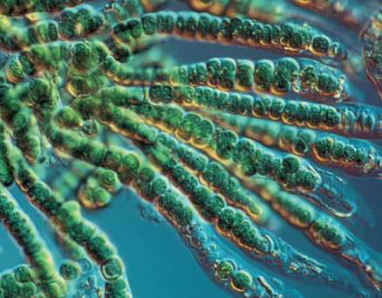
Carbonate Deposition/Sedimentation
Marine Calcium and
Magnesium Carbonate
Foraminifera
CaCO₃
MgCO₃
Mollusks
Algae
Corals
Notes:
The mineralogic composition of carbonate platforms may be either calcitic or aragonitic. Seawater is oversaturated in carbonate, so under certain conditions CaCO3 precipitation is possible. Carbonate precipitation is thermodynamically favoured at high temperature and low pressure. Three types of carbonate precipitation are possible: biotically controlled, biotically induced and abiotic. Carbonate precipitation is biotically controlled when organisms (such as corals) are present that exploit carbonate dissolved in seawater to build their calcitic or aragonitic skeletons. Thus they may develop hard reef structures. Biotically induced precipitation takes place outside the cell of the organism, thus carbonate is not directly produced by organisms, but precipitates because of their metabolism. Abiotic precipitation involves little or no biological influence.
Foraminifera typically produce a test, or shell, which can have either one or multiple chambers, some becoming quite elaborate in structure.[2] These shells are made of calcium carbonate (CaCO3)

Slide 23
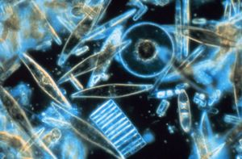
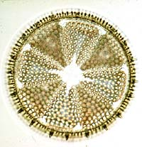
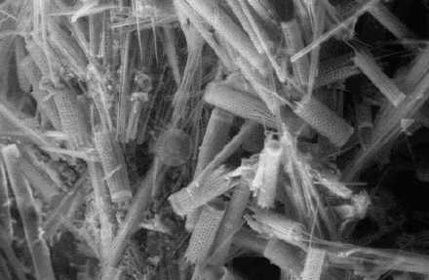
Life and Silica
Remove Silica, Calcium, Carbonate
Diatoms
Use silica as structural material
Notes:
Diatoms (Gr. dia 'through'; tomos 'cutting', i.e., "cut in half") are a major group of eukaryotic algae, and are one of the most common types of phytoplankton. Most diatoms are unicellular, although some form chains or simple colonies. A characteristic feature of diatom cells is that they are encased within a unique cell wall made of silica. These walls show a wide diversity in form, some quite beautiful and ornate, but usually consist of two symmetrical sides with a split between them, hence the group name.
Diatoms in both fresh and salt water extract silica from the water to use as a component of their cell walls (“test”, “shell”). Likewise, some holoplanktonic protozoa (Radiolaria), some sponges, and some plants (leaf phytoliths) use silicon as a structural material.
The richest sources of diatom fossils are deposits of their skeletons known as diatomite, or diatomaceous earth. This mineral was formed as ancient diatoms died and settled to the bottom of lakes or oceans. Today, they form large deposits of white chalky material, which is mined for use in cleansers, paints, filtering agents, and abrasives. Many toothpastes contain bits of fossil diatoms. The Bacillariophyta are the diatoms. With their exquisitely beautiful silica shells

Slide 24
Percentage of Total Dissolved Minerals
Ion
Carbonate
Calcium
Silicate
Chloride
Sodium
Magnesium
Potassium
Sulfate
River Water
35.15
20.39
11.67
5.68
5.79
3.41
2.12
12.14
Sea Water
.40
1.15
.0004
55.04
30.62
3.69
1.10
7.68

Slide 25
Next: Saltwater to Freshwater

