Slide 1
Ocean Fundamentals

Slide 2
Percentage of total earth water = 97%
Volume: 316 million cubic miles
388 billion billion gallons

Slide 3
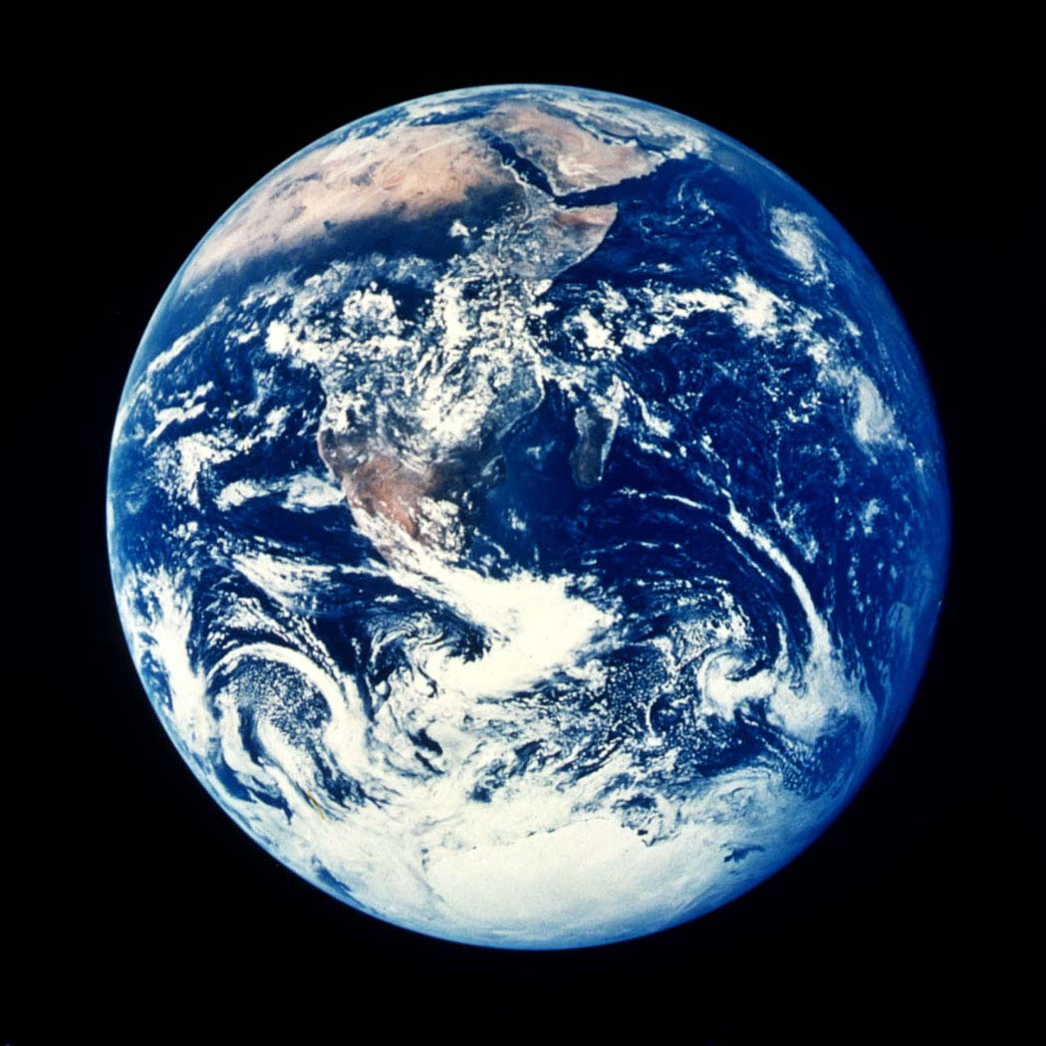
6000 feet deep
( > 1mile)
Notes:
If all the water in the oceans were spread evenly over the surface of the earth, it would be 6,000 feet deep everywhere. 1/4000 inch thick

Slide 4
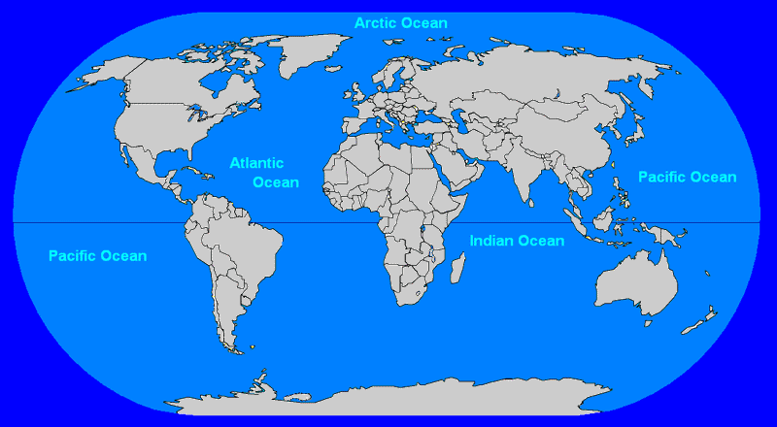
The Oceans of the World
Southern Ocean
International Hydrographic Organization, 2000

Slide 5
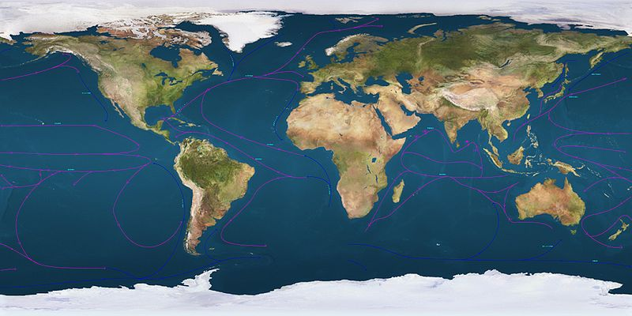
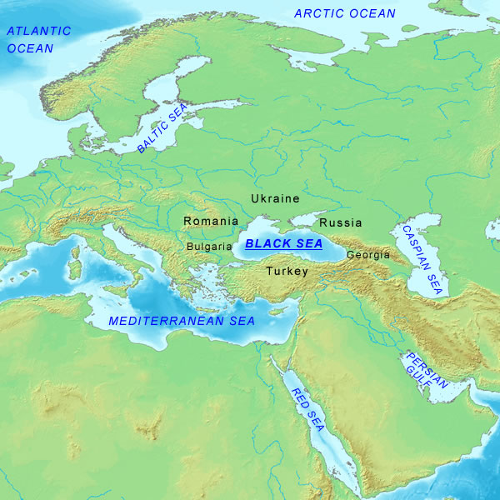
The World Ocean
Black Sea, Caspian Sea, Mediterranean Sea

Slide 6
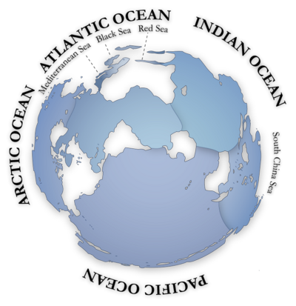
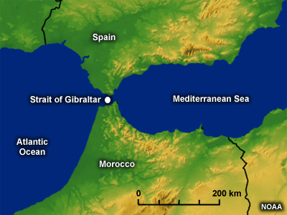
The World Ocean
Strait of
Gibraltar
Mediterranean
Notes:
Geologically, an ocean is an area of oceanic crust covered by water. Oceanic crust is the thin layer of solidified volcanic basalt that covers the Earth's mantle where there are no continents. From this point of view, there are three oceans today: the World Ocean, and the Black and Caspian Seas that were formed by the collision of Cimmeria with Laurasia. The Mediterranean Sea is very nearly its own ocean, being connected to the World Ocean through the Strait of Gibraltar, and indeed several times over the last few million years movement of the African Continent has closed the straight off entirely, making the Mediterranean a fourth ocean. (The Black Sea is connected to the Mediterranean through the Bosporus, but this is in effect a natural canal, cut through continental rock some 5000 years ago, rather than a piece of oceanic sea floor like the Strait of Gibraltar.)

Slide 7
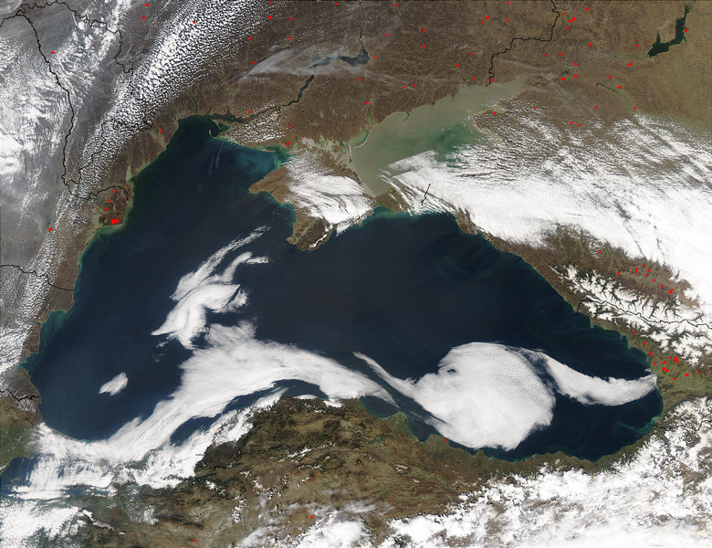
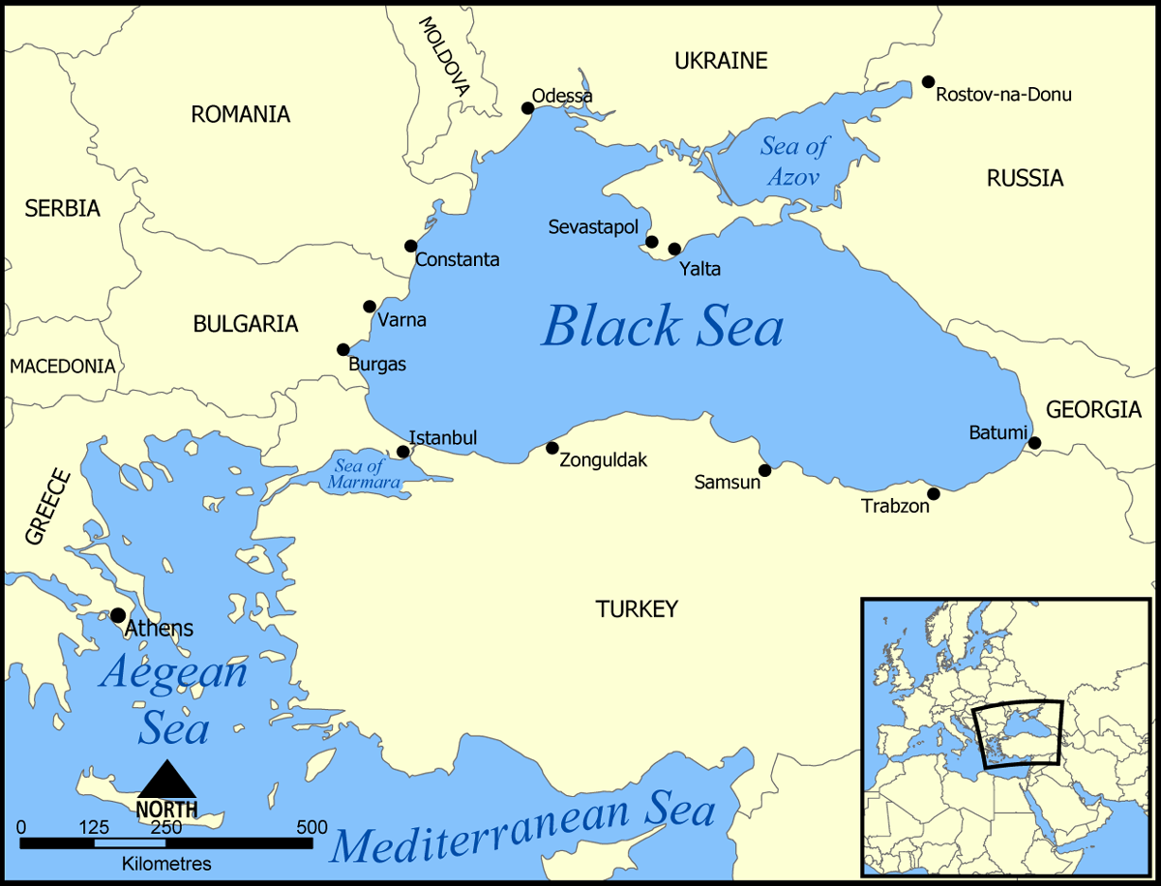
Black Sea
Connected to Mediterranean
By the Bosporus strait.
Notes:
The Black Sea (known as the Euxine Sea in antiquity) is an inland sea between southeastern Europe and Asia Minor. It is connected to the Mediterranean Sea by the Bosporus and the Sea of Marmara, and to the Sea of Azov by the Strait of Kerch. (The Black Sea is connected to the Mediterranean through the Bosporus, but this is in effect a natural canal cut through continental rock some 7,000 years ago, rather than a piece of oceanic sea floor like the Strait of Gibraltar.)
The Black Sea has an area of 422,000 km² and a maximum depth of 2210 m.

Slide 8
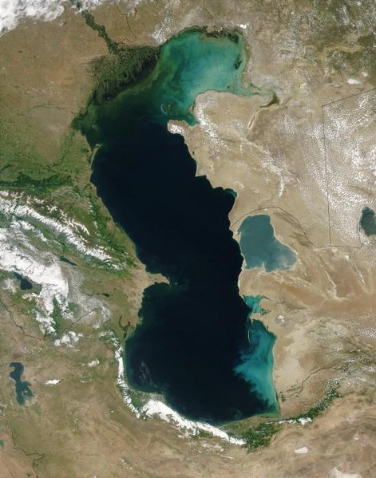
Caspian Sea
Volga
143,000 sq. mi.)
Largest Inland
Body of Water
(Lake?)
Endorheic Sea
Notes:
The Caspian Sea is a landlocked sea between Asia and Europe (European Russia). It is the world's largest inland body of water, with a surface area of 371,000 km² (143,000 sq. mi.), and therefore has characteristics common to both seas and lakes. It is often listed as the world's largest lake, though it is saline. It is often listed as the world's largest lake, though it is not a freshwater one. It has a salinity of approximately 1.2%, about a third the salinity of sea water.
It is endorheic

Slide 9
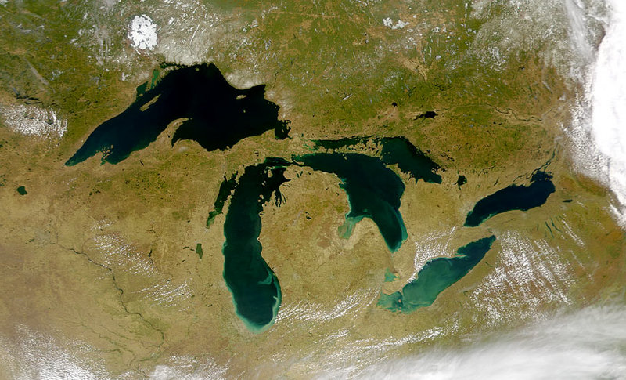
Lake Superior
Largest freshwater lake in the world by surface area
Notes:
Lake Superior (known as Gitchigume in the Native American language) is the largest of North America's Great Lakes. It is the largest freshwater lake in the world by surface area with Lake Baikal in Siberia having more volume. (The Caspian Sea is larger, but contains salt water.) Lake Superior has a surface area of 82,000 km² (32,000 sq. mi.),

Slide 10
Southern Ocean

Slide 11
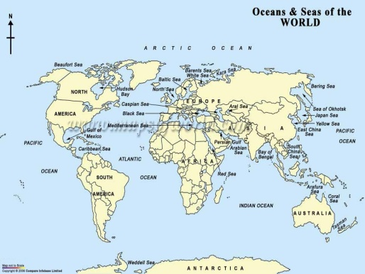
World Oceans by Size
Total area: 140 million square miles
(70% of earth’s surface)
1. Pacific (155,557,000 sq km)
2. Atlantic (76,762,000 sq km)
3. Indian (68,556,000 sq km)
4. Southern (20,327,000 sq km)
5. Arctic (14,056,000 sq km)
Notes:
A man-made connection between the Atlantic and Pacific is provided by the Panama Canal. On the east, the dividing line between the Atlantic and the Indian Ocean is the 20° East meridian, running south from Cape Agulhas to Antarctica. The Atlantic is separated from the Arctic by a line from Greenland to northwestern Iceland and then from northeastern Iceland to the southernmost tip of Spitsbergen and then to North Cape in northern Norway.[1]

Slide 12
Ocean Deeps
Averages
Pacific 14,000 ft Atlantic 12,900 ft Indian 12,700 ft
Southern 12,000 ft
Arctic 4,300 ft
Overall Average Depth: 2.33 miles

Slide 13
Ocean Deeps
Greatest Depth?
Pacific Mariana Trench 35,827 ft Atlantic Puerto Rico Trench 30,246 ft Indian Java Trench 24,460 ft Arctic Arctic Basin 18,456 ft
Southern Ocean (greatest depth in dispute)

Slide 14
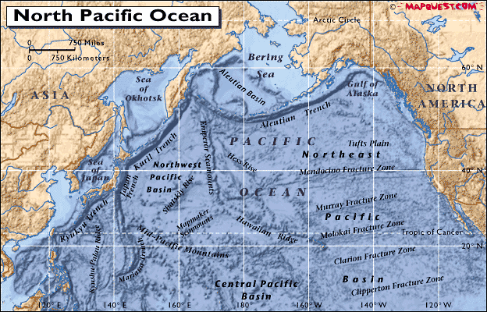
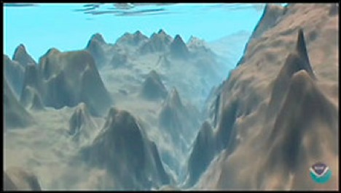
Mariana Trench
Japan

Slide 15
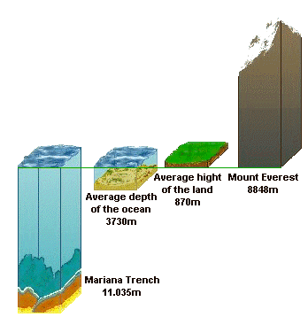
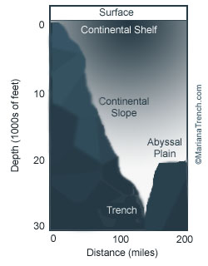
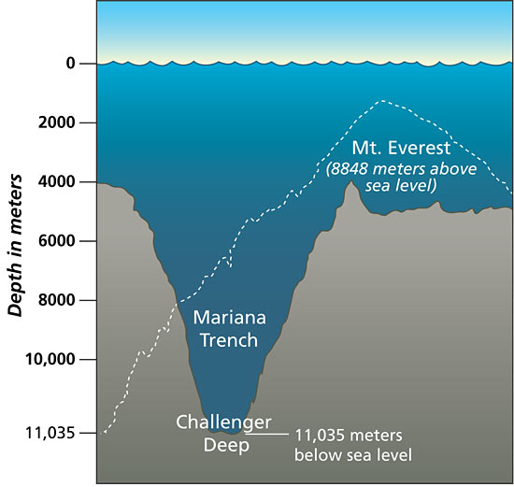
Land and Sea
2,818 ft
28,667 ft
12,085 ft
35,827 ft

Slide 16
Determining Ocean Depths
Notes:
We take it for granted that we know the depths of the oceans. How do we know?

Slide 17
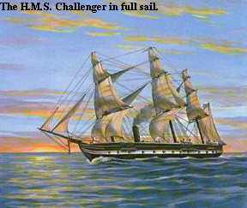
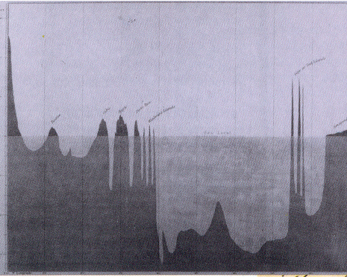
Ocean Depths
1872 - 1876
H.M.S. Challenger
Soundings to 26,850 feet
How do we measure
Ocean depths now?
68,890 nautical miles
Notes:
The H.M.S. Challenger embarked from Portsmouth, England on December 21, 1872 and changed the course of scientific history. Physicists, chemists, and biologists collaborated with expert navigators to map the sea. This interdisciplinary spirit has continued to the present day. During the 4 year journey, the voyages circumnavigated the globe, sounded the ocean bottom to a depth of 26,850 feet, found many new species, and provided collections for scores of biologists.
Between her departure in December 1872 and her return to Spithead on 24 May 1876, H.M.S. Challenger traversed 68,890 nautical miles, in the course of which she sampled in the North and South Atlantic and Pacific Oceans and traveled north of the limits of drift ice in the North Atlantic polar seas and south of the Antarctic Circle.

Slide 18
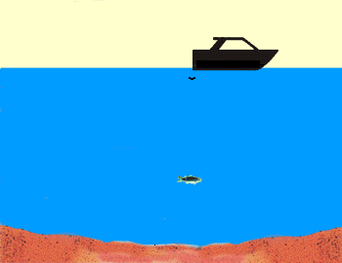
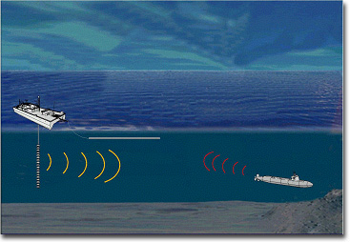
Sonar (Sound Navigation and Ranging)
1922
Notes:
Ocean bottom exploration was revolutionized in 1922 by the introduction of echo sounding. The idea was understood but the ability to generate ultrasonic waves had not yet been invented until Pierre Curie in 1880 discovered the piezoelectric effect which was ultimately utilized by Paul Langevin (French) to detect submarines in WWI.

Slide 19
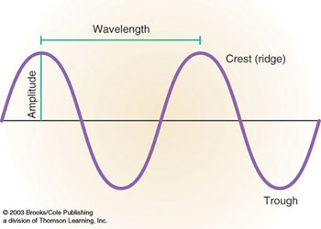
Reflection of Sound
The higher the frequency, the more efficiently sound will be reflected.
The highest frequency the human ear can perceive: 18,000 – 20,000 Hz.

Slide 20
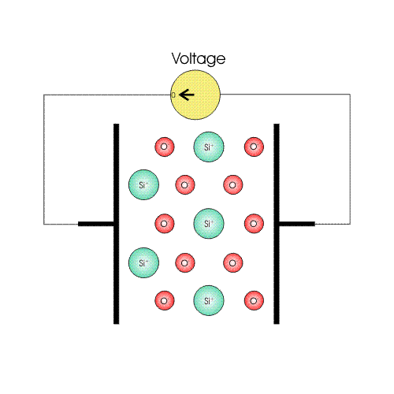
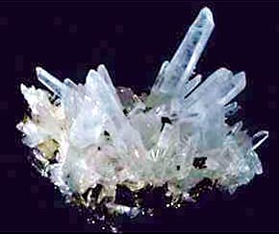
Piezoelectricity
Pierre Curie, 1880
tourmaline, quartz, topaz
2 Mhz
Notes:
A related property known as piezoelectricity, the ability of certain mineral crystals to generate electrical charge when heated, was known of as early as the 18th century, and was named by David Brewster in 1824. In 1880, the brothers Pierre Curie and Jacques Curie predicted and demonstrated piezoelectricity using tinfoil, glue, wire, magnets, and a jeweler's saw. They showed that crystals of tourmaline, quartz, topaz, cane sugar, and Rochelle salt (sodium potassium tartrate tetrahydrate) generate electrical polarization from mechanical stress. Quartz and Rochelle salt exhibited the most piezoelectricity. Twenty natural crystal classes exhibit direct piezoelectricity.
Converse piezoelectricity was mathematically deduced from fundamental thermodynamic principles by Lippmann in 1881. The Curies immediately confirmed the existence of the "converse effect," and went on to obtain quantitative proof of the complete reversibility of electro-elasto-mechanical deformations in piezoelectric crystals.
The first practical application for piezoelectric devices was sonar, first developed during World War I. In France in 1917, Paul Langevin (whose development now bears his name) and his coworkers developed an ultrasonic submarine detector. The detector consisted of a transducer, made of thin quartz crystals carefully glued between two steel plates, and a hydrophone to detect the returned echo. By emitting a high-frequency chirp from the transducer, and measuring the amount of time it takes to hear an echo from the sound waves bouncing off an object, one can calculate the distance to that object.

Slide 21
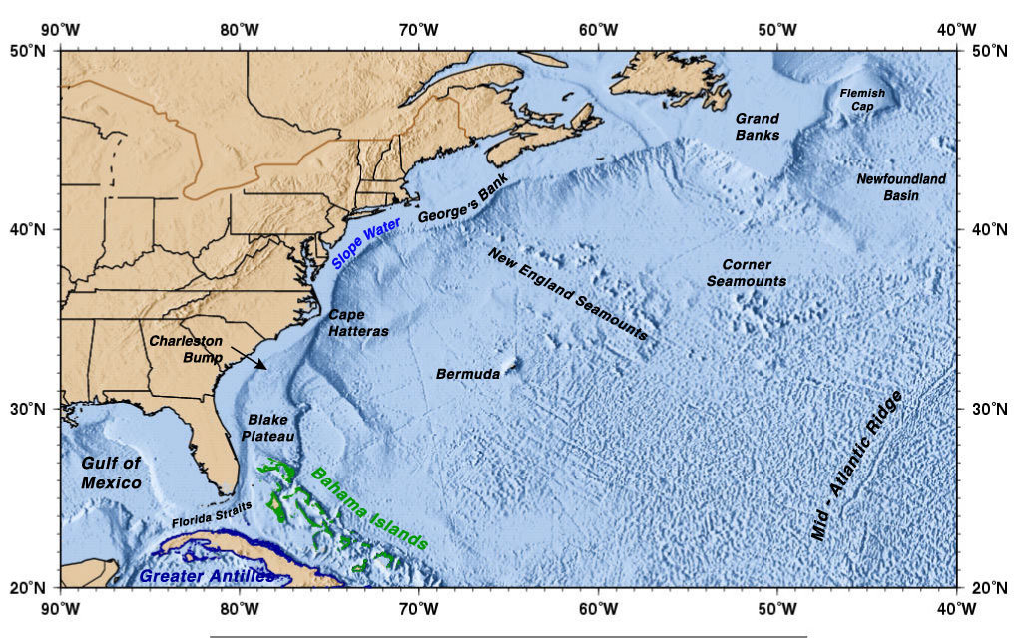

Slide 22
Ocean Water

Slide 23
Why is the ocean salty?

Slide 24
What is a salt?

Slide 25
Salts are made from Ions

Slide 26
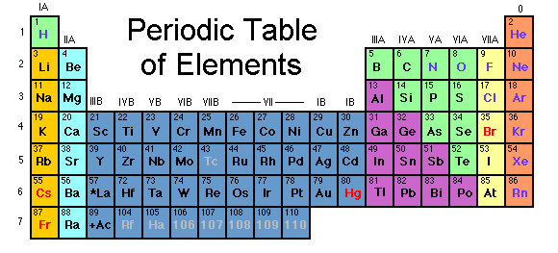
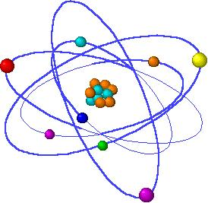
Elements
Electrons (-)
Elements in the periodic
table have equal numbers
of protons (+) and electrons (-).
They are electrically neutral
Protons (+)

Slide 27
Ions
Ions are stable forms of elements that acquire
an electrical charge by gaining or losing electrons
Elemental Sodium (Na)
11 protons (+), 11 electrons (-)
Sodium ion (Na⁺)
11 protons (+), 10 electrons (-)
By losing an electron, sodium has more protons than
electrons and becomes positively charged.
Na - 1e⁻ = Na⁺

Slide 28
Sodium Na
+
e-
e-
e-
e-
e-
Na
Na⁺
e-
e-
11 protons
e-
e-
e-
e-
Notes:
Much more stable
It is anxious, if fact, desperate to lose that electron and assume its more stable form.

Slide 29
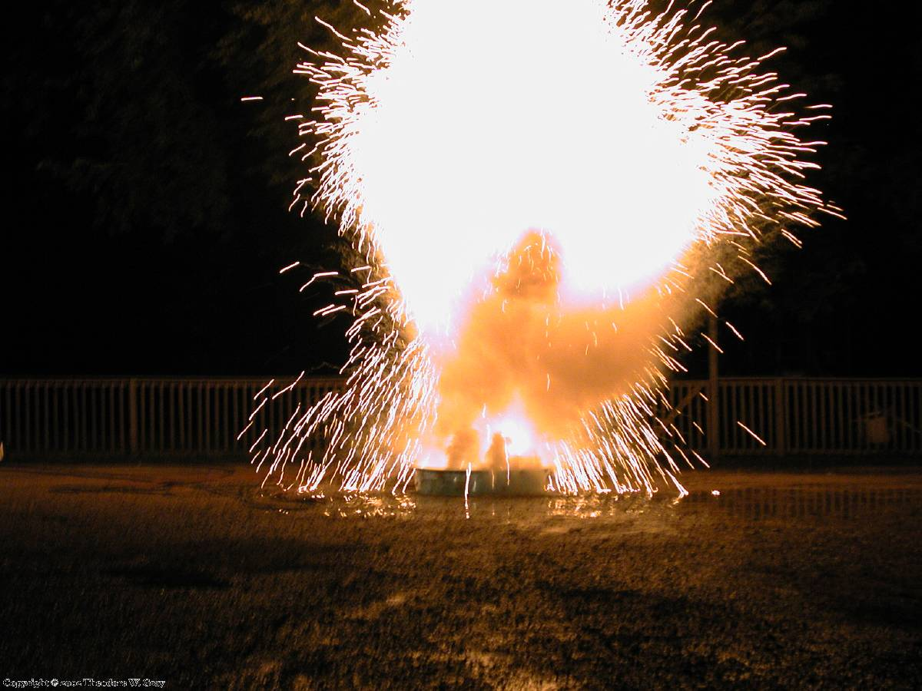
2Na + 2H₂0 2Na⁺ + 2 OH⁻ + H₂
http://video.google.com/videoplay?docid=-2158222101210607510&ei=syO5SuaVBJLiqgKWif37AQ&q=sodium+explosion&hl=en#

Slide 30
Ions
Ions are stable forms of elements that acquire
an electrical charge by gaining or losing electrons
Elemental Chlorine (Cl)
17 protons (+), 17 electrons (-)
Chloride ion (Cl⁻)
17 protons (+), 18 electrons (-)
By gaining an electron, chlorine has more electrons than
protons and becomes negatively charged.
Cl + 1e⁻ = Cl⁻

Slide 31
Chlorine
_
e-
e-
e-
e-
e-
e-
e-
Cl
Cl⁻
e-
e-
e-
e-
17 protons
e-
e-
e-
e-
e-
e-
e-
Notes:
Much more Stable

Slide 32
Elements that lose electrons and become
positively charged are called cations.
Na⁺, K⁺, Ca²⁺, Mg²⁺, Cu²⁺, Fe³⁺
Elements that gain electrons and become
negatively charged are called anions.
Cl⁻, Br⁻, F⁻, I⁻
CO₃²⁻, SO₄²⁻, PO₄⁻³
oxoanions

Slide 33
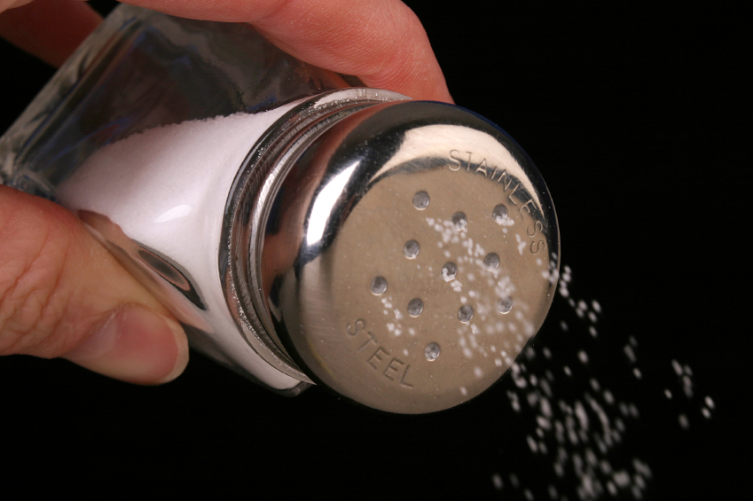
Dissolving Salt in Water
NaCl
Ions: stable forms of
the elements that
obtain charge by
gaining or losing
electrons.
KCl solubility
In water = 280 g/L
CaSO₄ solubility
In water = 2.4 g/L
Na⁺
Cl⁻
Cl⁻
Na⁺
NaCl solubility
In water = 350 g/L

Slide 34
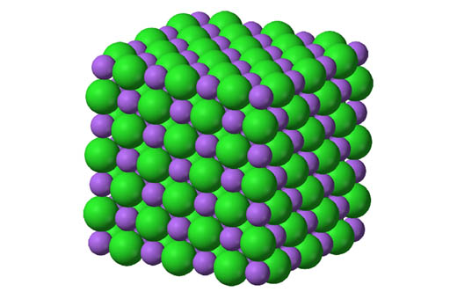
Dissolution
Cl⁻
Cl
Cl
Na
Cl
Cl
NaCl
Na⁺

Slide 35
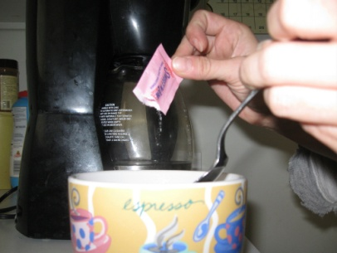
Dissolution of Salts = Ions
solid
solution
Water
KCl K⁺ + Cl⁻
Water
NaCl Na⁺ + Cl⁻
CaCO₃
CaSO₄
Ca⁺² and CO₃⁻²
Ca⁺² and SO₄⁻²

Slide 36
Ocean Ions
Chloride
Sodium
Cl⁻
Na⁺
Carbonate
Potassium
CO₃⁻²
Calcium
K⁺
Ca⁺²
Magnesium
Mg²⁺
Sulfate
SO₄⁻²
Notes:
99% of salts in the oceans

Slide 37
Oceans have enormous amounts
of salt (ions) dissolved in the water.
Average salinity = 3.5%
Next: Origins of Ocean Salinity

