Slide 1
Winds and Ocean Currents

Slide 2
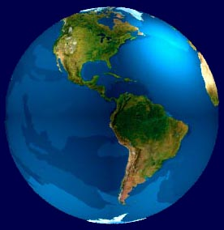
Latent Heat Transport
580 cal/g
Surface
wind
580 cal/g
Surface
wind
Notes:
Wind and Ocean Currents: “Heat Movers”
Both air currents and ocean currents move heat. Energy is stored as "latent heat" in the atmosphere. In the surface waters of the ocean it is stored as "sensible heat." Atmospheric and oceanic circulation share the task of heat redistribution on a roughly fifty-fifty basis. Even though transfer of heat by moving water in ocean currents is much less efficient than transfer by moving vapor in wind, the masses involved are much greater in the ocean currents than in the air currents. On the whole, heat has to be moved from the tropics (where the Sun is close to being overhead at noon) to the higher latitudes (where the Sun is 40 degrees off the vertical or lower, on average). These regions, beyond the 40th degree of latitude on either side of the equator, have a heat deficit, while the tropical belt has excess heat. "Heat deficit" refers to the fact that from these regions more heat is radiated back to space than is received from the Sun, while for the regions with a "heat excess" the reverse is the case. The climate machine acts as a heat-distributing device; It involves the energy received from the Sun (see "solar constant"), the energy reflected back to space (see "albedo") and the energy retained in the atmosphere through the trapping of infrared radiation (see "greenhouse effect"). If there were no energy transfer the poles would be 25 degrees Celsius cooler, and the equator 14 degrees Celsius warmer!

Slide 3
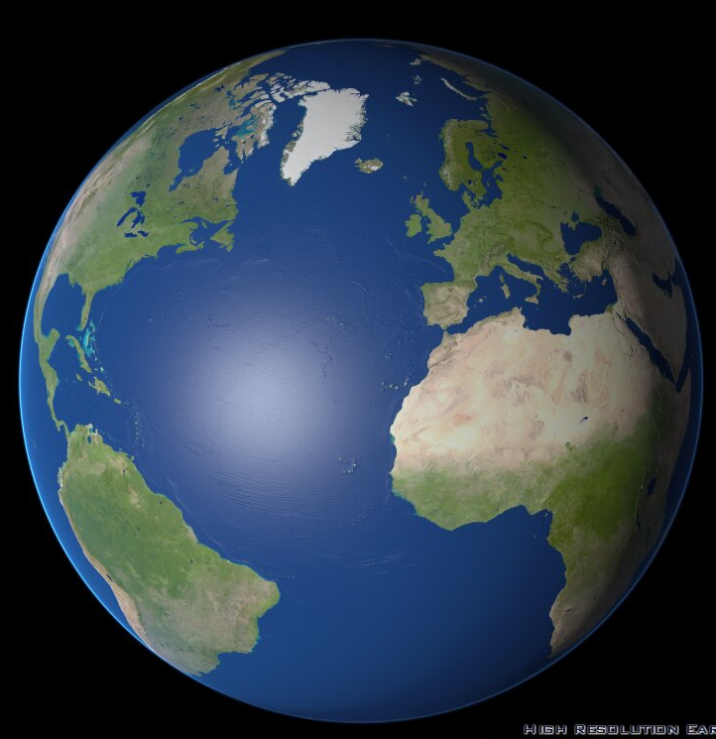
Northern Hemisphere
60º
30º
0º

Slide 4
Northern Hemisphere
60º
Fronts
30º
Hurricanes
0º
Something is redirecting the wind

Slide 5
The Coriolis Effect
Due to the rotation of a spherical earth
What is the circumference of the Earth?
~ 25,000 miles
How long does it take for the earth to make one rotation?
24 hours
0 mi/hr
25,000 mi at 0º latitude
1042 mi/hr

Slide 6
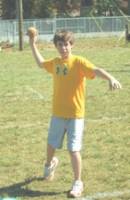
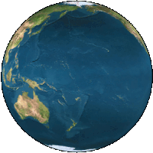
stationary
1042 mi/hr

Slide 7
The Coriolis Effect
Velocity at 90º latitude
zero
Velocity at equator
1042 mi hr
Objects moving in the northern hemisphere deflect to the right of the direction of travel.

Slide 8
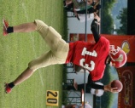
The Coriolis Effect
Stationary
Velocity at 90º latitude
zero
Velocity at equator
1042 mi hr
1042 mi/hr
Objects moving in the northern hemisphere deflect to the right of the direction of travel.

Slide 9
Northern Hemisphere
60º
30º
0º
The Coriolis Effect deflects the wind
to the right of the direction of travel

Slide 10
60º
30º
0º
The Coriolis Effect deflects the wind
to the right of the direction of travel

Slide 11
Surface Winds
60º
Prevailing
Westelies
30º
Tropical
Easterlies
Equator
30º
60º
Notes:
Without the coriolis effect surface winds between 30 degees and the equator would look like this.

Slide 12
In the Northern Hemisphere moving objects, including air,
are deflected to the right of the direction of travel
In the Southern Hemisphere moving objects, including air,
are deflected to the left of the direction of travel

Slide 13
1042 mi/hr
stationary

Slide 14
The Coriolis Effect
Velocity at equator
1042 mi hr
Velocity at 90º latitude
zero
Objects moving in the southern hemisphere deflect to the left of the direction of travel.

Slide 15
60º
30º
Equator
30º
60º
In the Southern Hemisphere moving objects, including air,
are deflected to the left of the direction of travel
Notes:
Without the coriolis effect surface winds between 30 degees and the equator would look like this.

Slide 16
60º
30º
Equator
30º
60º
Notes:
The air is also descending at 30 degrees south latitude and spreads out toward the equator and 60 degrees. But this air is also deflected by the coriolis effect.

Slide 17
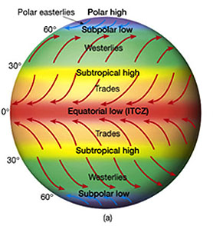
descending
Calm air
rising
Calm air
descending

Slide 18
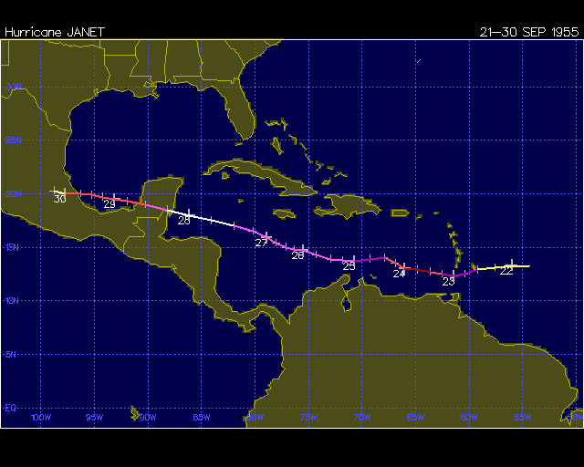
Hurricane Track
30º
0º
Notes:
On the other hand, Atlantic hurricanes tend to form between about 8 degrees and 20 degrees N latitude and ride the easterly trade winds toward the west. Hurricanes can change direction to some degree, but overall they move toward the west with the overall easterly flow.

Slide 19
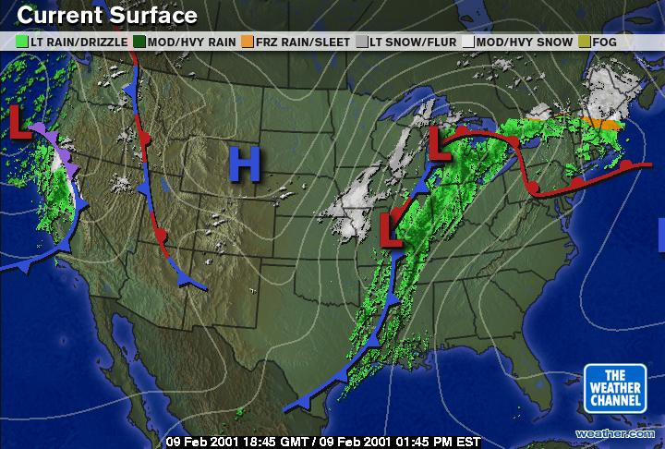
30º

Slide 20
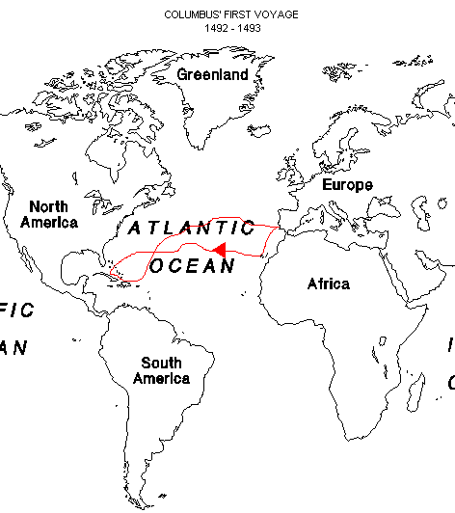
Sailing, Sailing…
Westerlies
30º
Trade winds
(easterlies)
Notes:
Knowledge of wind directions were very important to early mariners and traders, but they were particularly important to Columbus. Despite his other flaws, he was an extremely competent mariner. This is a diagram of the route Columbus took to and from the Americas in 1492. The blue line indicates the route to the new world and the orange line, the return route. Interestingly they are not direct routes. Columbus was a shrewd captain. He knew the overall directions of the winds on earth and took advantage of them. Notice that when he left Spain, he immediately diverted to the south (the blue line). The reason was so that he could ride the trade winds which blew from east to west. In fact, his crew was uncertain as to their ability to return to Spain, given this unabated flow of wind toward the west. They felt that this would become a headwind upon their return. But Columbus had deduced the overall wind patterns which is reflected in his return route. Notice that he quickly headed north until he was above 30 degrees latitude where he picked up the prevailing westerlies and smoothly sailed home. Few people had deduced this overall pattern of winds which is illustrated by his crew’s aprehensions. But it was this understanding that made the voyage possible.

Slide 21
Winds and Ocean Currents

Slide 22
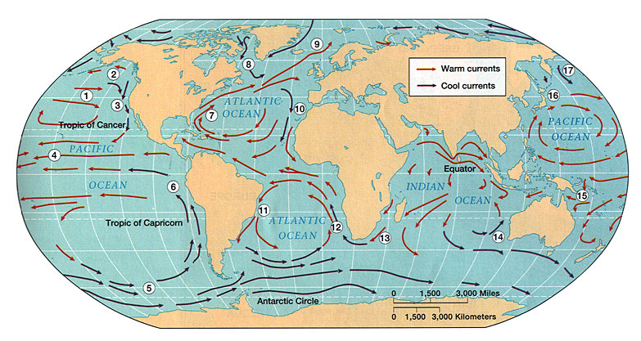
Ocean Surface Currents
Forces
1. Solar Heating (temp, density)
2. Winds
3. Coriolis
Notes:
1. Surface Currents--Surface Circulation
These waters make up about 10% of all the water in the ocean.
These waters are the upper 400 meters of the ocean.
2. Deep Water Currents--Thermohaline Circulation
These waters make up the other 90% of the ocean
These waters move around the ocean basins by density driven forces and gravity.
The density difference is a function of different temperatures and salinity
These deep waters sink into the deep ocean basins at high latitudes where the temperatures are cold enough to cause the density to increase.
Ocean Currents are influenced by two types of forces
1. Primary Forces--start the water moving
The primary forces are:
1. Solar Heating
2. Winds
3. Gravity
4. Coriolis

Slide 23
Solar Heating and Density
Density
Mass (g)
Volume (cm³)
Water Expands as it is heated

Slide 24
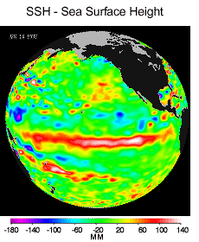
Solar Heating
Heat expands water near the Equator,
increasing its volume and creating a bulge
Equator
Notes:
1. Surface Currents--Surface Circulation
These waters make up about 10% of all the water in the ocean.
These waters are the upper 400 meters of the ocean.
2. Deep Water Currents--Thermohaline Circulation
These waters make up the other 90% of the ocean
These waters move around the ocean basins by density driven forces and gravity.
The density difference is a function of different temperatures and salinity
These deep waters sink into the deep ocean basins at high latitudes where the temperatures are cold enough to cause the density to increase.
Ocean Currents are influenced by two types of forces
1. Primary Forces--start the water moving
The primary forces are:
1. Solar Heating
2. Winds
3. Gravity
4. Coriolis
Solar heating cause water to expand. Near the equator the water is about 8 centimeters high than in middle latitudes. This cause a very slight slope and water wants to flow down the slope

Slide 25
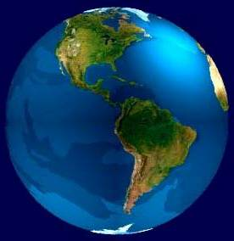
Solar Heating
Heat expands water near the Equator
Increasing its volume and creating a bulge
N
Water flows toward pole
equator
S
Water flows toward pole
Water flows away from equator
Notes:
1. Surface Currents--Surface Circulation
These waters make up about 10% of all the water in the ocean.
These waters are the upper 400 meters of the ocean.
2. Deep Water Currents--Thermohaline Circulation
These waters make up the other 90% of the ocean
These waters move around the ocean basins by density driven forces and gravity.
The density difference is a function of different temperatures and salinity
These deep waters sink into the deep ocean basins at high latitudes where the temperatures are cold enough to cause the density to increase.
Ocean Currents are influenced by two types of forces
1. Primary Forces--start the water moving
The primary forces are:
1. Solar Heating
2. Winds
3. Gravity
4. Coriolis
Solar heating cause water to expand. Near the equator the water is about 8 centimeters high than in middle latitudes. This cause a very slight slope and water wants to flow down the slope

Slide 26
General Circulation
pole
Ocean
Sun’s
rays
Earth
equator

Slide 27
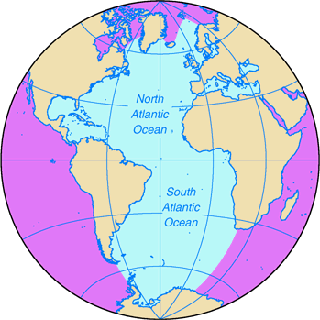
General Circulation (North)
1. Solar Heating
2. Winds
3. Coriolis
30º
Surface Water
equator

Slide 28
Winds Guide the Direction of Surface Water
Winds blow to the west between
0º and 30º latitude.
30º
0º

Slide 29
General Circulation (North)
30º
wind
equator
Surface Water

Slide 30
The Coriolis force deflects objects
To the right of the direction of motion.

Slide 31
Winds plus Coriolis Force
East winds blow water to the west
Coriolis deflects water to the right (east).
30º
East wind
equator

Slide 32
Winds plus Coriolis Force
Above 30º, westerlies push water to the east.
Coriolis deflects water to the right in the direction of travel (east).
West wind
30º
East wind
equator

Slide 33
Water encounters land and is deflected north and south.
The bulk is deflected to the south, and Coriolis deflects it to the right
Below 30º, moving water encounters east wind and is moved to the west
West wind
East wind
Notes:
The bulk is deflected to the south where it again encounters easterly winds.

Slide 34
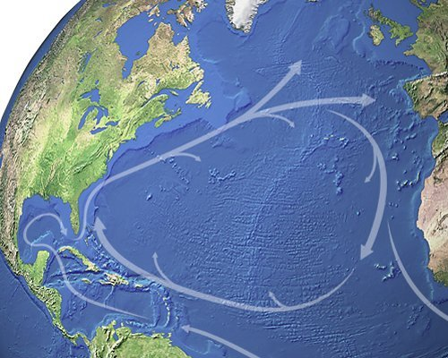
Atlantic Gyre

Slide 35
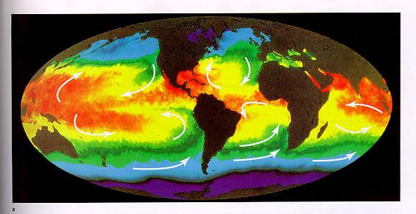
Temperature/Energy Transfer
cool
warm
cool

Slide 36
Unusual Example of Heat Transport

Slide 37
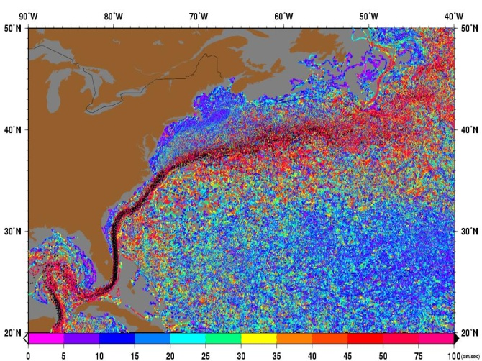
Ireland England
Spain
Gulf
Stream
Notes:
The Gulf Stream is one of the reasons why certain parts of the west of Britain and Ireland are an average of several degrees warmer than most other parts of those countries. Indeed, in Cornwall, and particularly the Isles of Scilly, its effects are such that plants associated with much warmer climates, such as palm trees, are able to survive the rigors of northern winters
On his return trip from London, in 1726, Franklin, now 20, noted a curious phenomenon. After several weeks at sea, the color of the water began to change. There were "hot damp winds," he noted in his journal, along with "an abundance of grass" and other seaweed visible in the water. To Franklin, the warmer air and warmer water suggested that the ship must be very near the coast, but the ship’s captain scoffed at that idea. And, indeed, after six days, the water regained its former darker color, and the hot wind and abundant seaweed disappeared. The ship was nowhere near the coast. For the moment, Franklin had no explanation for the peculiar changes in the character of the ocean he had seen in the mid Atlantic. In fact, what young Ben Franklin had encountered was the Gulf Stream

Slide 38
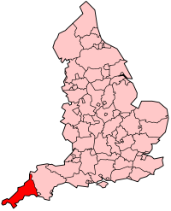
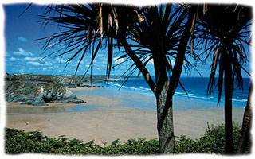
Ireland England
Spain
cornwall
Notes:
The Gulf Stream is one of the reasons why certain parts of the west of Britain and Ireland are an average of several degrees warmer than most other parts of those countries. Indeed, in Cornwall, and particularly the Isles of Scilly, its effects are such that plants associated with much warmer climates, such as palm trees, are able to survive the rigors of northern winters
On his return trip from London, in 1726, Franklin, now 20, noted a curious phenomenon. After several weeks at sea, the color of the water began to change. There were "hot damp winds," he noted in his journal, along with "an abundance of grass" and other seaweed visible in the water. To Franklin, the warmer air and warmer water suggested that the ship must be very near the coast, but the ship’s captain scoffed at that idea. And, indeed, after six days, the water regained its former darker color, and the hot wind and abundant seaweed disappeared. The ship was nowhere near the coast. For the moment, Franklin had no explanation for the peculiar changes in the character of the ocean he had seen in the mid Atlantic. In fact, what young Ben Franklin had encountered was the Gulf Stream

Slide 39
Next: Ocean Fundamentals

