Slide 1
Nutrients as Pollutants

Slide 2
Major Determinants of Water Quality
and the Impact or Availability of Water Pollutants
Organisms
Solubility
Oxygen
pH
Nutrients (N, P)
Metals (Hg, Pb, As)
Organic Chemicals (PCBs, Dioxins)

Slide 3
Nutrients: Nitrogen and Phosphorus

Slide 4
Nutrients: Nitrogen and Phosphorus
Sources: fertilizers, manures, wastewater discharge
Availability in the environment is controlled by
Oxygen
pH
Organisms
Both are limiting to primary productivity
Excess amounts can severely alter ecosystems

Slide 5
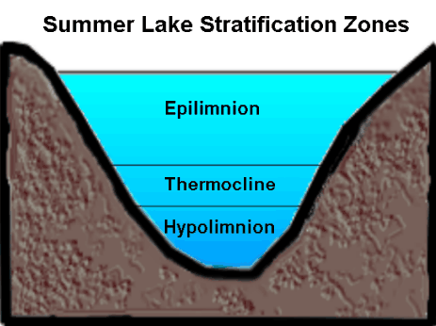
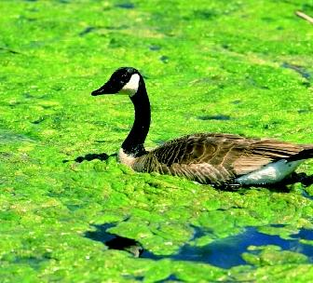
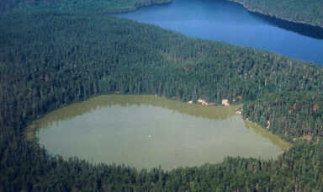
Eutrophication
Nutrient addition increases
primary productivity (algae)
Nutrient Additions
Sunlight is limited at greater depth
Photosynthetic life
Photoautotrophs die and become
food for aerobic heterotrophs
O₂
Aerobic autotrophs consume O₂
Oxygen content in water is reduced
bacteria
If oxygen is reduced sufficiently,
aerobic microbes cannot survive,
and anaerobic microbes take over

Slide 6
Nitrogen

Slide 7
Nitrogen
NH₄⁺ and NO₃⁻
Forms are controlled by organisms
NH₄⁺ is converted to NO₃⁻ by aerobic bacteria
The process is called nitrification
These bacteria, therefore, are controlled by oxygen levels
Nitrifying bacteria do not function well at low pH.
Organisms
Oxygen
pH

Slide 8
Dominant Forms: NH₄⁺ and NO₃⁻
Sources: fertilizers, manures, wastewater discharge
NO₃⁻ is more mobile in the environment than NH₄⁺
_
NH₄⁺
_
_
_
_
_
_
_
NO₃⁻
_
Soil particles possess
a negative electrical charge
Leaching to ground
Or surface water

Slide 9
Groundwater and Nitrates (NO₃⁻)
Nitrates do not interact significantly with soil
material and can move rapidly to groundwater.
What areas are particularly vulnerable?
1. The unconfined, surficial aquifer
2. Areas where natural groundwater recharge occurs
3. Areas where the aquifer confining unit
is thin are also particularly vulnerable.

Slide 10


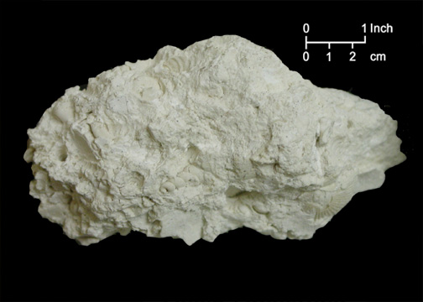
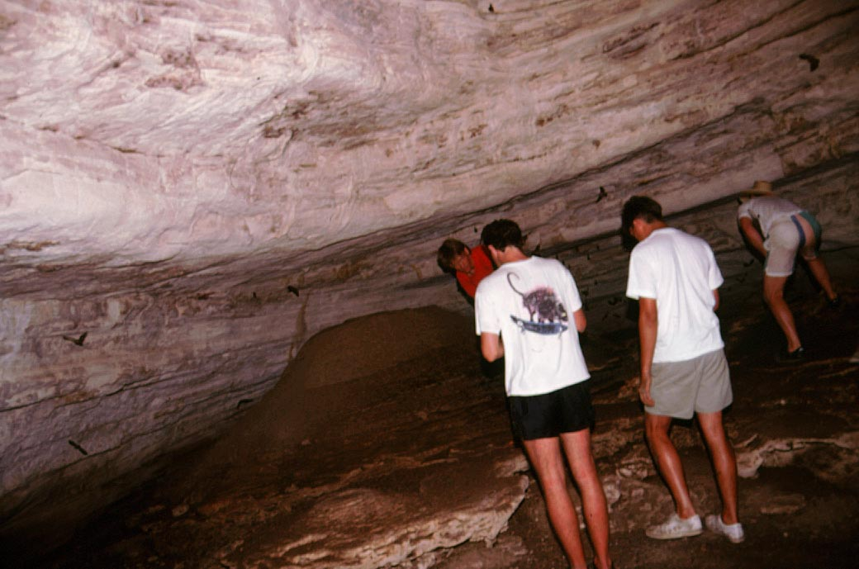
Unconfined Aquifers
Sandy Materials
Unconfined aquifer is
extensive throughout
the state of Florida
Miocene Clays
(Hawthorne Formation)
Low Permeability
Confining Unit
(poor water movement)
The Floridan aquifer
is a confined aquifer.
The water-bearing unit
is permeable limestone.
55 – 24 million years ago
Low permeability rock (confining)
Notes:
Once N enters the surficial aquifer it can easily move to rivers, streams and lakes because it does not interact appreciably with soil constitiuents.

Slide 11
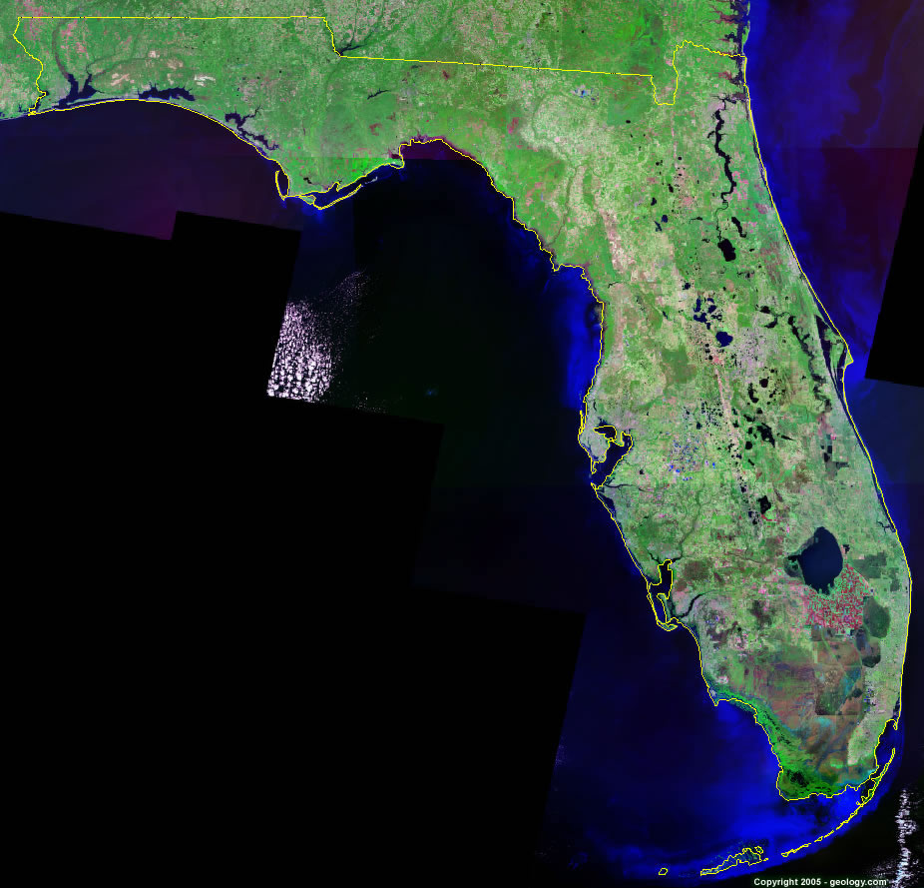
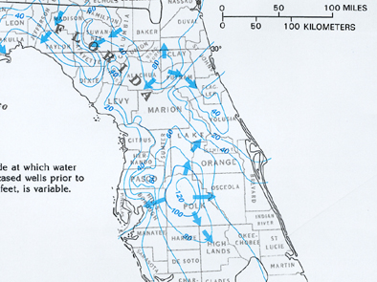
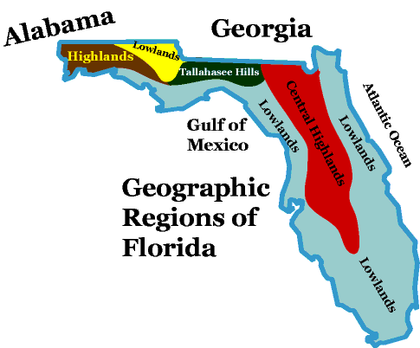
Recharge

Slide 12
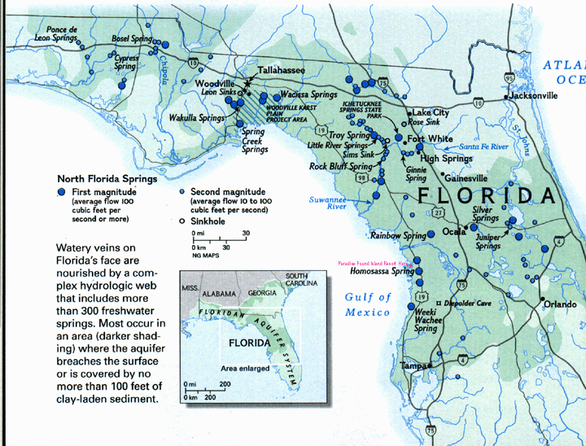
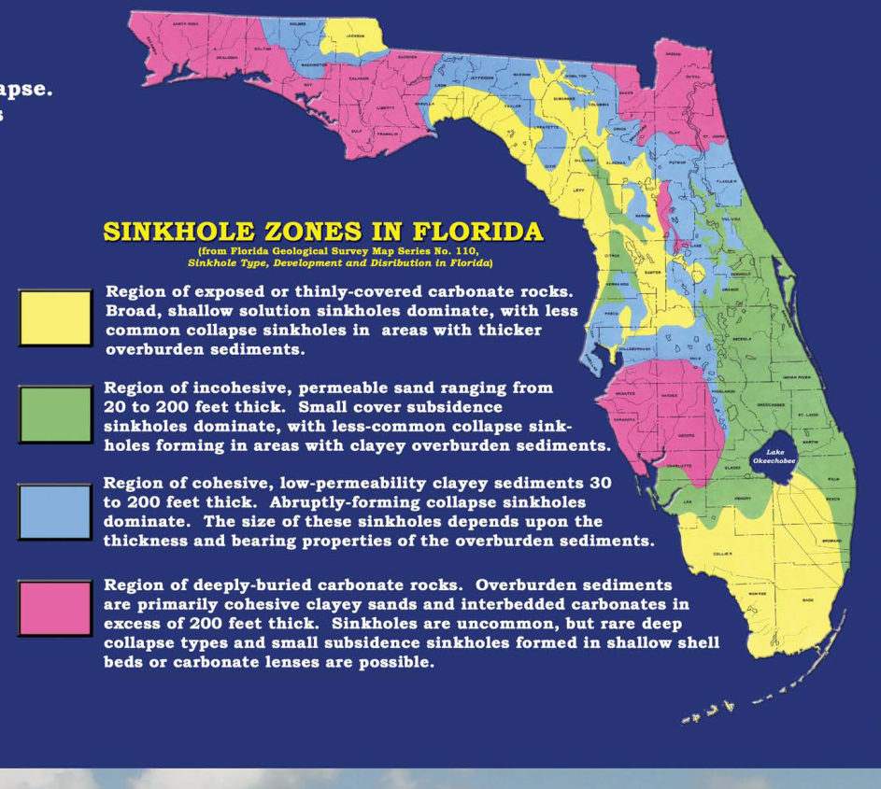
Where the Confining Layer is Thin
Groundwater
Thin sandy
overburden

Slide 13
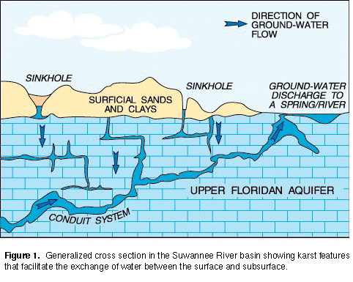
Lower Suwannee River Watershed
residential and commercial septic systems in rural areas
about 300 row crop and vegetable farms
44 dairies with more than 25,000 animals
150 poultry operations with more than 38 million birds
Nitrates
NO₃ Drinking water standard: 10 ppm

Slide 14
Environmental and Health Hazard
Methemoglobinemia
Nitrate is converted to nitrite in infants (pH, organisms)
Nitrite converts iron in the hemoglobin of red blood cells
to form methemoglobin which cannot bind oxygen
Adults possess an enzyme that reverses the conversion
Infants possess 60% less of the enzyme

Slide 15
Phosphorus

Slide 16
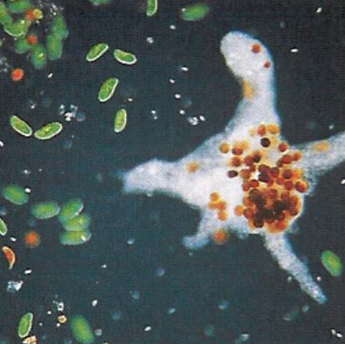
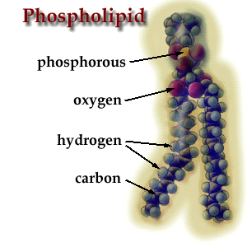
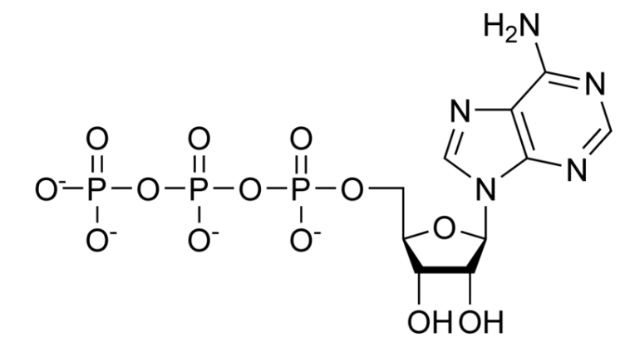
Phosphorus
Present in Fertilizers, animal wastes, wastewater
Limiting Element to Primary Productivity
Chlorophyll
ATP
Phospholipids
Additions increase Productivity
ATP

Slide 17
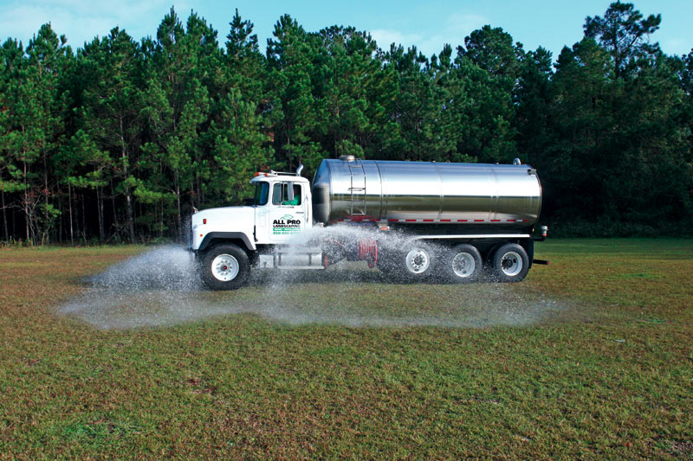
Fertility
Most phosphorus is unavailable to plants
Only 10-15% of applied fertilizer phosphorous is used by plants
The rest is bound to soil particles or forms insoluble solids
This leads to excess application

Slide 18
Plant Availablity and pH
H₂PO₄⁻
Most Available
HPO₄⁻²
pH 6-8
pH 3-6
pH 8-11
Optimum pH = 6.5 for plant availability

Slide 19
Binding of Phosphorus
Low pH High pH
Aluminum and Iron
phosphates
Calcium Phosphates
Formation of Insoluble solids
Reaction with soil particles
There is a finite capacity to immobilize phosphorus
If the capacity is exceeded, phosphorus becomes more mobile
Mobile phosphorus can contaminate surface and groundwater

Slide 20

Unimpacted
P-impacted
*

Slide 21
South Florida and Phosphorus
Notes:
“The overarching objective of the Plan is the restoration, preservation, and protection of the South Florida ecosystem while providing for other water-related needs of the region, including water supply and flood protection” (WRDA 2000). Success for the natural system will be to recover and sustain those essential hydrological and biological characteristics that both defined the original pre-drainage greater Everglades and made it unique among the world’s wetlands. These defining characteristics include the great extent of naturally interconnected and interrelated wetlands, sheet flow, extremely low levels of nutrients in freshwater wetlands, high levels of estuarine productivity, and the great resilience of the plant community mosaics and abundance of many of the native wetland animals. Although the future Everglades ecosystem will be a “new” Everglades because it will be smaller than the pre-drainage system, restoration will have been successful if the new system responds to the recovery of these defining characteristics by functionally behaving as a wild Everglades system rather than as a set of managed, disconnected wetlands. Success for the human systems will be to maintain or improve current levels of water supply and flood protection in a rapidly growing human population in south Florida, consistent with the goals of the Plan for the natural system. The Plan’s greatest strength is that it integrates natural and human system objectives into a single design, and thereby re-couples an array of public interests into a common strategy for the future of south Florida.

Slide 22
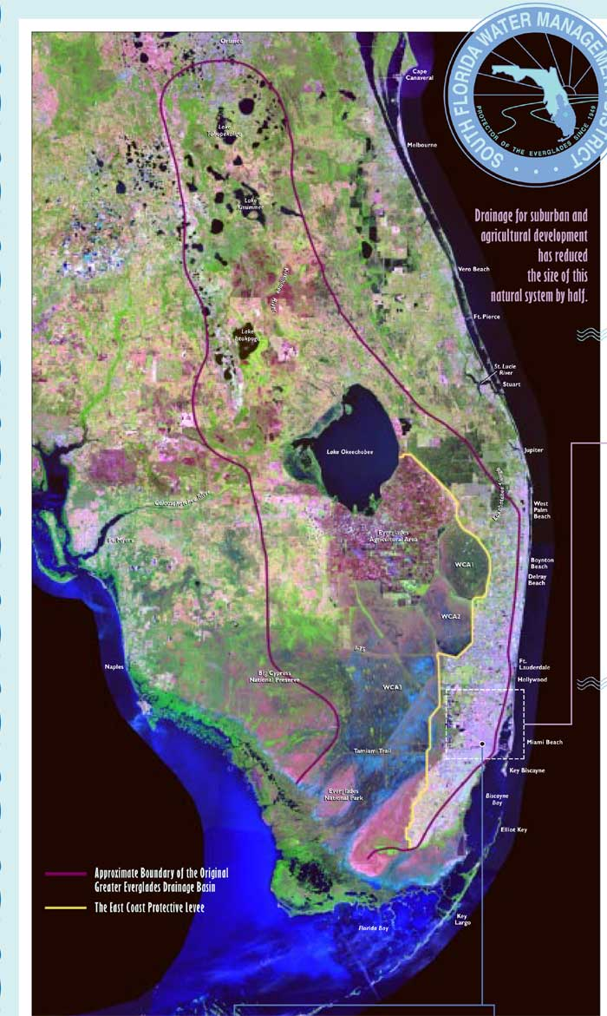
Phosphorus loading to S. Florida Ecosystem
Dairy/Beef
Inputs North
and South of
Okeechobee
Crop production

Slide 23
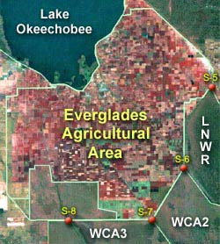
Crops: Everglades Agricultural Area
EAA
Sugar, Rice, Veg.
700,000 ac
Notes:
A significant product of the drainage efforts was the creation of the Everglades Agricultural Area south of Lake Okeechobee. The EAA encompasses about 700,000 acres and is used for sugar rice and vegetable production.

Slide 24
Phosphorus Fertilization (lbs/ac)
Based on how much P is already in soils
Low Soil P
V. High Soil P
Celery | 260 | 200 | 140 | 80 | 20 | 0 | 0 | 0 | 0
Endive | 200 | 175 | 150 | 125 | 100 | 75 | 50 | 25 | 0
Escarole | 200 | 175 | 150 | 125 | 100 | 75 | 50 | 25 | 0
Lettuce (Head) | 200 | 175 | 150 | 125 | 100 | 75 | 50 | 25 | 0
Radish | 100 | 40 | 0 | 0 | 0 | 0 | 0 | 0 | 0
Romaine | 200 | 175 | 150 | 125 | 100 | 75 | 50 | 25 | 0
Sugar Cane | 120 | 100 | 80 | 40 | 20 | 0 | 0 | 0 | 0
Notes:
These are Phosphorus recommendations for vegetable crops grown on organic soils typical of the EAA based on similar soil test indices. Many call for significant P fertilization. Note in particular the levels for sugar cane, the dominant crop in the EAA.

Slide 25
Phosphorus loading to S. Florida Ecosystem
Agriculture
Overstimulation of primary productivity
Notes:
Alteration of species diversity including both macrophytes and microbial communities.

Slide 26
Dairy and Beef

Slide 27
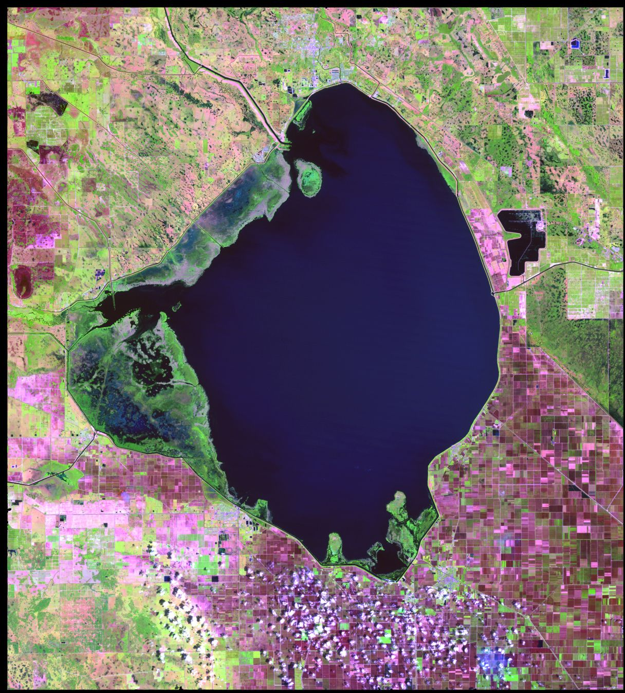
Dairy and Beef
Kissimmee drainage basin 12,000 km²
In 1521 Ponce de Leon
brought horses and cattle
to Florida.
(1947)
No other part of our country
had cattle until the Pilgrims
brought cattle in the early 1600's
Florida's ranchers now raise
the third largest number of
cattle of any state east of the
Mississippi
Notes:
Another significant source of phosphorus entering the everglades ecosystem is livestock production north of Lake Okeechobee. Cattle was brought to Florida in 1520 by Ponce de Leon. Dairy and beef operations began in earnest north of the lake in 1947 and now Florda is 3rd largest producer east of the Mississippi. Okeechobee supplies drinking water to communities around the lake, serves as reserve water for Florida's southeast coast, and provides water to the Florida everglades. The lake also serves as a recreational facility and provides some of the best sports fishing in the United States. Nutrient rich runoff from farm lands enters the lake and significant phosphorus contamination originates from the dairy and beef operations.

Slide 28
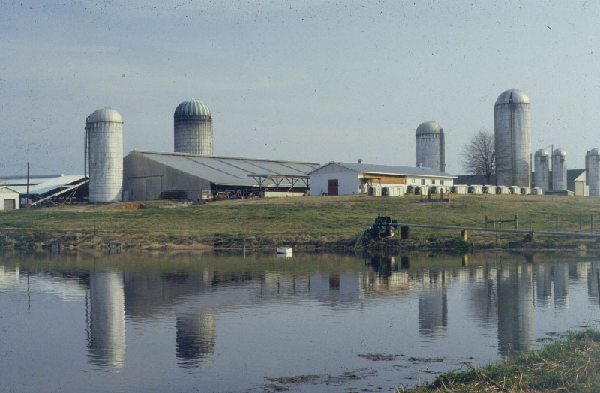
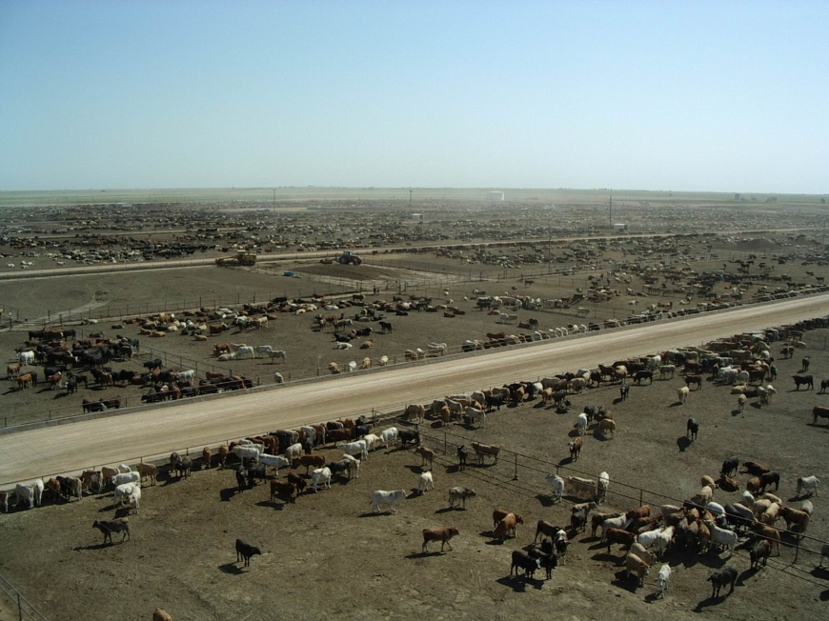
Phosphorus
Solid Manure:
5.5 g / kg total Phosphorus
One cow can excrete between 40
and 60 g of phosphorus per day
Subject to movement via runoff, stream
flow, soil water movement, and
groundwater movement
Notes:
Phosphorus and nitrogen play a major role in the structure and function of living cells. It is an integral component of nucleic acids, nucleotides, phospholipids, and proteins. However, much of the Phosphorus and Nitrogen consumed is excreted. For example, One cow can excrete between 40 and 60 g of phosphorus per day. Phosphorus and Nitrogen in Dairy lagoons can be as high as 7.8 and 12.0 lbs/1000 gallons of effluent, respectively. Solid manure deposited on land and can be as high as 5.5 g/kg of waste.
Nutrients contained in livestock waste is subject to movement via runoff, stream flow, soil water movement, and groundwater movement to adjacent water bodies enriching them with limiting nutrients and leading to eutrophication. Such is the case for Lake Okeechobee.

Slide 29
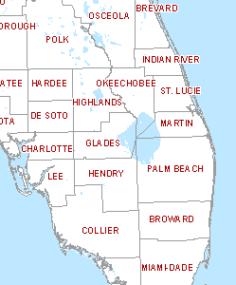
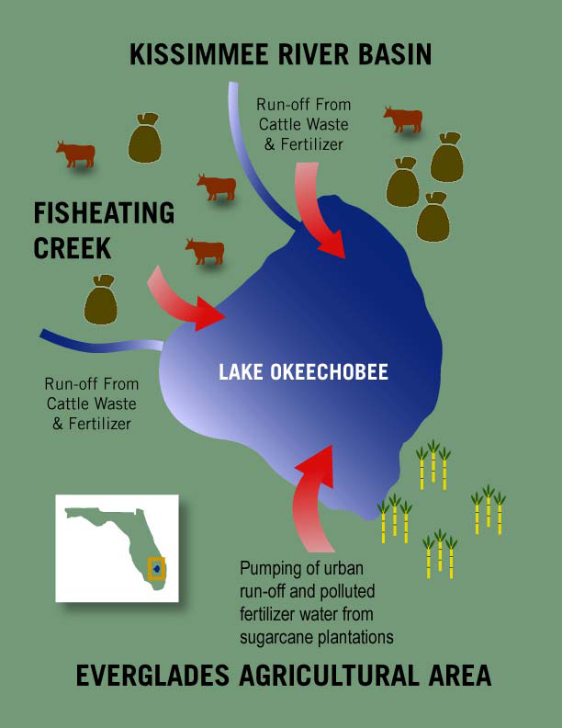
Cattle and Dairy
Okeechobee, Highlands, and Glades
Counties: 328,000 head (19% of total)
Okeechobee County is ranked number one for all cattle in the state
Notes:
Okeechobee, Glades and Highlands counties aloneproduce approximately 328,000 head, about 19% of the state total. All cattle and calves on Florida farms and ranches, as of January 1, 2005, including dairy cattle, totaled 1,740,000, unchanged from 2004. Okeechobee county is ranked #1 for all cattle in the state. Beef cattle in Okeechobee County total 70,000 head, according to the 2005 Florida Agricultural Statistics Directory.. According to the National Cattlemen's Beef Association (NCBA), beef is the number one protein in America.

Slide 30
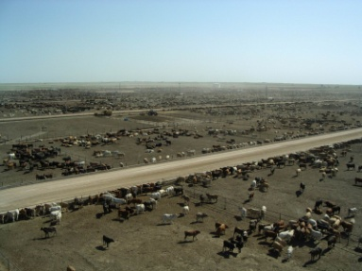
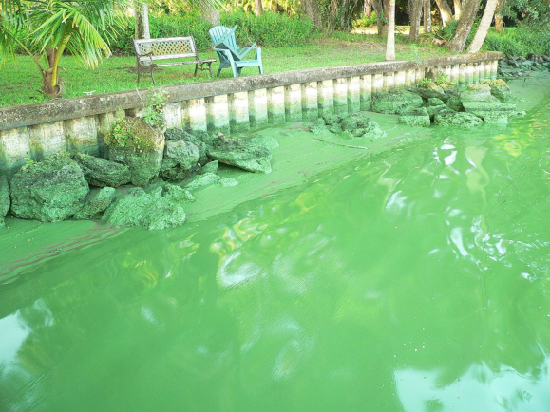
Kissimmee – Okeechobee - Everglades
The Lower Kissimmee River Basin is among largest sources of external phosphorus loading to Lake Okeechobee
The Kissimmee river alone contributes about 20% of the phosphorus flowing into
Lake Okeechobee
urban
Okeechobee, in turn, is a source
of phosphorus to the Everglades

Slide 31
Surface Water Improvement Management Act: SWIM
Mandated phosphorus load level of 397 tons/yr
urban
Clean Water act: 154.3 tons per year
DEP: 140 tons per year
SWIM Plan priority basins
Lake
Target level of 40 ppb
in Lake Okeechobee
Notes:
The SWIM of 1987 mandates a maximum phosphorus load level of 397 tons annually.
Water leaving the EAA receives additional treatment in one of several Stormwater Treatment Areas (STAs) before entering the Everglades. These constructed wetlands are filled with native plants and use "green" technology to further reduce phosphorus levels. More than 41,000 acres of land south of Lake Okeechobee have been converted to STAs, and an additional 18,000 acres will be added by 2010. Expansion of the STAs is part of the state's Acceler8 initiative to expedite critical restoration projects, providing for environmental benefits as soon as possible

Slide 32
Some Strategies
The Dairy Rule (1987)
creating lagoons to capture and contain dairy waste
Implement Best Management Practices (BMPs)
buffer areas around places animals congregate, eliminating
phosphorus fertilization near tributaries to the lake, reducing
phosphorus imports in animal feeds, reducing animal density
Works of the District Rule
permits are required for all discharges into waterways
Dairy Buy-Out Program
to facilitate removal of animals from dairies not able to comply
19 of 45 Dairies Remain
Notes:
To ameliorate the impacts of livestock derived N and P inputs into lake Okeechobee and number of strategies are being employed.
In 1987, the state passed the Dairy Rule which requires creating lagoons to capture and contain dairy waste. There is also a requirement for dairy farmers to implement BMPs to reduce the amount of nutrient runoff from their farms by creating buffer areas around places animals congregate, eliminating phosphorus fertilization near tributaries, reducing phosphorus
imports in animal feeds, reducing animal density . Following the rule caused a financial hardship for many dairymen. Out of 45 dairies that were operating in the Lake Okeechobee Basin in 1987, only 19 dairies remain. Many sold out or moved their operation to other states that do not have the same environmental concerns as South Florida.

Slide 33
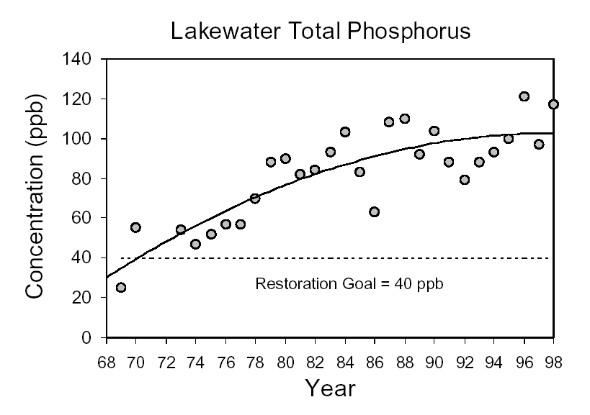
2007: 146 ton reduction of P entering Okeechobee
From a baseline of 433 tons/yr
The target level is 40 ppb.
Phosphorus concentrations in the Lake remain at about 117 ppb

Slide 34
Internal Loading
Two Sources
Decomposition of submerged aquatic vegetation
releasing phosphorus back into the water column
Dissolution of Iron and Aluminum compounds
in sediments which bind and store phosphorus.

Slide 35
Internal Loading
Phosphorus and Iron
Phosphorus has a strong affinity for iron
FePO₄
Solid Precipitate
Readily incorporates into bottom sediments

Slide 36
Iron Exists in Two Different Forms
Depending on Oxygen Content
Fe³⁺ high oxygen
Fe²⁺ low oxygen
Forms insoluble solids with Phosphate
Phosphorus compounds become soluble
Fe³⁺ + PO₄³⁻ = FePO₄
solid

Slide 37
Internal Loading
Fe³⁺ high oxygen
Fe²⁺ low oxygen
Dissolved phosphorus combines with oxidized iron (Fe³⁺) to create
an insoluble compound that becomes buried in lake sediments.
Simplified:
Fe³⁺ + PO₄³⁻ = Fe(PO₄)
solid
If oxygen contents are reduced (anoxic bottom sediments) the
Fe³⁺ converts to Fe²⁺ which solubilizes the compound returning P to water.
2+
3-
Fe
(PO₄)
to water
P released by sediments is taken up by photosynthetic
algae faster than it can be returned to the sediments
Notes:
the actual amount of phosphorus entering the Lake annually since 1990 has continued to increase. (These increases are believed to result from the huge internal loads of phosphorus
Ponds provide primary water quality improvement because dissolved phosphorus (PO4 3) combines with oxidized iron (Fe+3) to create insoluble compounds that can be buried in pond sediments. But, Fe+3 is chemically reduced to soluble Fe+2 in anoxic bottom sediments, making P mobile once more. In deeper lakes, oxygenated water below the photosynthetic zone recycles P back to the sediments. But in shallow ponds P released by sediments is taken up by photosynthetic algae blooms faster than it is returned to the sediments.

Slide 38
Lake Okeechobee Action Plan
Developed by the Lake Okeechobee Issue Team
December 6, 1999
RECOMMENDATION – Control Internal Phosphorus Loading.
Phosphorus-rich mud sediments need to be removed from the lake to the maximum extent that is practical, in order to reduce internal phosphorus loading. Unless this internal loading is substantially reduced, it may take as long as 100 years for the lake to respond to watershed phosphorus control programs.

Slide 39
Next: Arsenic, Fluoride, Mercury

Slide 40
Chemical Pollutants
Metals and Non-metals
Notes:
Chemical Pollutants
Heavy metals represent a common type of chemical pollution in water. They can be found naturally in bedrock and sediment or they may be introduced into water from industrial sources and household chemicals. Heavy metals harm humans through direct ingestion of contaminated water or through accumulation in the tissues of other organisms that are eaten by humans. The following are some common heavy metals found in water:
Mercury (Hg): Enters the environment through the leaching of soil due to acid rain, coal burning, or industrial, household, and mining wastes. Causes damage to nervous system, kidneys, and vision.
Lead (Pb): Sources include paint, mining wastes, incinerator ash, water from lead pipes and solder, and automobile exhaust. Causes damage to kidneys, nervous system, learning ability, ability to synthesize protein, and nerve and red blood cells.
Cadmium (Cd): Sources include electroplating, mining, and plastic industries, as well as sewage. Causes kidney disease.
Arsenic (As): Enters the environment through herbicides, wood preservatives, and mining industry. Causes damage to skin, eyes, gastrointestinal tract, and liver. May also cause cancer.
Aluminum (Al): Enters the environment through leaching due to acid deposition. Causes anemia and loss of bone strength, and may also contribute to dementia and Alzheimer’s disease.

Slide 41
Mercury, Arsenic, and Lead
Lead found in blood sample from 1 of 10 Washingtonians
Arsenic found in urine samples from 4 of 10 Washingtonians
Mercury found in hair samples from 10 of 10 Washingtonians

Slide 42

 | Common Health Effects
Lead | behavioral problems high blood pressure, anemia kidney damage memory and learning difficulties miscarriage, decreased sperm production reduced IQ
Mercury | blindness and deafness brain damage digestive problems kidney damage lack of coordination cognitive degeneration
Arsenic | breathing problems death if exposed to high levels decreased intelligence known human carcinogen: lung and skin cancer nausea, diarrhea, vomiting peripheral nervous system problems
Mercury

Slide 43



Wonderland
Mercury Nitrate
Symptoms included tremors, emotional instability, insomnia, dementia and hallucinations
Notes:
Mercury nitrate was used in the felting process and constant exposure to the chemical eventually caused the hatters to develop mercury poisoning. The connection between mercury poisoning and the hatters' behavior was not understood at the time, but the term "mad as a hatter" was in common usage.

Slide 44
Natural Groundwater Contaminants
Fluoride and Arsenic

Slide 45
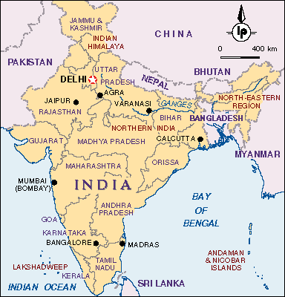

India
Failure of 246 surface
water quality projects
21 million backyard tube wells
$600 electric pumps
(1% of GDP)
95 %
water tables falling by 20 feet per year
What do you do when your water table falls?
Notes:
45
In Tamil Nadu, a state with more than 62 million people in southern India, wells are going dry almost everywhere. According to Kuppannan Palanisami of Tamil Nadu Agricultural University, falling water tables have dried up 95 percent of the wells owned by small farmers, reducing the irrigated area in the state by half over the last decade. 16
As water tables fall, well drillers are using modified oil-drilling technology to reach water, going as deep as 1,000 meters in some locations. In communities where underground water sources have dried up entirely, all agriculture is rain-fed and drinking water is trucked in. Tushaar Shah, who heads the International Water Management Institute’s groundwater station in Gujarat, says of India’s water situation, “When the balloon bursts, untold anarchy will be the lot of rural India.” 17
At this point, the harvests of wheat and rice, India’s principal food grains, are still increasing. But within the next few years, the loss of irrigation water could override technological progress and start shrinking the harvest in some areas, as it is already doing in China. 18

Slide 46
Deeper Wells and Fluoride
Naturally occurring element in Granite
which dissolves into the groundwater
Water near the surface is generally unaffected
Lowering water tables = deeper wells
Deep wells can penetrate granite with high fluoride levels
Fluoride in water can be a cumulative poison
What’s the obvious question?

Slide 47
Intentional Fluoridation of Water in the U.S.
Fluoridation became an official policy of the U.S.
Public Health Service in 1951.
By 1960 water fluoridation had become widely used
in the U.S. reaching about 50 million people.
By 2006, 69.2% of the U.S. population on public water
systems were receiving fluoridated water.

Slide 48
How does it work?
Tooth enamel is made of a mineral called hydroxyapatite
Ca₅(PO₄)₃OH
Bacteria in the mouth create acids (H⁺)
Hydroxyapatite is subject to dissolution by acids (H⁺)
Fluoridation changes the chemical composition of
hydroxyapatite to a crystal less subject to acid dissolution

Slide 49
Sodium fluorosilicate (Na₂SiF₆)
Sodium fluoride (NaF)
NaF Na⁺ + F⁻
Ingestion of fluoridated water increases
the F⁻ concentration in saliva
F⁻ replaces OH in hydroxyapatite making fluoroapatite
F⁻
Ca₅(PO₄)₃
OH
Fluoroapatite is less soluble in acid than hydroxyapatite

Slide 50

Fluoride concentrations
In U.S. tap water
0.5 – 1.0 mg/L
Lower values in warm climates

Slide 51
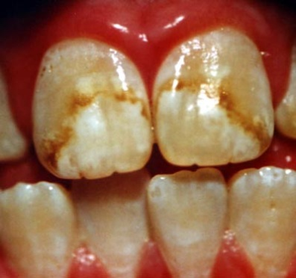
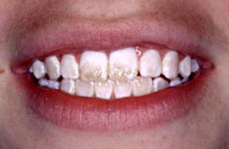
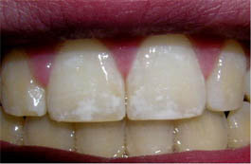
Fluoride levels > 1.5 mg/L
Dental Fluorosis
Intake:
1.6 to 6.6 mg/day
Colorado Brown Stain
Permissible fluoride limit in India is 1.2 mg/L
Fluoride levels between 5-25 mg/L have been found

Slide 52


Fluoride levels > 10 mg/L
*
Skeletal Fluorosis
Intake
9 mg/day to 12 mg/day
Fluorosis has risen from 1 million to 25 million
and threatens 60 million people in India.

Slide 53
Groundwater and Arsenic

Slide 54
Arsenic is Naturally Occurring
occurs primarily in association with sulfur-containing minerals
Natural waters, in general, contain low levels of total arsenic
Mobilization of arsenic in the environment arises from anthropogenic activities related to mining and ore processing, metallurgy, agriculture, wood preservation, and industry.
Notes:
mining and ore processing, metallurgy,
agriculture, wood preservation, and industry.
54

Slide 55
Inorganic Forms of Arsenic
AsO₃⁻³
AsO₄⁻³
Arsenite
Arsenate
Low Oxygen
High Oxygen
Arsenite is more toxic than arsenate, interfering with
enzyme activities which catalyze metabolic reactions
Arsenite compounds are also more mobile in the environment
Both arsenate and arsenite are chronic accumulative toxins

Slide 56
“The World’s Largest Mass Poisoning”

Slide 57
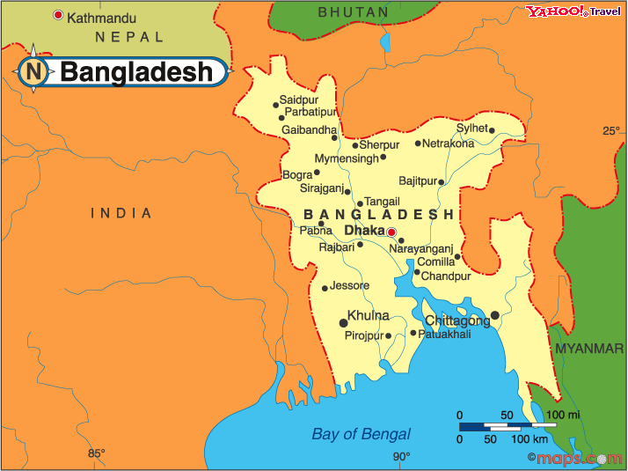
Bangladesh and W. India
ranked among the world's 10 poorest countries

Slide 58

Bangladesh Prior to 1970s
One of the highest infant mortality rates in the world
Principally due to waterborne disease.
Ineffective water and sewage systems
Periodic monsoons and floods
water-borne pathogens
cholera, dysentery
Deaths Due to Surface water contamination: 250,000/yr

Slide 59
Deaths Due to Surface water contamination: 250,000/yr
The Solution: Tap groundwater resources
easy
inexpensive
available
First 1 million wells were sunk with aid from
World Governments
UNICEF
World Bank

Slide 60
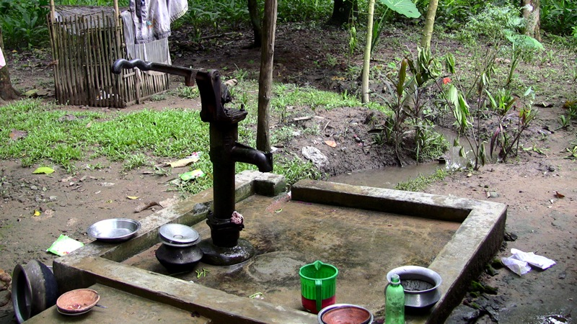
12 million hand-operated tube wells
deliver water to over 80% of the rural village population
Infant mortality and diarrheal illness reduced by 50%

Slide 61
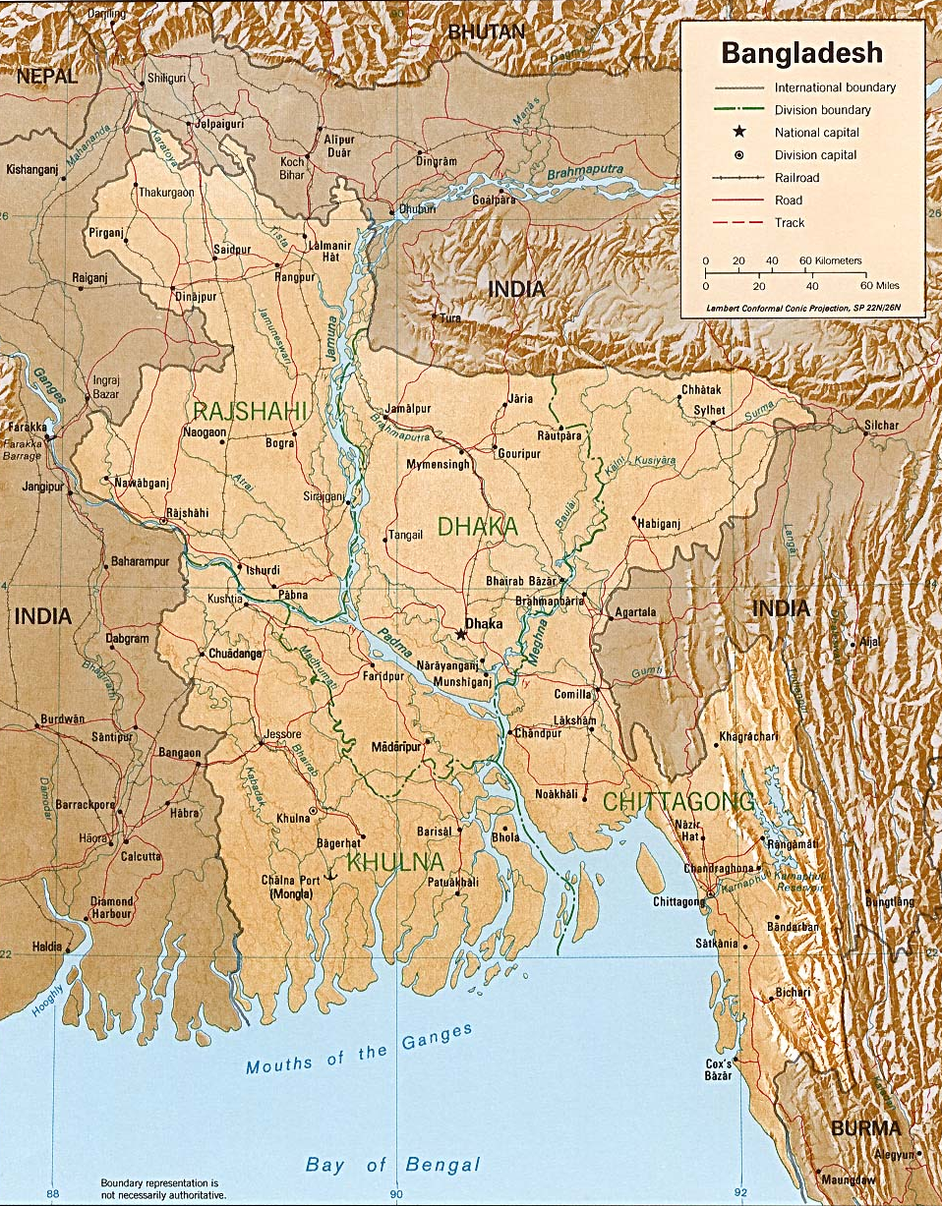
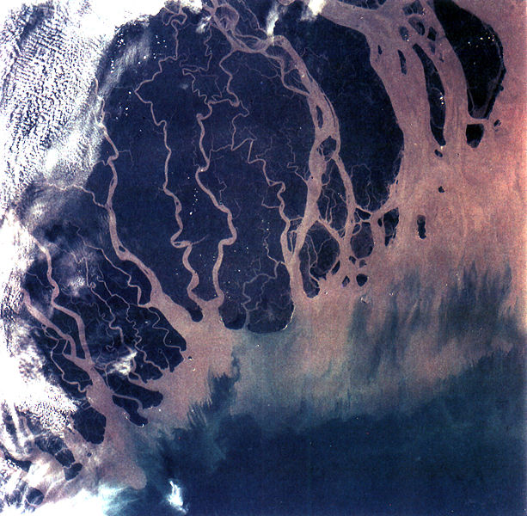
Floodplain and Delta of the
Ganges and Brahmaputra
Rivers.
Himalayas
Floodplain: area paralleling a
river that is periodically inundated
Ganges-Brahmaputra Delta
Deltas are formed from the deposition
of sediment carried by the river as
the flow leaves the mouth of the river
Accumulation of
thick muds
in the floodplains
and deltas

Slide 62
Wells in Floodplain
and Delta Sediments
Natural erosion of
arsenic to water-
bearing units.
Well depths between 20m and 100 m
Water Bearing Muds

Slide 63
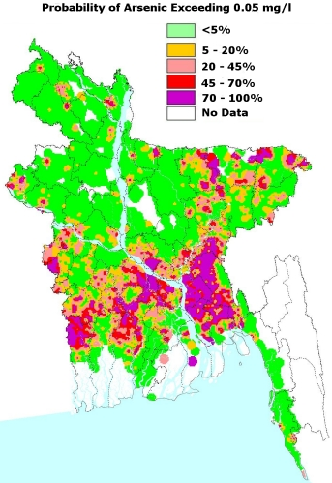
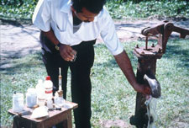
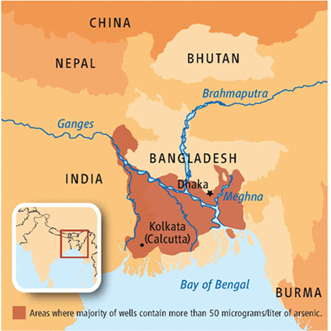
WHO/U.S limit: 10 ppb
Bangladesh limit: 50 ppb
Delta and Floodplain Regions
Majority of wells > 50 ppb arsenic
Some wells contain 500 - 1000 ppb
Notes:
Old U.S. standard was 50 ppb, but was changed to 10 ppb in 2006. This put between 35 and 38% of wells out of compliance in Arizona and California.
63

Slide 64
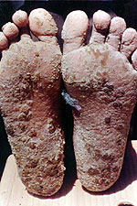
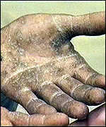
Exposure Estimates
Above 10 ppb: 57 million people
Above 50 ppb: 35 million people
Accumulative Toxin
Early Symptoms:
Skin lesions and thickening
Strong skin pigmentation
Long-term Exposure
breathing problems
death if exposed to high levels
lung and skin cancer
peripheral nervous system

Slide 65
2003 Studies

Slide 66
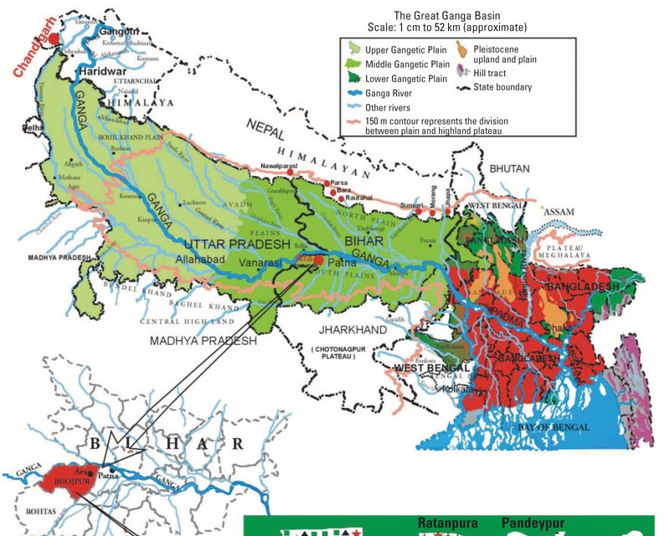
83 million people
Bihar: 40% wells contaminated

Slide 67
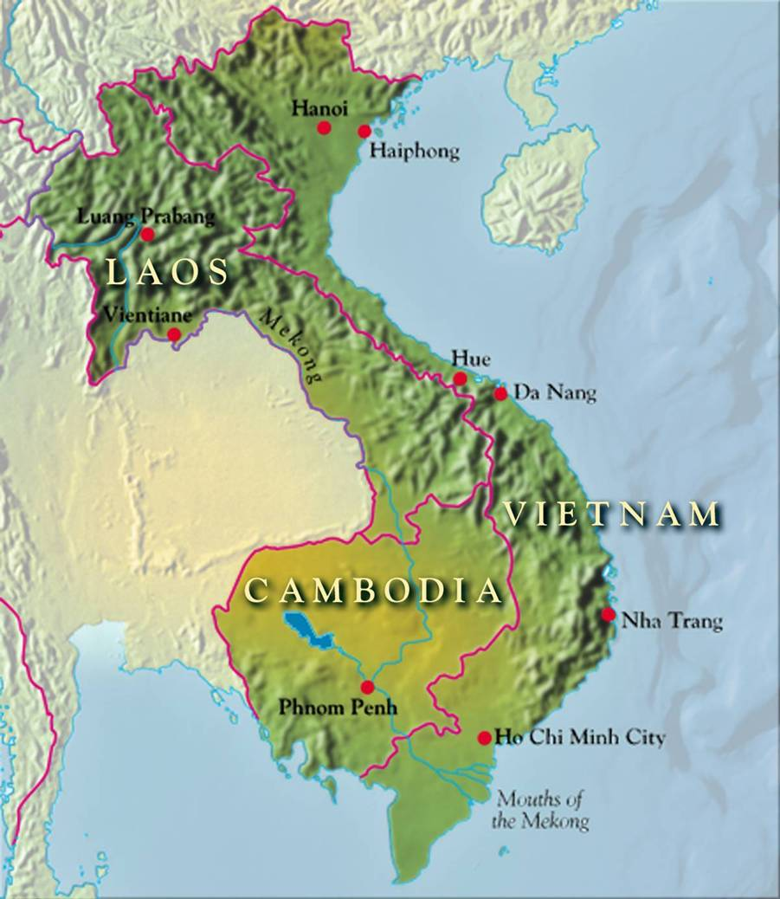
Red River Delta
11 million people
First wells sunk
7 years ago

Slide 68
Next: Mercury
Got Fish?

