Slide 1
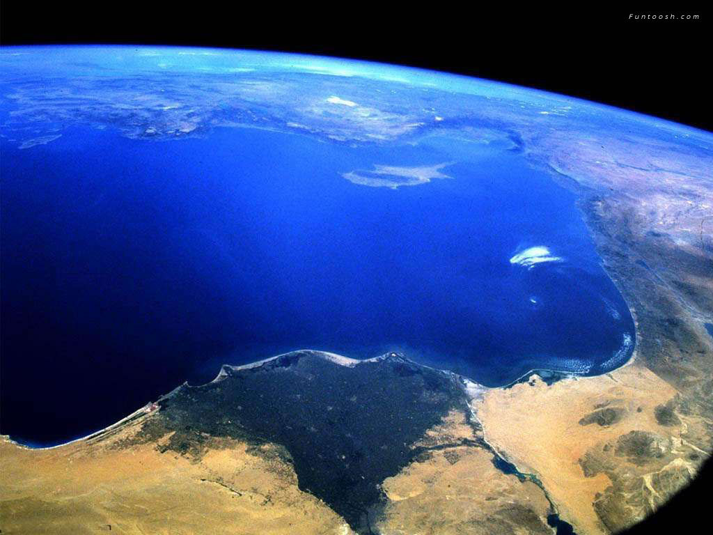
The World of Water
Welcome to
SWS 2007

Slide 2
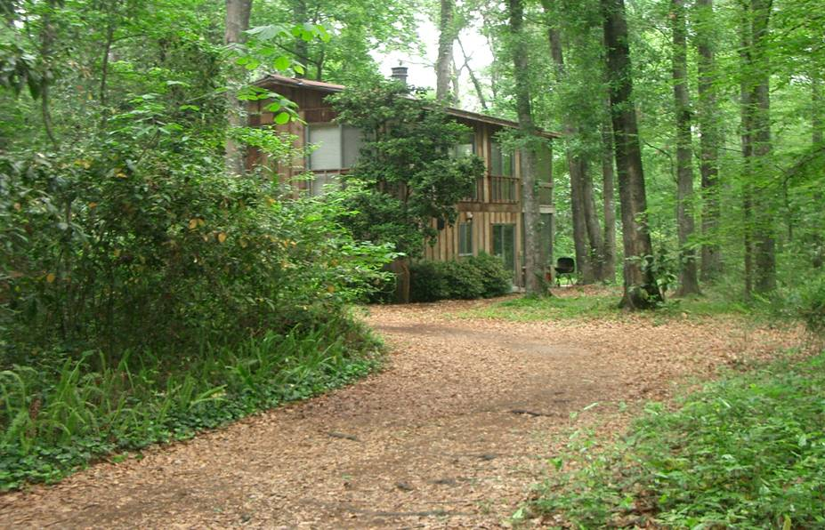
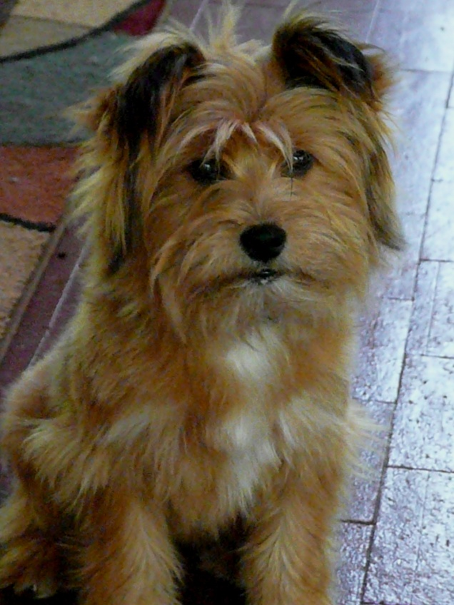
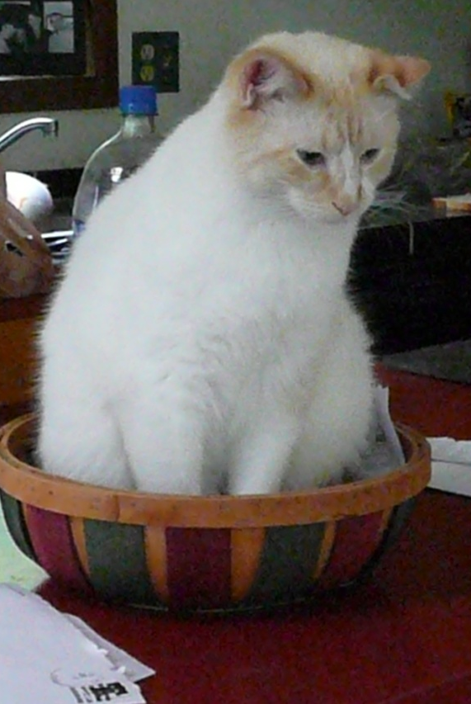
Dr. James Bonczek
G169 McCarty Hall A
bonczek@ufl.edu
University of Florida Graduate

Slide 3
Syllabus
This is an introductory course intended to acquaint students with
many of the essential roles of water in the environment. Topics
range from fundamental properties of water to the importance of
water and water quality to society. Course topics also will include
water in oceans, lakes, rivers, soils, and the atmosphere as well
as the importance of water to various environmental processes and life.
Abundance/Distribution
Quality
Relevance
http://soillab.ifas.ufl.edu

Slide 4
Chat Sessions
The URL for chat sessions will be e-mailed
Be sure to check your microphone
Use headphones, if possible

Slide 5
Water Use

Slide 6
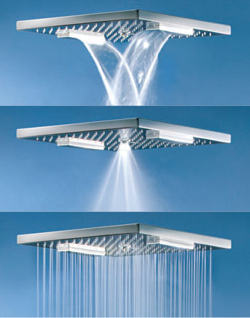
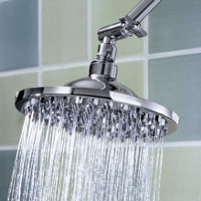
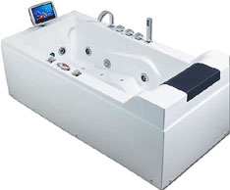
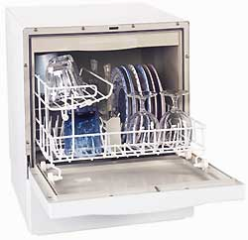
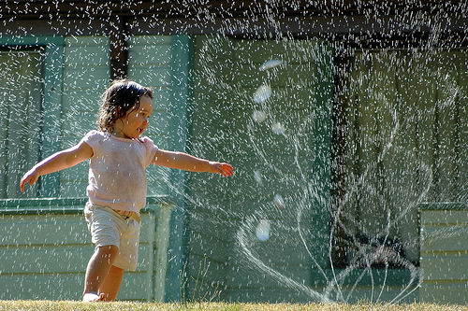
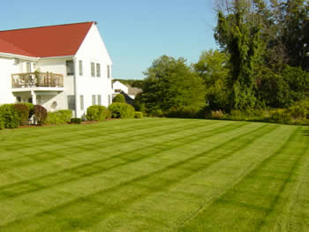
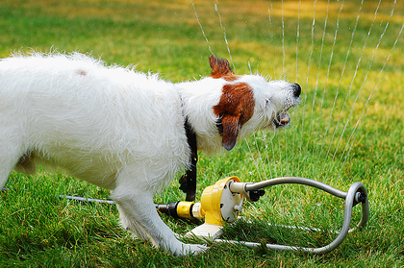
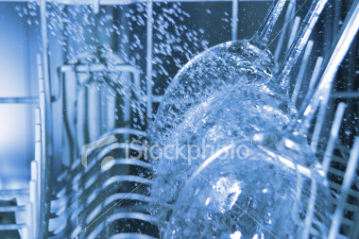
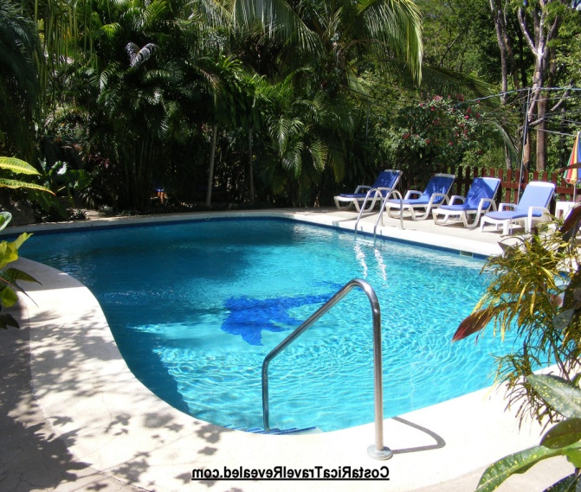
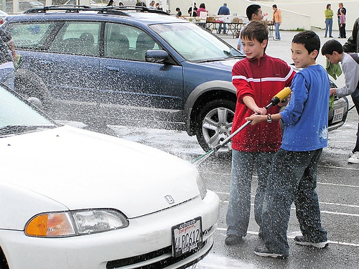
1.6-2.5 gpm
Guilty Pleasures
5-8 gpm
http://www.youtube.com/watch?v=vMITcQUe-9M
Notes:
After video: high flow = 5-8 gpm. Low flow = 1.6-2.5 gpm. Toilets went from 3.5 gpf to 1.6 gpf. Do you take long showers, leave the tap on while brushing, have a swimming pool, use a dishwasher, take baths, clean outdoors with water, keep your car impeccably clean?

Slide 7
How much water do you use?
http://ga.water.usgs.gov/edu/sacsq.html
Click on link and go to: How much water do you use at home on a typical day?

Slide 8
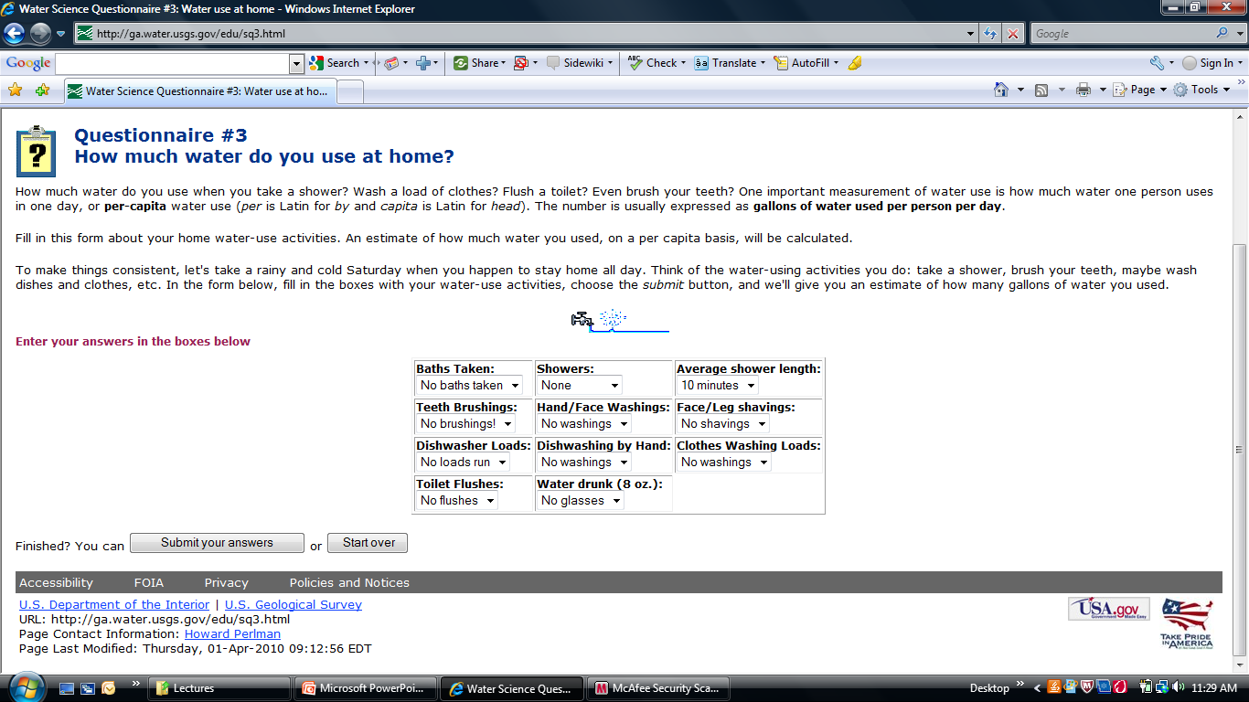

Slide 9
Water Usage
Use | Gallons per Capita | Percentage of Total Daily Use
Showers | 12.6 | 17.3%
Clothes Washers | 15.1 | 20.9%
Dishwashers | 1.0 | 1.3%
Toilets | 20.1 | 27.7%
Baths | 1.2 | 2.1%
Leaks | 10.0 | 13.8%
Faucets | 11.1 | 15.3%
Other Domestic Uses | 1.5 | 2.1%
Total
74 gallons
Notes:
This a rough distribution of domestic water use per person in the U.S. Toilets and clothes washers use the greatest amount of water.

Slide 10
How do you conserve water?
Notes:
Low flow shower heads, water off during brushing, dirty car, limit watering, time watering, shower

Slide 11
Does it make a difference?
Domestic water use: 10%
Industrial water use: 20%
Irrigation water use: 70%
1 pound of Rice 650 gallons 4800 pounds
1 pound of Wheat 130 gallons 1000 pounds
1 pound of Sugar 400 gallons 3000 pounds
1 pound of coffee 2650 gallons 10 tons
1 beer: 66 gallons
Notes:
8-16 gallons of water to make one gallon of bottled water.
Imbedded Water

Slide 12
Secondary Water
Grain Livestock
¼ pounder
Quart of milk
Pound of cheese
3000 gallons 11 tons
1000 gallons >3 tons
650 gallons 2.5 tons
Carnivores consume 100 times their weight in water each day
Vegetarians consume about ½ as much.
Notes:
Carnivores consume about 100 times their weight in water each day
Shirt takes about 1000 gallons.

Slide 13
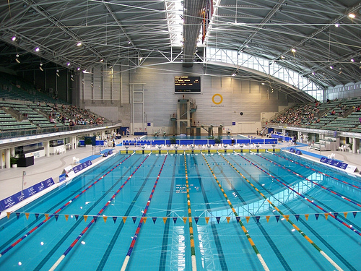
Yearly Totals
Drinking water: 250 - 300 gallons
Total water: 1500 – 3000 tons

Slide 14
Some Water Facts

Slide 15
Water Facts
Americans drink more than 1 billion glasses of tap water per day.
In some cases, 50 to 70 percent of home water is used outdoors for watering lawns and gardens.
Average household water use annually: 127,400 gallons
Average daily household water use : 350 gallons
Notes:
Here are some interesting facts about water use in the U.S.

Slide 16
Holidays
It takes about 4,776 gallons of water to raise a Christmas tree. To raise the 35 million Christmas trees U.S. families enjoy each year, a total of 167 billion gallons is required.
If mothers refresh their floral arrangements and flowering plants during the Mothers' Day week, they will use almost 3,000,000 gallons of water.
After Thanksgiving dinner in 1999, 16.4 million Americans watched football.
At halftime, American toilets flushed 16.4 million times and used 48.5 million gallons of water.
In 2006 an estimated 80 million people watched the Superbowl with similar results, using 236 million gallons.
Christmas
Mother’s
Day
Thanksgiving

Slide 17
Next: The Origins of Water

